Slide 1
SPICE modeling
Sayan Chatterjee

Slide 2
Introduction

Slide 8
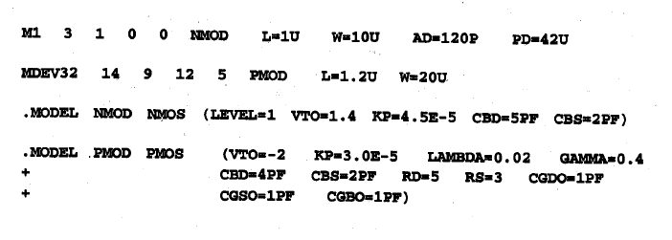
.MODEL for active device modeling

Slide 9
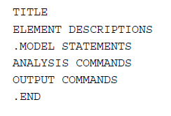

Slide 10
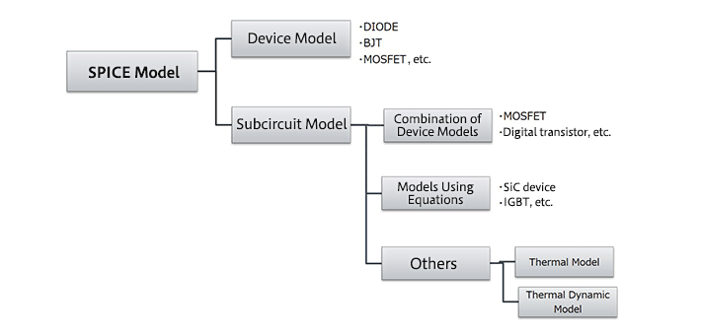
Device models essentially are models of elements such as diodes and MOSFETs. Subcircuit models are in essence combinations of device models, and can be thought of simply as circuit state models. In addition, there are also special models used to perform thermal calculations for circuits.

Slide 11
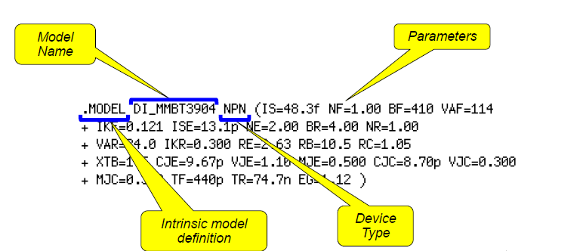

Slide 13
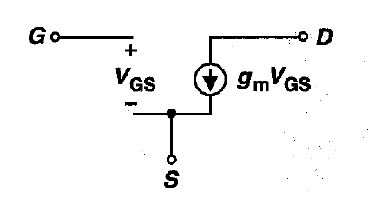
MOS Small signal model

Slide 14
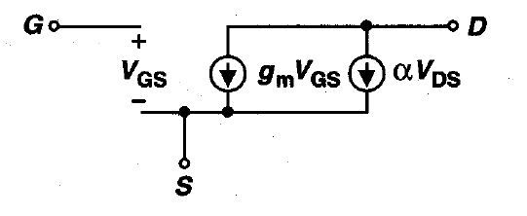
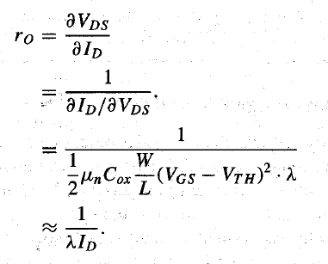
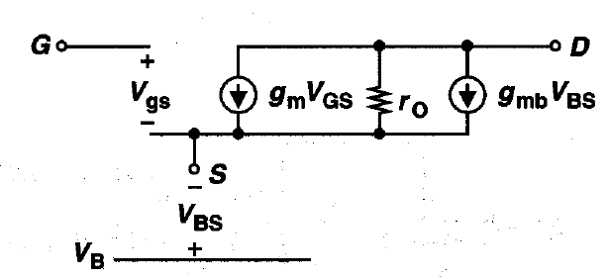

Slide 15
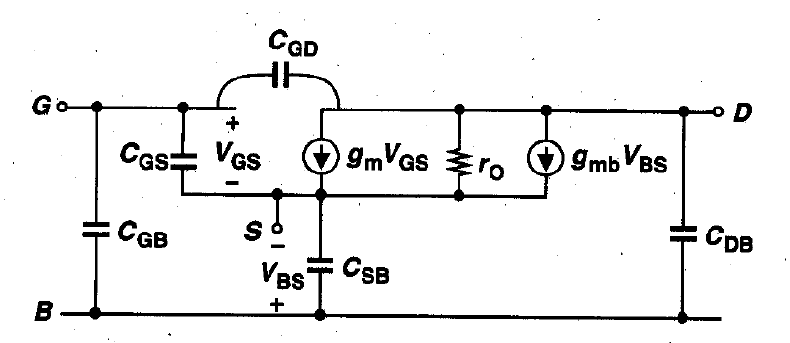
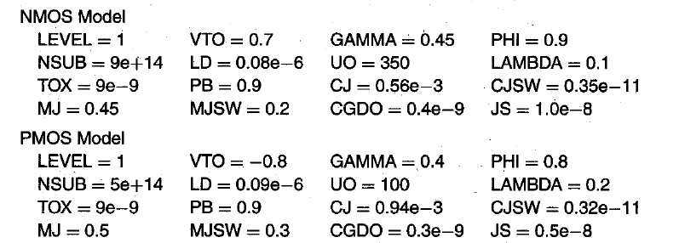

Slide 16
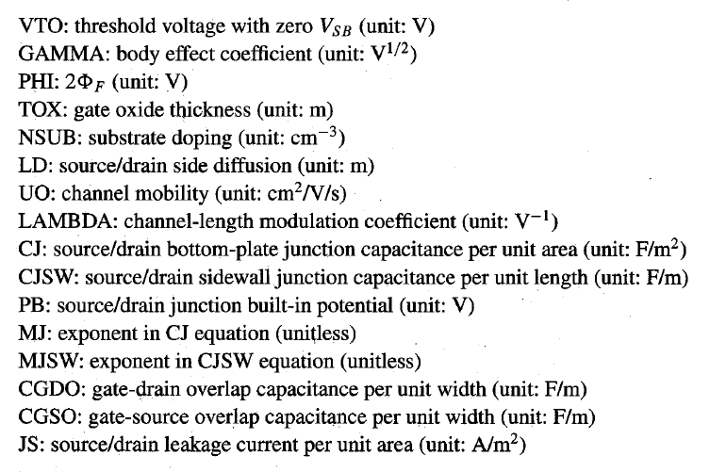

Slide 17
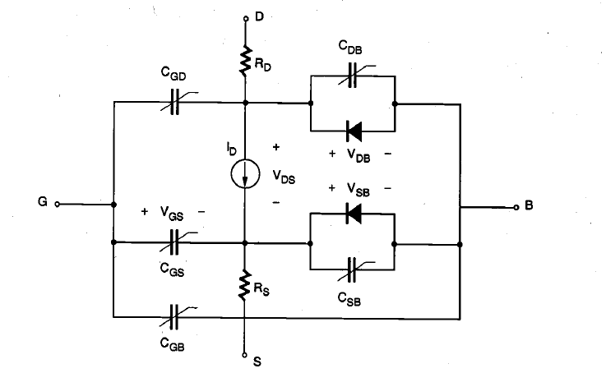
Why two different looks

Slide 18
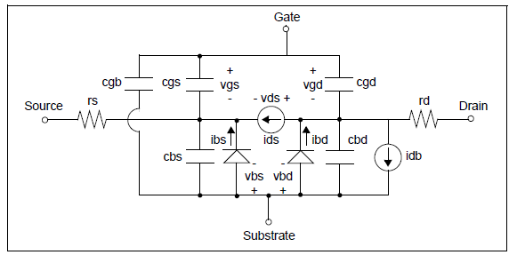
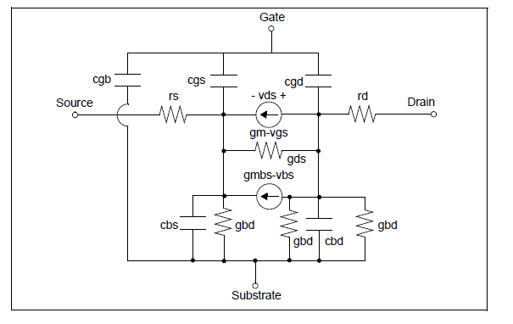

Slide 19
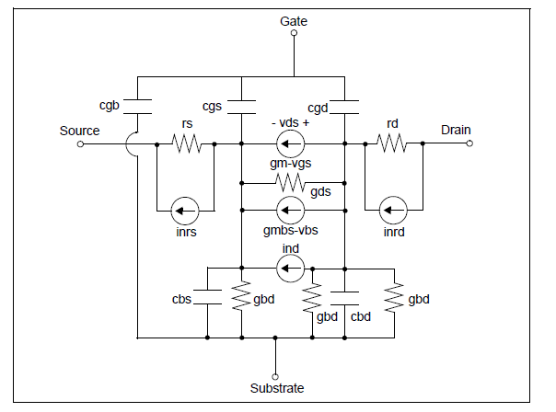
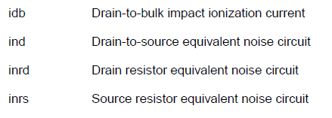

Slide 20
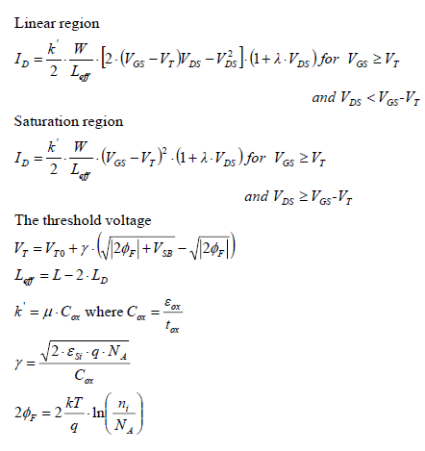

Slide 21
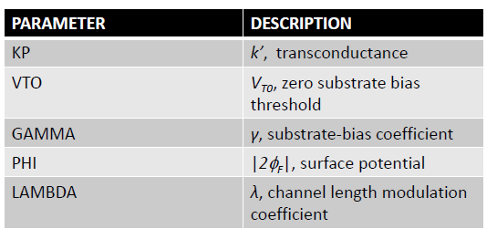
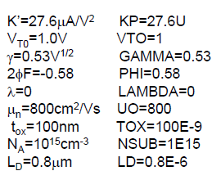

Slide 22
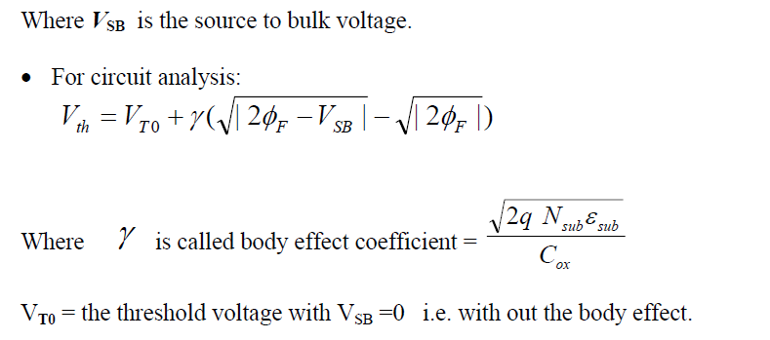
For Detail calc. Pg 59 in book CMOS digital integrated circuit by Kang

Slide 23
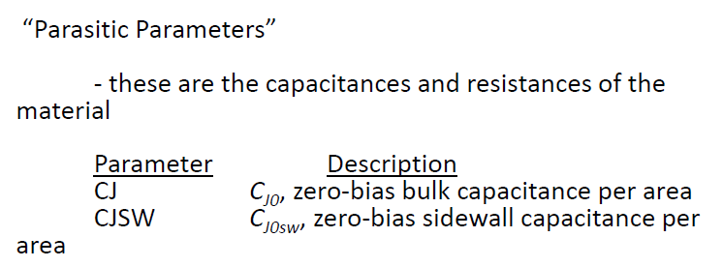

Slide 24
Kp
VTO
lamda
TOX

Slide 26
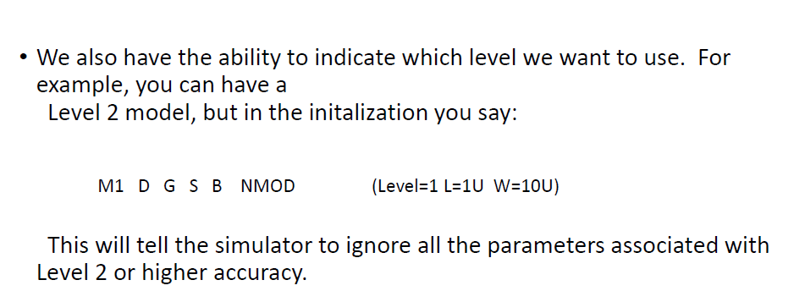
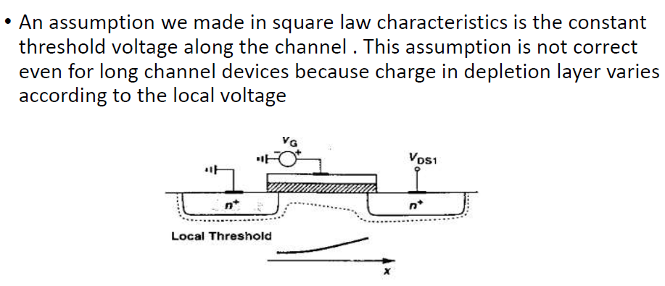

Slide 27
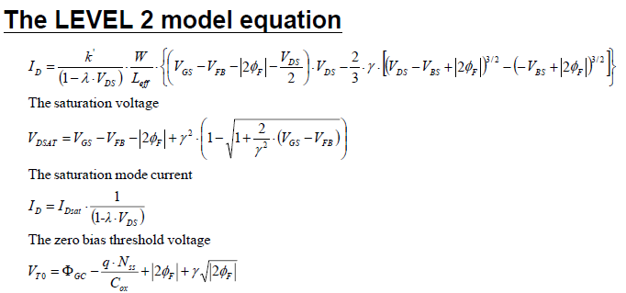

Slide 28
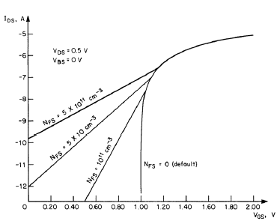
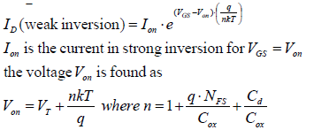

Slide 31
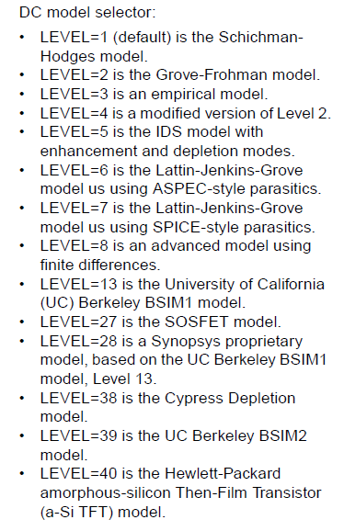
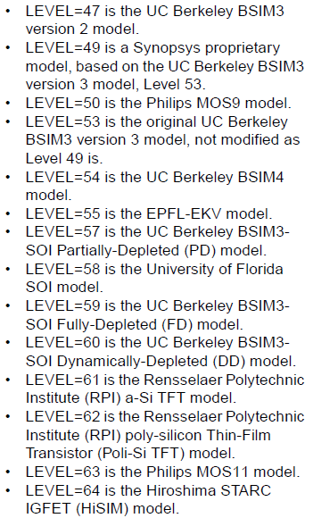

Slide 32
BSIM-CMG (Common Multi-Gate)
BSIM-IMG (Independent Multi-Gate) the only model published without source-code (whose publication is foreseen for July 13, 2021)
BSIM-SOI (Silicon-on-Insulator)
BSIM-BULK, formerly BSIM6,
BSIM4,used for 0.13 μm to 20 nm nodes,
BSIM3, a predecessor of BSIM4.

Slide 34
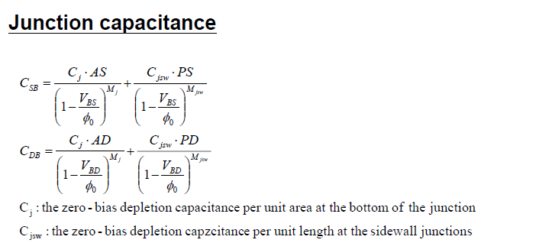

Slide 35
Modeling

Slide 37
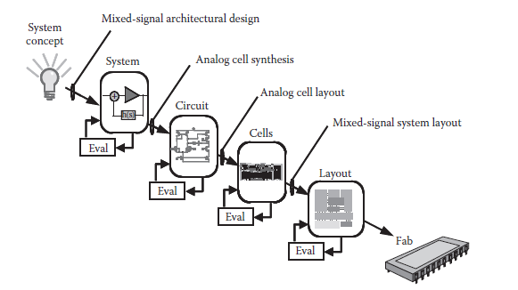
Top-down view of the mixed-signal IC design process

Slide 38
Models for circuit design
Transistor models are used for almost all modern electronic design work.
Analog circuit simulators such as SPICE use models to predict the behavior of a design.
LT SPICE is getting popularity too.
Most design work is related to IC designs which have a very large tool cost, primarily for the photo masks used to create the devices, and there is a large economic incentive to get the design working without any iterations.
Device models must include effect of various parameters on design like:
Width & length
Inter-digitation
Proximity to other devices
Transient and DC current-voltage characteristics
Parasitic device capacitance
Resistance and inductance
Time delays
Temperature effects

Slide 39
Device Modeling
It is extremely important to have a valid device modeling & simulation design prior to the device fabrication technology & design iteration are expensive and post fabrication tuning is not a fun.
Modern device designing is very complex, so it is difficult to predict performance characteristics of device without accurate computer models.
Device modeling actually describes the principal methods of representing and analyzing devices.
Device modeling is useful in device design, production control and performance analysis.

Slide 40
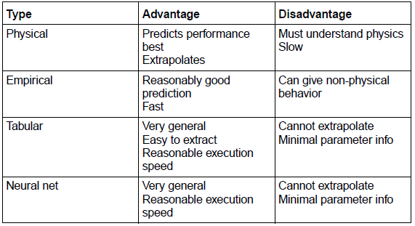
Transistor – Large signal nonlinear models
Large signal transistor models (non-linear models) fall into three main types.
Physical models
Empirical models
Tabular models

Slide 41
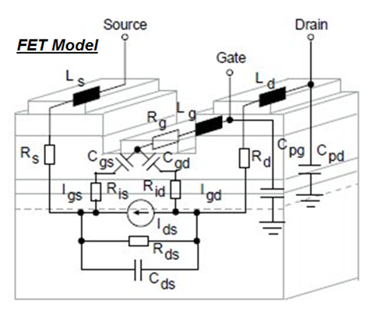
Physical models
These are models based upon device physics, which relies on the approximate modeling of physical phenomena within a transistor.
Parameters within these models are based upon physical properties such as
Oxide thicknesses, Substrate doping concentrations, Carrier mobility, etc.

Slide 42
Cont..
Physical device models are solved using either bulk carrier transport equations (the semiconductor equations), solutions to the Boltzmann transport equation or quantum transport concepts.
Bulk transport solutions have satisfied most device models
Boltzmann and quantum transport solutions have provided a strong insight into the detailed device physics.
The understanding of material properties, physical boundary conditions (such as surface physics, contact properties and device geometry) and device-circuit interaction are steadily improving, allowing more intricate models to be developed.

Slide 43
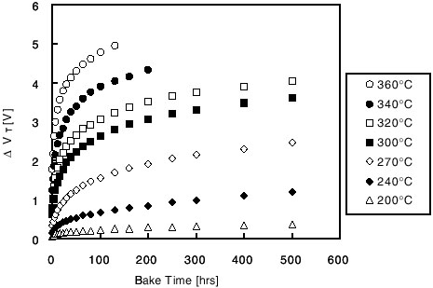
Empirical models
Empirical models are based upon curve fitting, subjected to the parameter and values which can fit describe the operation of the device (transistor).
Unlike a physical model, empirical model parameters are not based fundamentals, they mostly depends on the fitting procedure used to find them.
Fitting procedure is key to success of these models if they are to be used to extrapolate to designs lying outside the range of data to which the models were originally fitted.
Empirical model of carrier scattering on ionized impurity

Slide 44
Tabular models
Tabular models are based on look-up table (LUT) form, by considering effect of one parameter to the other.
Effect of parasitic components on drain current
These values are indexed in reference to their corresponding bias voltage combinations.
Thus, model accuracy is increased by inclusion of additional data points within the table.
Limitation of these models is that they work best for designs that use devices within the table (interpolation) and are unreliable for devices outside the table (extrapolation).

Slide 45
Small-signal parameters
A transistor’s parameters represent its electrical properties.
Engineers employ transistor parameters in production-line testing and in circuit design.
A group of a transistor’s parameters sufficient to predict circuit gain, input impedance, and output impedance are components in its small-signal model.
Parameters used in small-signal circuits (two ports) adopt names related to the names of these circuits such as
Transmission parameters (T-parameters),
Hybrid-parameters (h-parameters),
Impedance parameters (z-parameters),
Admittance parameters (y-parameters), and
Scattering parameters (S-parameters).
These parameters all can be evaluated using measured scattering parameter data.
Scattering parameters (S parameters) can be measured for a transistor at a given bias point with a vector network analyzer.

Slide 46
Numerical Based
Equivalent circuit models approach is generally limited in its applicability because of the DC bias, frequency dependence and the non-linear behavior of most devices with respect to signal level.
The principal advantage of this technique is that it is easy to implement and analyze.

Slide 48
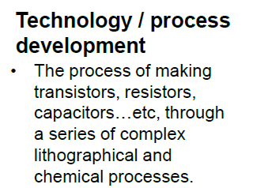

Slide 49
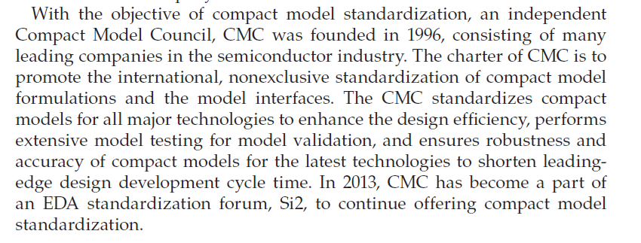

Slide 50
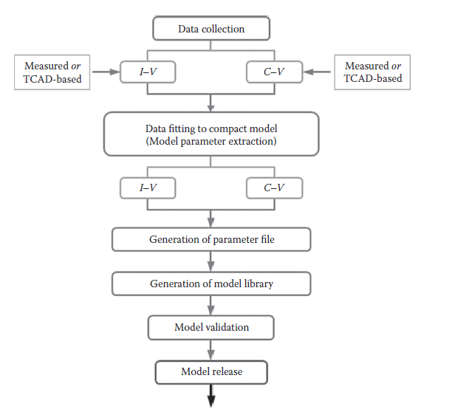

Slide 51
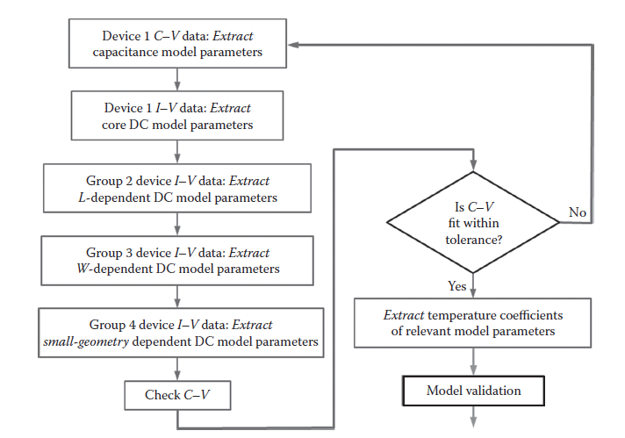

Slide 52
Scaling of MOS

Slide 54
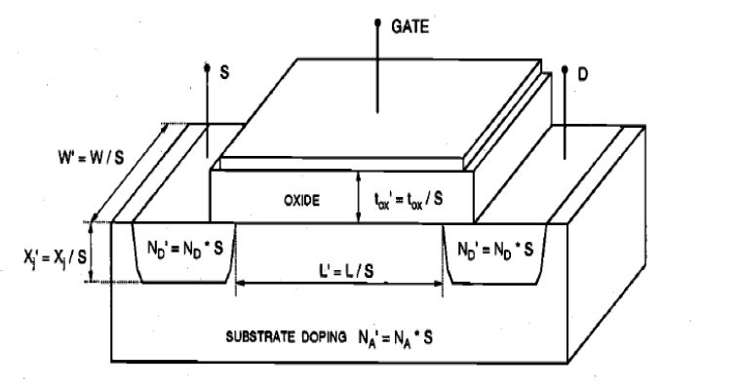

Slide 56
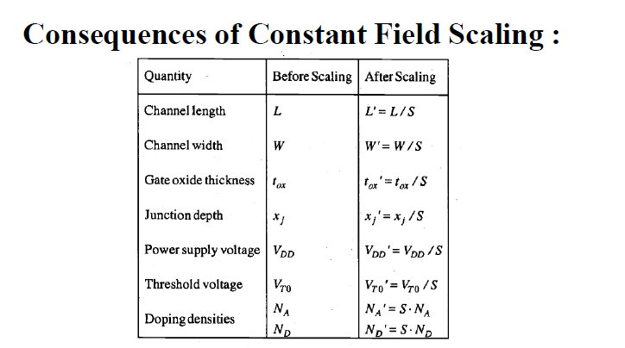
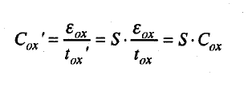

Slide 59
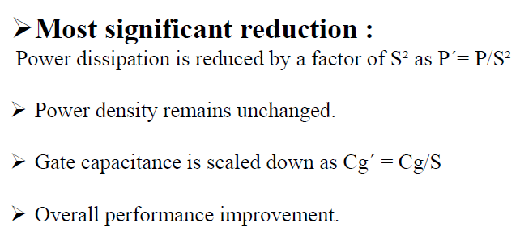
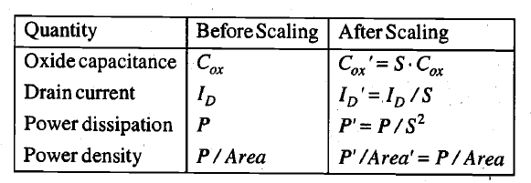
Note that with the device area reduction by S² discussed earlier, we find
the power density per unit area remaining virtually unchanged for the scaled device.

Slide 60
In constant-voltage scaling, all dimensions of the MOSFET are reduced by a factor of S, as in full scaling. The power supply voltage and the terminal voltages, on the other hand, remain unchanged.
The doping densities must be increased by a factor of s² in order to preserve the charge-field relations.

Slide 62
To summarize, constant-voltage scaling may be preferred over full (constant-field) scaling in many practical cases because of the external voltage-level constraints.
However, that constant-voltage scaling increases the drain current density and the power density by a factor of S³.
This large increase in current and power densities may eventually cause serious reliability problems for the scaled transistor, such as electromigration, hot-carrier degradation, oxide breakdown, and electrical over-stress.

Slide 63
Power Dissipation

Slide 65
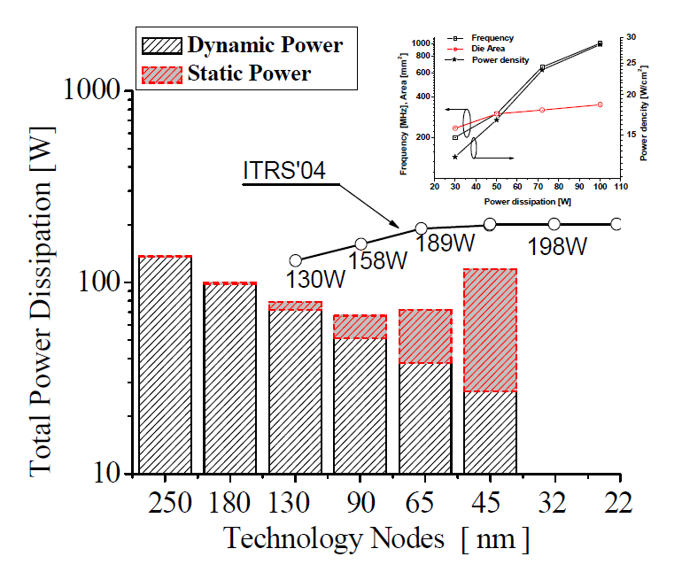

Slide 66
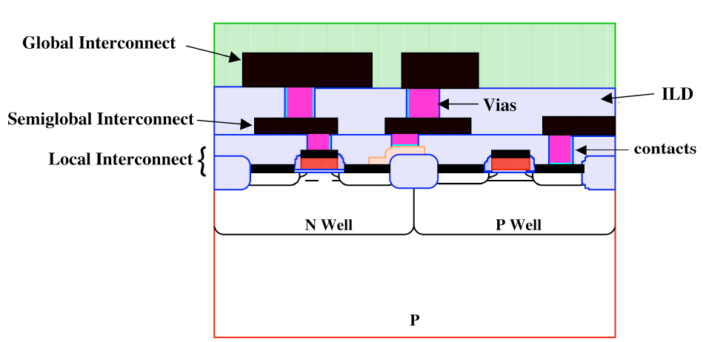

Slide 67
Interconnects can either be global or local. In general, local interconnects are the first, or lowest, level of interconnects. They usually connect gates, sources and drains in MOS technology, and emitters, bases, and collectors in bipolar technology.
In MOS technology a local interconnect, polycrystalline silicon, also serves as the gate electrode material.
Global interconnects, mostly made of Al, are generally all of the interconnect levels above the local interconnect level. They often travel over large distances, between different devices and different parts of the circuit, and therefore are always low resistant metals.

Slide 68
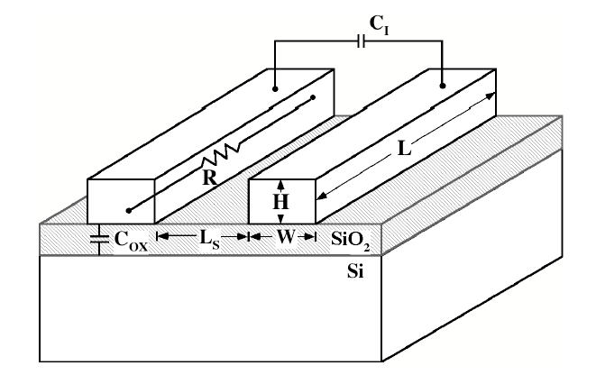

Slide 69
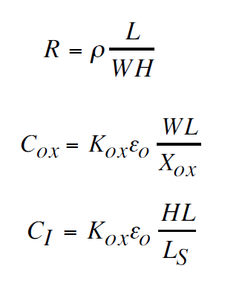
So think about reduction of parameters for local and global interconnects

Slide 70
