Slide 1
VLSI Design Cycle
Concept of EDA
Where simulation stands
Design cycle

Slide 2
EDA : The current Wikipedia definition of EDA is “the category of tools for designing and producing electronic systems ranging from printed circuit boards (PCBs) to integrated circuits. This is sometimes referred to as ECAD (electronic computer-aided design) or just CAD.” The workshop attendees felt that this definition was somewhat narrow, as it focuses mainly on the use of EDA technologies.
1. EDA consists of a collection of methodologies, algorithms and tools, which assist and automate the design, verification, and testing of electronic systems.
2. It embodies a general methodology that seeks to successively refine a high-level description to low-level detailed physical implementation for designs ranging from integrated circuits (including system-on-chips), to printed circuit boards (PCBs) and electronic systems.
3. It involves modeling, synthesis, and verification at every level of abstraction.
EDA: Software engineers use to design integrated circuits
Most tools focus on large digital ICs:
Microprocessors (Intel, Sun, Motorola)
Graphics chips (nVidia, S3)
Digital signal processors (TI, Motorola)

Slide 3
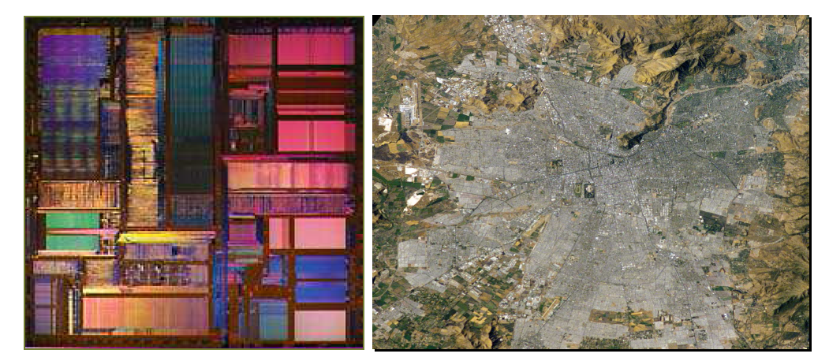
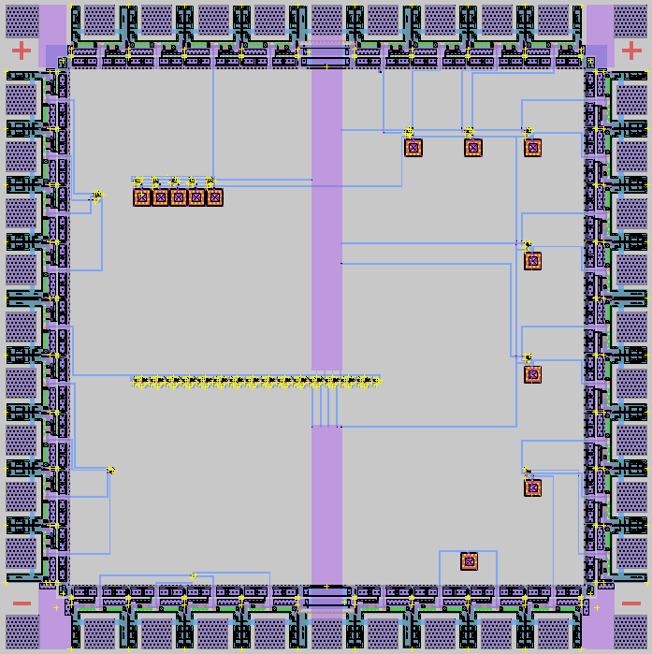
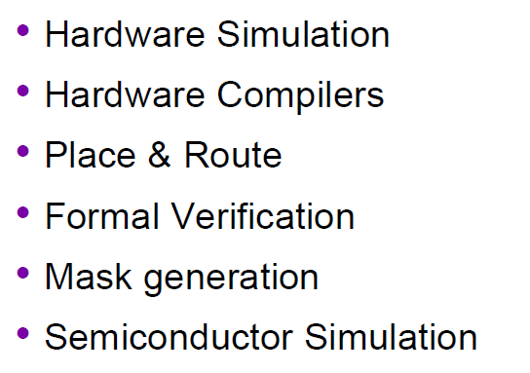
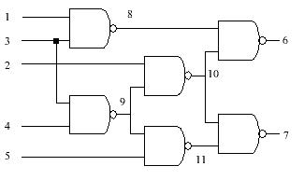
If a city is as crowded as a chip and if you have to find out new routes with narrow lanes

Slide 4
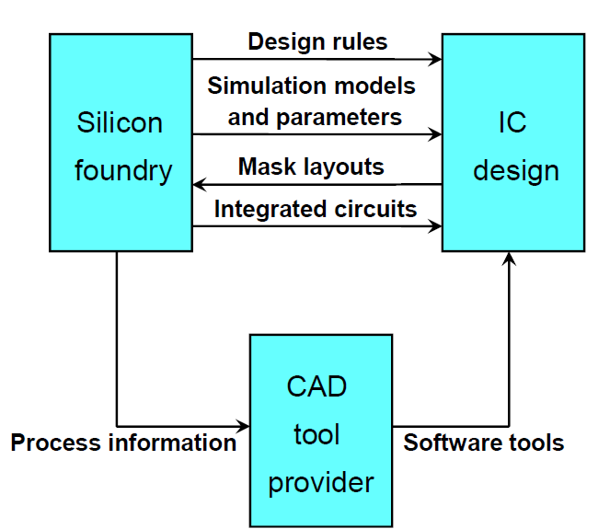
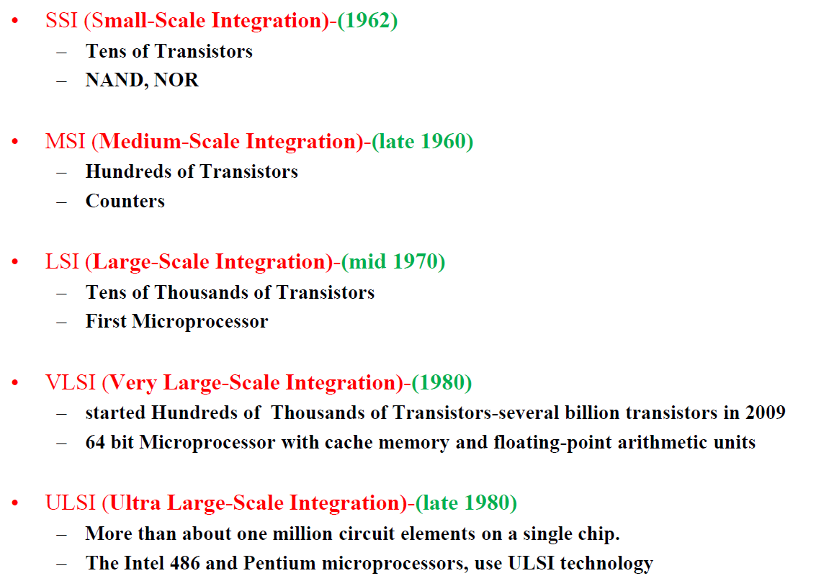
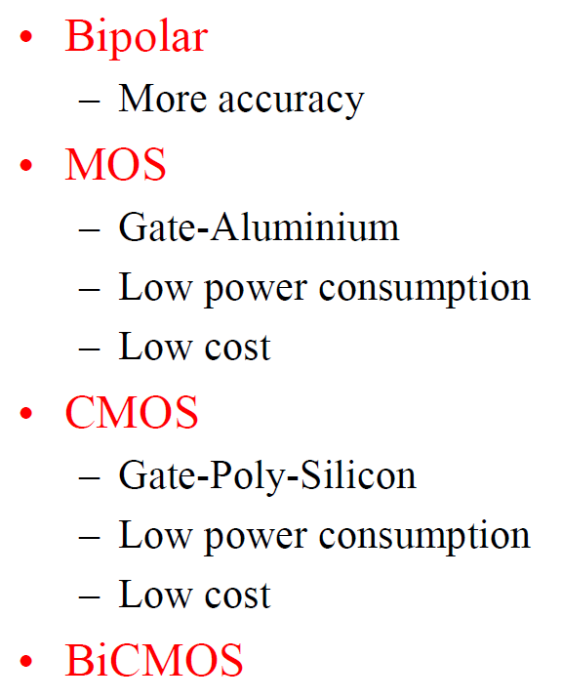
VLSI Design Methodologies
Design methodology
Process for creating a design
Methodology goals
Design cycle
Complexity
Performance
Reuse
Reliability

Slide 5
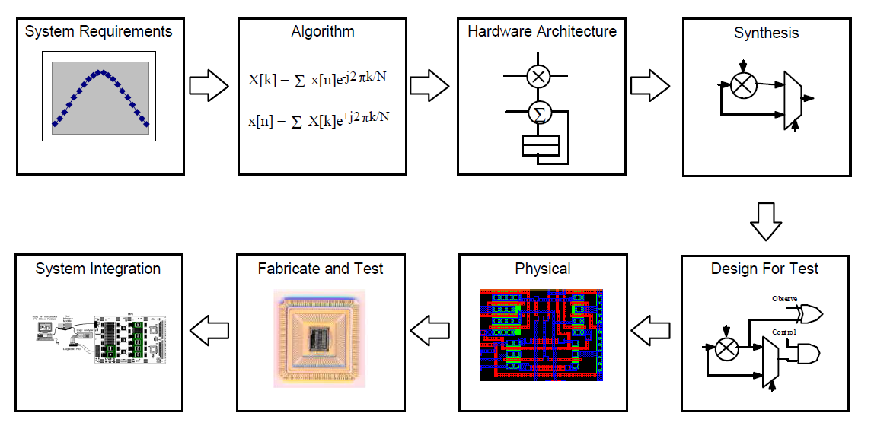

Slide 7
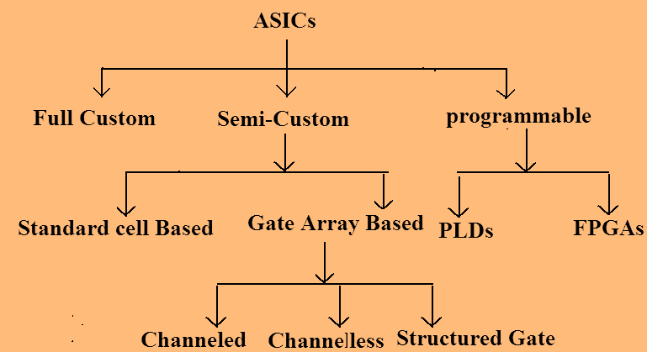

Slide 10
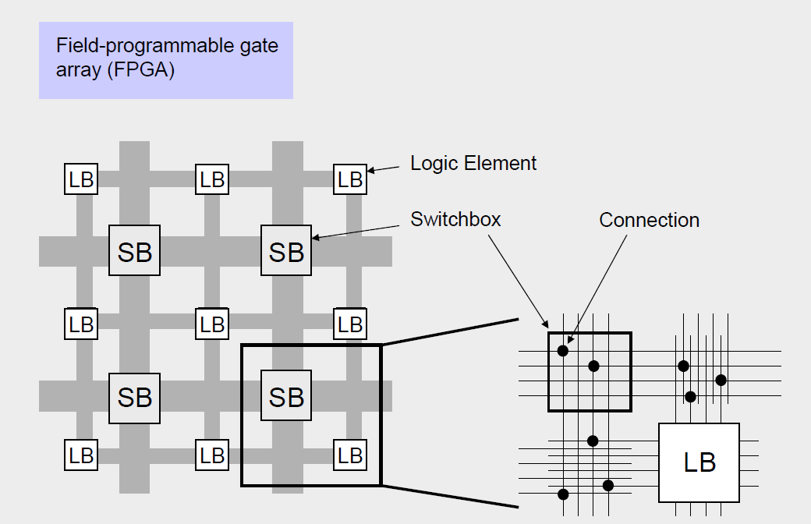
FPGA

Slide 12
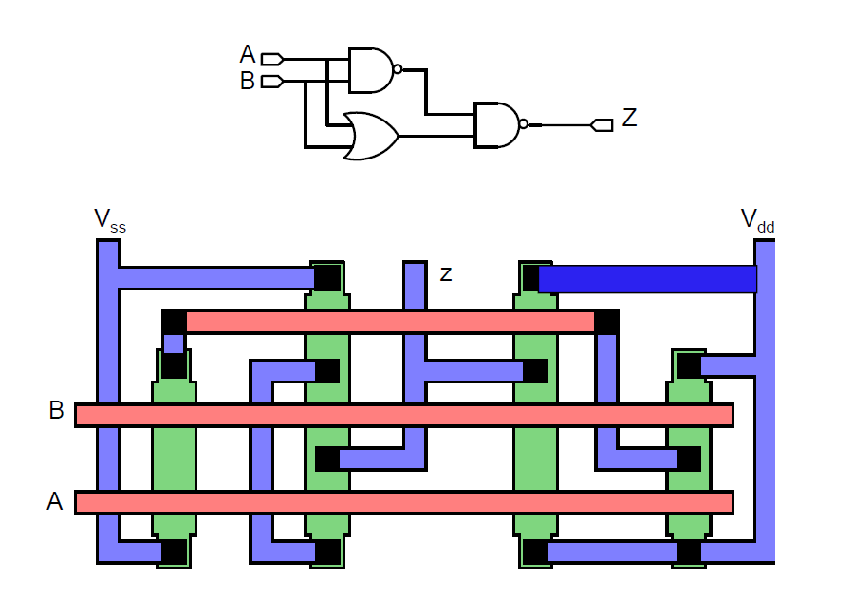
Full Custom

Slide 13
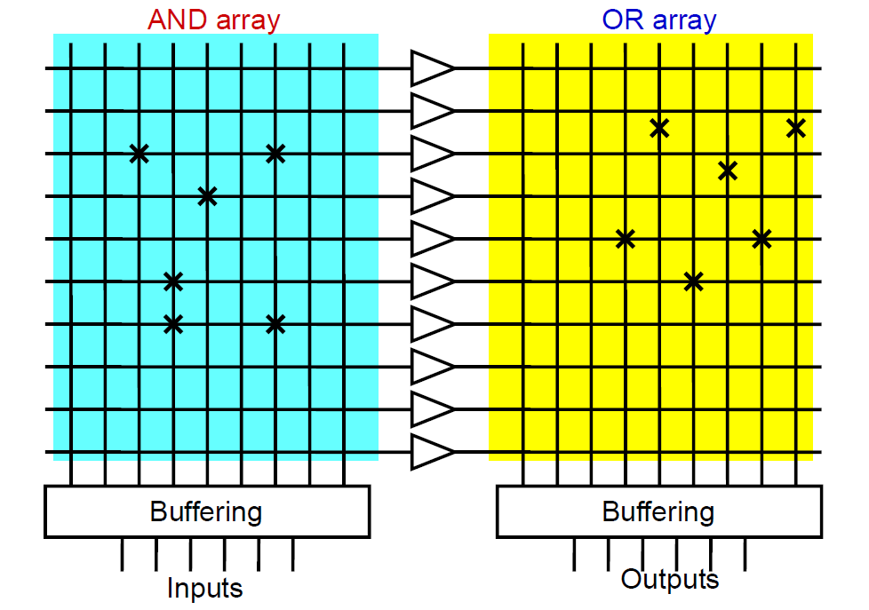
PLA

Slide 14
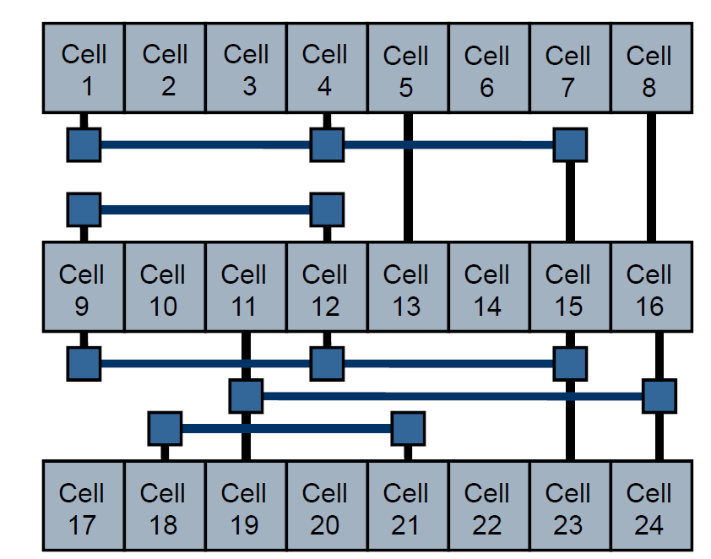
Gate Array
In a gate array (sometimes abbreviated GA) or gate-array
based ASIC the transistors are predefined on the silicon wafer

Slide 15
Can the design process depends on frequency of operation?

Slide 16
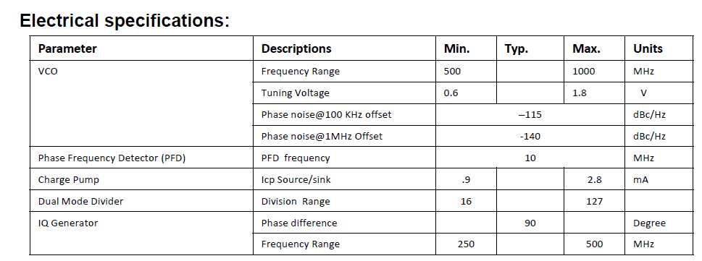
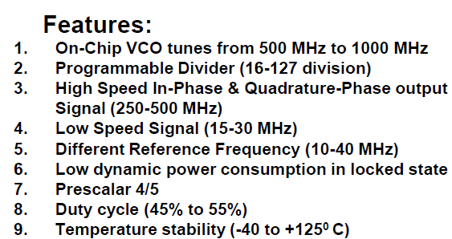

Slide 17
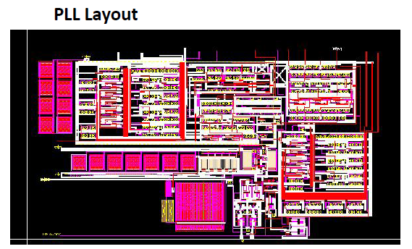
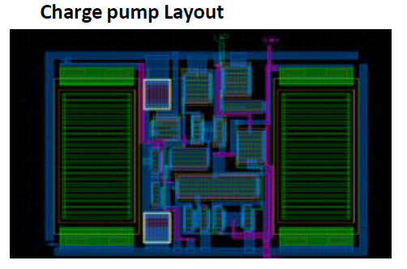

Slide 18
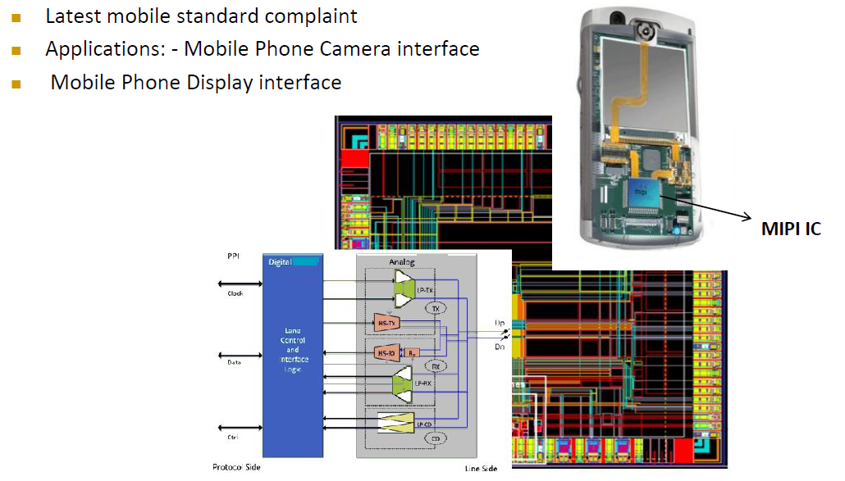
Complex CMOS transceiver design

Slide 19
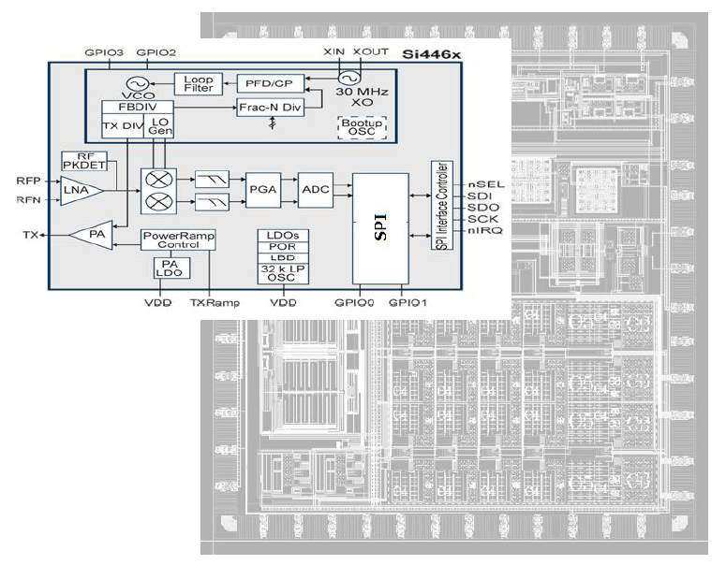

Slide 20
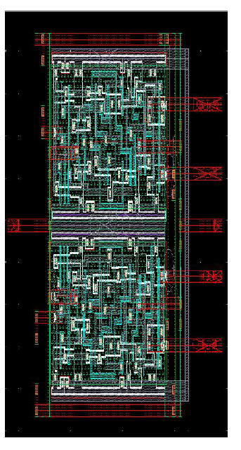

Slide 21
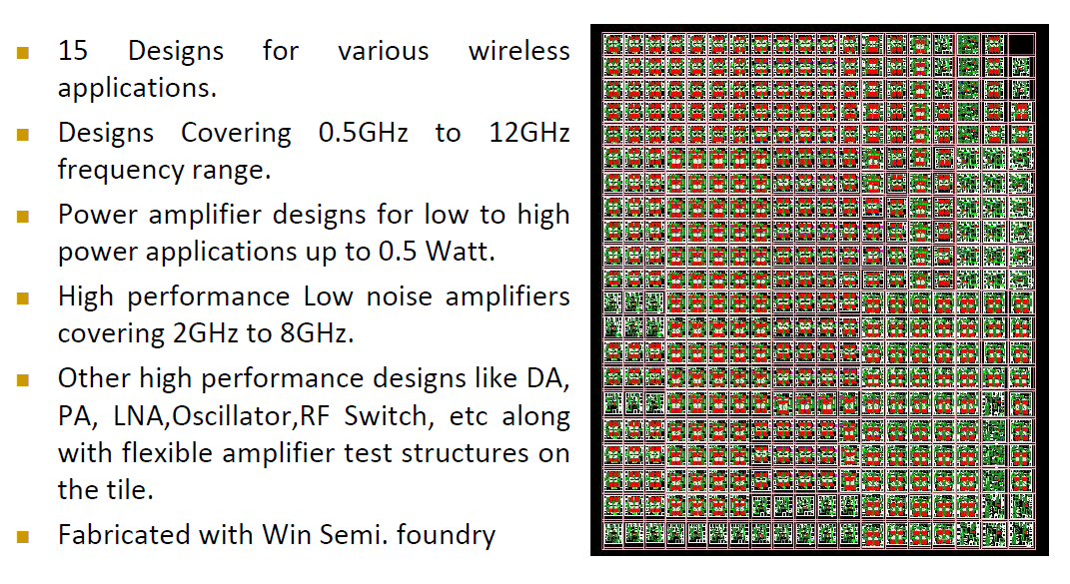

Slide 22
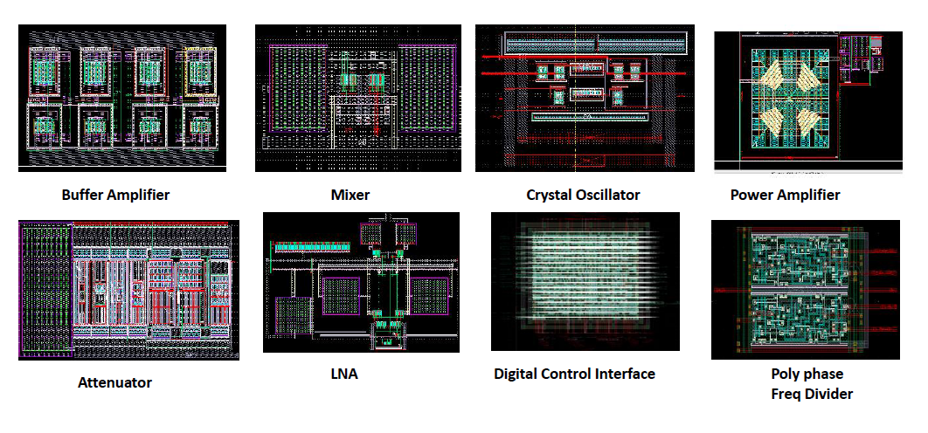
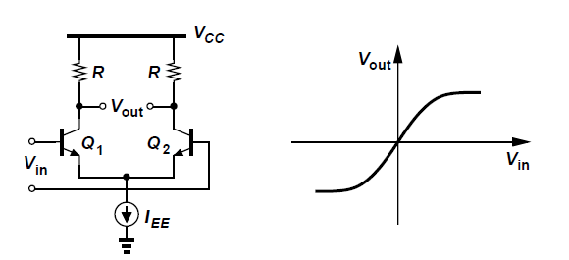

Slide 23
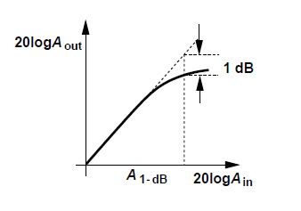
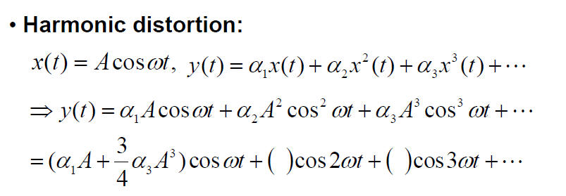
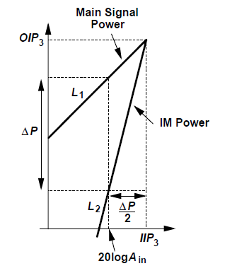
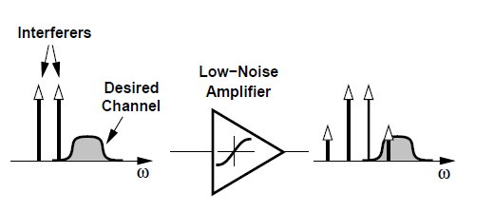
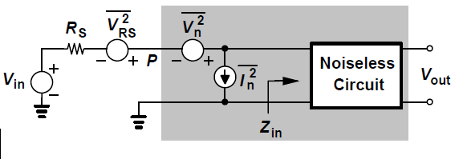

Slide 24
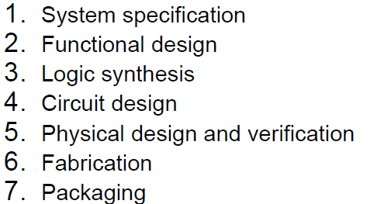
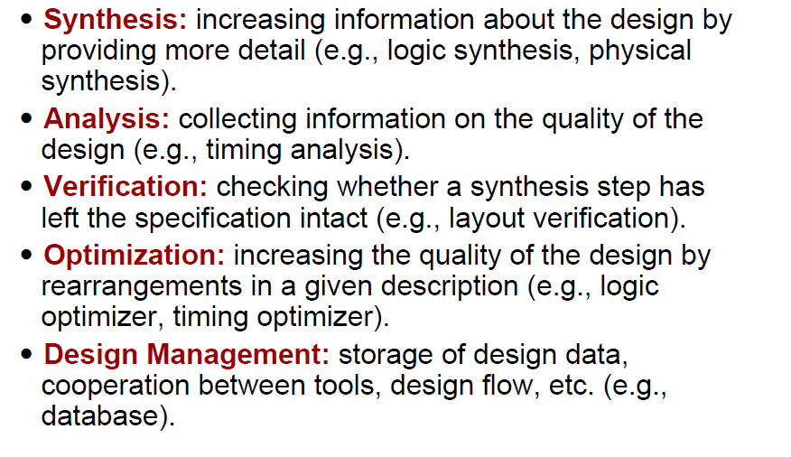

Slide 25
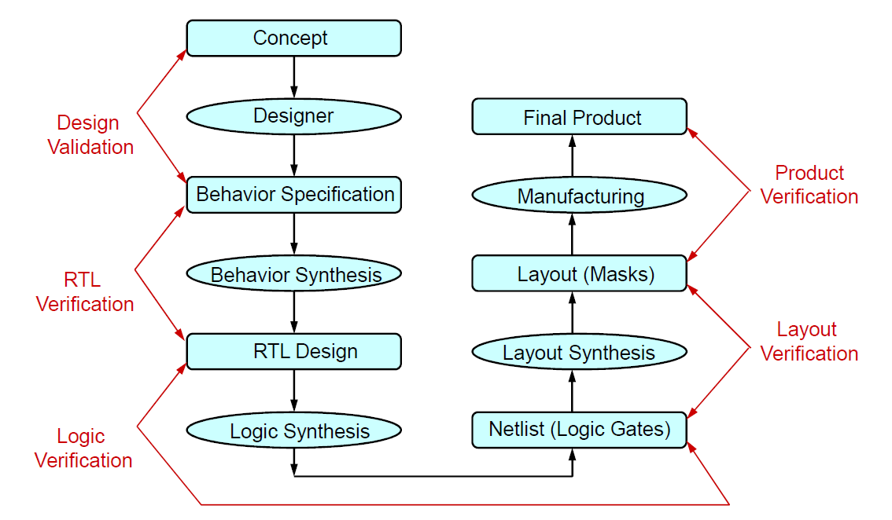

Slide 26
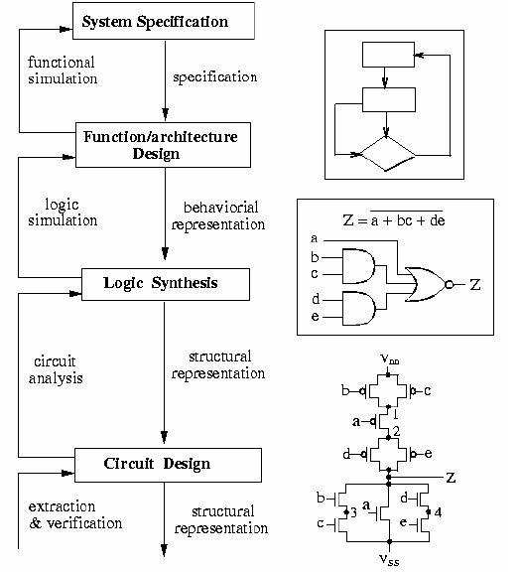
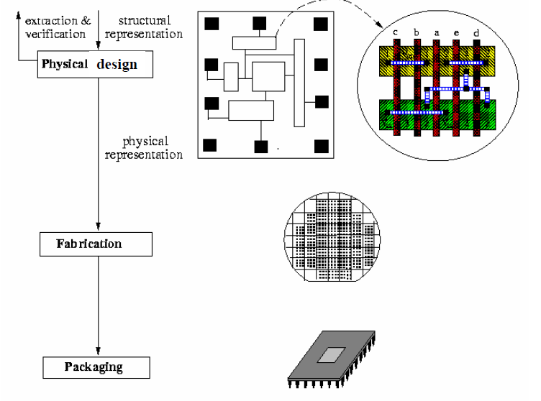

Slide 32
The same design we can specify with respect to its behavior, with respect to its structure where at this level design would consist of a block diagram some cells and their interconnections and finally the implementation level or the physical level.
In terms of the y diagram you can assume that there are several concentric circles as we have shown out here and as we move away from the centre of this y towards outside the design becomes more and more abstract. So when you are at the outer layer of the circles we are at a very abstract level may be behavior structure or physical. But as we go towards the inner side of this y the design becomes more and more detailed.
Structural description all basic building blocks will be some components and the components may be cells from the libraries.
Front end
Behavioral level if you recall this specifies the behavior of the circuit or the system without explaining how this behavior has to be implemented or realized.
synthesis
Physical design
Back end

Slide 33
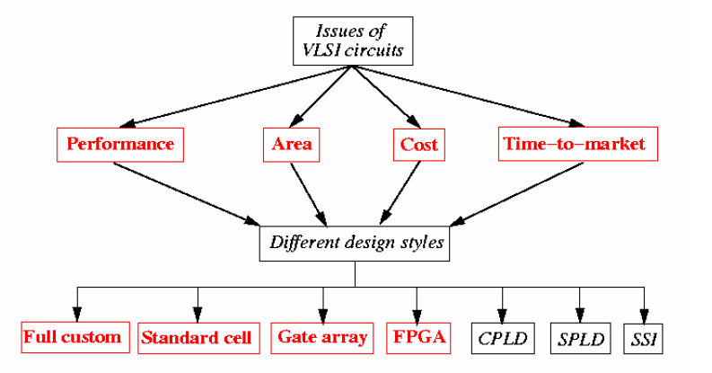
Synthesis is essentially a detailing out of the design
Suppose we have given behavioral description out here, now when we carry out synthesis we translate this behavioral description into the corresponding structural description this is the process of synthesis.
Translation from behavior to structure is also sometimes called front end design. So when we talk about front end design or front end CAD tools we are essentially talking about the translation from behavior to structure.
In implementation level the primary requirement is the interconnections of blocks. So the process from structural to physical design transmission is called physical design and sometimes this process of translation is also known as back end design or back end CAD tools

Slide 34
Algorithm / flowchart
Processor
Memory
Bus
S
B
Outer most level
PCB
SoC
P
Behavior at the most abstract level a design can be specified by simply specifying the algorithm or if it is a system label design you can also specify the flow chart. So algorithm or flowchart is a very high level kind of a design specification. So when we synthesize a algorithm or flow chart at the corresponding structural level we will have a some kind of a block diagram - some basic building blocks and their interconnections. Now these basic building blocks at the level of algorithm or flow chart will be something like processors, memories, buses, other IO interface units. So at this abstract level we are more concerned with a block diagram kind of a design, how these high level blocks are interconnected rather than going into the details of it.

Slide 35
In Physical domain now we are either talking about a printed circuit board where each of these modules or cells will correspond to 1 VLSI chip or we can talk of a multi chip module were inside the same integrated circuit we have several silicon wafers which are embedded on them and they are interconnected. So this PCB and MCM are very similar kind of PCB the chips are put on a board MCM.
S
B
Next lower level
Registers
Multiplexers
ALU
R1<-R2+R3
RTL
ASIC
FPGA
P

Slide 36
Now register transfer level design will look something like this. Suppose R1 assigned R2 plus R3, there can be a number of conditions. If then else kind of thing there can be a number of such register transfer operations you defined based on the inputs you give. So here we specify the behavior. But we do not say that how these register banks are implemented, how these adders, subtractors, are implemented. How many adders are there? So all those details we do not specify.
But one can understand with respect to the algorithm description, as we had said earlier this is a much more detailed description. This may correspond to the so called microinstruction level. So at a very high level you can specify a processor with the external IO pins and the instruction set. But as we go into the design of the control unit of the processor, we will have to specify the different microinstructions.
Now this register transfer level behavior when we translate into structure we get a design for the blocks are registers multiplexers ALU’s and similar register transfer level components. Similarly when you map them into the physical implementation. So you can either have an application specified circuit or you can have a prototype on a field programmable gate array.

Slide 37
S
B
Next lower level
Gates
FF
Boolean eq
FSM
Cells
P
But as you recal the design further from the register transfer level the next natural jump will take in to something like a logical level behavior specification where if it is a combination logic we will specify the behavior by a set of Boolean expressions. If it is a sequential logic we will specify by finite state machines. These represent the behavior of the circuit of the system we try to design. Now as you know starting from the Boolean expression or FSM there are many methods which are available for synthesis where we get a circuit where the basic building blocks now become gates and flip flops, so we have now an interconnection of gates and flip flops starting from the behavior at this level.

Slide 38
In the physical implementation you are working through the back end CAD tool. There is something called a library it is sometimes also called technology library. Now in the library you have the standard components already available - standard components like gates flip flops , arithmetic logic units. So at this level once you have the gate level implementation you simply replace each gate or each flip flop by the corresponding cell available from the library. So now at this level you have actually a tentative layout on silicon where you have the cells, these cells are fairly low level cells gates and flip flops and the way they are interconnected.
S
B
Next lower level
Transistors
Transistor/CMOS functions
And as you go even further down you get a design at the lowest level. Well with respect to the behavior; see ultimately we want to implement a circuit typically in CMOS; using CMOS technologies.
Transistor layout
P

Slide 39
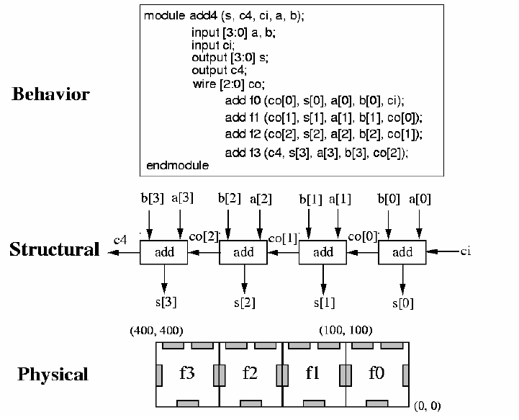
You can also specify the behavior of a CMOS net list with respect to the transistor functions typically for digital circuits a transistor or a MOS transistor is modeled in a very ideal way. We treat this as a simple switch. So each transistor is modeled as a switch this is what we mean by the transistor functions.
Well with respect to some more simplified model, when you go to the structural level. We get the actual net list of the transistors which is used to implement the behavior which we specify out here and finally at the physical level we get the actual layout of the transistors.

Slide 40
Logic design
RTL/
Boolean level
Logic verification
Logic synthesis
Component
library
stimulus
netlist
Logic simulation
Technology map
Cell library
performance
netlist
Back
annotation
Physical design
In synthesis we are talking about translating the behavior into the structural specification.
we start with the level of logic design where the specification is given either in terms of set of Boolean expressions. It can be FSM’s also or it can be slightly higher, it can be register transfer level specifications also.

Slide 41
We are specifying the behavior of the circuit and from there we are trying to go through the different steps of synthesis. Now this diagram will show you what are the different steps that we typically go through
logic synthesis is the block which accepts the specification as the input and generates some kind of a synthesized net list as the output net list means some basic components and their interconnection.
But when you are trying to implement it this net list may not be sufficient. Why? See suppose you are trying to design using FPGA. So using FPGA you have some constraints you know that these are the functions I can implement using FPGA and these are the things I cannot.
Now if the specification is in the terms of Boolean expressions, then this net list will consist of gates possibly flip flops and then interconnections.
Simple example
Suppose we are trying to design using CMOS. Now in CMOS again we will be having some kind of a library available with you where you will be getting a list of available gates or cells which you can use in your design. So the net list that we have obtained through the logic synthesis process, the basic cells out there, they will have to be mapped some how into the cells that belongs to that library. So that process is achieved or accomplished through a step called technology mapping

Slide 42
So technology mapping takes the net list which is generated by the logic synthesizer it also accepts the library this is a given cell library
And it tries to map the cells out here to the cells available in the library. And as the output, it generates another net list where the basic cells are those which are available in the library. So this net list is something which can be implemented
So this is the essential process and after completing the physical design if you find that something is wrong the circuit is not working according to the specification, then you may have to redesign and have to go back and change the original specification.
You lost : cost/ time / manpower/ load
So usually what people do before going for the actual physical design, so you take the net list which was obtained by the synthesizer and try to check whether this net list is working as per the specifications or not this you do through a process called logic simulation.

Slide 43
So logic simulation will again take this net list as the input. it will also take a stimulus which is just a set of inputs. If I have circuit and want to test the circuit for these inputs. So we apply these inputs and the simulator will tell you what will be the outputs.
I can verify if the outputs are correct or not. So when you are doing logic simulation the behavior of all the cells of this net list must be known that is available in another library. This is called the component library. Here all the basic components that can be there in this net list are present as well as their behavior is also present which helps in carrying out the logic simulation.
So after simulation we get the performance and if we see the performance is not according to our requirement we again to do redesign go back and change the specs.
Now sometimes even during the physical design we can do something called back annotation. Back annotation means form of very low level design specification we can re extract possibly the gate level design again. So we can go back to the logic simulation phase and again simulate with the same stimulus and check the performance.

Slide 44
logic simulation process takes as input a logic level net list. Logic level net list means net list comparison of gates/ comparison of flip flops and it simulates the functional behavior.
we would like to see whether the input output specifications are correct that if you give a particular input to the circuit what is the expected response or what is the response that we get
Simulation tool is a software program where the circuit you want to stimulate in terms of suitable data structure and through a systematic scan of the circuit of the data structure.
Design a ckt by sim
Input
Expected outcome
The simulated circuit is a close model of the netlist
Obtained from synthesis
This is an unknown system I can say which on table
Top I have to test

Slide 45
Component library : when you are doing simulation you need the behavior of the components behavior of the components what does that mean? Suppose if the components are simple gates like AND, OR, NOT, then what you need is the input output behavior of the gates. You need either the Boolean function or the truth table in some form. So you need the behavior of the gate in order to evaluate the output of a gate when some particular input values are applied to it okay. So behavior of the components is assumed to be present in the so called component library. Now component library can be quite exhaustive you can have gates out there. You can have sequential elements like flip flops and registers you can have slightly more combinational more complex blocks like multiplexers, adders and other functions and models like decoders
one of the requirements of logic simulation is that it should be possible to handle large circuits. So when we talk of large circuits in the present day scenario, we are actually talking about millions of gates okay. So the logic simulation process should be very efficient it should be able to handle large circuits of the order of millions.
Objectives of simulation:
Functional correctness -> test bench
Timing analysis
Test generations

Slide 46
Test Generation : you have a design and you have done some kind of synthesis on it. So what we obtained is a net list . But this is not something which you have already fabricated. This net list is still on your computer . So through simulation you try to verify whether the net list is working as per the specification . This is done on the design.
But suppose the design process is what you have completed the physical design process also and now the chips are getting fabricated. Suppose you have fabricated 1000 chips for your design. Now during fabrication there can be a large number of faults which can creep in obviously. So once you have manufactured the circuits in terms of the chips you will have to test each and every chip by applying some input stimulus input test vector and checking the output. This is the so called manufacture test
Design for manufacturability
Finding out yield
Response model

Slide 47
Logic synthesis
Logic synthesis
Outputs:
Netlist of gates and FF
Combinational
Sequential
Inputs:
B expression
FSM
Design Goal :
Number of level ( delay)
Number of gates ( area)
Low power
Constraint
Target library
Suppose you are trying to design a circuit for a very critical application where delay is most important to you. You want to design a circuit that will work as fast as possible. So here if it is combination circuit your designed goal will be to minimize the number of gate levels. So as you reduce the number of levels
to minimize signal active means as the switching activity in the circuits get reduced the total power consumption also get reduced. So we want to ensure that the number of signal transitions that are going on signal transition means 1 to 0, 0 to 1 they are going on per unit time in the circuit is as less as possible.

Slide 48
Circuit breakup
if you have a gate with large number of inputs.
You have a AND gate with a large number of inputs. So instead of having 1 AND gate with a large number of inputs you may be possibly break it up into several smaller AND gates. But you may argue that if I do this I am increasing the number of levels. So apparently I am also increasing the delay because the number of gate delays is more. But well this is not true. ------ Assignment
Technology Mapping
Technology mapping is a process where we have the net list with us. We have a technology library with us we will have to map our net list from some modules which are available in the technology library. So the basic concept is that during synthesis we will have to map portions of the net list to so called cells which are available in the cell library. cells can be these standard gates NAND, NOR, NOT, AND, OR, invert or depending on the target where you want to map the design on if it is FPGA.

Slide 49
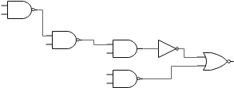
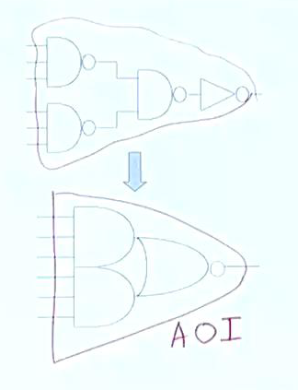
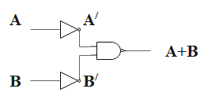
This is the standard
Component library
So the idea is simple you have a big net list of gates you try to find out the small sub circuits from there which matches with some net list available in your technology library. And if you find a match replace it by the corresponding component of the technology library. So if you do this what you have is that your entire net list which was there at the beginning will now get transformed into a net list of cells which have been picked up from the technology library. Now as I had said there can be overlap among the cells, the objective is to have minimum number of cells if area is important or to reduce the number of levels of the cell net list if delay is more important.

Slide 50
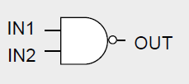
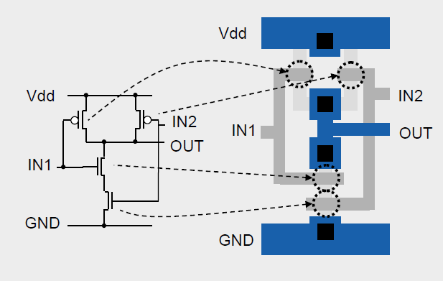
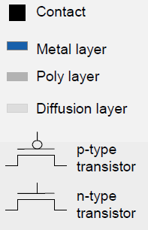
A pictorial overview of design flow

Slide 51
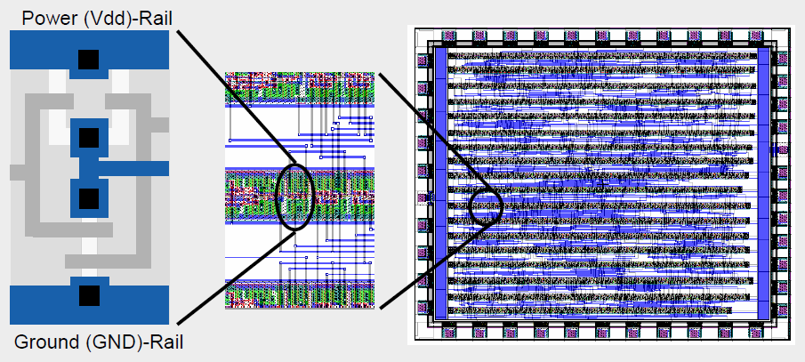
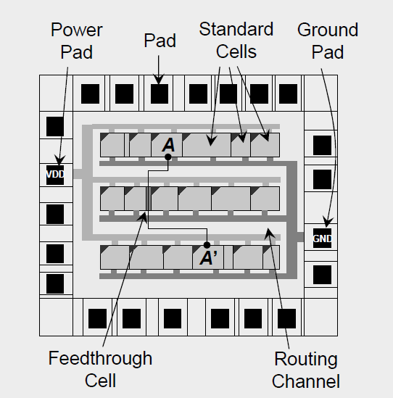

Slide 52
What is Simulation

Slide 59
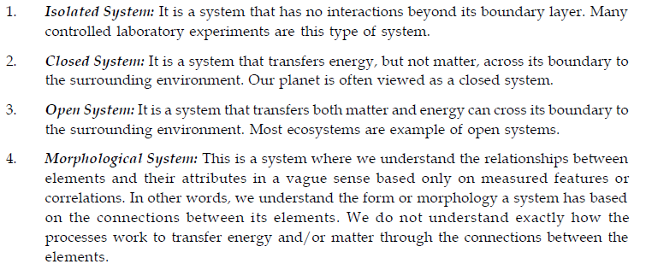

Slide 60
System State Variable
System state variables are the collection of all information needed to define what is happening within the system to a sufficient level.
Having defined system state variables, a contrast can be made between discrete-event models and continuous models based on the variables needed to track the system state.
The system state variables in a discrete-event model remain constant over intervals of time and change value only at certain well defined points called event times.
Continuous models have system state variables defined by differential or difference equations giving rise to variables that may change continuously over time.

Slide 62
Entities and Attributes
An entity represents an object that requires explicit definition.
An entity can be dynamic in that it "moves" through the system, or it can be static in that it serves other entities.
Attributes should be considered as local values.

Slide 63
Activities and Delays
An activity is duration of time whose duration is known prior to commencement of the activity.
The duration can be a constant, a random value from a statistical distribution, the result of an equation, input from a file, or computed based on the event state.
A delay is an indefinite duration that is caused by some combination of system conditions.
When an entity joins a queue for a resource, the time that it will remain in the queue may be unknown initially since that time may depend on other events that may occur.

Slide 64
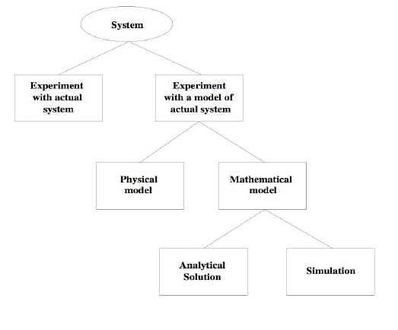

Slide 66
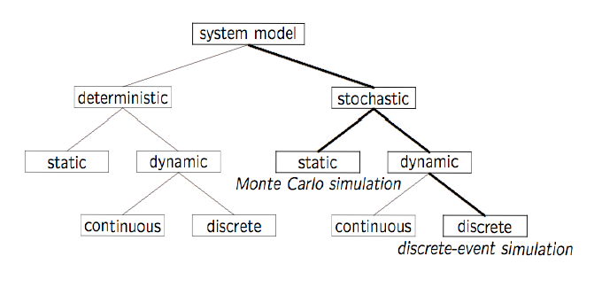

Slide 68
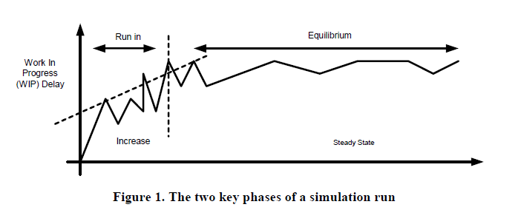
Phases in Simulation
A simulation run typically starts in the empty and idle state. The run is therefore characterized by a "run-in" phase followed by a "steady state" phase, see Figure 1. The run-in phase is generally ignored and is only used for investigating the effects of transient conditions such as starting up a new factory or performing radical changes within an existing facility.
Typically the steady state phase is of greater interest. At this stage checks must be made to ensure no long term trends exist, such as continual build up of stock in the factory, that suggest the model (hence the real system) will be unstable and unworkable.

Slide 69
Verification and Validation
The validation efforts can be grouped into two parts
1. validation of the abstract model itself
2. validation of its implementation
The first part consists of examining all assumptions, which transform the real world system into the conceptual model.
Testing the validity of an implementation is a more objective and easier task. It consists of checking the logic, the flowchart, and the computer program to ensure that the model has been correctly implemented.

Slide 72
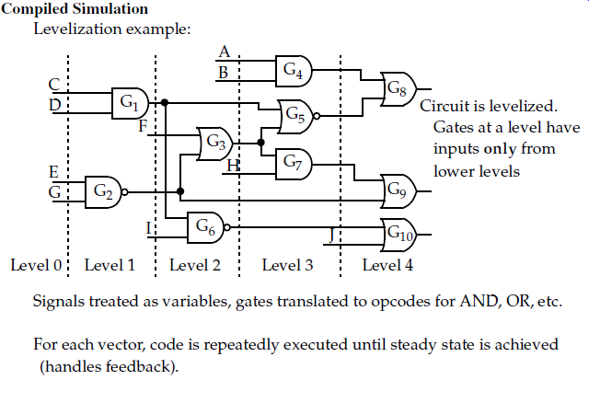

Slide 73
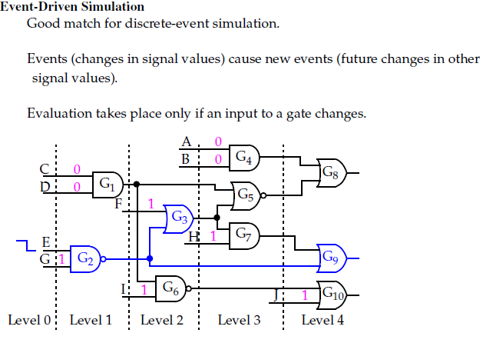

Slide 74
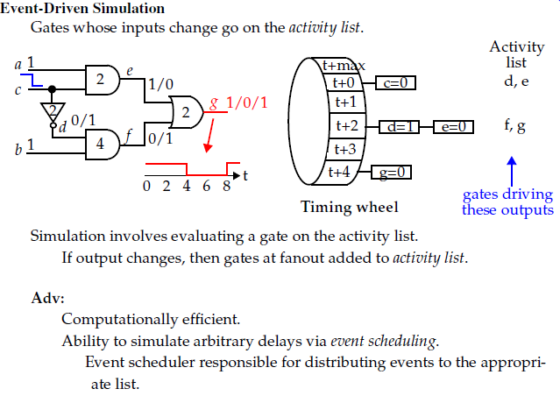

Slide 75
Timing Analysis

Slide 77
Micro-instructions

Slide 78
Scheduling

Slide 79
Classification of EDA

