Slide 1
Design for Manufacturability Design of Experiment

Slide 2
Total Yield
Here Y_{line} denotes line yield or wafer yield which is the fraction of wafers which survive through the manufacturing line.
Y_{batch} is the fraction of integrated circuits which on each wafer fully functional at the end of the line.
Y_{batch} can be further classified based on either type of defect or of failure. Failure-type
taxonomy is as follows.
Catastrophic Yield Loss. These are functional failures such as open or short circuits
which cause the part to not work at all. Extra or missing material particle defects
are the primary causes for such failures.
Parametric Yield Loss. Here the chip is functionally correct but it fails to meet some
power or performance criteria. Parametric failures are caused by variation in one
or set of circuit parameters, such that their specific distribution in a design makes
it fall out of specifications.

Slide 3
Defect
It is important to understand that both random and systematic defects can cause parametric or catastrophic yield loss. For example, lithographic variation which is typically systematic and pattern dependent can cause catastrophic line-end shortening leading gate (polysilicon over diffusion) not forming and hence a functional failure.

Slide 4
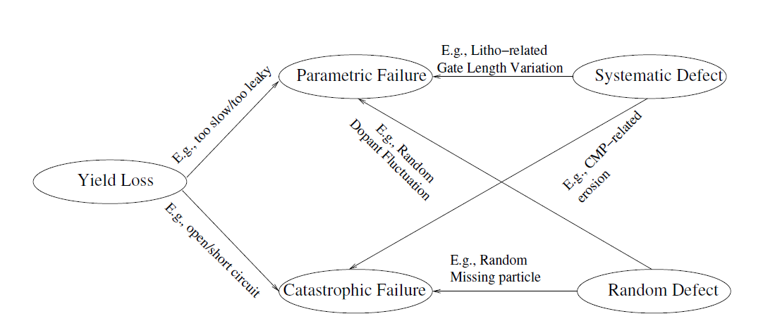

Slide 5
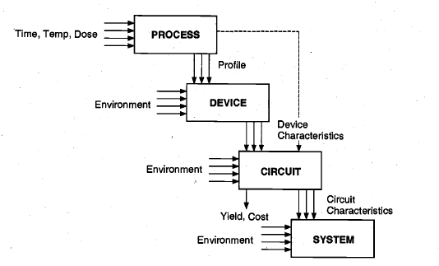
It is, therefore, important that the effect of these inevitable statistical variations in the processing and environmental conditions be considered early on during the design of the circuit. The circuit performance should be made least sensitive to these variations and should have enough margins that a large fraction of the manufactured circuits pass the acceptability criteria. This is the essential motivation for design for manufacturability (DFM).

Slide 6
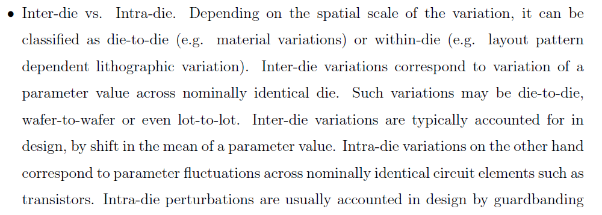

Slide 7
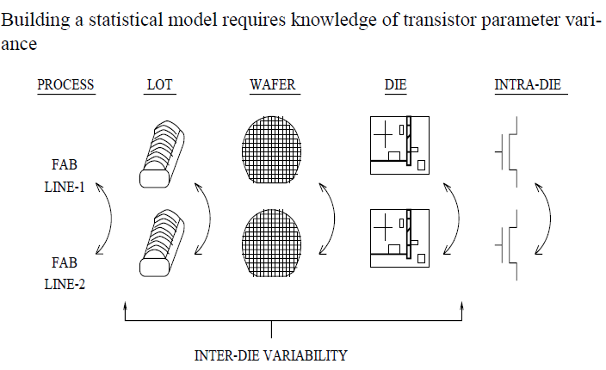

Slide 8
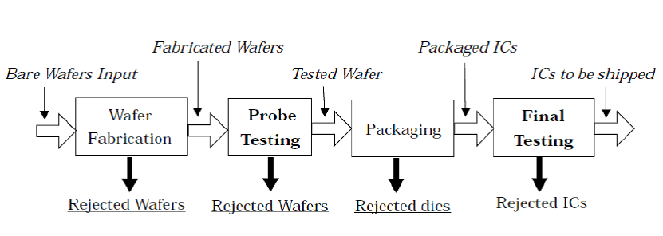
In the wafer fabrication process the structure of integrated circuits is sketched on the wafers and each of them is tested with the help of a probe in the probe testing stage.
Once tested, the wafers are then cut (diced) into many pieces, with each piece containing a copy of a fully functional IC, these individual pieces are called a die.
The dies that pass the test stage are packaged and sent for a final yield test before shipping.
Faults or processing issues that may occur during any of these stages can cause some or all of the ICs on the wafers to malfunction.
Such failures in ICs are detected at any of the two testing stages, probe testing or final testing.

Slide 9
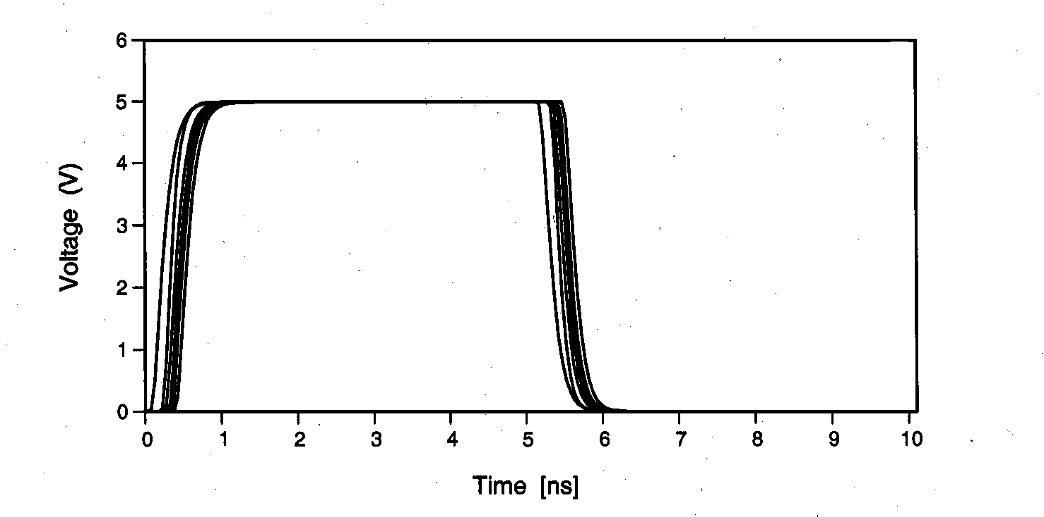
It can be seen that the output varies significantly due to variations in device parameters caused by process fluctuations

Slide 10
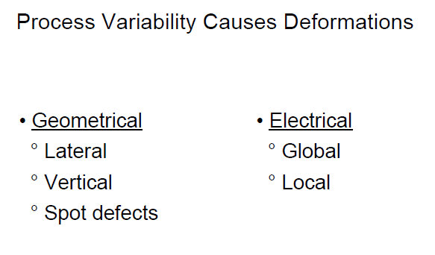

Slide 11
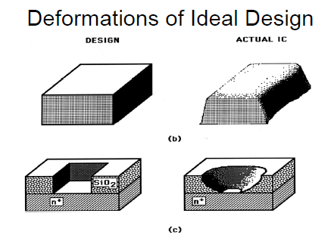

Slide 12
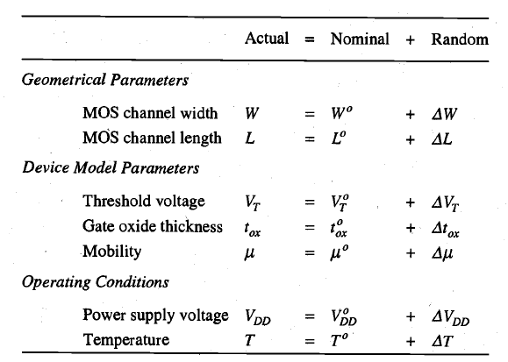

Slide 13
For the device model parameters and operating conditions, the nominal component is not under the control of the designer and is set by nominal processing and operating conditions. For these parameters, the nominal and random components are together called the noise component, e.g., VT and VDD.

Slide 14
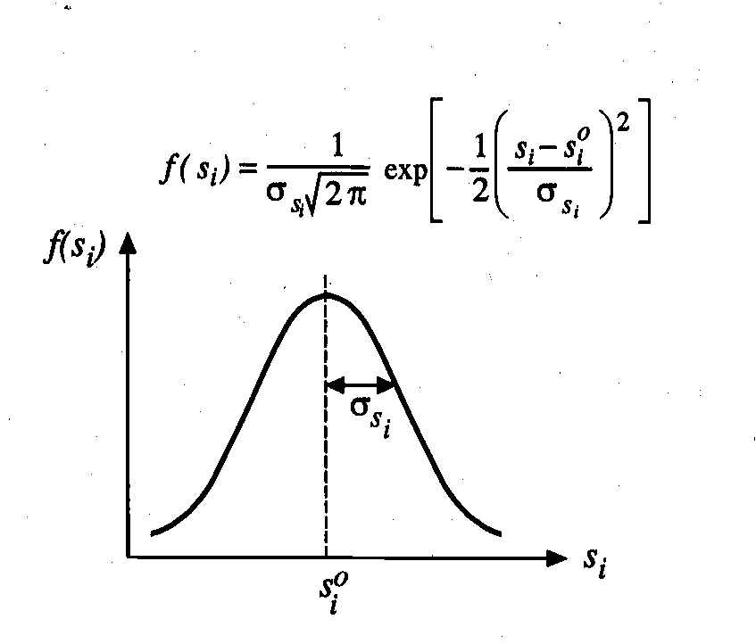
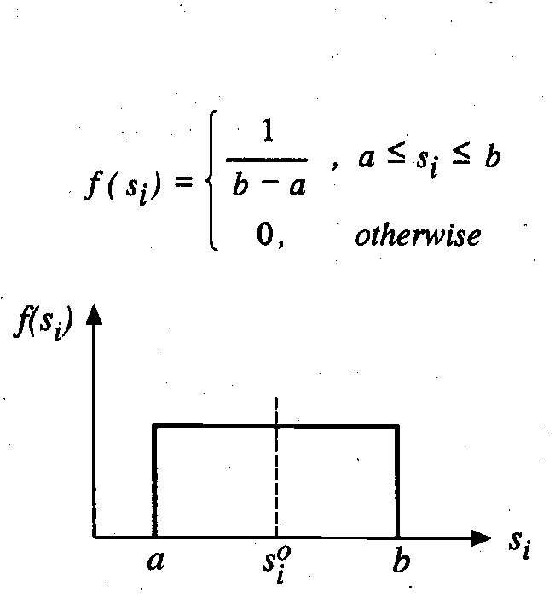
The statistical distributions of the internal noise parameters can be obtained via test
structure measurements and parameter extraction.
To simplify the analysis, a commonly used assumption is that the internal noise parameters have a Gaussian distribution, while the external noise parameters are uniformly distributed random variables
The internal noise parameters are statistically correlated due to the sequential nature of the processing steps.
The external noise parameters are, however, statistically independent random variables.

Slide 15
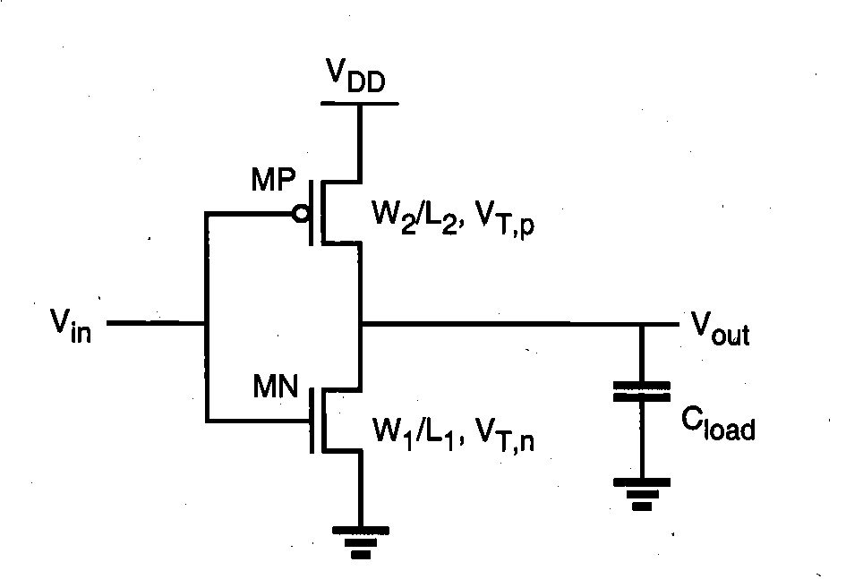
A Typical example

Slide 16
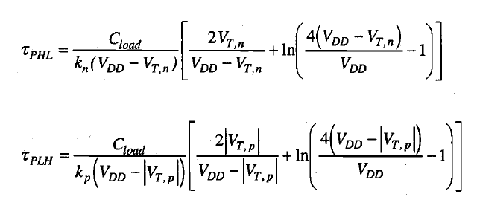
Now Performance measure : propagation delay

Slide 17
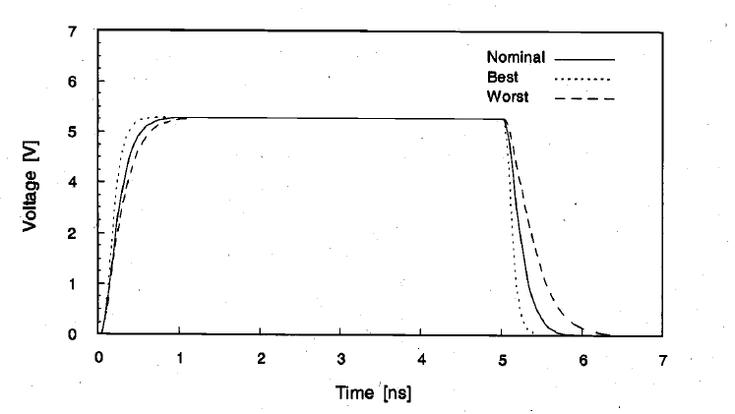

Slide 18
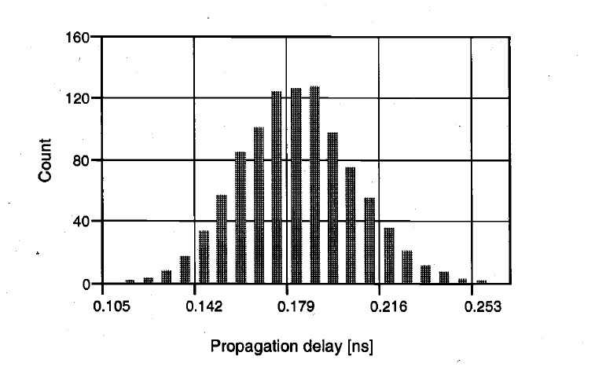
The circuit performance measure, which is a function of the random circuit parameters,
is also a random variable. Therefore, a performance measure will have a mean value
and a standard deviation.

Slide 19
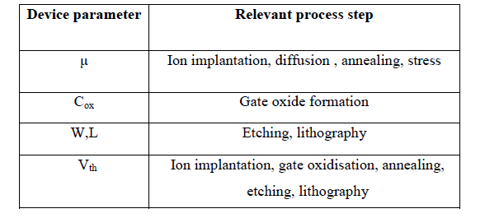
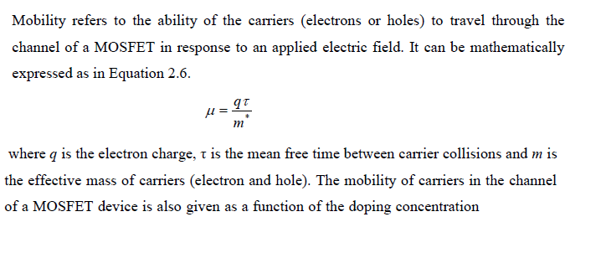

Slide 20
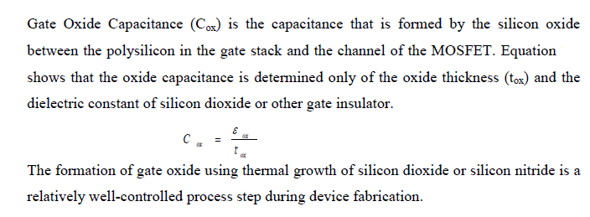

Slide 21
PVT
PVT is abbreviation for Process, Voltage and Temperature. In order to make our chip to work in all possible conditions, like it should work in -40°C and also at 60°C, we simulate it at different corners of process, voltage and temperature which IC may face after fabrication. These conditions are called as corners. All these three parameters affect the delay of the cell.
Process:
Process variation is the deviation in attributes of transistor during the fabrication.
Voltage:
Now a days, supply voltage for a chip is very less. Lets say chip is operating at 1V. So there are chances that at certain instance of time this voltage may vary. It can go to 1.1V or 0.9V. To take care of this scenario, we consider voltage variation.
Temperature:
The temperature variation is with respect to junction and not ambient temperature.

Slide 22
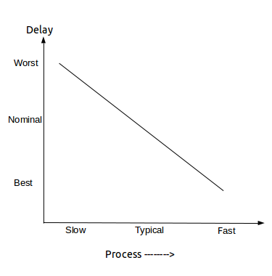
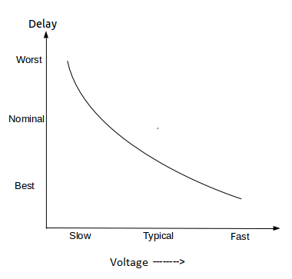
the relation between process and delay can be better understood with the following curve
important reason for voltage variation is supply noise caused by parasitic
On Chip Variations (OCV):
Variations are of two types:
1. Global variations
2. Local Variations

Slide 23
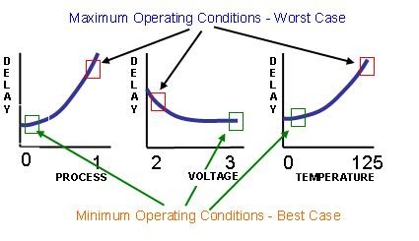

Slide 24
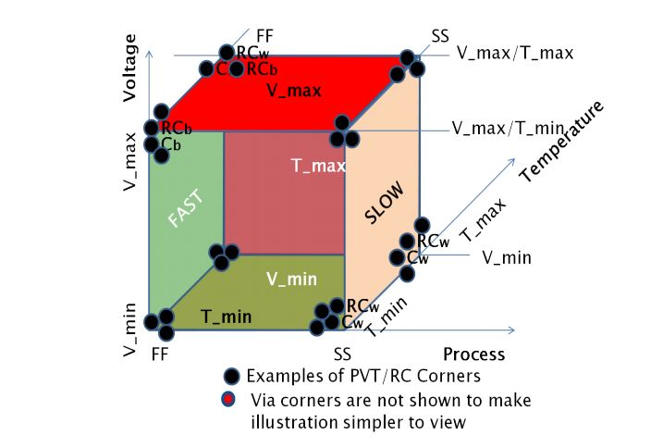

Slide 25
Process Corner
From the designer’s point of view, the collective effects of process and environmental variation can be lumped into their effect on transistors: typical (also called nominal), fast, or slow.
In CMOS, there are two types of transistors with somewhat independent characteristics, so the speed of each can be characterized. Moreover, interconnect speed may vary independently of devices. When these processing variations are combined with the environmental variations, we define design or process corners.

Slide 26
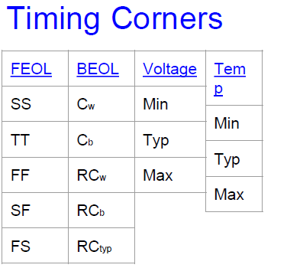
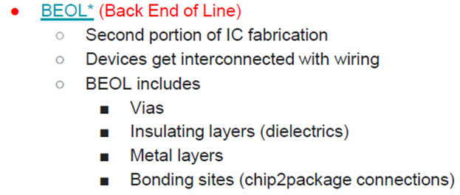

Slide 27
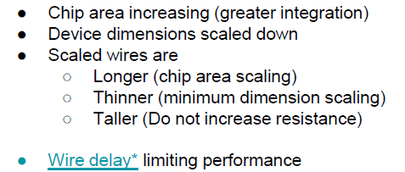

Slide 28
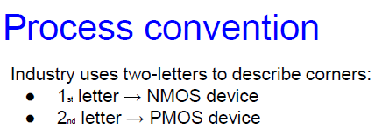
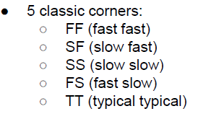
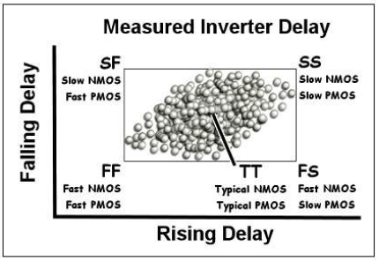

Slide 31
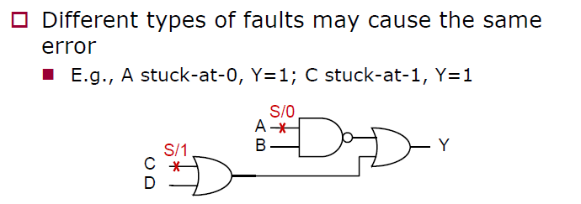

Slide 32
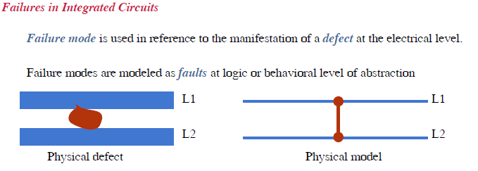

Slide 33
Reliability
Infant mortality : Early failure in life :: Most IC product follow some initial failure as a function of its versions. Failure rate decreases rapidly to a low value with more iteration.
Bathtub curve : Failure will gain increases with end of life. End of product lifetime --- failure is high.
Overall reliability of any IC chip can be measured by using the mean time between failure ( MTBF) for a repairable product or mean time to failure (MTTF) for a fatal failure.
Also uses failure in time (FIT) where 1 FIT equals a single failure in 10⁹ hours.

Slide 34
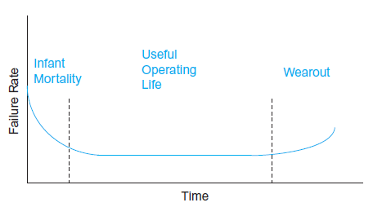
MTBF is the mean time between failures: (number of devices × hours of operation) / number of failures.
FIT is the failures in time, the number of failures that would occur every thousand hours per million devices

Slide 35
Fault Model
Mapping from Physical fault to logical fault.
Distinguish among different logical fault.
Three types of logical fault
Degradation fault
Open circuit fault
Short circuit fault.
Degradation fault of two types
Parametric fault
Delay fault.

Slide 36
Cont.
Parametric fault leads to incorrect switching value/ threshold value
Delay fault leads to critical path
Open circuit or short circuit fault provides wrong logic level transfer from one end to other.
Most short circuit fault occurs due to bad interconnections – often called as bridging fault.
Bridging fault can be feedback type or non-feedback type.

Slide 37
Single stuck at fault
It is a one fault model.
Can be used as separate entity in multiple stuck at fault model.
There are some eqv model like stuck on fault like stuck open / stuck off fault model.

Slide 38
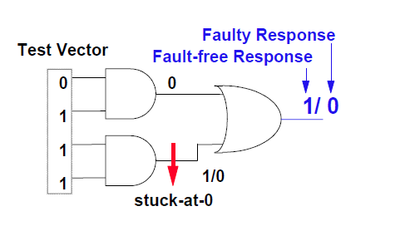

Slide 39
Cont.
Net fault : forces all the logic cell inputs either to logic 0 or logic 1.
Input fault : attached to a logic cell input forces the input to logic 1 or 0. But it is confined to a particular logic cell and may not affects other.
Output Fault: If it is a rail strength fault--- all the logic cell output connected to supply rail will force to either 0->1 or 1->0.

Slide 40
Cont.
Generally Stuck at fault injected at input or output pins of logic cell.
We do not injected this to the internal nodes like internal pins of flip flop etc.
We call the earlier fault as pin fault model/ structural fault model/ gate level model.
If internal fault is applied then it is transistor / switch level model.
Fault effects travel through the circuit to other logic cells causing other constitutive faults – This is called fault propagation.
Fault collapsing : same output due to multiple fault. Can be minimized to a single model.

Slide 41
Fault Detection in Combinational Circuits
Circuit: Let Z(x) be the logic function of a circuit N, where x represents an arbitrary input vector and Z(x) denotes the mapping realized by N circuit.
Faulty circuit: The presence of a fault f transforms N into a new circuit N_{f} with a new function Z_{f} (x).
Test: Denote by t, a specific input vector (test vector), and by Z(t) the response of N. Let us call a sequence of test vectors by test:T={t₁ t₂ ... t_{n} }.
The circuit is tested by applying a test T and by comparing the output response with the expected output response of N Z(t1)…
Fault detection: A test vector t detects a fault f if Z(t) not equals to Z_{f}(t)

Slide 42
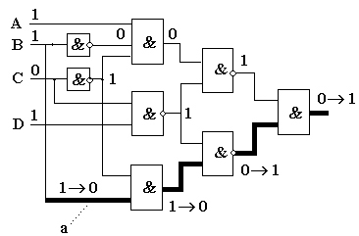
In Figure a fault a/0 is sensitized by the value 1 on a line a.
A test t = 1101 is simulated, both without and with the fault a/0. The results of the simulation are different in the two cases, shown in a form v->vf where v and vf are corresponding signal values in the fault-free and in the faulty circuit. The fault is detected since the output values in the two cases are different. A path from the faulty line a is sensitized (bold lines) to the primary output of the circuit.

Slide 43
Detectability of Faults
A fault f is detectable if there exists a test t that detects f , otherwise, f is an undetectable fault.
The presence of an undetectable fault f may prevent the detection of another fault g.
In Figure, the fault b/1 is undetectable. As we saw in the previous example, the test t = 1101 detects the fault a/0. However, in the presents of b/1, the test t is not any more able to detect the fault a/0.

Slide 44
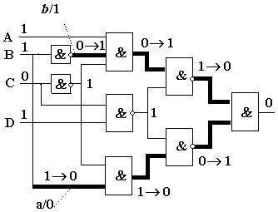

Slide 45
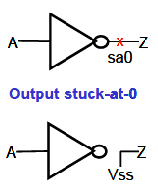
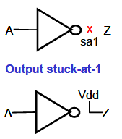

Slide 46
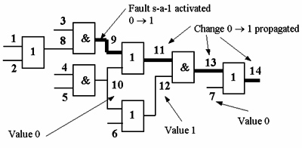
Fault Propagation

Slide 47
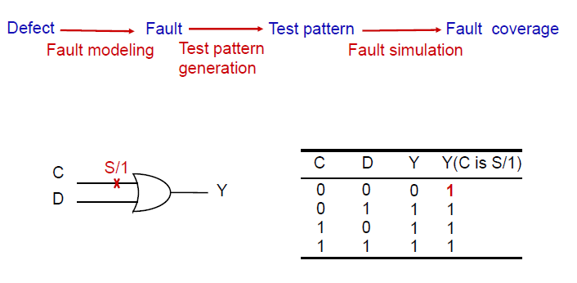

Slide 52
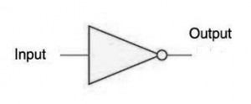
Digital Circuits and the Stuck at Fault Model
With a stuck at fault model you are applying a structural test approach. Instead of testing all combination of 1’s and 0’s to a VLSI device, you will test with a reduced set of test vectors. Stuck at Fault Models operate at the logic model of digital circuits. An input or an output can be Stuck at Zero (S@0) or Stuck at One (S@1)
Inverter Logic Table
A | D
1 | 0
0 | 1
Inverter Stuck faults list: A S@0, A S@1, D S@0, DS@1

Slide 53
Testing With Stuck at Fault Model
With a stuck at fault you apply a pattern (set of 1’s and 0’s) to the inputs of the logic gate such that you get a faulty response. So let’s start with the inverter. Suppose A is S@1. Easy test, you need to apply a 0. Now lets’ look at the output D stuck at 0, you need to apply a 0 to A. Table below tabulates the test pattern per S@ fault.
Inverter S@ Fault and Test Table
S@ Fault | Test A | Pass D | Failing D
A S@1 | 0 | 1 | 0
A S@0 | 1 | 0 | 1
DS@1 | 1 | 0 | 1
D S@0 | 0 | 1 | 0
Now while there exist 4 faults to test you only need 2 tests as shown in the table below. This is commonly called fault collapsing.

Slide 54
Inverter S@ Fault Coverage of Tests
A | Stuck @ Faults Detected
1 | A-S@0, D-S@1
0 | A-S@1, D-S@0
NAND S@ Fault and Tests
S@ Fault | Test A | Test B | Pass Y | Fail Y
A S@1 | 0 | 1 | 1 | 0
A S@0 | 1 | 1 | 0 | 1
B S@1 | 1 | 0 | 1 | 0
B S@0 | 1 | 1 | 0 | 1
Y S@1 | 1 | 1 | 0 | 1
Y S@0 | 1 | 0 | 1 | 0
Y S@ 0 | 0 | 1 | 1 | 0
CYS@ 0 | 0 | 0 | 1 | 0

Slide 56
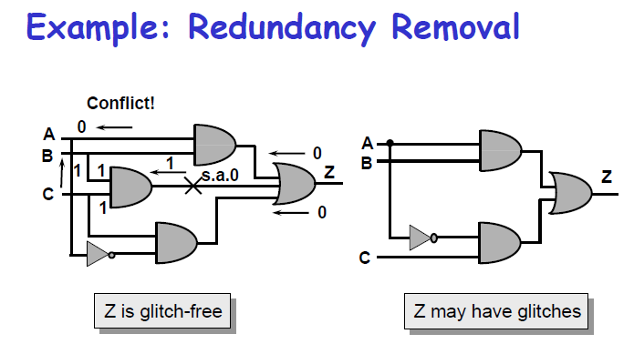
If error happens then
1+ stuck at 0 + 0 = 1
1 x 1 = 1 ( if no fault)
0 x 1 = 0
1 x 1 =1
1+0+1= 1

Slide 58
Design of Experiments (DOE)
Design of experiments (commonly referred to as DOE) is a data-driven technique for robust design. In the early 1900's, DOE was used by agricultural engineers to improve crop yields. Today circuit and system designers are applying the method as a means to the same end-yield improvement.
A typical DOE includes three primary steps:
Plan the experiment:
Assess the experimental resource budget.
Identify the input and response variables.
Assign levels (values) to input variables.
Perform the experiment and collect response data.
Analyze the data using statistical methods.
Sequential application of this methodology can be used to improve the statistical performance of a given circuit or system. Because of an inherent compromise between statistical performance prediction accuracy and the number of input variables, a screening experiment is used to identify variables that contribute significantly to performance variation. Next a refining experiment can be used to improve on the target statistical response.

Slide 59
DOE and Computer Simulation
In a general application, DOE methods are designed to accommodate errors of the type found in any experiment. But because circuit and system simulators provide identical results for any analysis having the same input values, complexity in setting up, performing, and analyzing experiments is reduced.
Since the computer is being used to perform the experiment, a more complete characterization of input/output relationships can be realized. Finally, since the computer handles the tedious tasks of bookkeeping during the experiment, there is a further reduction in the possibility of human error.
The primary purpose of DOE is to characterize an unknown process. In circuit or system simulation, the unknown process is predicting the response of the design under test (DUT). A simple technique for characterizing a DUT is to perturb each input variable ( factor ) in turn, and to record the resulting output response. However this approach breaks down if the response due to a change in one factor depends on the value of a different factor.

Slide 62
ANOVA
The total variation present in a set of observable quantities may, under certain circumstances, be partitioned into a number of components associated with the nature of classification of the data
The systematic procedure of achieving this is called analysis of variance (ANOVA).
The purpose of ANOVA is to test for significant difference between means.

Slide 63
The name is derived from the fact that in order to test for statistical significance between means , we are actually comparing (analyzing) variances.
Assumptions of ANOVA :
(i) Subjects are chosen via a simple random sample.
(ii) Within each group/population, the response variable is normally distributed.
(iii) While the population means may be different from one group to the next, the population standard deviation is the same for all groups.

Slide 64
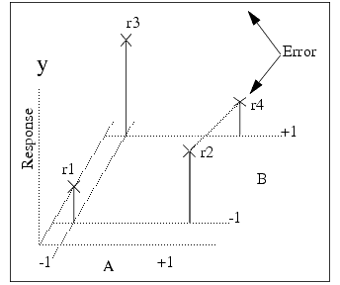
DOE Concepts
The following figure shows two factors, A and B, and the associated response at various values ( levels ) of the factors.
Notice that the factors have two levels: one low (−1) and one high (+1). The ±1 notation indicates the factor values are in design units , and are obtained from physical values using the following equation:
where X is the minimum (maximum) physical value of the variable, and X _{lo} , X _{hi} , and X _{mid} are the minimum, middle, and maximum physical values. For example, a capacitor value might be 100pF ± 10%, leading to low, mid, and high values of 90, 100, and 110pF respectively.

Slide 65
If we were to note the change in response due to a change in factor A (from low to high), we would be led to believe that increasing A causes an increase in the response-the same would be observed for factor B. A model from the three response points r1, r2, and r3 can be formulated as the plane surface.
Components of Experimental Design
Factors, or inputs to the process. Factors can be classified as either controllable or uncontrollable variables. In this case, the controllable factors are the ingredients for the cake and the oven that the cake is baked in. The controllable variables will be referred to throughout the material as factors. Note that the ingredients list was shortened for this example - there could be many other ingredients that have a significant bearing on the end result (oil, water, flavoring, etc). Likewise, there could be other types of factors, such as the mixing method or tools, the sequence of mixing, or even the people involved. People are generally considered a Noise Factor - an uncontrollable factor that causes variability under normal operating conditions, but we can control it during the experiment using blocking and randomization.

Slide 66
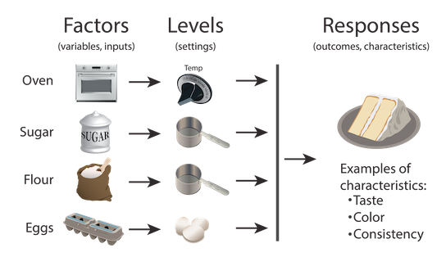
Levels, or settings of each factor in the study. Examples include the oven temperature setting and the particular amounts of sugar, flour, and eggs chosen for evaluation.
Response, or output of the experiment. In the case of cake baking, the taste, consistency, and appearance of the cake are measurable outcomes potentially influenced by the factors and their respective levels. Experimenters often desire to avoid optimizing the process for one response at the expense of another. For this reason, important outcomes are measured and analyzed to determine the factors and their settings that will provide the best overall outcome for the critical-to-quality characteristics - both measurable variables and assessable attributes.

Slide 68
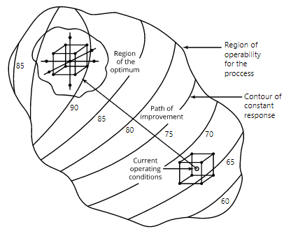
objective of Response Surface Methods (RSM) is optimization, finding the best set of factor levels to achieve some goal.

Slide 69
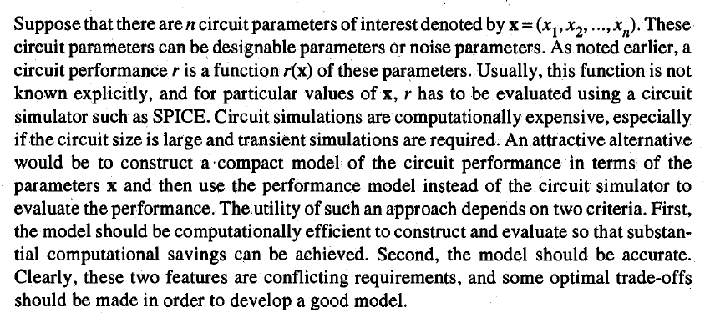
Since the model is to act as a surrogate to the circuit simulator, it should be built from values of r obtained by circuit simulations.
The model building procedure consists of four steps.
First, m training points are selected in the x-space. The i^{th} training point is denoted by x_{i} = (x_{1i} , x_{2i}, ..., x_{nj}).
In the second step, the circuit is simulated at the m training points, and the values of the performance measure are obtained from the simulation results as r(x₁),...,r(x_{m}).

Slide 70
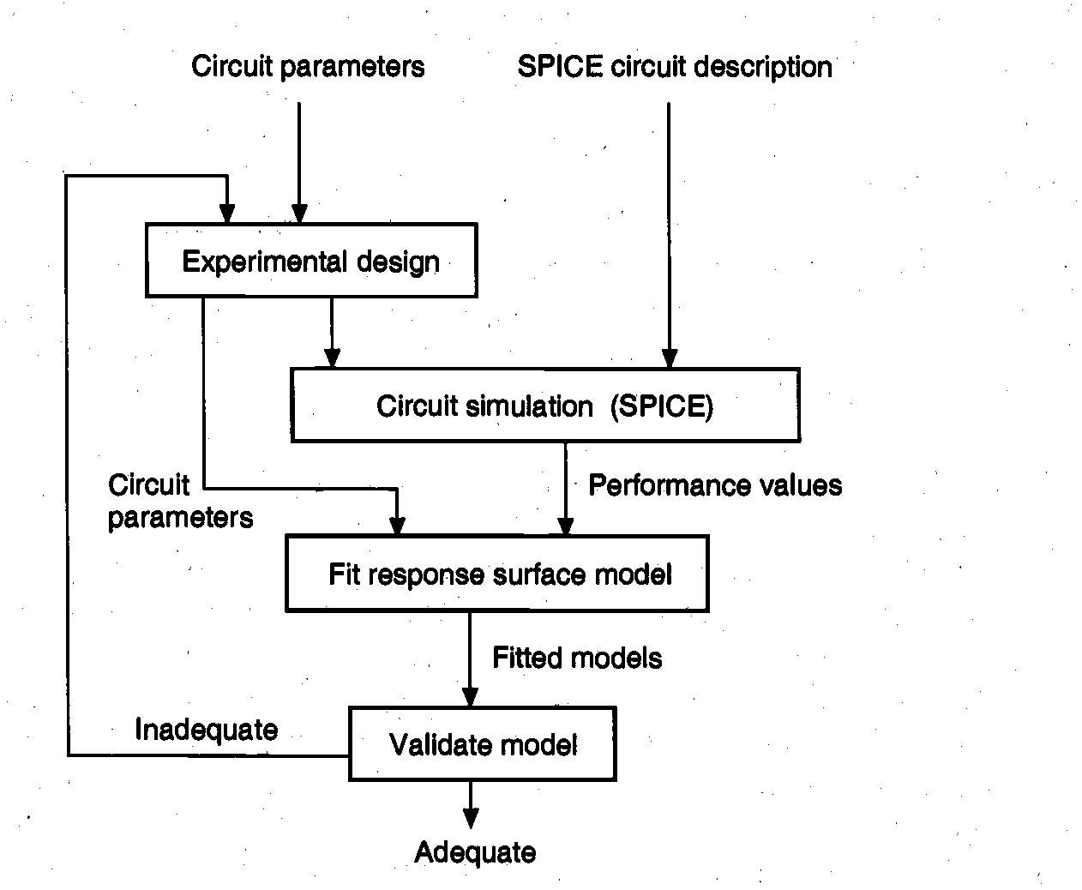
function of r in terms of x is "fitted" to the data. In the final step, the model is validated for accuracy. If the model is not sufficiently accurate, then the modeling procedure is repeated with a larger number of training points or with different models.

Slide 72
RSM resolve around the assumption that the response is a function of a set of independent(design) variables x1,x2,x3….xk and
function can be approximated in some region of polynomial model.
𝑦 = 𝑓 (𝑥𝑖)
𝑦 = 𝑓 (𝑥1, 𝑥2 … … 𝑥𝑘)
Here response variable is “y” that depend on the “k” independent variables.
If the factors are given then directly estimate the effects and interaction of model.
And if the factors are unknown then first calculate them by using the Screening method.

Slide 73
Estimate The Interaction effect using 1st order model.
y = 𝛽0+𝛽1𝑥1+𝛽2𝑥2+𝜀
If curvature is found then use the RSM. And 2nd order model will be used to approximate the response variable.
Make the graph and find the stationary point. Maximum response, Minimum response or saddle point by using the obtained values of
𝑥1, 𝑥2, 𝑥3 … . 𝑥4.
The computational cost of modeling depends on m, the number of training points, and on the procedure of fitting the model to the simulation data. The accuracy of the model is calibrated.by computing error measures which quantify the "goodness of fit." The accuracy of the derived model would be influenced greatly by the manner in which the training points are selected from the x-space.

Slide 74
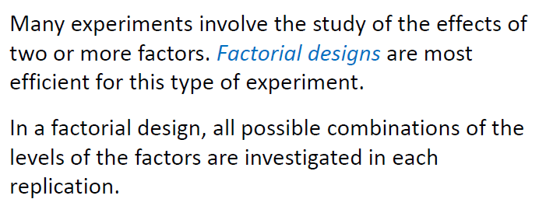

Slide 75
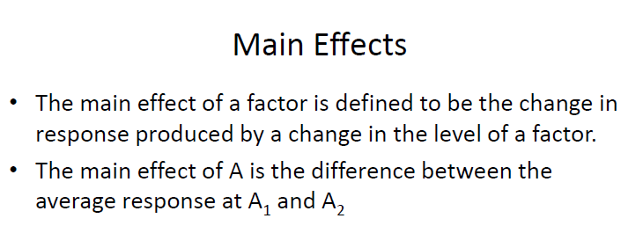

Slide 77
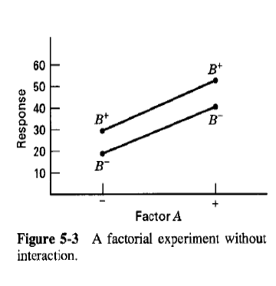
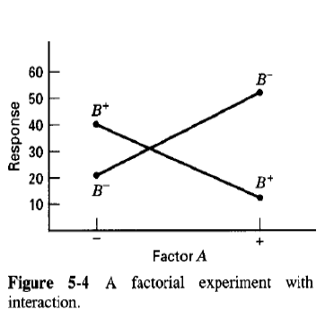
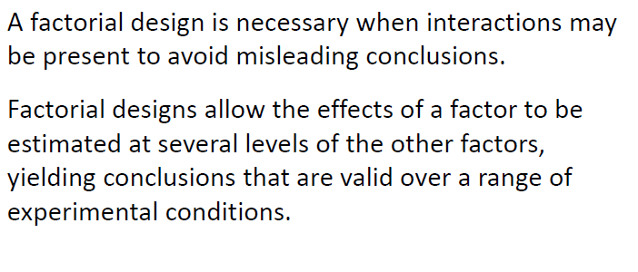

Slide 78
For example, if we believe that factors A and B are independent and that each has only a first-order effect on the response, then the following equation is a suitable model.
R = β₀ + β_{a}A + β_{b}B
where R is the response, A and B are the factor levels, and β₀, β_{a}, and β_{b} are adjustable parameters whose values are determined by a linear regression analysis. We call this equation an empirical model of the response surface because it has no basis in a theoretical understanding of the relationship between the response and its factors.
As shown here, we build an empirical model by measuring the response for at least two levels for each factor—indicated by the plus and minus signs in the tables—and complete a simple regression analysis. This is known as a 2^{k} factorial design because it requires 2^{k} experiments where k is the number of factors.

Slide 79
A 2^{k} factorial design can model only a factor’s first-order effect on the response. A 2² factorial design, for example, includes each factor’s first-order effect (β_{a} and β_{b}).
A first-order interaction between the factors (β_{ab}), and an intercept, (β₀); with four experiments we need enough information to calculate the four β values.
R = β₀ + β_{a}A + β_{b}B + β_{ab}AB

Slide 80
A 2^{k} factorial design cannot model higher-order effects because there is insufficient information. Here is simple example that illustrates the problem. Suppose we need to model a system in which the response is a function of a single factor. As illustrated here, a 2¹ factorial design has but two responses, which means we can fit only a straight line to the data. To see evidence of curvature we must measure the response for at least three levels for each factor, as shown in figure.

