Slide 1
MECHANICAL MEASUREMENT AND INSTRUMENTATION
Ref: Measurement Systems – Application and Design – E.O.Doebelin

Slide 2
Introduction: Applications of Measuring Instruments
Monitoring of processes and operations
Performs a monitoring role
Examples:
thermometers, barometers, anemometers used by weather office ⇒ indicate the conditions of the atmosphere
domestic water, gas and electric meters ⇒ records amount of the quantities used to compute the cost of consumption

Slide 3
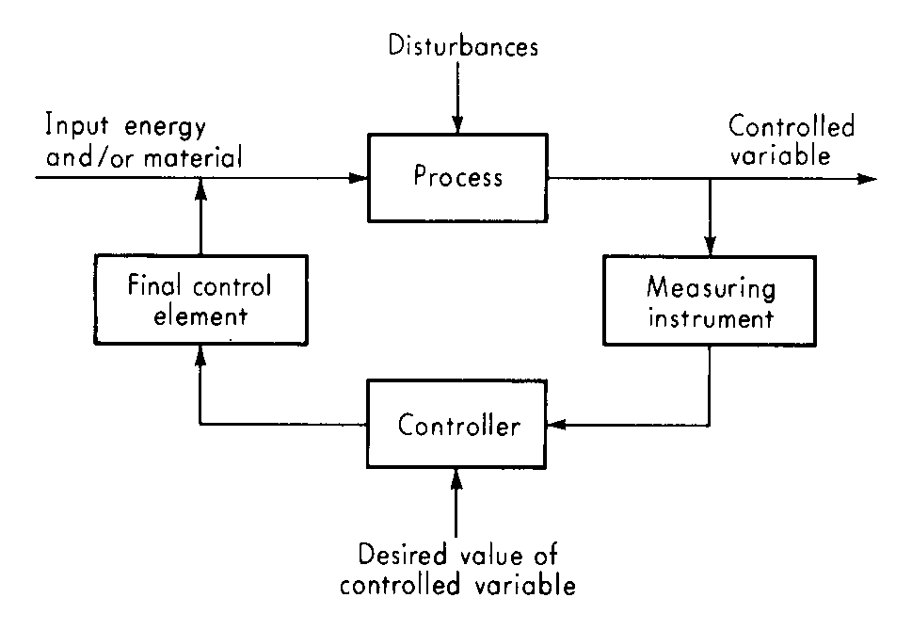
Introduction: Applications of Measuring Instruments
Control of processes and operations
Serves as a component of an automatic control system (feedback mechanism)
Feedback Control System

Slide 4
Introduction: Applications of Measuring Instruments
Experimental engineering analysis
Performs a crucial role for accurate measurements in experimental systems with the objectives of:
Model generation
Model validation
System identification
Dimensional Analysis etc.
Computer aided machines and processes

Slide 5
Functional Elements of an Instrument or Measurement System
The elements shown above are functional elements and NOT physical elements. So:
A typical hardware may perform the role of several elements;
There may be repetitions of a particular element;
There is no specific order of occurrence of the elements mentioned above.

Slide 6
Functional Elements of an Instrument or Measurement System
The first element that receives some energy from the “measurand” and produces an output
Converts a variable into a more suitable variable while preserving the information content of the original signal
Changes the numerical value of a variable according to some definite rule but preserving the physical nature of the variable.

Slide 7
Functional Elements of an Instrument or Measurement System
Transmits data from one functional element to another physically separated element.
Stores data in a form that can be recreated on command. Eg. Magnetic tape recorder, CD etc.
Translates the information of the measured quantity in some form recognizable by human senses, so that it can be used for monitoring, control or analysis. Eg. A pointer generating a graph.

Slide 8
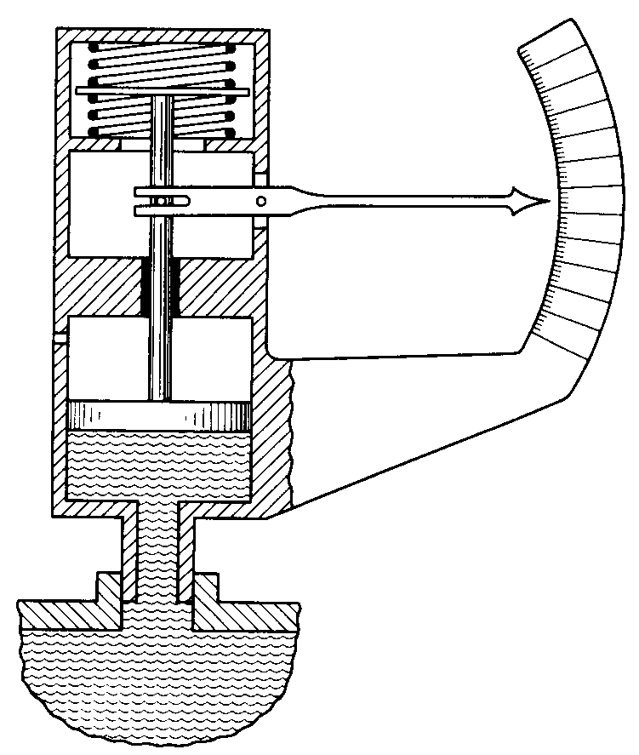
Functional Elements of an Instrument: A Spring-loaded Pressure Gauge
Spring
Scale
Pointer
Linkage
Piston Rod
Piston
Fluid (measured medium)

Slide 9
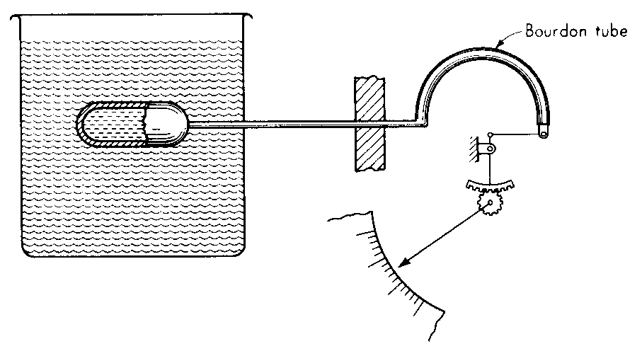
Functional Elements of an Instrument: A Pressure-type Thermometer
Bulb
Tubing
Bourdon Gauge
Linkage and Gear
Scale and Pointer
Fluid (measured medium)

Slide 10
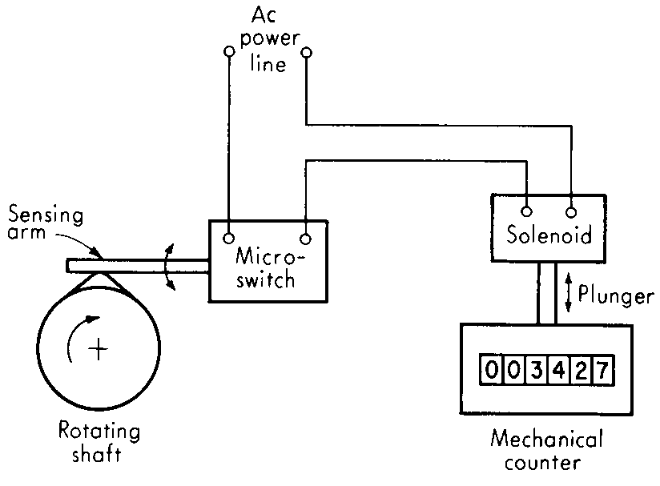
Functional Elements of an Instrument: A Digital Revolution Counter
Wires
Variable Conversion
+
Variable Manipulation
+
Data Presentation
Cam
Mechanical Reciprocation
Electrical Oscillation
Rotating
Shaft
Cam and Sensing Arm
Micro-switch
Electrical
Oscillation
Solenoid
Wires
Plunger
Rotation
Linear
Motion
Mechanical Reciprocation

Slide 11
Active and Passive Transducers
Transducer ⇒ devices that is associated with energy conversion eg. (say) mechanical to electrical.
⇒ devices whose output signal is electrical.
Passive Transducer ⇒ a device whose output energy is supplied entirely or almost entirely by its input signal.
⇒ the output energy may be of the same form as the input or there may be some energy conversion involved.
⇒ Examples: Spring-loaded Pressure Gauge; Pressure-type Thermometer

Slide 12
Active and Passive Transducers
Active Transducer ⇒ a device which has an auxiliary power source that supplies bulk of the output power, while the input signal supplies only an insignificant part of the output power.
⇒ Examples: Digital Revolution Counter

Slide 13
Null and Deflection Methods
Deflection type device ⇒ the measured quantity produces some
physical effect that generates a similar but opposite effect in some parts of the instrument.
⇒ the opposing effect is closely related to some variable (usually a mechanical displacement or deflection) that can be directly observed by some human sense.
⇒ the opposing effect increases until a balance is achieved, at which point the “deflection” is measured and the value of the measured quantity inferred from this.
⇒ Example: Spring-loaded Pressure Gauge.

Slide 14
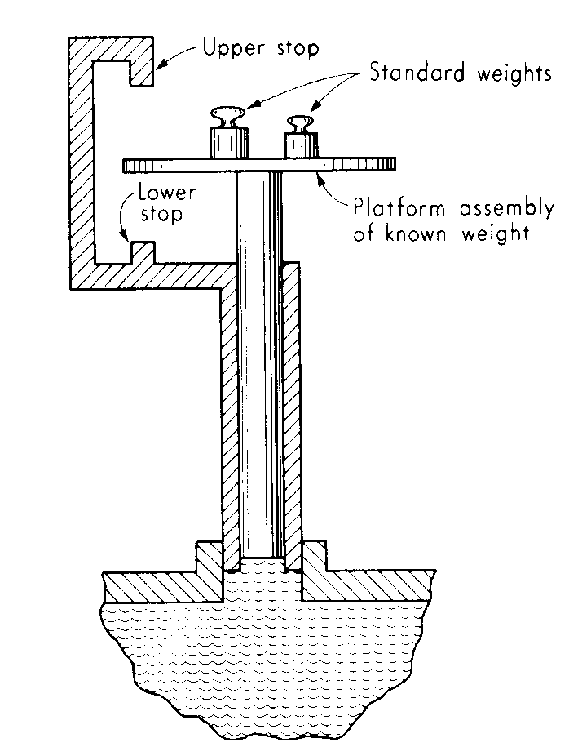
Null and Deflection Methods
Null type device ⇒ attempts to maintain deflection at zero by suitable application of an effect opposing that generated by the measured quantity.
⇒ necessary to such an operation are a detector of unbalance and a means (manual or automatic) of restoring balance.
⇒ since deflection is kept at zero (ideally), determination of numerical values of the measured quantity requires accurate knowledge of the magnitude of the opposing effect.
⇒ Example: Deadweight Pressure Gauge.
0

Slide 15
Null and Deflection Methods
Null type device | Deflection type device
Accuracy is more, as numerical value of output depends on the standard weights | Accuracy is less, as numerical value of output depends on a secondary component (like the spring) which needs to be calibrated against standards.
More sensitive and compact as deflection is only by a small amount near the zero irrespective of the magnitude of the measured quantity. | Less sensitive and larger and more rugged – as the deflection can be quite large depending on the magnitude of the measured quantity.
Not suitable for dynamic (time varying) measurements – like fluctuating pressure. | Can be used for dynamic (time varying) measurements – like fluctuating pressure.

Slide 16
Generalized Input/output Configuration of Measuring Instruments/Systems
INPUTS
Desired
Interfering
Modifying
the quantities that the instrument is intended to measure
the quantities to which the instrument is unintentionally sensitive
the quantities that cause a change in the input-output relations for the desired and interfering inputs
Spurious inputs

Slide 17
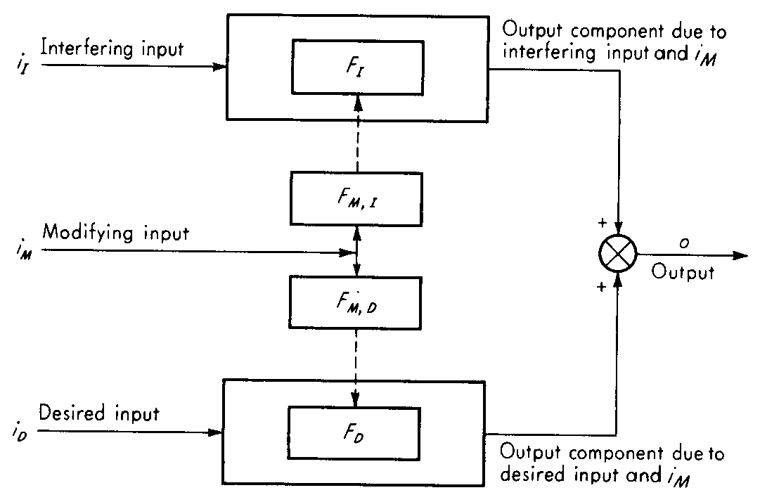
Generalized Input/output Configuration of Measuring Instruments/Systems

Slide 18
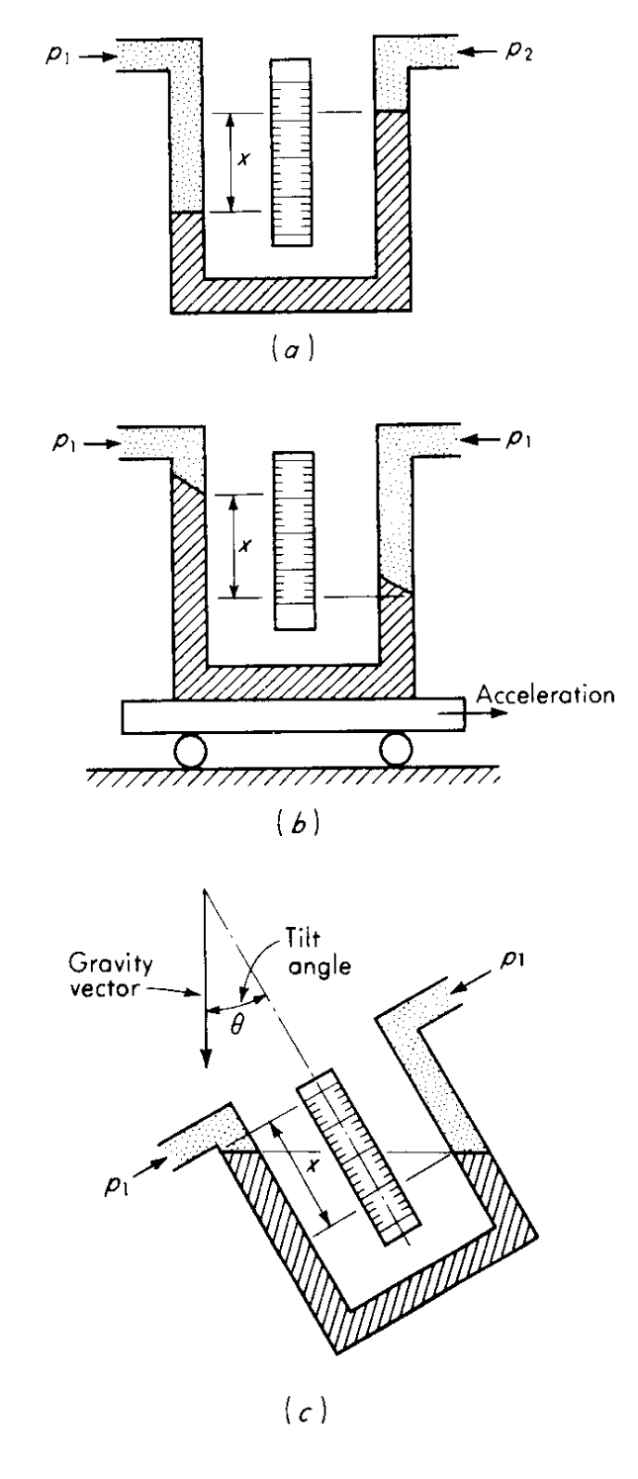
Generalized Input/output Configuration
Desired inputs ⇒ p₁ and p₂
Interfering inputs ⇒ acceleration and tilt
Modifying inputs ⇒ ambient temperature – affects the length of the scale and the density of the manometric fluid
⇒ acceleration due to gravity

Slide 19
Methods of Correction for Interfering and Modifying Inputs
Method of inherent insensitivity
Method of high-gain feedback
Method of calculated output corrections
Method of signal filtering
Method of opposing inputs

Slide 20
Methods of Correction for Interfering and Modifying Inputs – Method of inherent insensitivity
Based on the design philosophy that the elements of the instruments should be only sensitive to the desired inputs.

Slide 21
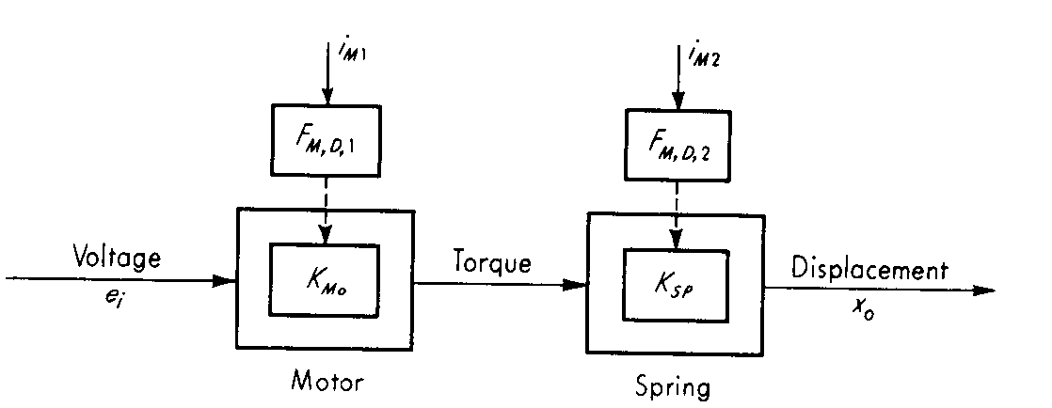
Methods of Correction for Interfering and Modifying Inputs – Method of high-gain feedback
Consider a system where a voltage e_{i} is to be measured by applying it to a motor whose torque is applied to a spring causing a displacement x_{o} which can be measured on a calibrated scale.
x_{o} = (K_{MO}K_{SP})e_{i}
Open Loop System

Slide 22
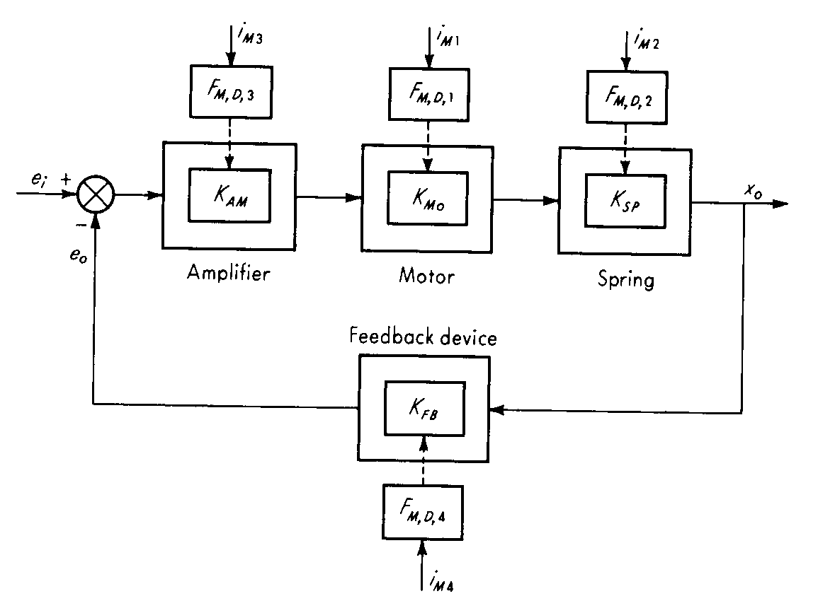
Methods of Correction for Interfering and Modifying Inputs – Method of high-gain feedback
If K_{AM} is very large, then
Close Loop System
So,
So only K_{FB} to be made insensitive to i_{M4}
As amplifier supplies most of the power, so power drain from system by e_{i} is low.
Critical issue ⇒ Dynamic stability

Slide 23
Methods of Correction for Interfering and Modifying Inputs – Method of calculated output corrections
It requires one to measure or estimate the magnitudes of the interfering and/or modifying inputs and to know quantitatively how they affect the outputs.
With this information it is possible to calculate corrections which may be added to or subtracted from the indicated output so as to leave (ideally) with only the component associated with the desired input.
For example, in the case of the manometer the effect of temperature on the scale and density of the manometric fluid can be accurately calculated and the output corrected accordingly.

Slide 24
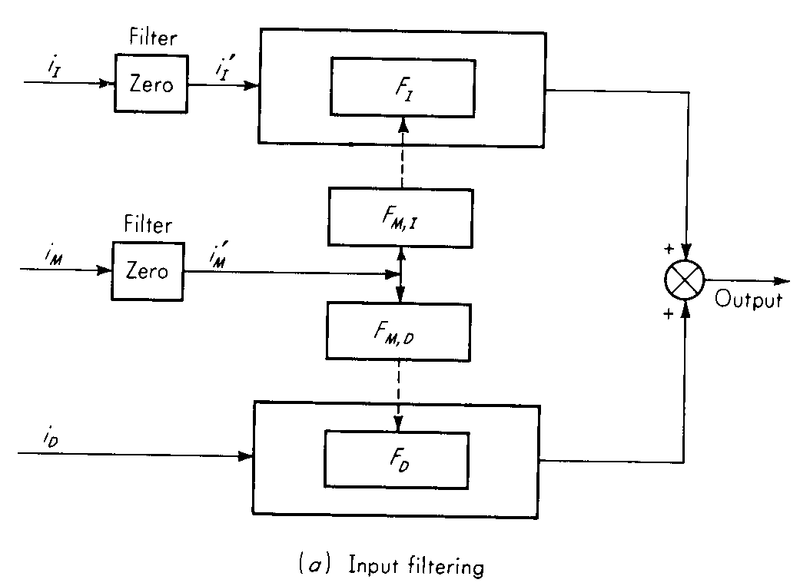
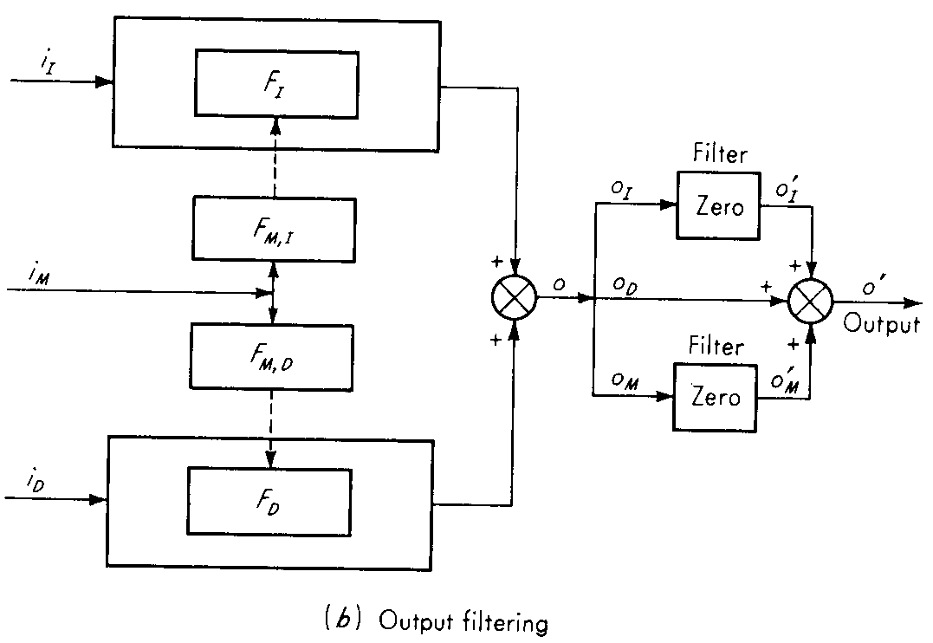
Methods of Correction for Interfering and Modifying Inputs – Method of signal filtering
Introduction of certain elements called “FILTERS” which block the spurious signals so that their effects on the output are removed or considerably reduced.
FILTERS may be applied to any signal – input, output or intermediate.

Slide 25
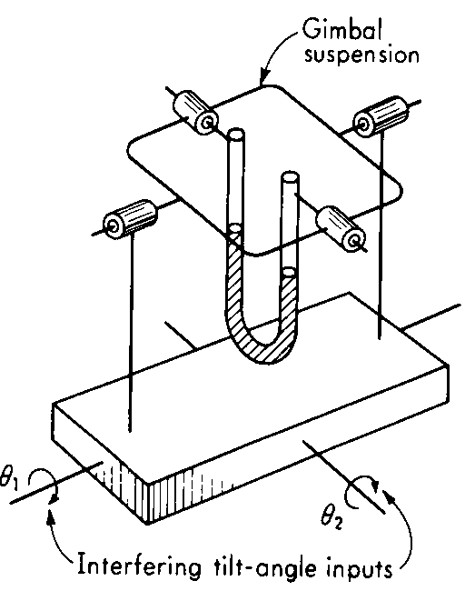
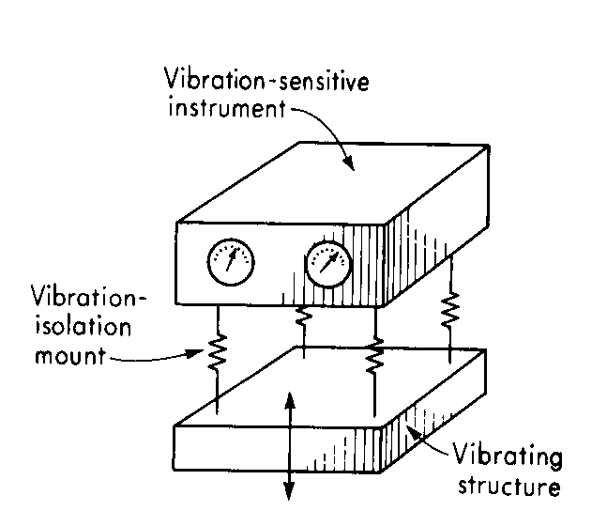
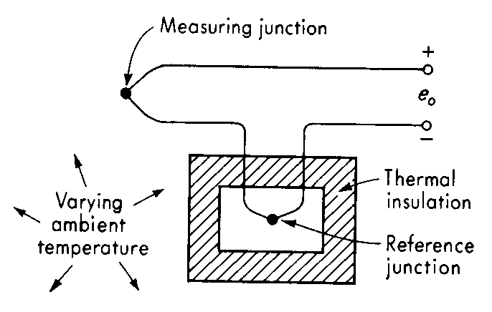
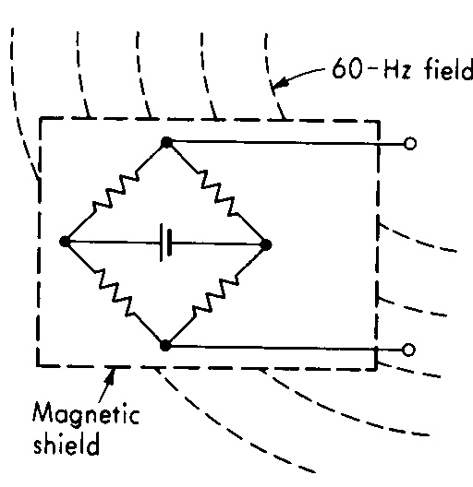
Methods of Correction for Interfering and Modifying Inputs – Method of signal filtering - EXAMPLES

Slide 26
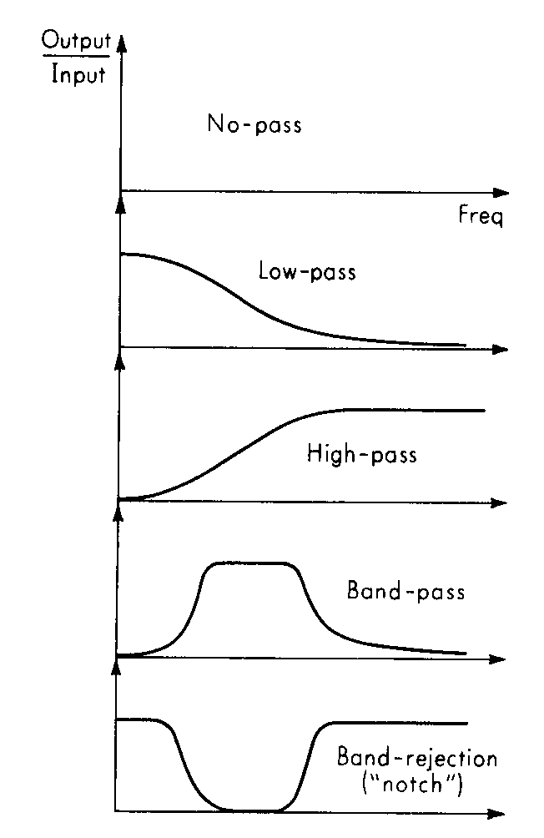
Methods of Correction for Interfering and Modifying Inputs – Method of signal filtering – Basic Filter Types

Slide 27
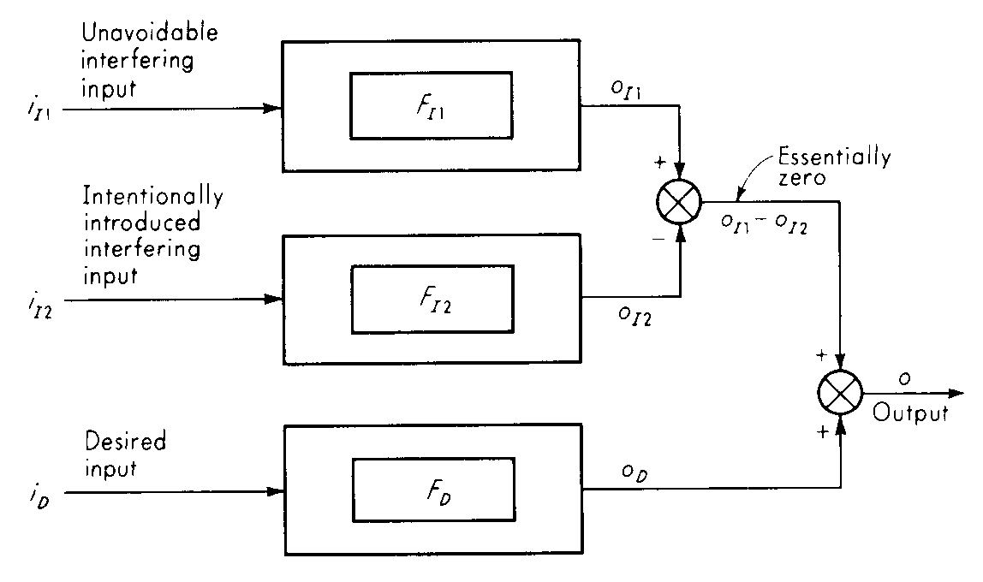
Methods of Correction for Interfering and Modifying Inputs – Method of opposing inputs
Involves intentionally introducing into the system interfering and/or modifying inputs that tend to cancel the effects of the unavoidable spurious inputs.

Slide 28
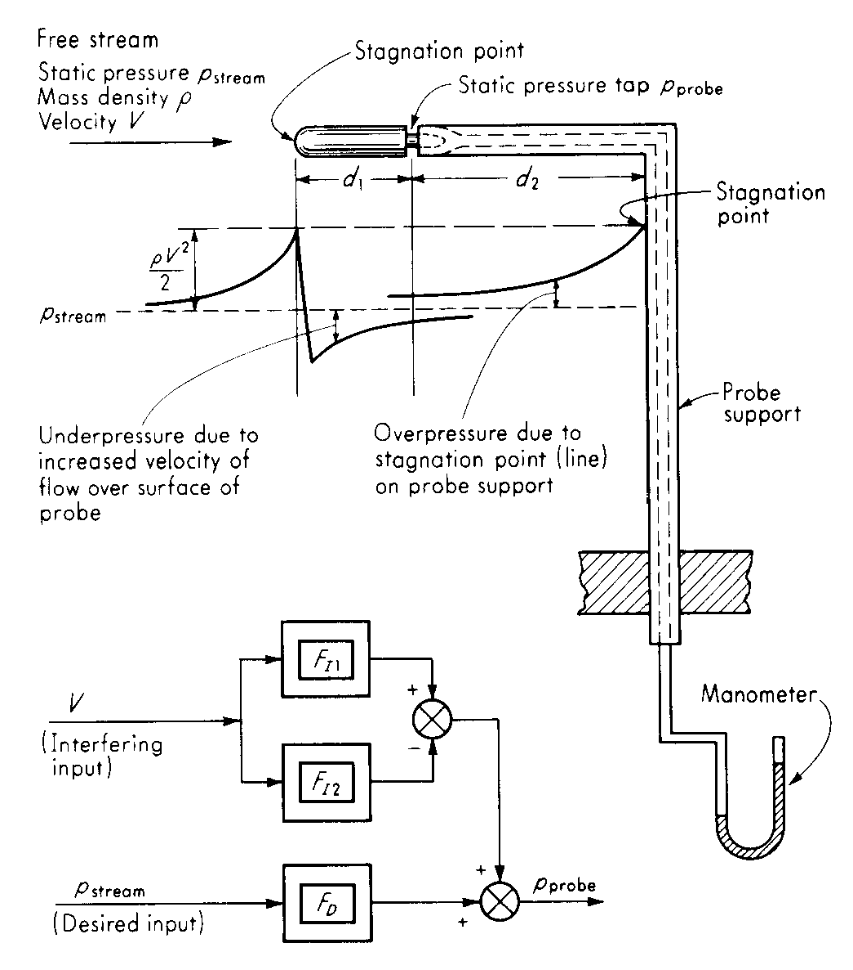
Methods of Correction for Interfering and Modifying Inputs – Method of opposing inputs – EXAMPLE

Slide 29
