Slide 1
Verilog Programming
Prof. Sayan Chatterjee
Jadavpur University

Slide 2
Introduction
Verilog is designed for circuit verification and simulation, for timing analysis, for test analysis (testability analysis and fault grading) and for logic synthesis.
Verilog HDL is a Hardware Description Language that can be used to model a digital system at many levels of abstraction:
Algorithmic-level
Gate-level
Switch-level

Slide 3
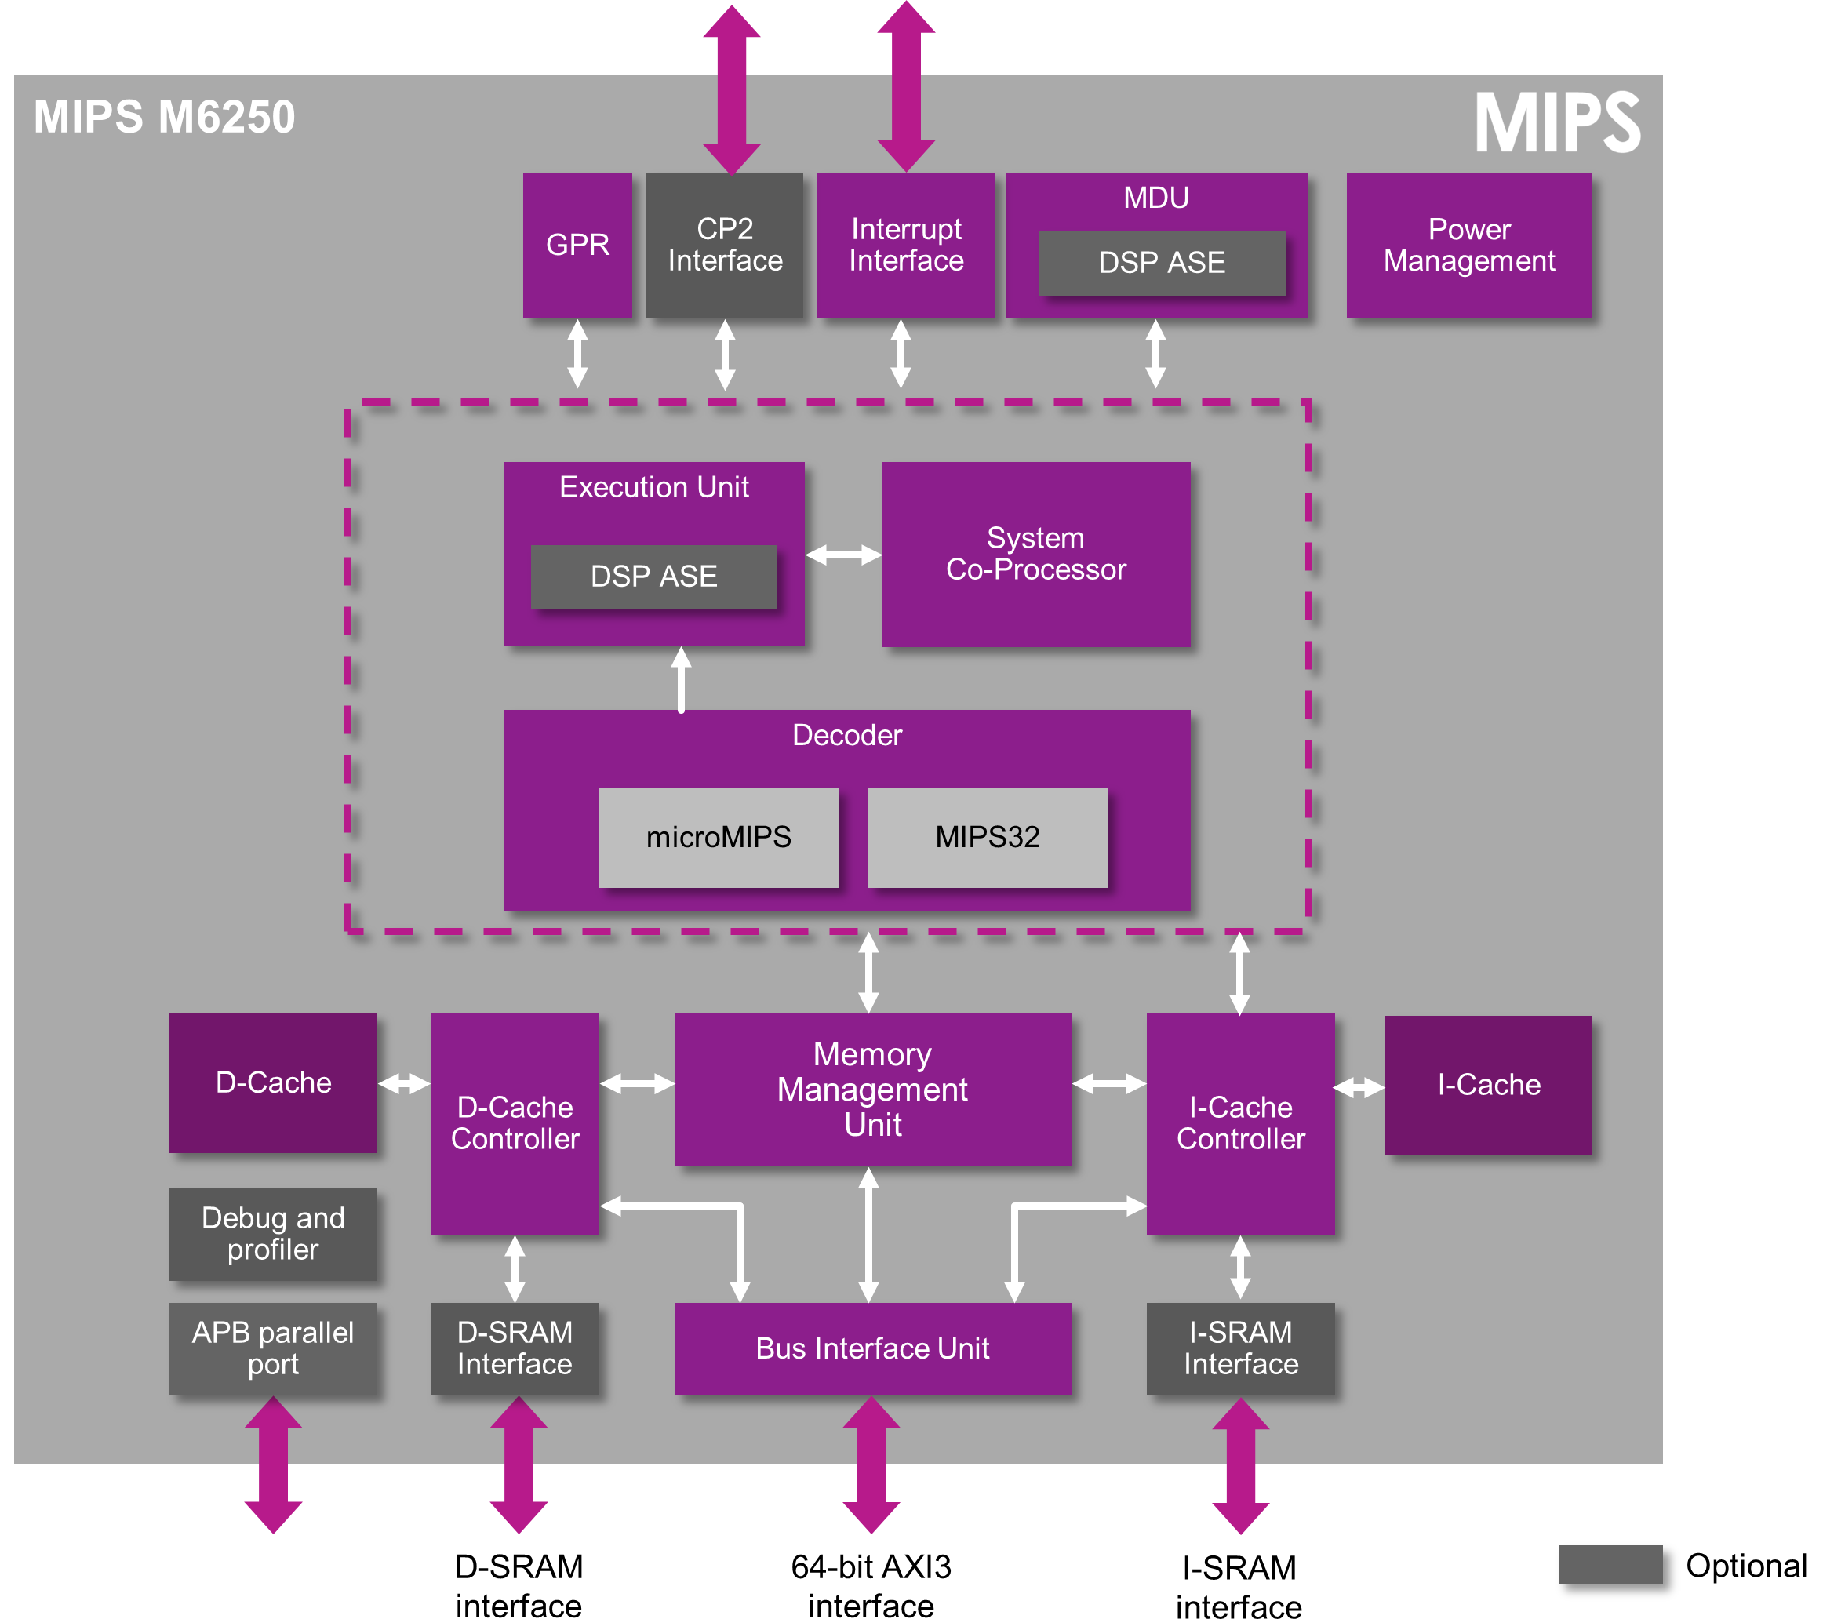
Design Flow
System level architecture

Slide 4
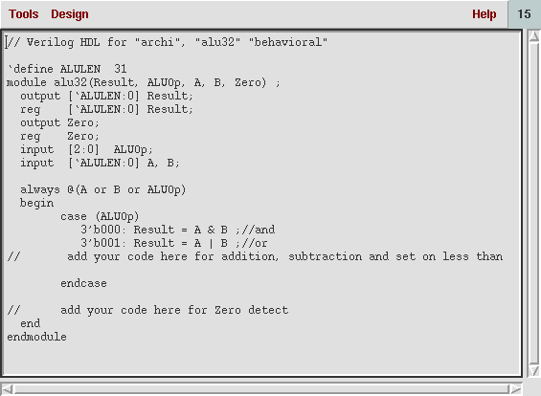
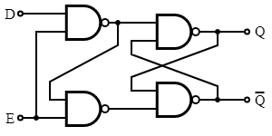
Sub blocks are defined by HDL to
describe functionality
Technology library are not
considered in this level
HDLs are then converted to gate level schematics that also involve technology libraries that characterize digital elements like flip-flops. For example, the digital circuit for a D latch contains NAND gates arranged in a certain fashion such that all combinations of D and E inputs produce an output Q given by the truth table.

Slide 5
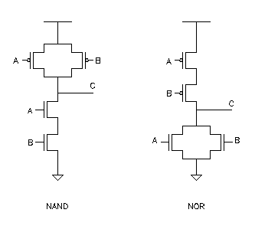
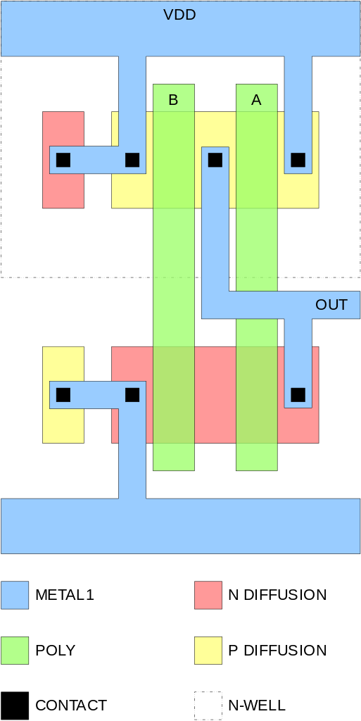
Implementation of a NAND gate is done by the connection of CMOS transistors in a particular format. At this level, the transistor channel widths, Vdd and the ability to drive the output capacitive load are taken into account during the design process.
The final step is the layout of these transistors in silicon using EDA tools so that it can be fabricated.

Slide 6
History
Verilog HDL was first developed by Gateway Design Automation in 1983 for hardware modeling
Cadence Design Systems acquired Gateway in 1989, and with it the rights to the language and the simulator. In 1990, Cadence put the language (but not the simulator) into the public domain, with the intention that it should become a standard, non-proprietary language.
Open verilog International was formed and in 1995 Verilog HDL standardized through IEEE standard.
The standard is called IEEE Std 1364-1995

Slide 7
A significantly revised version was published in 2001: IEEE Std. 1364-2001.
There was a further revision in 2005 but this only added a few minor changes.
Accellera, which was formed from the merger of Open Verilog International (OVI) and VHDL International, also developed a new standard - systemVerilog, which extends Verilog. SystemVerilog became an IEEE standard (1800-2005) in 2005.

Slide 8
Salient points
Primitive logic gates are built in the language
User defined primitive where primitive could either be combinational or sequential logic.
Switch level modeling primitive gate are also built in
Language can provide pin to pin delay, path delay and timing check
Hierarchical design can be described up to any level

Slide 9
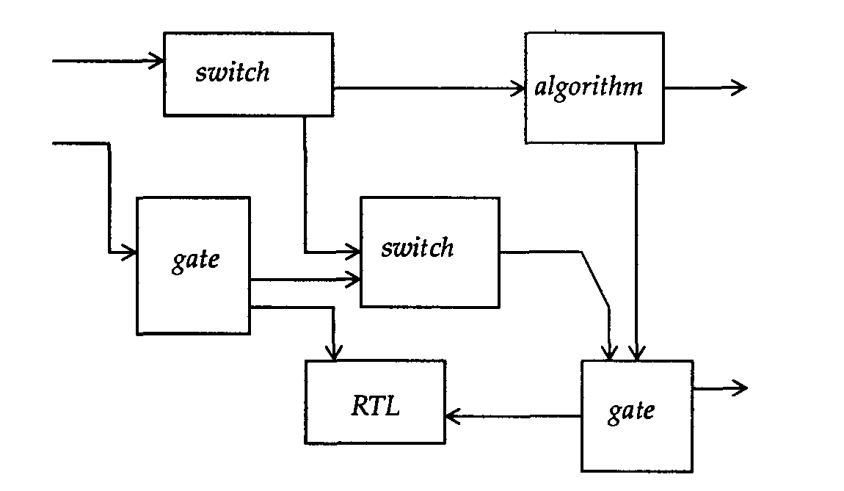
Mixed level Modeling

Slide 10
Primitives
Verilog provides a standard set of primitives, such as and, nand, or, nor, and not, as a part of the language. These are also commonly known as built-in primitives.
Verilog provides the ability to define User-Defined Primitives (UDP). These primitives are self-contained and do not instantiate other modules or primitives. UDPs are instantiated exactly like gate-level primitives.

Slide 11
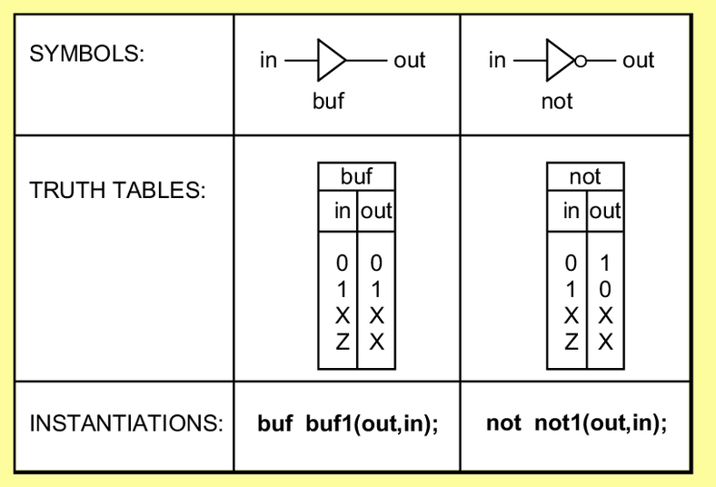
Examples (Primitives)
Multiple-input gates:
and, nand, or, nor, xor, xnor
xor xor1(out, inA, inB, inC);
Multiple-output gates:
buf, not
Not inverter1(fanout1, fanout2, in);

Slide 12
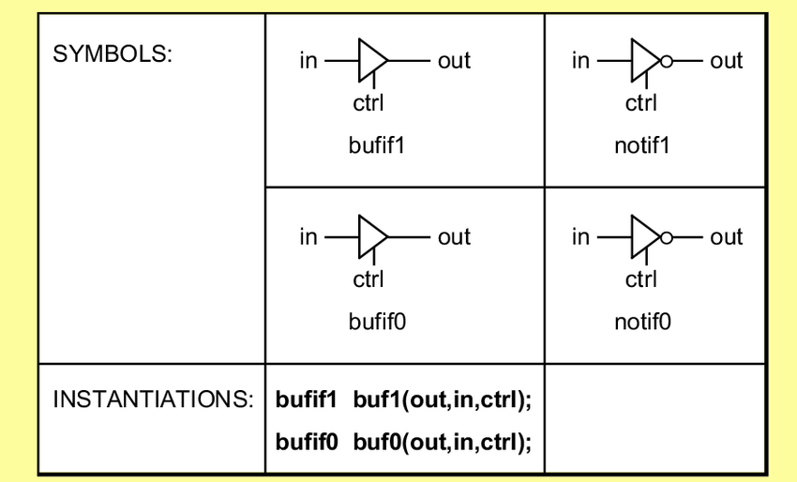

Slide 13
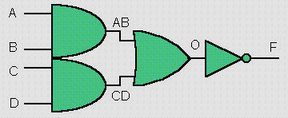
Modules
Module module_name (port_list);
Declarations:
input, output, wire, parameter…..
System Modeling:
describe the system in gate-level, data-flow, or behavioral style…
endmodule
Used to construct design hierarchy
Cannot be nested

Slide 14
Input Output
Input Declaration
Scalar
input list of input identifiers;
Example: input A, B, c_in;
Vector
input[range] list of input identifiers;
Example: input[15:0] A, B, data;
Output Declaration
Scalar Example: output c_out, OV, MINUS;
Vector Example: output[7:0] ACC, REG_IN, data_out;

Slide 15
// Compute the logical AND and OR of inputs A and B.
module AND_OR(andOut, orOut, A, B);
output andOut, orOut;
input A, B;
and TheAndGate (andOut, A, B);
or TheOrGate (orOut, A, B);
endmodule
Operation/
primitives
User defined name

Slide 16
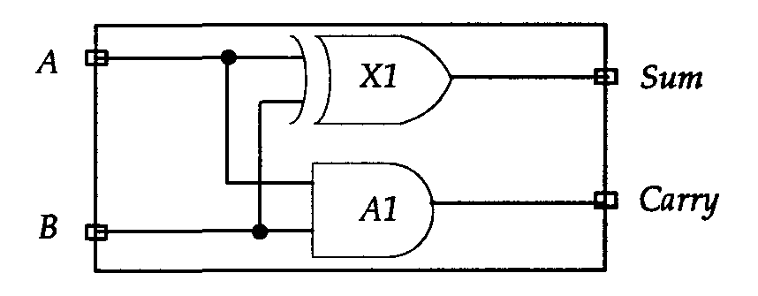
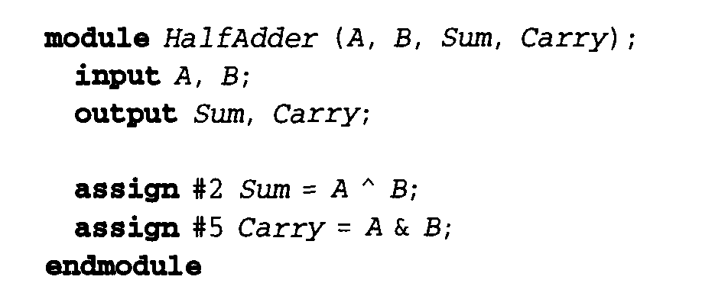
Half Adder

Slide 17
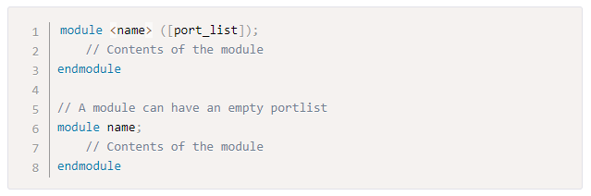
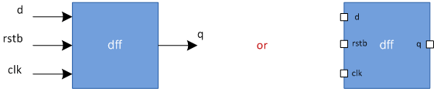
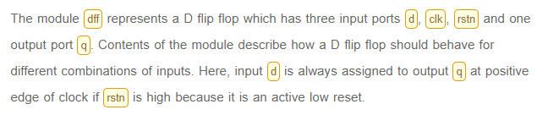

Slide 18
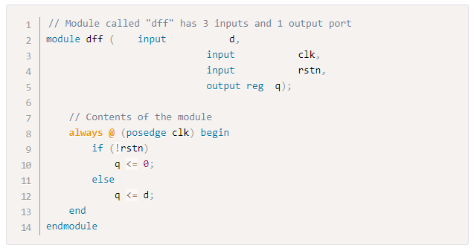
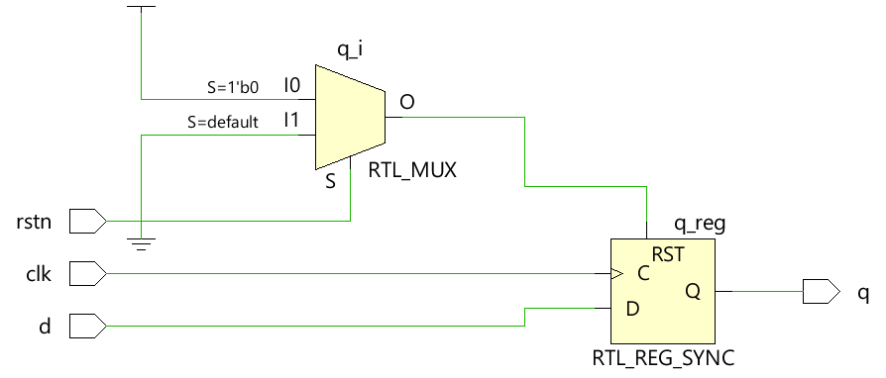
Hardware Schematics
An example of synthesis

Slide 19
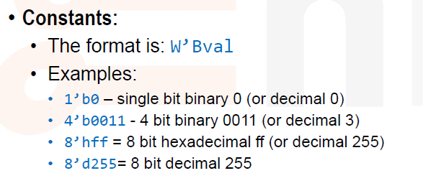
Constants

Slide 20
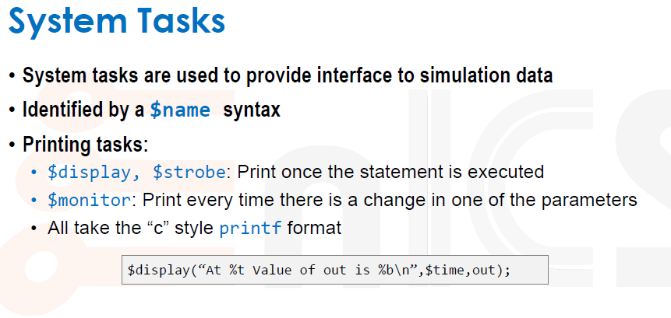
Output message

Slide 21
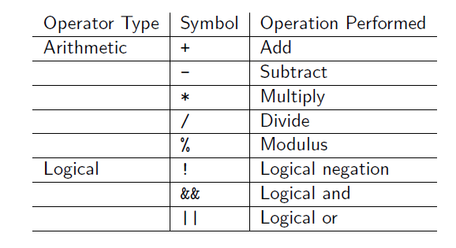
Operators

Slide 22
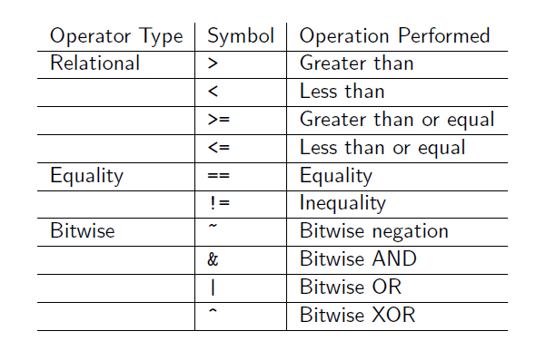

Slide 23
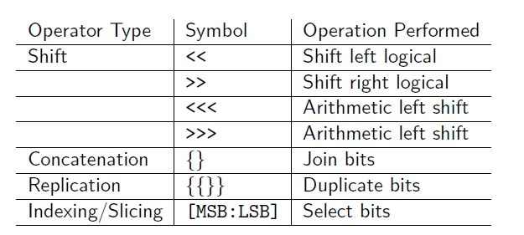

Slide 24
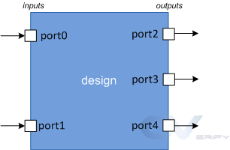
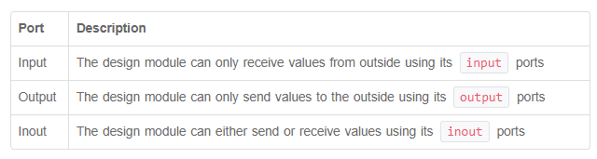

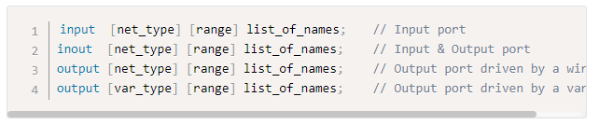
Ports

Slide 25
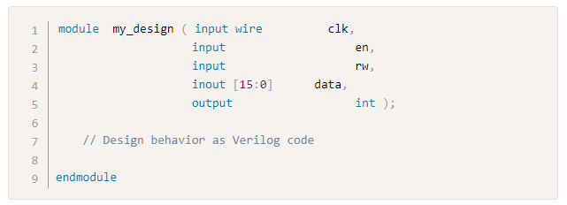
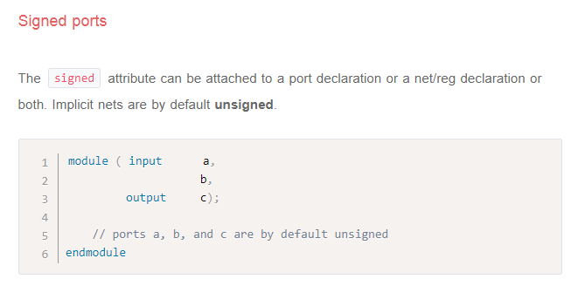
In, out and inout in a single module declaration

Slide 26
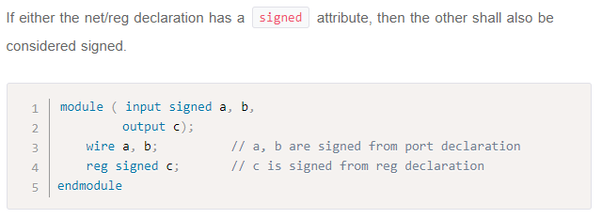
Verilog reg, Verilog wire
Verilog data types are divided into two main groups: nets and variables. The distinction comes from how they are intended to represent different hardware structures.
A net data type represents a physical connection between structural entities (think a plain wire), such as between gates or between modules. It does not store any value. Its value is derived from what is being driven from its driver(s). Verilog wire is probably the most common net data type, although there are many other net data types such as tri, wand, supply0.

Slide 27
A variable data type generally represents a piece of storage. It holds a value assigned to it until the next assignment. Verilog reg is probably the most common variable data type. Verilog reg is generally used to model hardware registers (although it can also represent combinatorial logic, like inside an always@(*) block). Other variable data types include integer, time, real, realtime.
Almost all Verilog data types are 4-state, which means they can take on 4 values:
0 represents a logic zero, or a false condition
1 represents a logic one, or a true condition
X represents an unknown logic value
Z represents a high-impedance state
Verilog variable data types can only be assigned values using procedural assignments. This means inside an always block, an initial block, a task, a function. The assignment occurs on some kind of trigger (like the posedge of a clock), after which the variable retains its value until the next assignment (at the next trigger). This makes variables ideal for modeling storage elements like flip-flops.
Verilog net data types can only be assigned values by continuous assignments. This means using constructs like continuous assignment statement (assign statement), or drive it from an output port.

Slide 28

Wire vs Reg
wire data types can be used for connecting the output port to the actual driver. Below is the code which when synthesized gives a AND gate as output, as we know a AND gate can drive a load.
1 module wire_example( a, b, y);
2 input a, b;
3 output y;
4 wire a, b, y;
5 assign y = a & b;
6 endmodule
What this implies is that wire is used for designing combinational logic, as we all know that this kind of logic can not store a value. As you can see from the example above, a wire can be assigned a value by an assign statement. Default data type is wire: this means that if you declare a variable without specifying reg or wire, it will be a 1-bit wide wire.

Slide 29
Now, coming to reg data type, reg can store value and drive strength. Something that we need to know about reg is that it can be used for modeling both combinational and sequential logic. Reg data type can be driven from initial and always block.
Reg data type as Combinational element
1 module reg_combo_example( a, b, y);
2 input a, b;
3 output y;
4
5 reg y;
6 wire a, b;
7
8 always @ ( a or b)
9 begin
10 y = a & b;
11 end
12
13 endmodule
This gives the same output as that of the assign statement, with the only difference that y is declared as reg. There are distinct advantages to have reg modeled as combinational element; reg type is useful when a "case" statement is required.

Slide 30
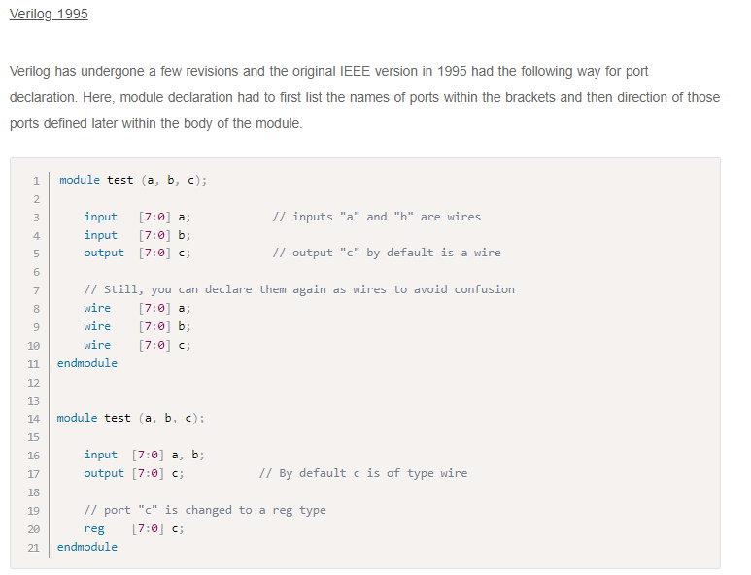
Revision with Version

Slide 31
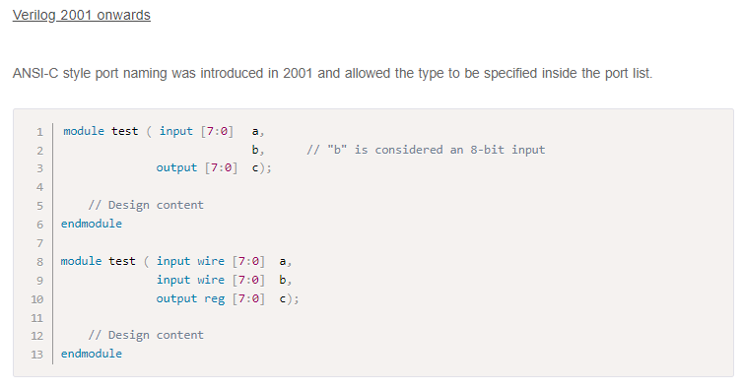

Slide 32
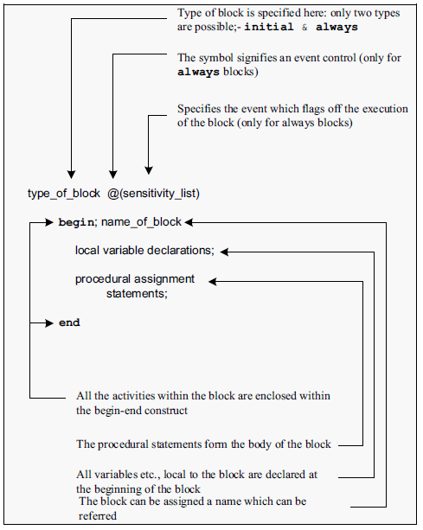
Procedural block
If a procedural block has only one assignment to be carried out, it can be specified
as initial #2 a=0;
More than one procedural assignment is to be carried out in an initial block. All such assignments are grouped together between “begin” and “end” declarations.
Every begin declaration must have its associated end declaration.
begin –end constructs can be nested as many times as desired.

Slide 33
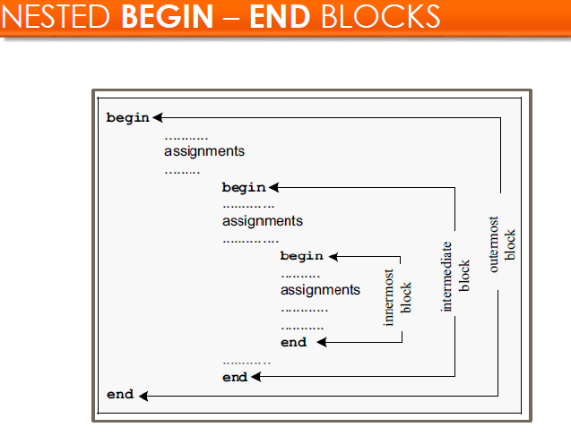

Slide 34
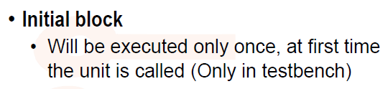
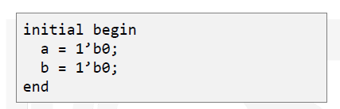
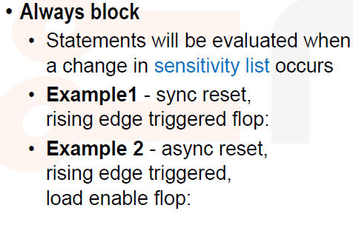
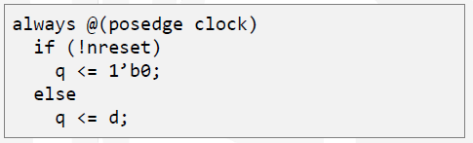
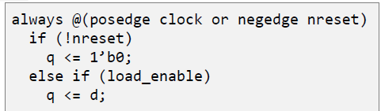

Slide 35
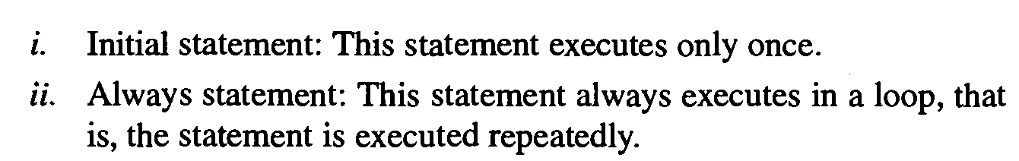
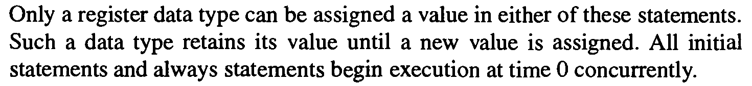
The block has three inputs and two outputs.
Sum,Cout , T1 , T2 and T3 are declared to be as type reg
They are assigned within always statement.
Always statement has sequential block within begin end pair associated with event control.
It means when an event occurs on A, B or Cin the sequential block executed
Statements executed sequentially and execution suspended after the last statement in the sequential block has executed

Slide 36
The always block indicates a free-running process, but the initial block indicates a process executes exactly once. Both constructs begin execution at simulator time 0, and both exec
Initial blocks can be used in either synthesizable or non-synthesizable blocks. They are commonly used in test.
Initial blocks cause particular instructions to be performed at the beginning of the simulation before any other instructions operate. Initial blocks only operate once.

Slide 37
Initial
Example
The register variables a and b are initialized to binary 1 and 0 respectively at simulation time zero.
The initial statement is completed and not executed again during that simulation run. This initial statement is containing a begin-end block of statements. In this begin-end type block, a is initialized first, followed by b.

Slide 38
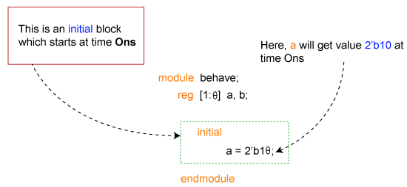
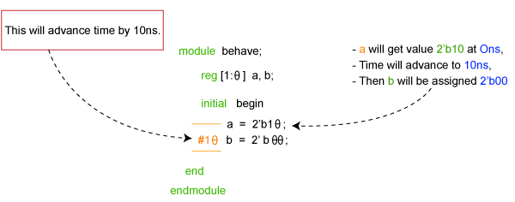
Without Delay
With Delay

Slide 39
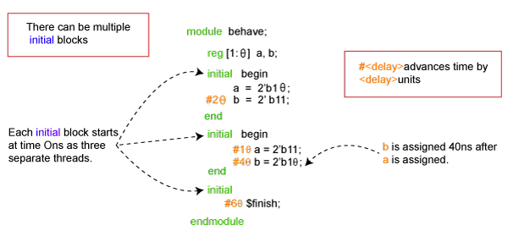
There are no limits to the number of initial blocks that can be defined inside a module. The code shown below has three initial blocks, all of which are started at the same time and run in parallel.
$finish is a Verilog system task that tells the simulator to terminate the current simulation
In the above image, the first block has a delay of 20 units, while the second has a total delay of 50 units (10 + 40), and the last block has a delay of 60 units. Hence the simulation takes 60-time units to complete since there is atleast one initial block still running until 60-time units.

Slide 40
Always
An always block always executes, unlike initial blocks that execute only once at the beginning of the simulation. The always block should have a sensitive list or a delay associated with it
always @ (event)
[statement]
always @ (event) begin
[multiple statements]
end
The symbol @ after reserved word always, indicates that the block will be triggered at the condition in parenthesis after symbol @.

Slide 41
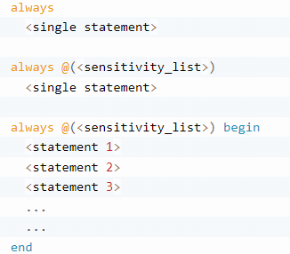
always @ (x or y or sel)
begin
m = 0;
if (sel == 0) begin
m = x;
end else begin
m = y;
end
end
In the above example, we describe a 2:1 mux, with input x and y. The sel is the select input, and m is the mux output.
In any combinational logic, output changes whenever input changes. When this theory is applied to always blocks, then the code inside always blocks needs to be executed whenever the input or output variables change.

Slide 42
There are two types of sensitive list in the Verilog, such as:
Level sensitive (for combinational circuits).
Edge sensitive (for flip-flops).
always @ (posedge clk) begin
[statements]
end
module tff (input d, clk, rstn, output reg q);
always @ (posedge clk or negedge rstn) begin
if (!rstn)
q <= 0;
else
if (d)
q <= ~q;
else
q <= q;
end
endmodule

Slide 43
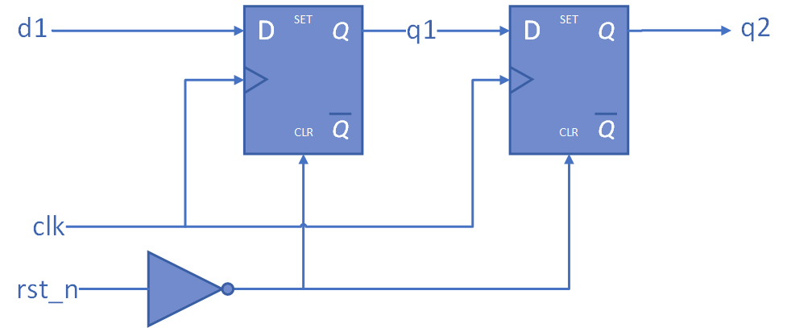
always @(posedge clk or negedge rst_n)
if (!rst_n)
q1 <= 1'b0;
else
q1 <= d1;
always @(posedge clk or negedge rst_n)
if (!rst_n)
q2 <= 1'b0;
else
q2 <= q1;
always @(posedge clk or negedge rst_n)
if (!rst_n) begin
q1 <= 1'b0;
q2 <= 1'b0;
end
else begin
q1 <= d1;
q2 <= q1;
end

Slide 44
Modeling Combinational Logic
The Verilog always block can also model combinational logic, but it is a bit less straight forward to understand.
A physical implementation of a combinational circuit obviously operates continuously, sampling the inputs and calculating the resulting outputs.
A simulator, however, cannot execute a logical statement “continuously”, without causing the zero-delay infinite loop described at the beginning of the article.
Therefore to simulate combinational circuit, we have to define specific events at which the simulator should execute procedures, while maintaining correct behavior.
The simple answer is, to model combinational circuit, the sensitivity list needs to contain all the inputs to the circuit (all the variables on the right hand side of the assignment).

Slide 45
The following code describes a combinational AND gate using a Verilog always block.
always @(A or B)
C = A & B;
Using Comma in Event Expression
Verilog-2001 standard introduced the use of comma “,” to separate items in the event expression.
always @(posedge clk, negedge rst_n)
if (!rst_n)
q <= 1'b0;
else
q <= d;

Slide 46
Implicit Event Expression @* or @(*)
Sensitivity list is a frequent source of bugs in a Verilog design/model.
More precisely, the “@*” and “@(*)” syntax will add all nets and variables that appear in the (right hand side of a) statement to the event expression, with some exceptions.
always @*
C = A & B;
always @(*)
C = A & B;
always@( * ) blocks are used to describe Combinational Logic, or Logic Gates. Only = (blocking) assignments should be used in an always@( * ) block. Never use <= (non-blocking) assignments in always@( * ) blocks. Only use always@( * ) block when you want to infer an element(s) that changes its value as soon as one or more of its inputs change.

Slide 47
Verilog Block
The block statements are the grouping of two or more statements together, which act syntactically like a single statement. There are two types of blocks
Sequential block
Parallel block
These blocks can be used if more than one statement should be executed. All statements in the sequential blocks will be executed sequentially in the given order.
All statements in the parallel blocks are executed at the same time or concurrently. It means that the next statement's execution will not be delayed even if the previous statement contains a timing control statement.

Slide 48
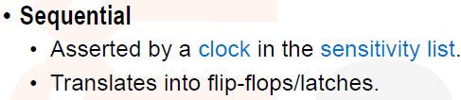
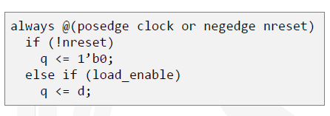
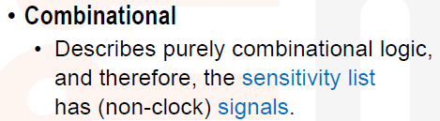


Slide 49
Blocking and Non-blocking
Blocking and non-blocking assignments statements within the always block.
The blocking assignment is similar to software assignment statements found in most popular programming languages.
The non-blocking assignment is the more natural assignment statement to describe many hardware systems, especially for synthesis.
The blocking assignments can only be used in a few situations, such as modeling combinational logic, defining functions, or implementing testbench algorithms.

Slide 50
Non-blocking assignments happen in parallel. In other words, if an always@ block contains multiple <= assignments, which are literally written in Verilog sequentially, you should think of all of the assignments being set at exactly the same time.
Blocking assignments happen sequentially. In other words, if an always@ block contains multiple = assignments, you should think of the assignments being set one after another.

Slide 51
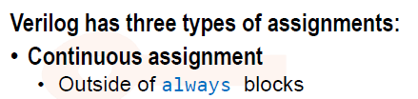

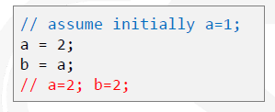


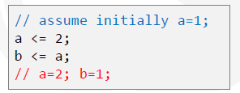
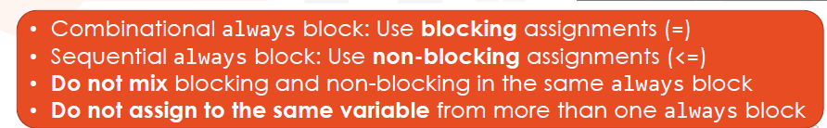
Assignment operator

Slide 52


It species a circuit that reads “when the sensitivity list is satisfied”, B gets A's value, C gets B's old value, and D gets C's old value." The key here is that C gets B's old value, etc This ensures that C is not set to A, as A is B's new value, as of the always@ block's execution.
It species a circuit that reads “when the sensitivity list is satisfied”, B gets A, C gets B, and D gets C." But, by the time C gets B, B has been set to A. Likewise, by the time D gets C, C has been set to B, which, as we stated above, has been set to A.

Slide 53
always@(posedge Clock) (“always at the positive edge of the clock") or always@(negedge Clock) (“always at the negative edge of the clock") blocks are used to describe Sequential Logic, or Registers.
Only <= (non-blocking) assignments should be used in an always@(posedge Clock) block.
Never use =(blocking) assignments in always@(posedge Clock) blocks. Only use always@(posedge Clock) blocks when you want to infer an element(s) that changes its value at the positive or negative edge of the clock.

Slide 54


This is a shift register
If we are not following this <= operator within always and
use = operator then what will happen?

Slide 55


Consider the shift register from prev slide. If you place = assignments inside of an always@(posedge Clock) block to produce the shift register, you instead get the parallel registers.

Slide 56




Comparative example: Combinational
Mux design
If conditional expression?
True expression : false expression;

Slide 57



Comparative example: Sequential

Slide 58



Slide 59




wire vs reg in block

Slide 60

Assign statement
The assignment syntax starts with the keyword assign, followed by the signal name, which can be either a signal or a combination of different signal nets.
The drive strength and delay are optional and mostly used for dataflow modeling than synthesizing into real hardware. The signal on the right-hand side is evaluated and assigned to the net or expression of nets on the left-hand side.
assign <net_expression> = [drive_strength] [delay] <expression of different signals or constant value>

Slide 61
Rules: Assign
Some rules need to be followed during the use of an assign statement:
LHS should always be a scalar, vector, or a combination of scalar and vector nets but never a scalar or vector register.
RHS can contain scalar or vector registers and function calls.
Whenever any operand on the RHS changes in value, LHS will be updated with the new value.
Assign statements are also called continuous assignments.
Cannot drive or assign reg type variables with an assign statement because a reg variable is capable of storing data and is not driven continuously.

Slide 62



Implicit vs Explicit
When an assign statement is used to assign the given net with some value, it is called an explicit assignment.
If an assignment to be done during the net is declared, it is called an implicit assignment.
Combinational logic requires the inputs to be continuously driven to maintain the output, unlike sequential elements like flip flops where the value is captured and stored at the edge of a clock.

Slide 63
Delay , Timescale
Verilog simulation depends on how time is defined because the simulator needs to know what a #1 means in terms of time. The `timescale compiler directive specifies the time unit and precision for the modules that follow it.
The time_unit is the measurement of delays and simulation time, while the time_precision specifies how delay values are rounded before being used in the simulation.
$printtimescale system task to display time unit and precision.

Slide 64

Dataflow style

Slide 65

A changes @ 15
Delay 2
Z[2] changes at 15+2= 17
EN changes at 5ns, statement 3,4,5,6 changes
EN changes @ 5
Delay 2
Z[0] changes at 5+2= 7

Slide 66



Behavioral Style

Slide 67


Structural Modeling

Slide 68


Now use the same one bit FA to a 4 bit FA

Slide 69


Original mapped with present

Slide 70

Port Mapping
Port mapping by order
Port mapping by name
Figure shows module “SYNCHRO” which consists of 2 ‘D’ flip-flops and are connected in serial fashion. Module “SYNCHRO” has 2 input ports “ASYNC” and “CLOCK” and 1 output port “SYNC”.
Verilog Programming for DFF instantiated in the SYNCHRO module:
1 2 3 4 5 6 | module DFF (Q, D, CLK); input D, CLK; output reg Q; always @ (posedge CLK) Q <= D; endmodule

Slide 71
MODULE PORT MAPPING BY ORDER
module SYNCHRO (ASYNC,SYNC,CLOCK);
input ASYNC;
input CLOCK;
output SYNC;
wire C1_ASYNC;
DFF DFF1 (C1_ASYNC, ASYNC, CLOCK);
DFF DFF2 (SYNC, C1_ASYNC, CLOCK);
endmodule
Here first instance name of ‘D’ flip-flop is “DFF1” and second instance name is “DFF2”. In this module ports are connected by order. Order of ports in instantiation of DFF1 and DFF2 is same as order of ports in DFF. If the number of ports increased, then it is very difficult to do “module ports connection by order”.
MODULE PORT MAPPING BY NAME
In this module, ports are connected by Name. Order of ports in instantiation of DFF1 and DFF2 is different from order of ports in DFF. In this ‘.’ is used to represent port name followed by associated port name in small brackets i.e. “()”.
Module SYNCHRO (ASYNC, SYNC, CLOCK);
input ASYNC;
input CLOCK;
output SYNC;
wire C1_ASYNC;
DFF DFF1 (.D (ASYNC), .CLK (CLOCK), .Q (C1_ASYNC));
DFF DFF2 (.D (C1_ASYNC), .Q (SYNC), .CLK (CLOCK));
endmodule

Slide 72

Mixed Design

Slide 73


Identifier & Comments

Slide 74

Format

Slide 75

Compiler directives
The compiler directives are similar to C language preprocessor directives that may be used to specify certain information and ask the compiler to process it.
The character ` is used prior to the specific keyword. Its declaration can be put outside of the module and its scope may not be limited to a single module.

Slide 76

Compiler directives | Description
`define | To define text macros. (Similar to #define in C language)
`include | To include entire content from another Verilog file into the existing file during compilation. (Similar to #include in C language).
`ifdef…`endif `ifdef..`else..`endif | Conditional compiler directives that behave as if..else conditional statements.
`timescale | To specify time units and precision for the module

Slide 77




Slide 78



Slide 79




Slide 80


Slide 81



Multiple Driver
If multiple drivers drive a wire then
following table determine the stages
Wire | 0 | 1 | x | z
0 | 0 | x | x | 0
1 | x | 1 | x | 1
x | x | x | x | x
z | 0 | 1 | x | z
tri net used for multiple driver

Slide 82


Wor and Trior
Wire | 0 | 1 | x | z
0 | 0 | 1 | x | 0
1 | 1 | 1 | 1 | 1
x | x | 1 | x | x
z | 0 | 1 | x | z

Slide 83


Wand and Triand
Wire | 0 | 1 | x | z
0 | 0 | 0 | 0 | 0
1 | 0 | 1 | x | 1
x | 0 | x | x | x
z | 0 | 1 | x | z

Slide 84



Trireg net

Slide 85



Multiple input gate

Slide 86



Multiple output gate

Slide 87



Conditional Statement ( Behv model)

Slide 88



Case Statement

Slide 89



Example

Slide 90




Loop Statement

Slide 91




Slide 92





Slide 93



Slide 94
User Defined primitive
user can virtually argument predefined gate primitives by designing and specifying new primitive elements called user-defined primitives (UDPs).
AND, NAND, NOT, OR, and NOR, as a part of the language. Part of built-in primitive.
Instances of these new UDPs can be used in the same manner as the gate primitives to represent the circuit being modeled.
Each UDP has exactly one output, which can be in one of these states: 0, 1, or x.

Slide 95
These two types of behavior can be represented in user-defined primitives:
Combinational UDP
Sequential UDP
A sequential UDP uses the value of its inputs and the current value of its output to determine the next value of output. latches and flip-flops.
A sequential UDP can model both level-sensitive and edge-sensitive behavior.
The maximum number of inputs to a sequential UDP is limited to 9 because the internal state counts as an input.

Slide 96
primitive UDP_name (output, input, ...);
port_declaration
[ reg output; ]
[ initial output = initial_value; ]
table
truth_table
endtable
endprimitive
UDPs should be defined outside the module and endmodule.
Hardware behavior is described as a primitive state table that lists out a different possible combination of inputs and their corresponding output within the table and endtable.

Slide 97
Combinational UDP
In combinational UDPs, the output state is determined solely as a function of the current input states. Whenever an input changes state, the UDP is evaluated, and one of the state table rows is matched. The output state is set to the value indicated by that row. The maximum number of inputs to a Combinational UDP is 10.
// Output should always be the first signal in the port list
primitive mux (out, sel, a, b);
output out;
input sel, a, b;
table
// sel a b out
0 1 ? : 1;
0 0 ? : 0;
1 ? 0 : 0;
1 ? 1 : 1;
x 0 0 : 0;
x 1 1 : 1;
endtable
endprimitive
A ? indicates that the signal can be either 0, 1 or x and does not matter in deciding the final output.

Slide 98
Sequential UDP
Sequential UDP allows the mixing of the level-sensitive and edge-sensitive constructs in the same description. The output port should also be declared as reg type within the UDP definition and can be optionally initialized within an initial statement.
1. Level-Sensitive UDPs
Level-sensitive sequential behavior is represented the same way as combinational behavior, except that the output is declared to be reg type, and there is an additional field in each table entry.

Slide 99
primitive d_latch (q, clk, d);
output q;
input clk, d;
reg q;
table
// clk d q q+
1 1 : ? : 1;
1 0 : ? : 0;
0 ? : ? : -;
endtable
endprimitive
In the above code, a hyphen "-" on the last row of the table indicates no change in value for q+

Slide 100
2. Edge-Sensitive UDPs
In level-sensitive behavior, the inputs and the current state's values are sufficient to determine the output value.
Edge sensitive behavior differs in that changes in the output are triggered by specific transitions of the inputs.
primitive d_flop (q, clk, d);
output q;
input clk, d;
reg q;
table
// clk d q q+
// obtain output on rising edge of clk
(01) 0 : ? : 0;
(01) 1 : ? : 1;
(0?) 1 : 1 : 1;
(0?) 0 : 0 : 0;
// ignore negative edge of clk
(?0) ? : ? : -;
// ignore data changes on steady clk
? (??): ? : -;
endtable
endprimitive

Slide 101

Test Bench
Generate stimulus for testing the hardware block.
Apply the stimulus.
Compare the generated outputs against the expected outputs.
Comparing
Generated Outputs and Expected Outputs
Generating
Input
Stimuli
Design Under Test (DUT)

Slide 102


Slide 103


Code for TestBench by example

Slide 104


Slide 105

Summary

