Slide 1
Propagation

Slide 2
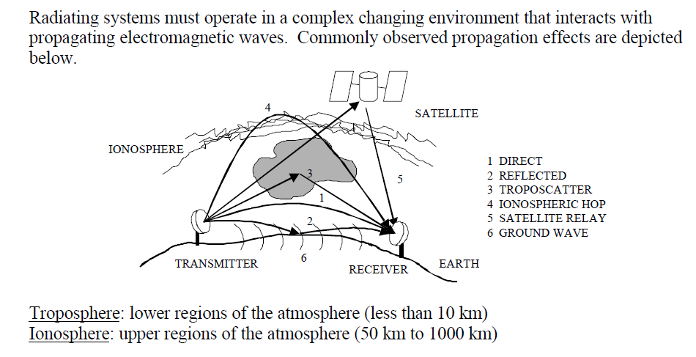

Slide 3
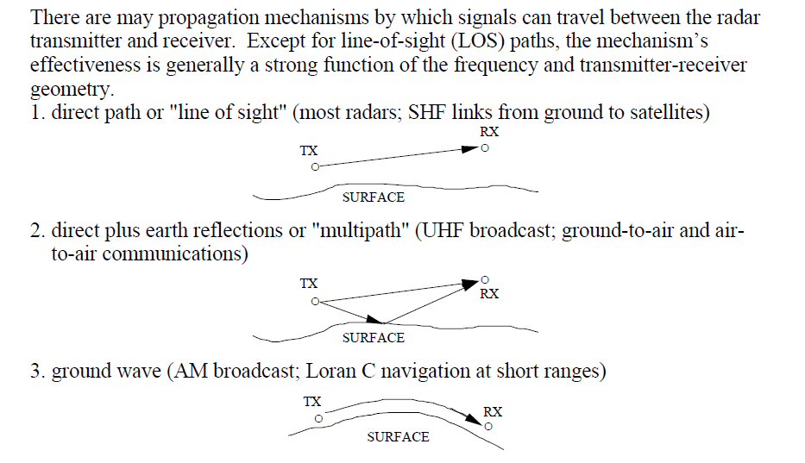

Slide 4
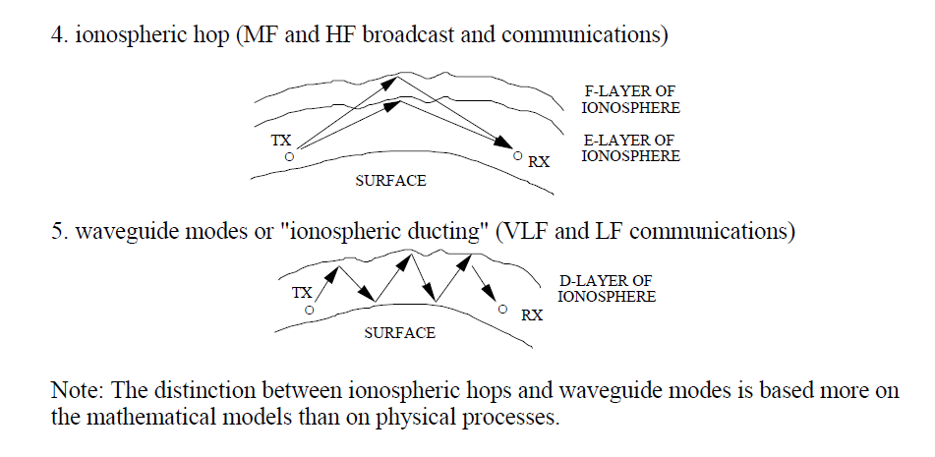

Slide 5
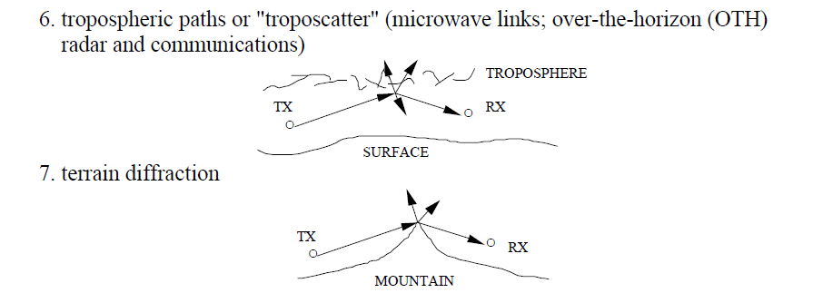

Slide 6
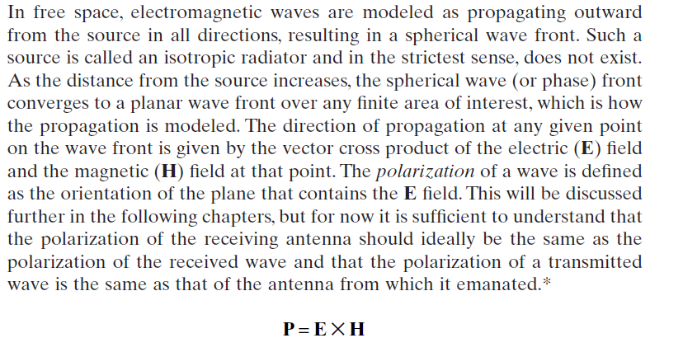

Slide 7
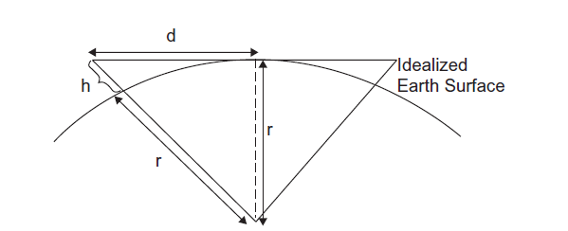
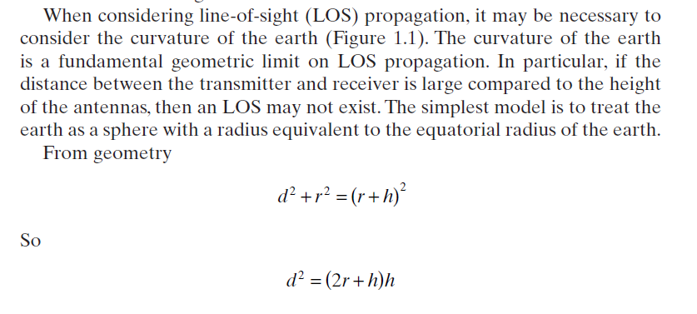

Slide 8

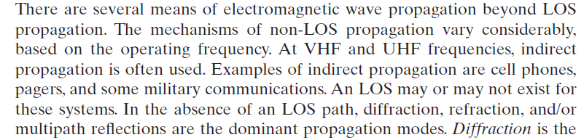
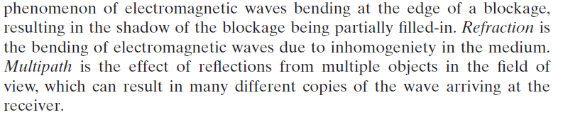

Slide 9
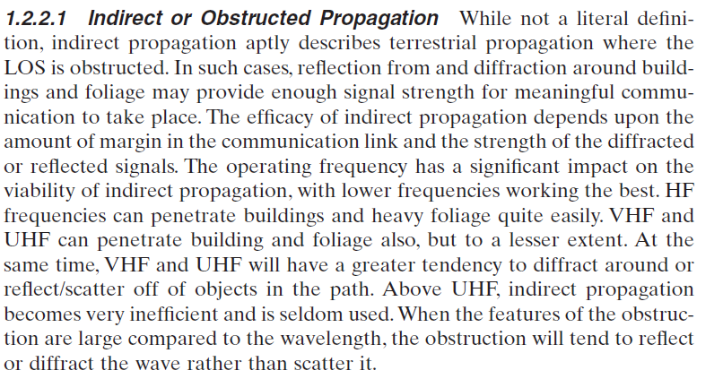

Slide 10
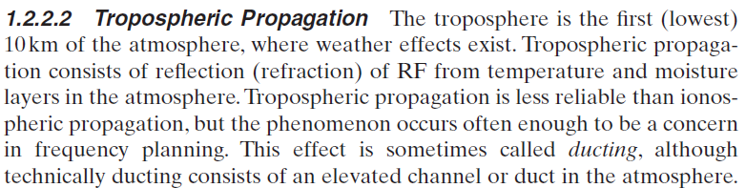
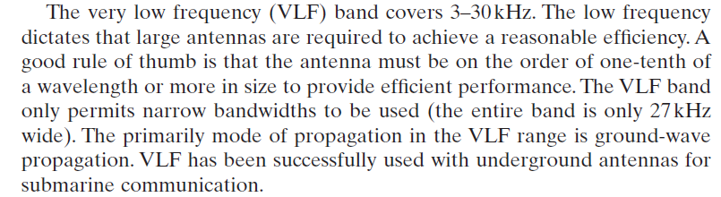

Slide 11
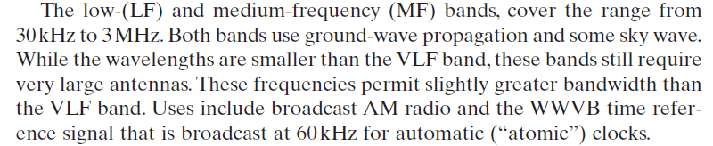
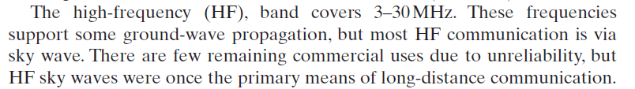

Slide 12
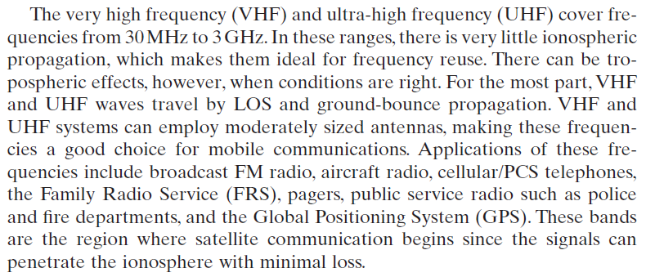
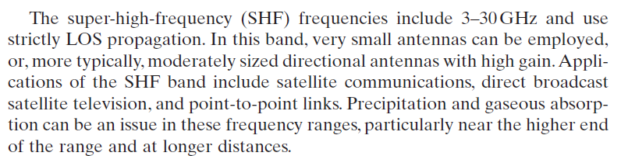

Slide 13
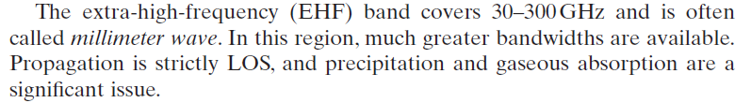
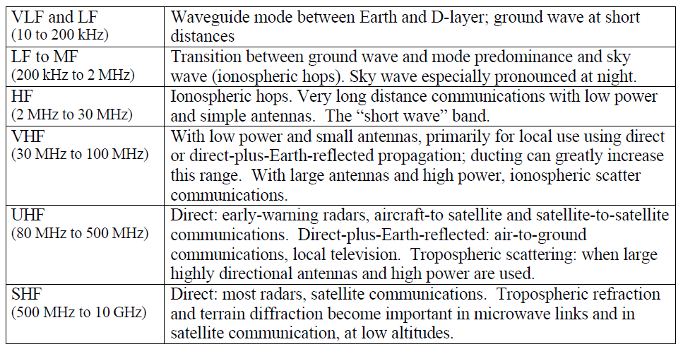

Slide 14
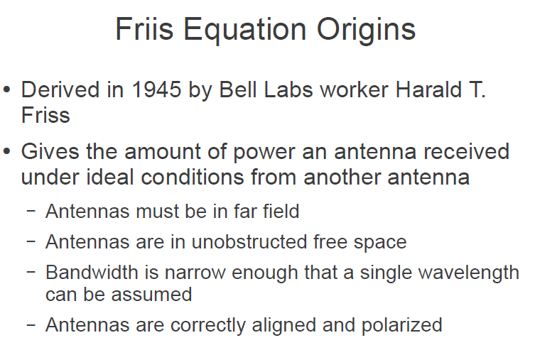

Slide 15
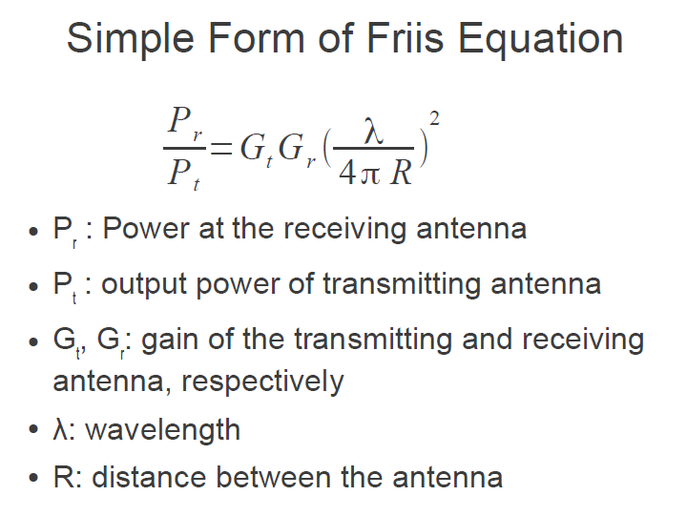

Slide 16
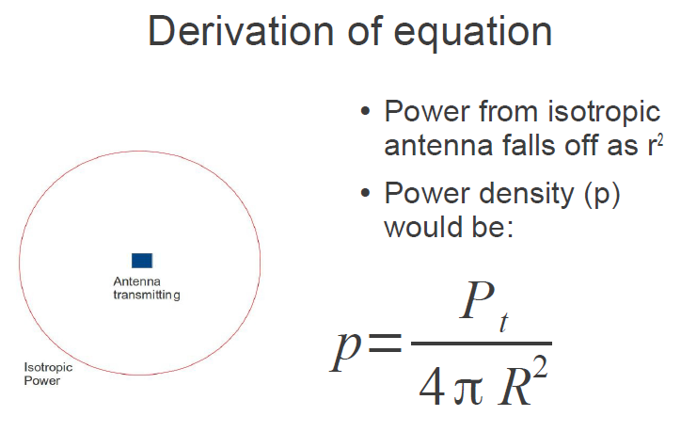

Slide 17
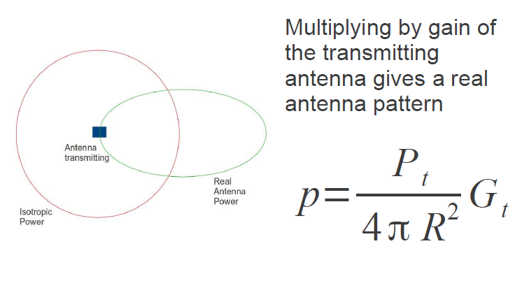

Slide 18
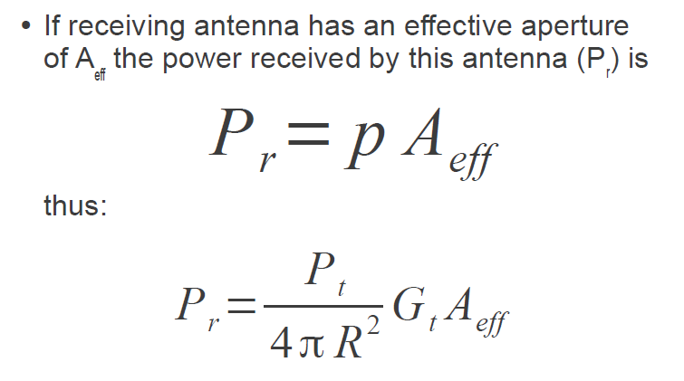

Slide 19
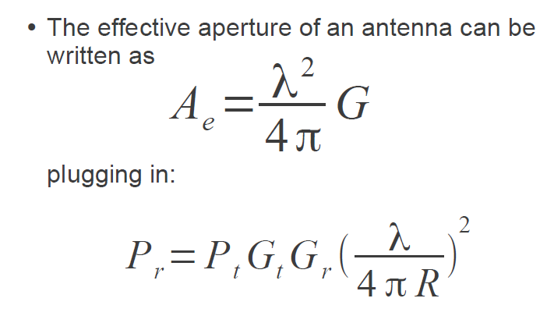

Slide 20
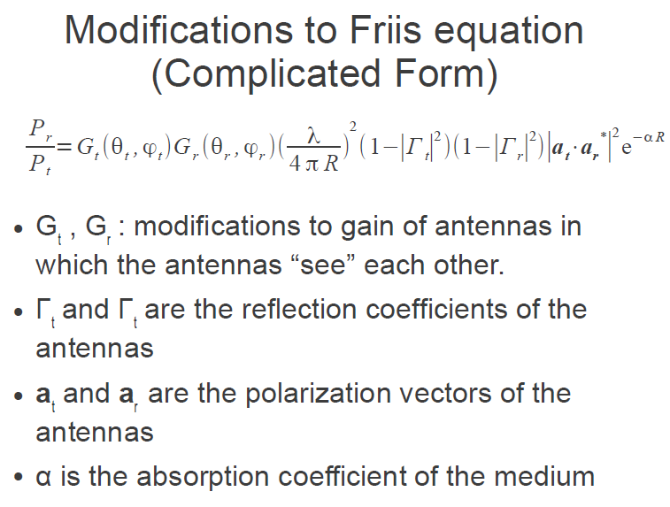

Slide 21
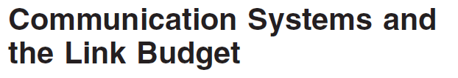
Radio-frequency (RF) planning for networks such as cellular telephone systems or wireless local area networks (LANs) is a key part of network deployment. Insufficient planning can result in overdesign and wasted resources or under design and poor system performance. Prior to planning a network, the parameters controlling the performance of each individual link must be understood. The essential parameters are the received signal strength, the noise that accompanies the received signal, and any additional channel impairments beyond attenuation, such as multipath or interference.
For link planning, a link budget is prepared that accounts for the transmitter effective isotropically radiated power (EIRP) and all of the losses in the link prior to the receiver

Slide 22
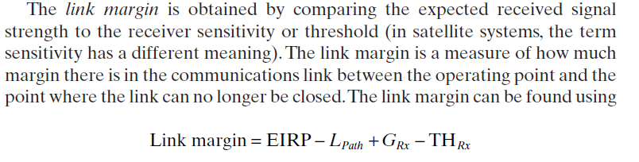
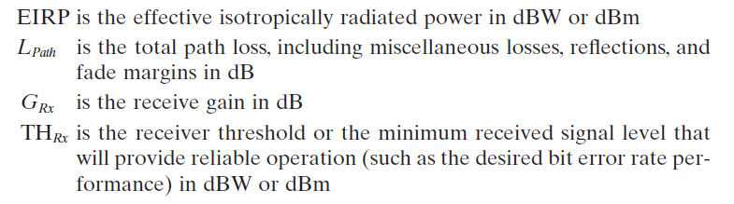

Slide 23
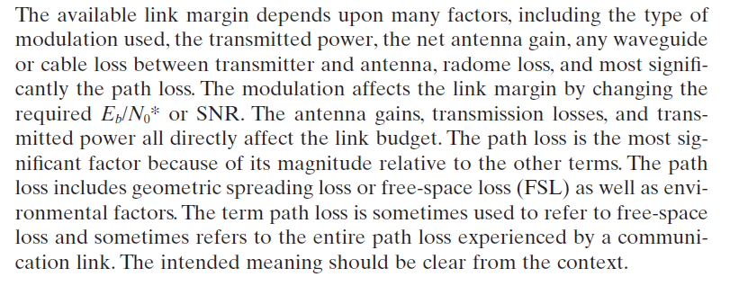

Path loss is the link budget element of primary interest in this text as it relates to the topic of RF propagation.The path loss elements include free-space loss, atmospheric losses due to gaseous and water vapor absorption, precipitation, fading loss due to multipath, and other miscellaneous effects based on frequency and the environment.

Slide 24
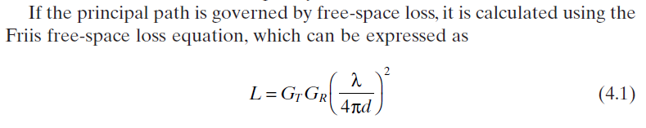
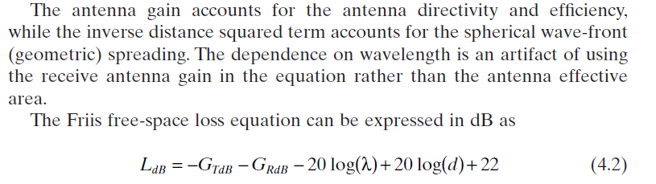
L is actually a gain (albeit less than unity) rather than a loss.

Slide 25
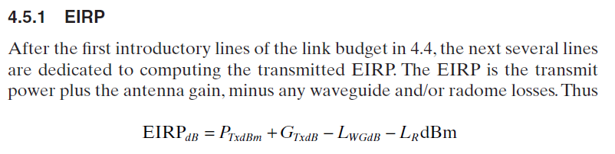
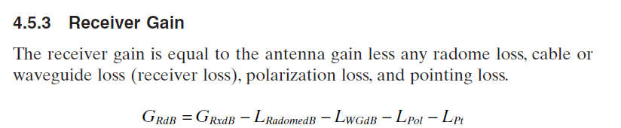
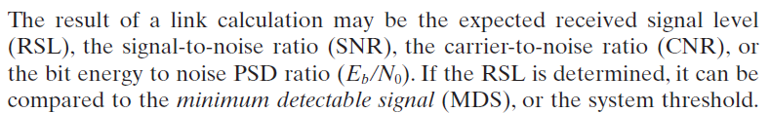

Slide 26

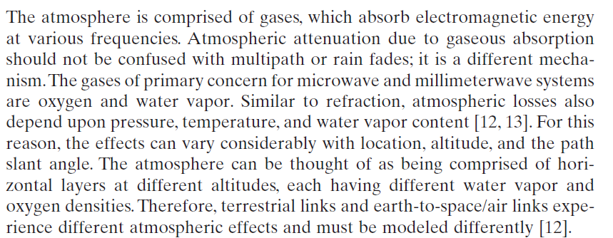
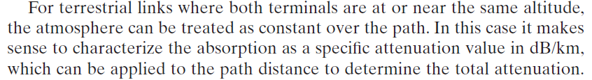


Slide 27
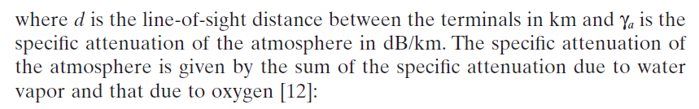

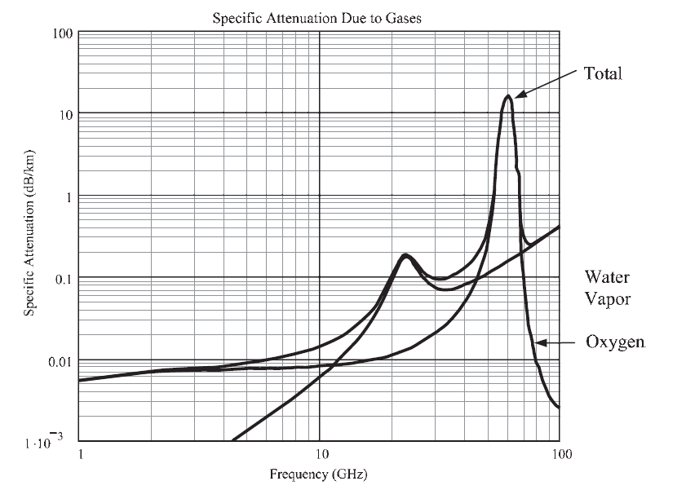

Slide 28
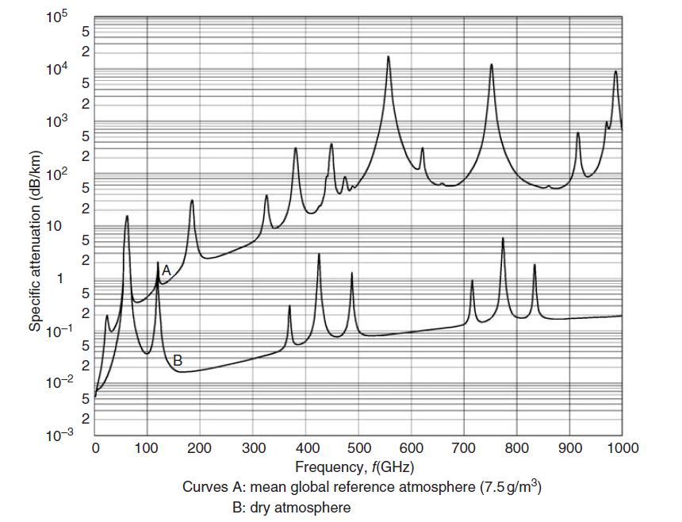

Slide 29

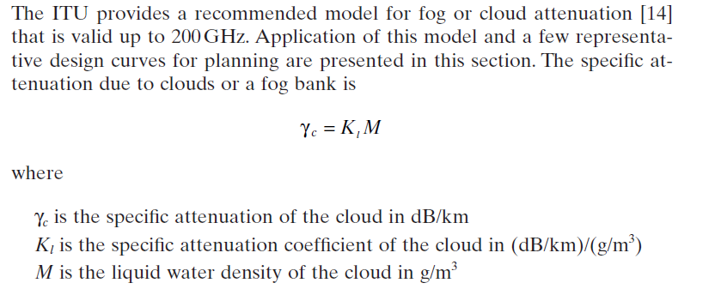
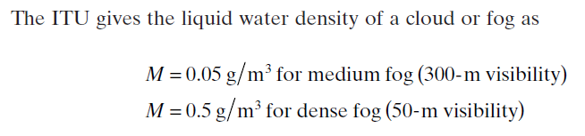

Slide 30
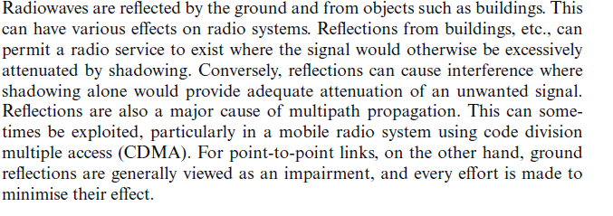
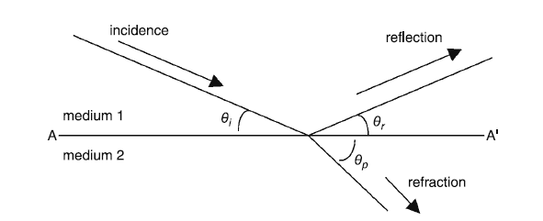

Slide 31
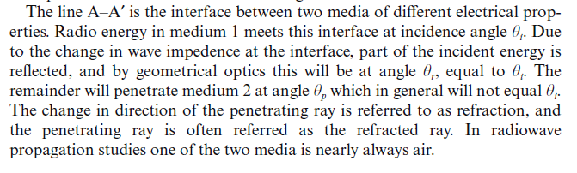
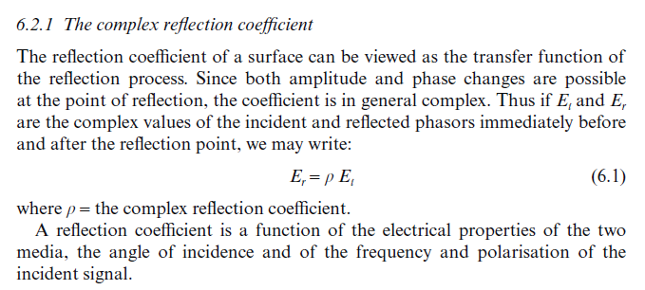

Slide 32
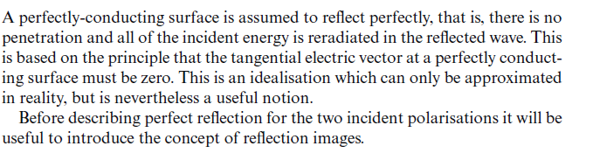
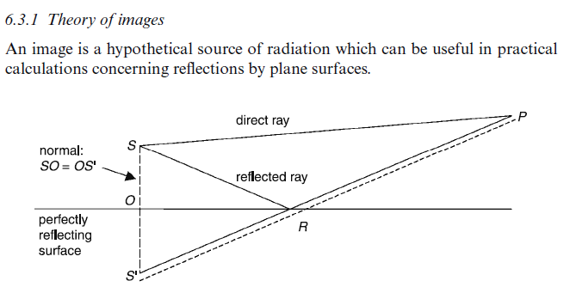

Slide 33
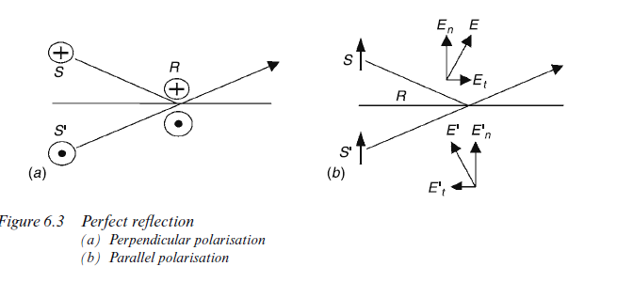
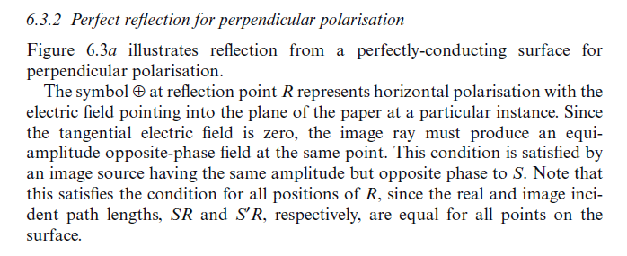

Slide 34
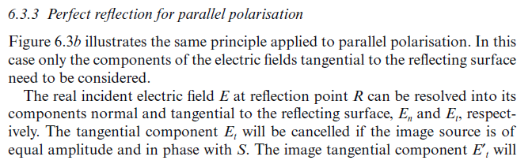


Slide 35


Slide 36




Slide 37



Slide 38




Slide 39



Slide 40



Slide 41


Slide 42

If a parallel beam of light from a distant source encounters an obstacle, the shadow of the obstacle is not a simple geometric shadow but is, rather, a diffraction pattern. For example, it is well known that the diffraction pattern formed by a slit looks like the function shown in Figure 1.
Such diffraction is called Fraunhofer diffraction.
If, however, the source of light is not distant, but is close to the diffracting obstacle so that the incident waves are not plane waves, the diffraction pattern will look somewhat different. Such diffraction is called Fresnel diffraction, and its theory is, unsurprisingly, a little more difficult than the theory for Fraunhofer diffraction.

Slide 43




Slide 44



Slide 45



Slide 46





Direct Ray TR ${= d}_{1}+d_{2}$
Reflected Ray TPR = $\sqrt{d_{1}^{2}+ h^{2}}+\sqrt{d_{2}^{2}+ h^{2}}$
So the path length difference is
$$∆ =\sqrt{d_{1}^{2}+ h^{2}}+\sqrt{d_{2}^{2}+ h^{2}}− d_{1}−d_{2}$$
As h<<d₁ and h<<d₂ then using Binomial expansion
$$\sqrt{d_{1}^{2}+ h^{2}}≅d_{1}\left(1+\frac{h^{2}}{2d_{1}^{2}}\right)$$

Slide 47



Hence
$∆ =d_{1}+ d_{2}+ \frac{h^{2}}{2d_{1}}+ \frac{h^{2}}{2d_{2}}− d_{1}−d_{2}$ = $\frac{h^{2}}{2d_{1}}+ \frac{h^{2}}{2d_{2}}$
So corresponding phase difference
$∅= \frac{2π∆}{λ}$ = $\frac{2π}{λ} \frac{h^{2}}{2}\left(\frac{d_{1}+d_{2}}{d_{1}d_{2}}\right)$
Now Fresnel – Kirchhoff diffraction is used to describe a number called v number as
$$v=h\sqrt{\frac{2(d_{1}+d_{2})}{λd_{1}d_{2}}}$$
Depending on sign of h, v changes. For zero h this v number is zero.

Slide 48




If $∅=nπ$then $∆ =\frac{nλ}{2}$
Hence $nλ =h^{2}\left(\frac{d_{1}+d_{2}}{d_{1}d_{2}}\right)$
Hence it is clear that increase in distance is added with a square terms.
$$∅=\frac{πv^{2}}{2}$$
The v-parameter in Fresnel diffraction analysis can be thought of as the arc length along the amplitude vector diagram called the Cornu spiral. In the Fraunhofer diffraction case where the source wavefront was assumed to be planar, the different elements of the wavefront had a constant phase difference and the incremental amplitude elements added to form the arc of a circle. In the Fresnel diffraction case where the curvature of the wavefront is included, the relative phase is not constant and the amplitude elements bend into the spiral curve.

Slide 49

Now we need to calculate the total amount of intensity of signal received at point P.
How this integration arrives : This is called Fresnel Integration. Fresnel integration is a term to solve Fresnel / near field diffraction parameter. So if a Electric field E originates from a source and if there are spatial /path variation on a single frame then how to calculate total E field at receiver due to all cumulative variable path diff effects.
In the above expression u is a dummy variable which has been used as integration factor related to height h in v number.

Slide 50


Cornu Spiral ( Eular Spiral ) is a plot of S vs C
An Euler spiral is a curve whose curvature changes linearly with its curve length
S
C

Slide 51

Propagation above 50 MHz with small antenna mounted over any structure
Preferable communication – LOS.
But the problem is interference.
Assume Flat Earth

Slide 52





Direct wave
Ground Reflected Wave
Total Received

Slide 53




Slide 54




Slide 55



Slide 56





Slide 57



Slide 58



Slide 59




Slide 60




Slide 61


Slide 62



Slide 63
Pls note ionosphere required to study
This presentation
From scan note (wave propagation –III)
3,
3.1.
3.2
3.3.1
3.3.2
3.3.3
3.3.4
3.3.9
3.3.10
3.3.11

