Slide 1

LOADING EFFECTS IN MEASURING INSTRUMENTS

Slide 2
What is LOADING EFFECT?
The introduction of the sensing element into the process or system being measured causes the value of the measured variable to change.
The output of a sensor device may deviate from the correct value due to loading effect.

Slide 3
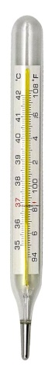


What is LOADING EFFECT?

Slide 4
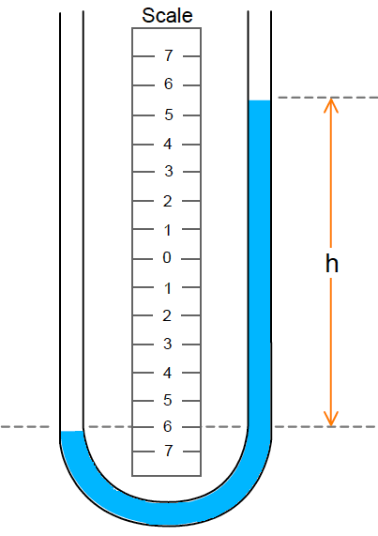
What is LOADING EFFECT?
A
Q^{t}
B
A
Q^{m}
B
Q^{t} ∝ ΔP_{AB} (Hagen-Poisseuille eq)
Q^{m} ∝ ΔP_{AB}
Depends on ΔP_{frictional}
Depends on ΔP_{frictional} + ΔP_{orificemeter}

Slide 5
LOADING EFFECT
So introduction of the sensing element into the process or system is always associated with extraction of some energy from the medium which causes the value of the measured variable to change.
This effect cannot be removed altogether – but it can be minimized.

Slide 6
LOADING EFFECT
Primary Input (q_{i1})
Input (q_{i})
MEASUREMENT SYSTEM/ COMPONENT
Output (q_{o})
Secondary Input (q_{i2})
Primary Input (q_{i1}) | Secondary Input (q_{i2})
Pressure (ΔP) | Flow (Q)
Force (F) | Velocity (v)
Voltage (E) | Current (i)
Flow (Q) | Pressure (ΔP)
Velocity (v) | Force (F)
Current (i) | Voltage (E)
Power Drain
ΔP×Q
F×v
E×i
ΔP×Q
F×v
E×i
Power Drain = q_{i1}× q_{i2}

Slide 7
LOADING EFFECT
Another classification of variables
Flow/Through Variable
Effort/Across Variable
Power Drain is product of a flow variable and an effort variable
FLOW VARIABLE: an extensive variable in the sense that its magnitude depends on the extent to which the system takes part in energy exchange. Examples: flow, current, velocity
EFFORT VARIABLE: an intensive variable in the sense that its magnitude is independent on the extent to which the system takes part in energy exchange. Examples: pressure, voltage, force

Slide 8
Generalized Input Impedance
Primary Input (q_{i1})
MEASUREMENT SYSTEM/ COMPONENT
Output (q_{o})
Secondary Input (q_{i2})
If q_{i1} is an effort variable then,
Generalized Input Impedance is defined as
Then power drain/loading effect is
So HIGHER is input impedance Z_{gi},
LOWER is power drain Π

Slide 9
Example of Generalized Input Impedance
R₁
i_{m}
b
b'
+
+
Voltmeter
E_{b}
i
R₃
E_{o}
E_{m}
R_{m}
R₂
−
−
a
a'
Here q_{i1} = E_{m} is an effort variable & q_{i2} = i_{m} is a flow variable.
So generalized input impedance is defined as
So now we need to check that to have low loading effect, R_{m} should be high.

Slide 10
Example of Generalized Input Impedance
+
By Thevenin’s Theorem
R_{eq}
b
b'
i_{m}
E_{o}
E_{m}
R_{m}
a
a'
−
where, q_{1m} → measured value of effort variable (E_{m})
q_{1u} → true/undisturbed value of effort variable (E_{o})
Z_{gi} → input impedance (R_{m})
Z_{go} → output impedance (R_{eq})

Slide 11
Example of Generalized Input Impedance
+
By Thevenin’s Theorem
R_{eq}
b
b'
i_{m}
E_{o}
E_{m}
R_{m}
a
a'
−
So, q_{1m} → q_{1u} if (Z_{go} / Z_{gi} ) → 0
Or, Z_{gi} >> Z_{go}
i.e. R_{m} >> R_{eq}
So to have low loading effect, input impedance R_{m} should be high.

Slide 12
Generalized Input Admittance
Primary Input (q_{i1})
MEASUREMENT SYSTEM/ COMPONENT
Output (q_{o})
Secondary Input (q_{i2})
If q_{i1} is a flow variable then,
Generalized Input Admittance is defined as
Then power drain/loading effect is
So HIGHER is input admittance Y_{gi},
LOWER is power drain Π

Slide 13
Example of Generalized Input Admittance
By Thevenin’s Theorem
R₁
R_{eq}
b
Ammeter
b
Ammeter
i_{u}
i_{m}
i_{m}
R_{m}
R_{m}
E_{b}
E_{ab}
a
a
R₂
R₃
Here q_{i1} = i_{m} is a flow variable & q_{i2} = E_{m} is an effort variable.
So generalized input and output admittance are defined as
So now we need to check that to have low loading effect, Y_{gi} should be high.

Slide 14
Example of Generalized Input Admittance
R_{eq}
b
Ammeter
R_{m}
i_{m}
E_{ab}
a
So, q_{1m} → q_{1u} if (Y_{go} / Y_{gi} ) → 0
Or, Y_{gi} >> Y_{go}
i.e. R_{m} << R_{eq}
So to have low loading effect, input admittance (1/R_{m}) should be high.

Slide 15
Generalized Input Static Stiffness
Primary Input (q_{i1})
MEASUREMENT SYSTEM/ COMPONENT
Output (q_{o})
Secondary Input (q_{i2})
If q_{i1} is an effort variable and say is force F.
If q_{i2} is a flow variable and is velocity v.
Then generalized Input Impedance is
But then when a steady state is reached while taking reading
v = 0. So Z_{gi} = F/v = F/0 = ∞

Slide 16
Generalized Input Static Stiffness
Primary Input (q_{i1})
MEASUREMENT SYSTEM/ COMPONENT
Output (q_{o})
Secondary Input (q_{i2})
To overcome this difficulty a new parameter is defined as:
So if q_{i1} = F (effort variable) and q_{i2} = v (flow variable), then

Slide 17
Generalized Input Static Stiffness
Generalized input static stiffness is defined as:
It can be shown that:
where S_{go} is the generalized output static stiffness
So, q_{1m} → q_{1u} if (S_{go} / S_{gi} ) → 0
Or, S_{gi} >> S_{go}
So to have low loading effect, input static stiffness S_{gi} should be high.

Slide 18
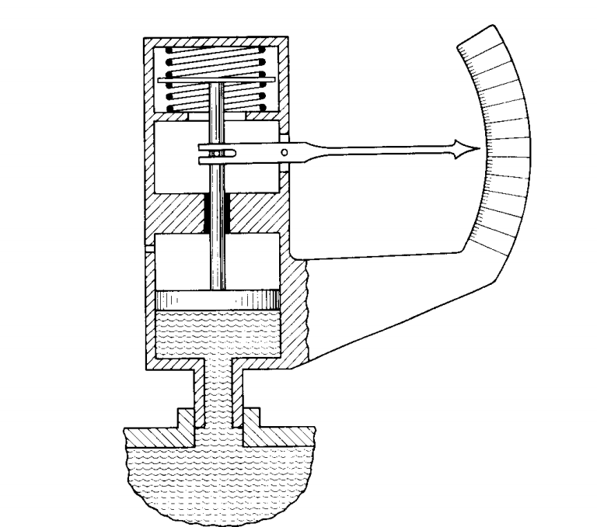
Example of Generalized Input Static Stiffness
k_{s}
θ
x
A
P
P

Slide 19
Example of Generalized Input Static Stiffness
q_{i1} = P_{m} (effort variable)
q_{i2} = Q_{m} (flow variable)
k_{s}
θ
x
A
P
So to have low loading effect, input static stiffness S_{gi} should be high i.e. spring stiffness k_{s} should be high.

Slide 20
Generalized Input Static Compliance
Primary Input (q_{i1})
MEASUREMENT SYSTEM/ COMPONENT
Output (q_{o})
Secondary Input (q_{i2})
If q_{i1} is a flow variable and say is displacement x.
If q_{i2} is an effort variable and is rate of change of force .
Then generalized Input Admittance is
But then when a steady state is reached while taking reading

Slide 21
Generalized Input Static Compliance
Primary Input (q_{i1})
MEASUREMENT SYSTEM/ COMPONENT
Output (q_{o})
Secondary Input (q_{i2})
To overcome this difficulty a new parameter is defined as:
So if q_{i1} = x (flowvariable) and (effort variable), then
Inverse Stiffness

Slide 22
Generalized Input Static Compliance
Generalized input static compliance is defined as:
It can be shown that:
where C_{go} is the generalized output static compliance
So, q_{1m} → q_{1u} if (C_{go} / C_{gi} ) → 0
Or, C_{gi} >> C_{go}
So to have low loading effect, input static compliance C_{gi} should be high.

Slide 23
Example of Generalized Input Static Compliance
F
ΔL₁ = C_{gi}F = ΔL_{t}
L₂
C_{go}
ΔL₂ = C_{go}F
ΔL_{m} = ΔL₁ + ΔL₂
= (C_{gi} + C_{go})F
Gauge Length
L₁
C_{gi}
So to have low loading effect, input static compliance C_{gi} should be high.

