Slide 1
Computer Programming
Session: 2020-21
Semester: 2nd
Operators in C
Part II
Achintya Mukhopadhyay

Slide 2
Unary Operators
C includes a class of operators that act upon a single operand to produce a new value. Such operators are known as unary operators
  Most unary operators precede the operand but some unary operators come after the operand
Common unary operators in C are
  Unary minus
  Increment/decrement operator
  sizeof operator

Slide 3
Unary Minus Operator
Perhaps the most common unary operation is unary minus
In unary minus operator, a numerical constant, variable or expression is preceded by a minus sign.
  Unlike some programming languages that allow a minus sign to be included as a part of a numeric constant, in C, all numeric constants are positive
  A negative number is actually an expression, consisting of the unary minus operator, followed by a positive numeric constant
Unary minus is distinct from subtraction operator, which is a binary operator and requires two operands
Examples of unary minus operator:
  -5 (applied to an integer constant)
  -4.5 (applied to a floating point constant)
  - solution (applied to a numeric variable)
  -(x+y) (applied to an expression

Slide 4
Increment and Decrement Operator
Increment operator (++)
  Appears as ++i or i++
  Implies i is incremented by 1 i.e., i = i+1
Decrement operator (--)
  Appears as --i or i--
  Implies i is decremented by 1 i.e., i = i-1
Prefix and postfix operator
  Prefix operator: If the operator precedes the operand (e.g., ++i), the operand will be altered in value before it is utilized for its intended purpose within the program.
  Postfix operator: If the operator follows the operand (e.g., i++), the value of the operand will be altered after it is utilized.

Slide 5
Illustration
Prefix Operator | Postfix Operator
int i=1; printf(“%d \n”, i); printf(“%d \n”,++ i); printf(“%d \n”, i); | int i=1; printf(“%d \n”, i); printf(“%d \n”, i++); printf(“%d \n”, i);
Output: 1 2 (The value of i is first increased by 1 and then printed) 2 | Output: 1 1 (The value of i is first printed and then increased by 1) 2

Slide 6
Illustration
If p =5, find d =++p+5;
d=++p+5= (5+1)+5 = 11
If c=2, find d =++c + c++ +4;
d=(2+1)+3+4=10
If c=2, find d =++c + c++ +c;
d=(2+1)+3+4 = 10
If m = 12, find n=m++*5 + --m
n= 12*5+(13-1)=72
If a=4, b=3, find c = a++ * 6 + ++b*5 + 10
c=4*6+4*5+10 =54
If a=12, b = 8, find the value of a*=++a/6 + b++%3;
a= 12*(++a/6 + b++%3)=12+(13/6+8%3)=12*(2+2)= 48

Slide 7
sizeof Operator
Returns the size of the oprand in bytes
Always precedes the operand
Can be used on variables or cast
Useful for dynamic memory allocation
Illustration
int a =5;
printf (“Integer: %d\n”, sizeof a);
printf (“Character: %d\n”, sizeof (char));
Output:
Integer: 4
Character: 1

Slide 8
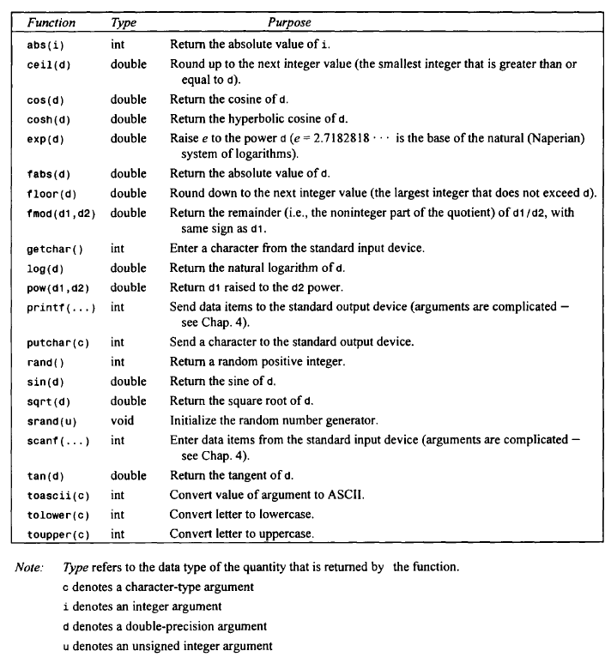
Mathematical Functions

Slide 9
Mathematical Functions
Standard library functions require inclusion of two additional header files (in addition to #include<stdio.h>)
  #include<stdlib.h>
  #include <math.h>
Each mathematical function takes specific class of arguments and returns specific (same or different from the arguments) class of values
In C, there is no exponentiation operator. This is handled by a library function pow(d1,d2)⇒d1^{d2}
Takes a double as argument
Returns a double

Slide 10
Illustration
# include <stdio.h>
# include <math.h>
main()
{
double a = 1.0, b = 8.0, c = 15.0,d;
d=pow(b,2)-4.0*a*c;
d=sqrt(d);
printf("d= %f\n",d);
}

Slide 11
Try this!
# include <stdio.h>
# include <math.h>
main()
{
int a = 1.0, b = 8.0, c = 15.0,d;
int p=16;
d=pow(b,2)-4.0*a*c;
d=sqrt(d);
p=sqrt(p);
printf("d= %d\n",d);
printf("p= %d\n",p);
}

Slide 12
Practice
Write a programme that
  Takes values of length and breadth of a rectangle
  Calculates and prints its area and perimeter
  Calculates and prints the length of each side of a square whose area is equal to the rectangle
  Calculates and prints the ratio of the perimeters of the rectangle and the square

