Slide 1
Computer Programming
Session: 2020-21
Semester: 2nd
Expressions and Assignments in C
Achintya Mukhopadhyay

Slide 2
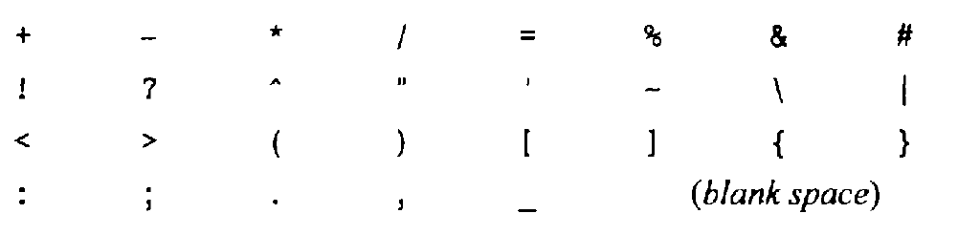
Character Sets
Hierarchy of learning C
Characters in C
  Alphabets (A – Z, a – z)
  Digits (0 – 9)
  Special Characters
    Certain combinations of special characters are used for special purposes and are known as escape sequences (considered as single character) \n, \t, \b
Character Set (Alphabet)
Constants, Variables, Keywords
(Words)
Instructions
(Sentences)
Programmes
(Paragraphs)

Slide 3
Identifiers
Identifiers: Names given to programme elements like variables, functions, arrays
  Consist of letters and digits in any order but the first character must be a letter
  Both upper case and lower case letters can be used though lower case letters are preferred
  Upper and lower case are not interchangeable i.e., identifier names are case sensitive (Big and big are two different identifiers)
  Underscore (_) can also be used in identifier name (underscore is the only special character that can be used in an identifier and is considered a letter)
Identifiers can be of any length but certain compilers consider only the first few (8 or 31) characters only
Identifier names should be meaningful so that its purpose can be easily understood
  Should not be too long (e.g., average_marks and not average_of_all_marks)

Slide 4
Valid and Invalid Identifiers
Valid Identifiers
  abc
  innings1
  a4bc
  best_result
  _temperature
  PRESSURE
  Resistance
Invalid Identifiers
  4acb (Cannot start with a number)
  best-result (Illegal character ‘-’)
  “average” (Illegal character “ “)
  maximum temperature (space not allowed)

Slide 5
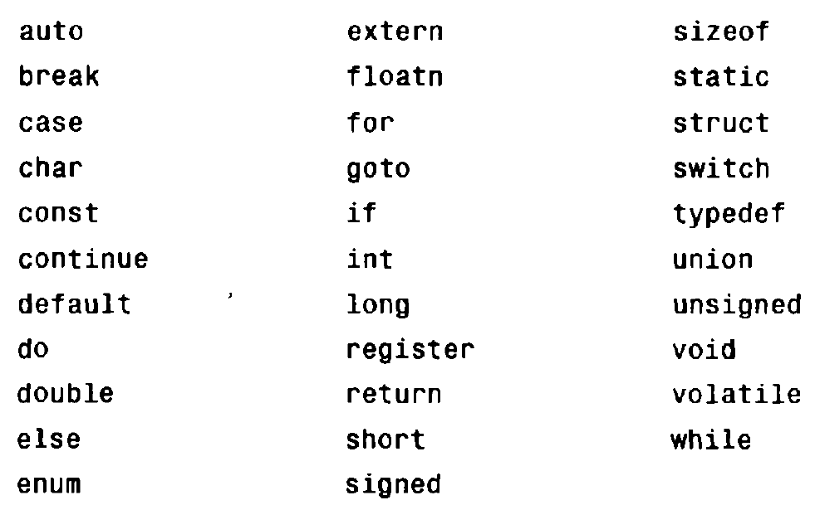
Keywords
Keywords: Certain reserved words have predfined meanings in C
  Cannot be used a names for user-defined identifiers
  Keywords are all lowercase (Uppercase can be used as an user-defined identifier but not usually done)
  Standard keywords

Slide 6
Keywords
Keywords: Certain reserved words have predfined meanings in C
  Cannot be used a names for user-defined identifiers
  Keywords are all lowercase (Uppercase can be used as an user-defined identifier but not usually done)
  Standard keywords

Slide 7
Data Types
Data Type | Description | Typical Memory Requirements
int | Integer quantity | 2 bytes or 1 word
float | Floating point number ( number containing a decimal point) | 1 word (4 bytes)
double | Double precision floating point number (with more significant figures) | 2 words (8 bytes)
char | Single character | 1 byte
Basic data types can be augmented by use of qualifiers long, short, signed, unsigned

Slide 8
Constants and Variables
Constants: Quantities which remain unchanged during the entire execution
Variables: Identifier that is used to represent some specified type of information within a designated portion of the program
  Data item must be assigned to the variable at some point in the program
  Value of a variable can change during execution of the programme

Slide 9
Constants
Four types of constants in C
  Integer constant
  Floating point constants
  Character constants
  String constants
  Another type of constant also exists, known as enum constants
  Integer and Floating point constants are together known as numeric-type constants
Rules for numeric type constants
  Commas and blank spaces cannot be included within the constants
  Value of each type of constant cannot exceed specified minimum and maximum bounds, depending on the type of constants ( exact vlaues depend on the compiler)
  Constant can be preceded by a minus sign

Slide 10
Integer Constants
Integer valued numbers
Sequence of digits
  Can contain ‘-’ sign at the start ( ‘-’ is actually an operator in C)
  Cannot contain decimal points
Can be written in three different number systems
  Decimal (base 10): Contain the digits 0 – 9 (For constants with more than 1 digit, the first digit cannot be 0)
  Octal (base 8): Contain the digits 0 – 7 ( First digit must be 0 to identify it as an octal integer)
  Hexadecimal (base 16): Contain the digits 0 – 9 and the letters A – F (in upper or lower case) (Must begin with 0x or 0X)
Depending on the architecture of the computer, magnitude of integers can generally range from 0 to 2¹⁵ – 1 or 2³¹ – 1

Slide 11
Valid and Invalid Integer Constants
Valid decimal integer constants
  0, 2, 20, -574, 9999
Valid octal integer constants
  0, 03, 045, 0567, 034567
Valid hexadecimal integer constants
  0, 0x1, 0xDEF, 0xabcd, 0x139
Invalid decimal integer constants
  5,679 (contains comma)
  578.0 (contains decimal point)
  0874 (starts with 0)
Invalid octal integer constants
  756 (does not start with 0)
  0128 (contains invalid digit 8)
Invalid hexadecimal integer constants
  0be76 (does not start with 0x or 0X)
  0x12fg7 (contains invalid character g)

Slide 12
Floating Point Constants
Floating-point constant is a base- 10 number that contains either a decimal point or an exponent (or both)
  123.45
  6.023e23
  5.67e-8
If an exponent is present, its effect is to shift the location of the decimal point
  12345.67 ≡ 123.4567e2 ≡ 123456.7e-1
In C, normally floating point numbers are stored as double precision
Invalid floating point numbers
  12345 (no decimal point)
  1.2345e1.2 ((exponent cannot contain decimal point)
  345 e5 (illegal character (space))
  1,457.98 (Contains illegal character “,”)

Slide 13
Character Constants
A character constant is a single character, enclosed in single quotes (‘a’, ‘9’, ‘*’, ‘+’)
Most computers follow ASCII character set
  Each individual character is numerically encoded with its own unique 7-bit combination
  A total of 2⁷ = 128 characters
    Digits are arranged consecutively in their numerical sequence ( 0 – 9)
    Letters arranged alphabetically, with upper case preceding the lower case
  ASCII encoding gives unique integer value for each character
    Allows certain arithmetic operations on character constants

Slide 14
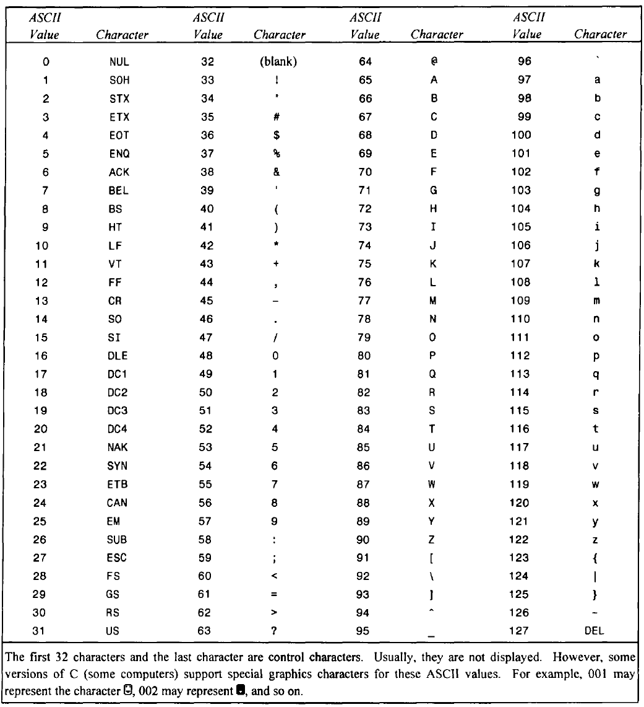
ASCII Characters

Slide 15
Escape Sequences
Certain nonprinting characters, as well as the backslash (\) and the apostrophe ( `), can be expressed in terms of escape sequences
  Always begins with a backward slash and is followed by one or more special characters
  Represent single characters

Slide 16
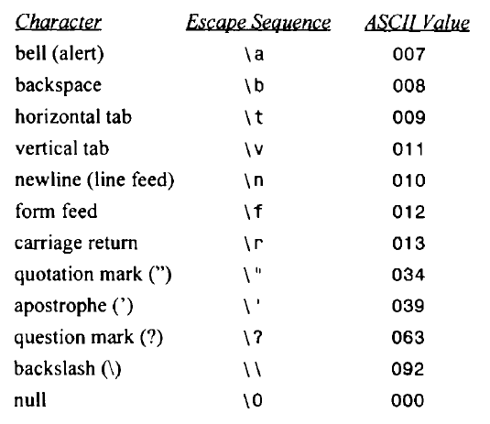
Escape Sequences

Slide 17
String Constants
Consists of any number of consecutive characters (including none), enclosed in (double) quotation marks
  Example: “name”, “125”
Compiler automatically places a null character (\0) at the end of every string constant, as the last character within the string (before the closing double quotation mark)
  Not visible when printed
Individual characters in a string can be extracted and examined
Difference between 0, ‘0’, “0”, ‘\0’
  0: Integer constant
  ‘0’: Character constant
  “0”: String constant consisting of a single character
  ‘\0’: Escape sequence (null character) representing end of a string in computer memory

Slide 18
Variables
Variables must be declared as specific data types (integer, float, character etc)
Data items must be assigned to variables at some point in the programme
  Data item can be later accessed in the name by simply referring to the variable name
  Value assigned to a variable can change during the execution of a programme but data type cannot

Slide 19
Declarations
A declaration associates a group of variables with a specific data type.
  All variables must be declared before they can appear in executable statements
A declaration consists of a data type, followed by one or more variable names, ending with a semicolon
  int year, student_number;
  float height_student, per_cent_student;
  char option;
  char student_roll_number [15] (declaration for a string, which is an array of characters)

Slide 20
Symbolic Constants
A symbolic constant is a name that substitutes for a sequence of characters
  Characters may represent a numeric constant, a character constant or a string constant
  A symbolic constant allows a name to appear in place of a numeric constant, a character constant or a string
  When a program is compiled, each occurrence of a symbolic constant is replaced by its corresponding character sequence
Syntax of symbolic constant declaration
#define name text
  #define PI 3.14159
  #define UNIVERSITY “Jadavpur University”
  #define TRUE 1
Statement does not end with a semicolon as it would imply that ; is part of the text
Generally written in uppercase to distinguish from usual variables

Slide 21
Expressions
An expression represents a single data item, such as a number or a character
  May consist of a single entity, such as a constant, a variable, an array element or a reference to a function
  May also consist of some combination of such entities, interconnected by one or more operators
  Examples
  a+b
  a-b
  a*b
  a/b
  a+(b*(c+d))
  (a+b)/(a-b)

Slide 22
Statements
A statement causes the computer to carry out some action.
Three different classes of statements in C.
  Expression statements
  Compound statements
  Control statement
Expression statements consist of an expression followed by a semicolon
  Assignment statement evaluates an expression on the right of ‘=‘ sign and assigns it to the variable on the left
  a=3.7;
  c=a+b;
  Other examples
  printf (“Sum = %f”, c);
  scanf (“%f”, &b);

Slide 23
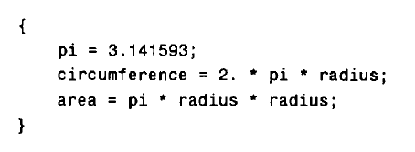
Statements
A compound statement consists of several individual statements enclosed within a pair of braces { }.
  Individual statements may themselves be expression statements, compound statements or control statements
  Provides a capability for embedding statements within other statements
  Does not end with a semicolon

Slide 24
A Typical Programme
/* An Example Programme*/
/* Programme to calculate surface area and volume of a sphere*/
#include <stdio.h> /*Header file containing important functions*/
main () /*Function main () indicates no arguments*/
{
float radius, volume, area; /* Declaration statement*/
#define PI 3.14159 /*Symbolic constant; Enables programmer to write the value of pi multiple times*/
printf ("Enter the value of radius \n"); /*Output Statement to make the programme user-friendly*/
scanf ("%f",&radius); /*Input Statement &radius denotes the meory location where the variable radius is stored*/
area=4.0*PI*radius*radius; /*Assignment statement*/
volume=4.0*PI*radius*radius*radius/3.0;
printf ("Radius of the sphere = %f \n", radius); /*Output statement*/
printf ("Surface area of the sphere = %f \n", area);
printf ("Volume of the sphere = %f \n", volume);
}

