Slide 1
Effects of saturation, harmonics& solid iron rotor/pole shoe in SM
Day 15

Slide 2
ILOs – Day15
Understand the effects of solid iron rotor/pole shoe (Eddy current) on generalized analysis of electric machines
Familiarize with the concept of skin effect

Slide 3
Effects of Eddy current
The transformation matrices developed in Chapter 1 also were based on the following additional assumptions:
The electrical conductors are of small section, over which the current density is uniform (Eddy current inside body of the conductors were neglected)
It is also assumed that the flux in the magnetic circuit
can be divided into a relatively small number of components (main and leakage)
No currents flow in the magnetic material (Eddy current inside body of the magnetic material was neglected)

Slide 4
Effects of Eddy current
Eddy current in body of the magnetic material:
Any magnetic material carrying alternating flux during normal operation must be laminated in order to limit the losses due to eddy currents
The calculation of such losses is empirical. They include:
  Losses in the laminated material due to the main flux
  Losses due to high frequency pulsations at the air-gap surface
  Losses due to stray fluxes linking the structural material of the machine
The total loss when the machine is excited but does not carry any load current is known as the core loss
Though it is a small proportion of the rated output but it has an important effect on the efficiency and the heating of the machine
For the purpose of making performance calculations it is usually either represented by a single resistance parameter or is neglected entirely
The core loss is an unavoidable drawback of the machine and the design is carried out so as to make it as small as possible

Slide 5
Effects of Eddy current
Eddy current in body of the magnetic material:
In a loaded machine the currents in the windings cause a redistribution of the flux
This flux now is assumed to consist of separate main and leakage components
The core loss is thereby increased
To allow for this loss in performance calculations of synchronous machines, the armature resistance is increased
In induction motors a separate value of loss is deducted from the output

Slide 6
Effects of Eddy current
Eddy current in body of the magnetic material:
Under normal steady conditions the flux in the secondary rotor field poles (DC) does not vary with time in a synchronous machine
  The rotor is thus not laminated (both salient pole and cylindrical rotor structures)
The secondary (rotor) flux is of low frequency (sf_{s}) in an induction motor
  It is thus not necessary to laminate the rotor iron material, it is
  Nevertheless common practice to laminate the entire magnetic circuit of an induction motor to reduce the pulsation losses
The presence of unlaminated material, usually referred to as solid iron, in the secondary magnetic circuit has an important effect during any transient condition when the secondary flux varies.

Slide 7
Effects of Eddy current
Eddy current in body of the magnetic material:
There are certain beneficial effects of eddy currents also:
  Some special induction motors are sometimes built with its rotor made of an iron cylinder, the eddy currents in which produce the motor torque (remember induction type energy meter?)
  In a synchronous machine the eddy currents in solid material on the secondary member can provide the starting torque of a synchronous motor or the damping effect of a synchronous generator

Slide 8
Effects of Eddy current
Eddy current in body of the conductor:
Eddy current effects occur in electrical conductors if the their cross section is too thick
The distribution of current density over the conductor section is non-uniform
  It is a combination of a uniform main load current with superimposed eddy currents
  The current tend to pass through outer section of the conductor (skin effect)
  Whereas inner section of the conductor remain much un-utilized by the current
The effective resistance of the conductor is thereby increased
In the primary winding, the result is an undesirable load loss

Slide 9
Skin effect

Slide 10
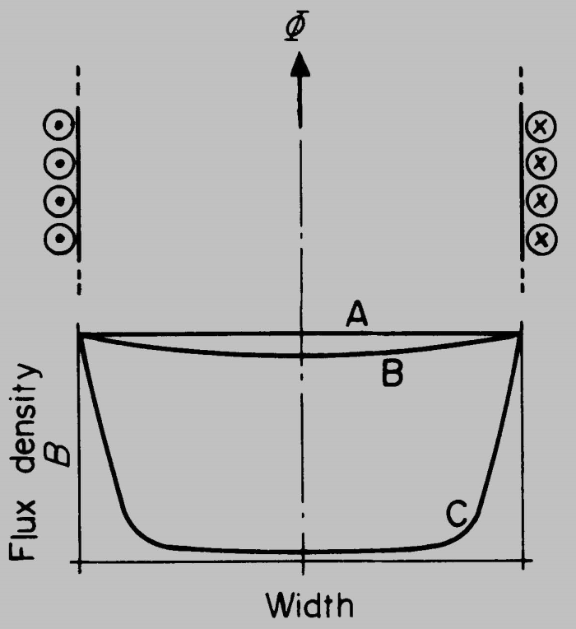
Skin effect
Eddy currents have the effect of concentrating the resultant flux and current near to the surface of the material - the so-called skin effect
Flux density distribution across the width of a solid iron block forming core of an electromagnet
Uniform distribution (no skin effect)
Distribution at low frequencies
Distribution at high frequencies (severe skin effect)
Note that at higher frequencies the flux distribution becomes increasingly non-uniform; greater near the surfaces and low near center of the material

Slide 11
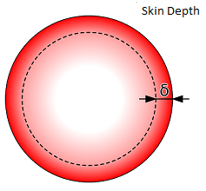
Skin effect
Eddy currents have the effect of concentrating the resultant flux and current near to the surface of the material - the so-called skin effect
Similarly, for a conductor:
When an AC current is applied to a conductor, the current concentrates near the surface of the conductor and its strength decreases as you go towards the center of the conductor.
The skin depth is defined as the depth below the surface of the conductor at which the current density has fallen to 1/e (about 0.37) of the value at the surface

Slide 12
Skin effect
Eddy currents have the effect of concentrating the resultant flux and current near to the surface of the material - the so-called skin effect
The Skin Depth is dependent on the frequency of the current/signal and the resistivity of the material. It inversely proportional to the frequency and directly proportional to the resistivity.
The Skin Depth can be calculated using the following formula:
ρ = Resistivity of the material
f = Frequency o the current
μ_{r} = Relative permeability
μ₀ = Absolute permeability = 4π×10⁻⁷

