Slide 1
Heat Transfer in Natural Convection from a Vertical Cylinder
Heat Power Laboratory I (Thermodynamics and Heat Transfer)
ME II Sec A₃
2020-21 2nd Semester
Prof. Achintya Mukhopadhyay

Slide 2
Title:
Heat Transfer in Natural Convection from a Vertical Cylinder
Objective:
To estimate the average heat transfer coefficient and average Nusselt number in natural convection from an internally heated vertical cylinder and compare the results with existing correlations

Slide 3
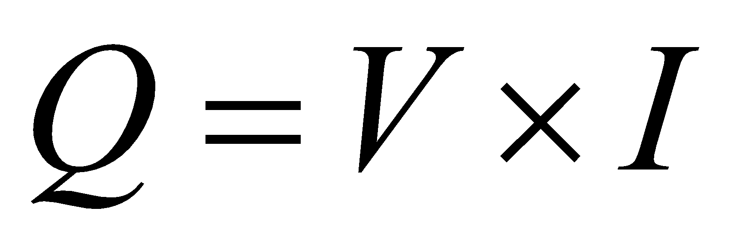
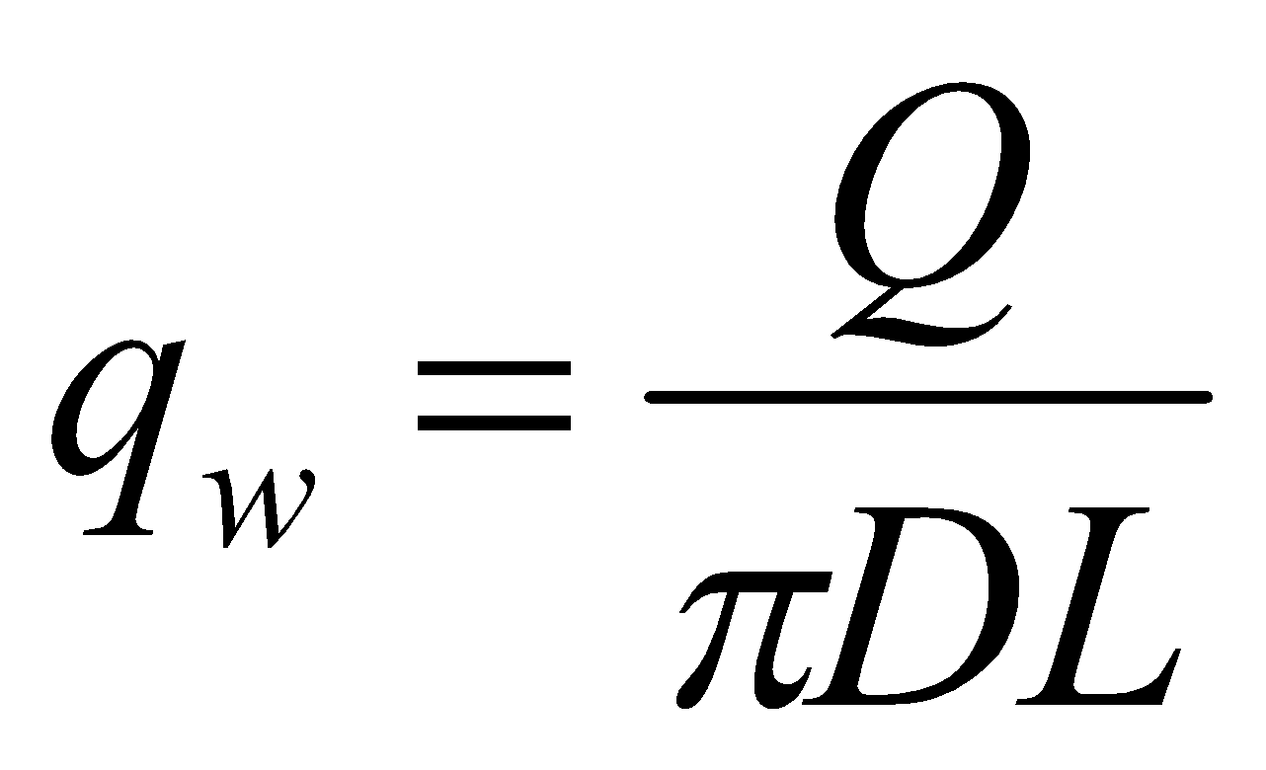


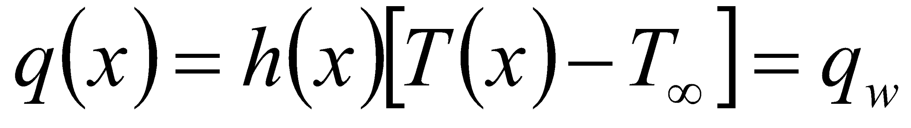
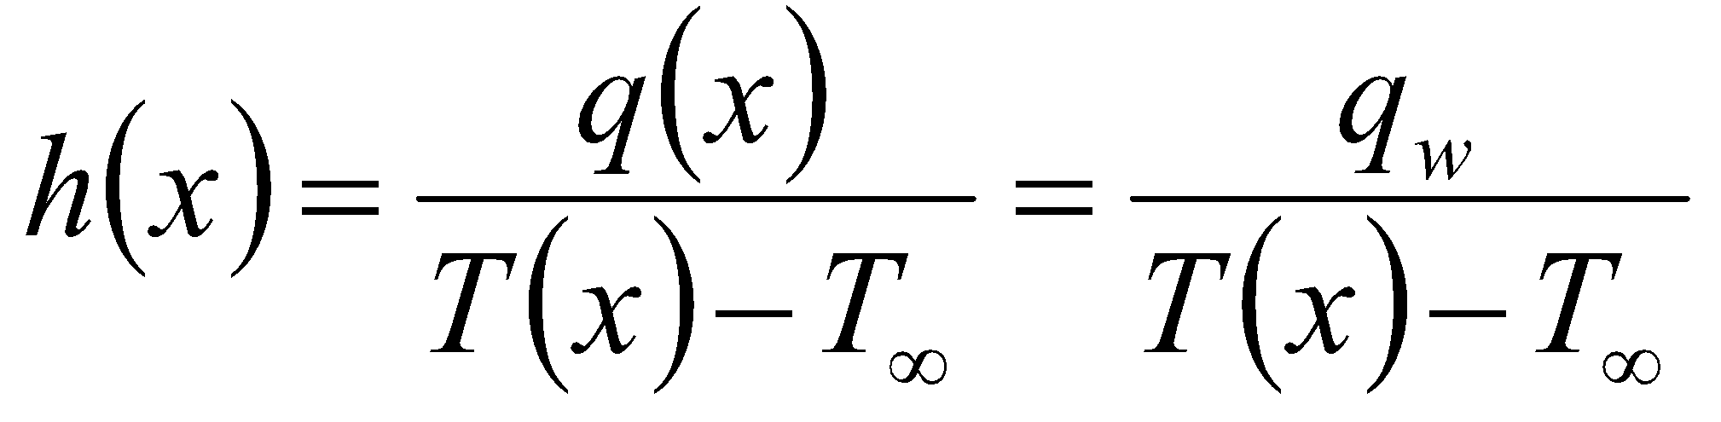
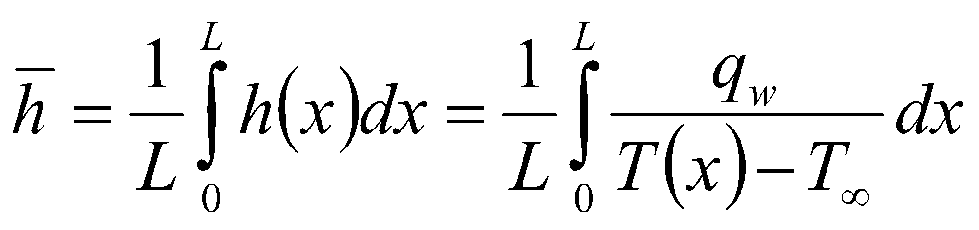
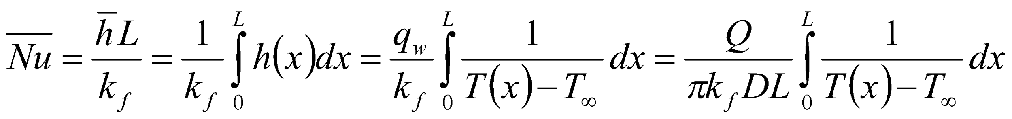
Background Theory
Theory
Schematic Diagram
For an electrically heated cylinder of diameter D and length L
  Total power input (V= voltage, I = current)
  Heat flux (constant)
  At any location,
  Local heat transfer coefficient
  Average heat transfer coefficient
  Average Nusselt number
T₇
T₆
T₅
T₄
q(x)=q_{w}
T(x)
T∞
T₃
T₂
T₁

Slide 4
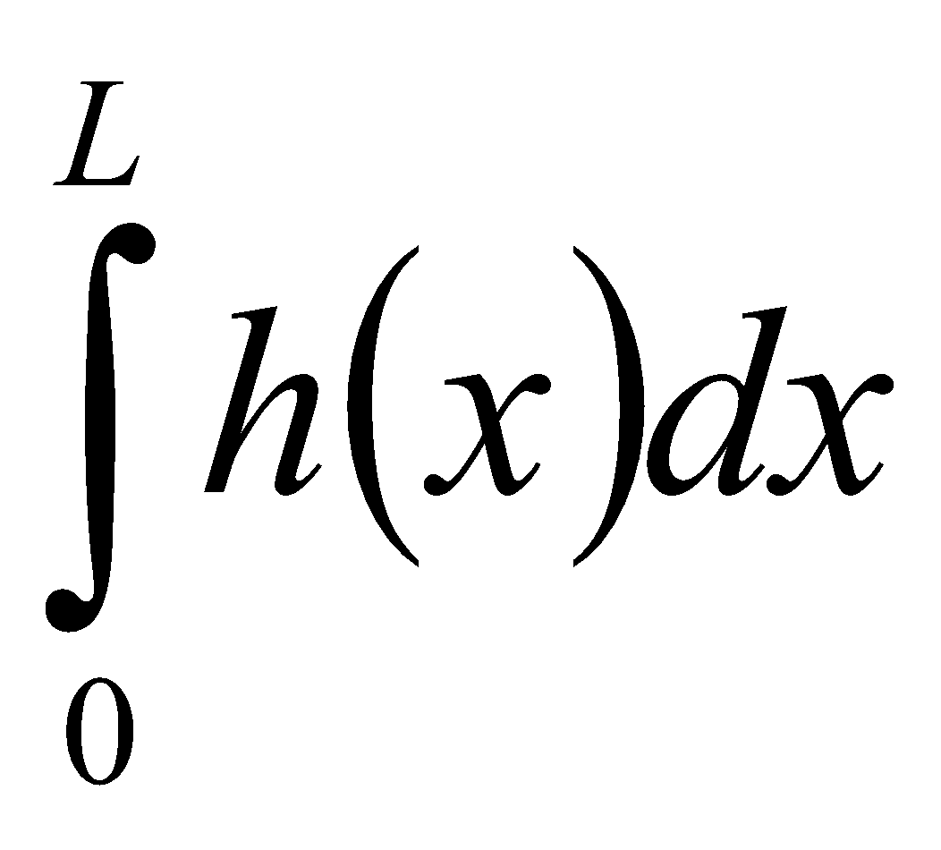
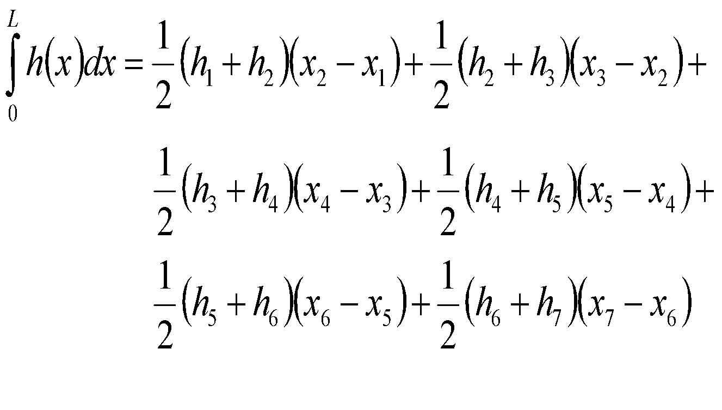
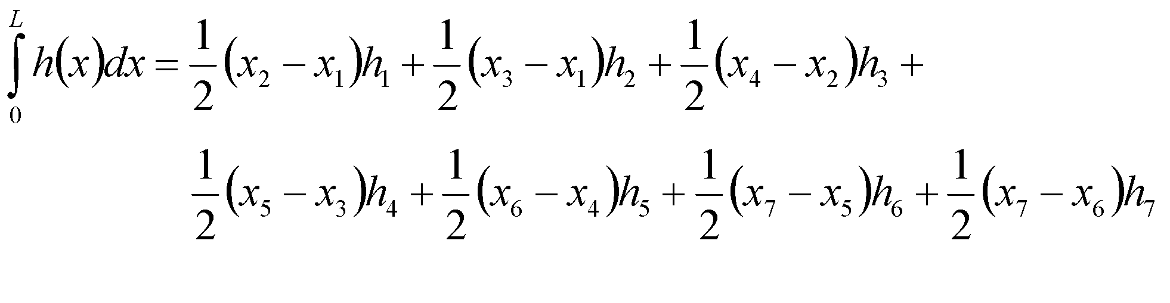
Background Theory
Theory
Schematic Diagram
How to evaluate ?
Using Trapezoidal Rule,
Rearranging
x
x₇
T₇
h₇
T₆
x₆
h₆
T₅
x₅
h₅
T₄
x₄
h₄
T₃
x₃
h₃
T₂
x₂
h₂
T₁
x₁
h₁
h(x)

Slide 5
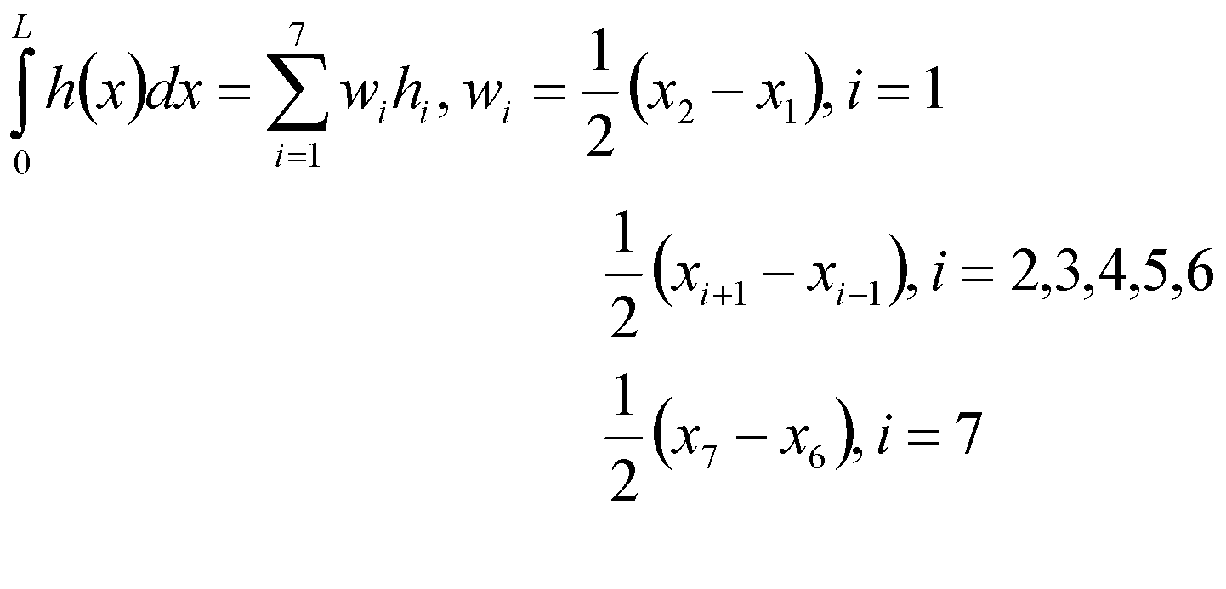
Background Theory
Theory
Schematic Diagram
Using compact notation,
x
x₇
T₇
h₇
T₆
x₆
h₆
T₅
x₅
h₅
T₄
x₄
h₄
T₃
x₃
h₃
T₂
x₂
h₂
T₁
x₁
h₁
h(x)

Slide 6
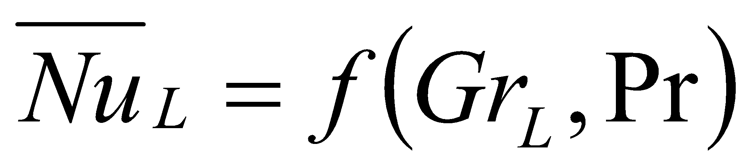
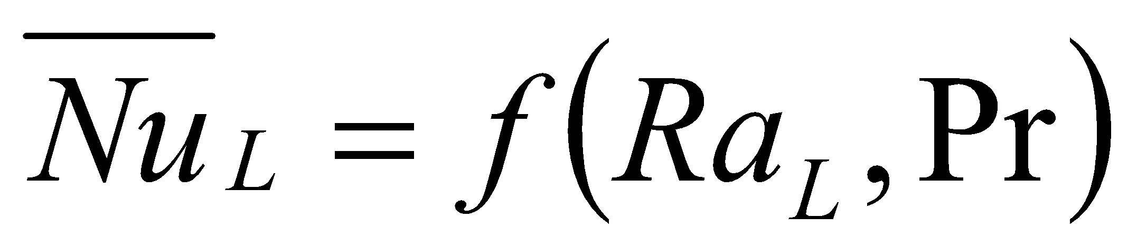
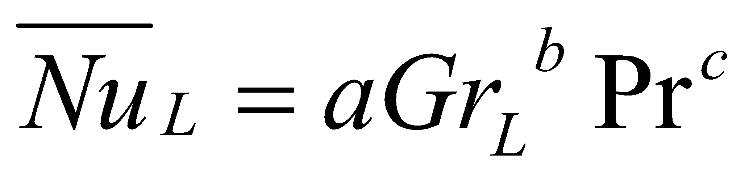
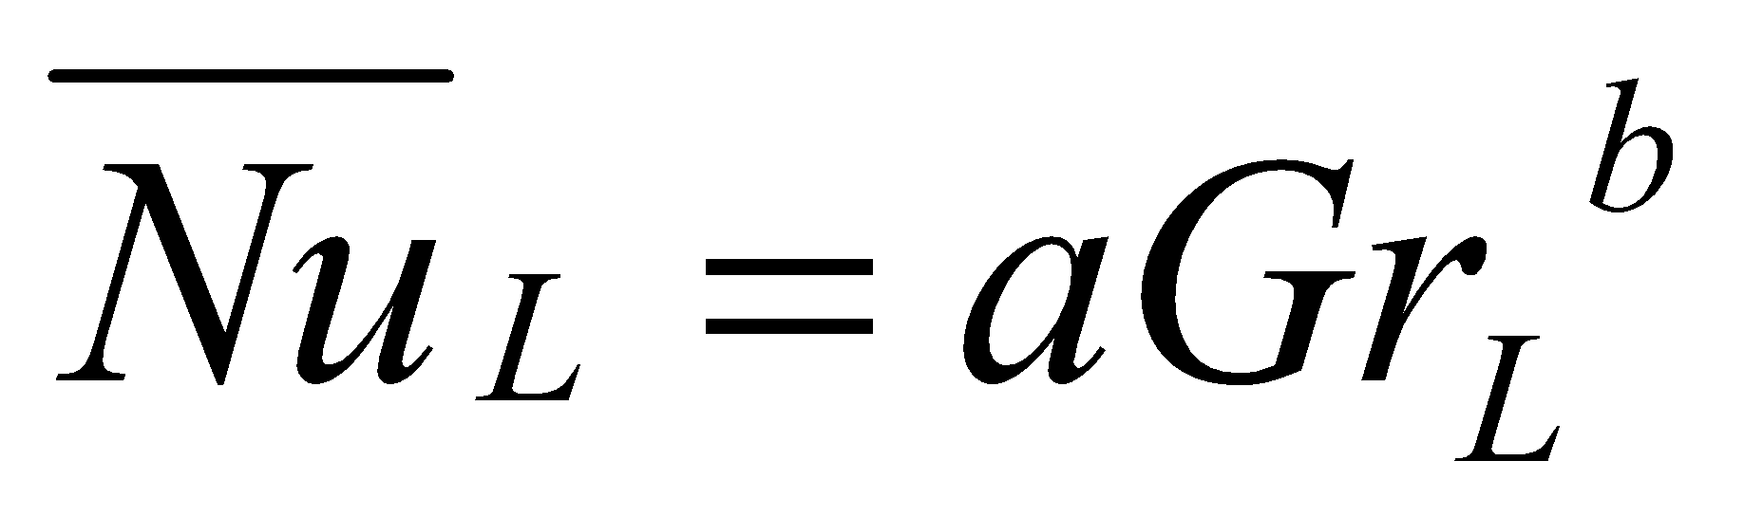
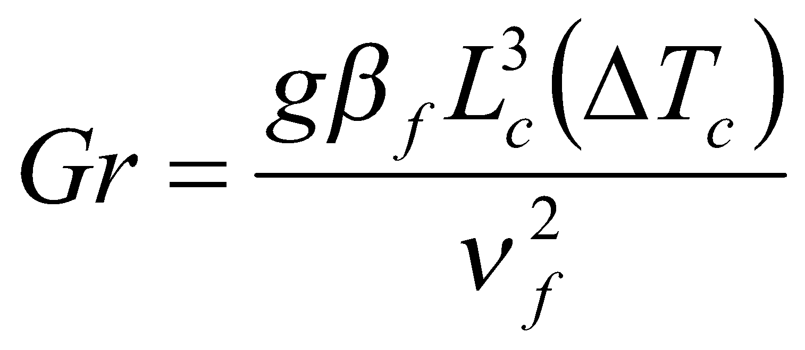
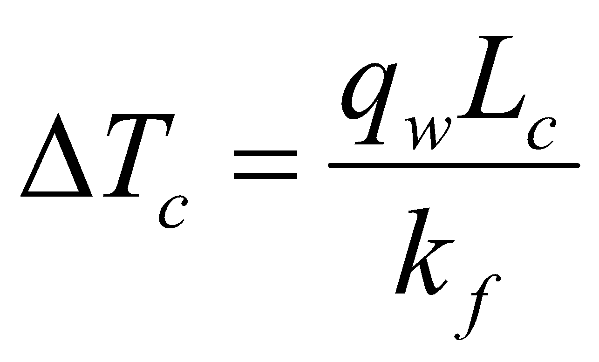
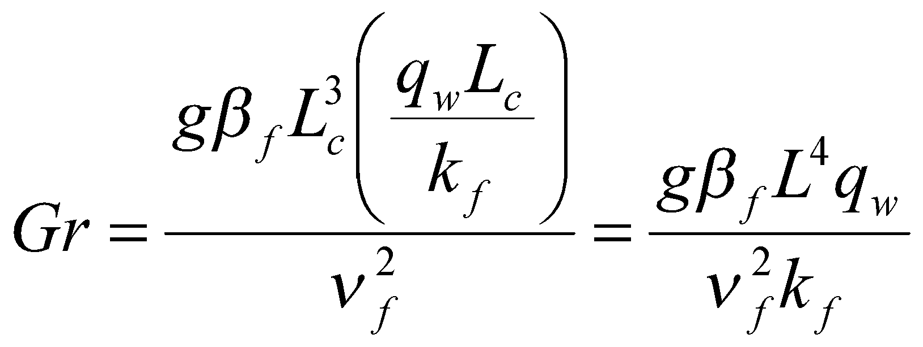
Background Theory
Comparison with correlations
For natural convection, convective heat transfer coefficient is expressed in terms of dimensionless parameters as
or in the form
( or a similar form in terms of Ra_{L})
For a given fluid, Pr is fixed and hence
Grashof number is defined in terms of a characteristic length scale L_{c} and a characteristic temperature scale ΔT_{c} as
For vertical plates and cylinders L_{c} = L ( length of plate/ cylinder)
For isoflux conditions, Hence

Slide 7
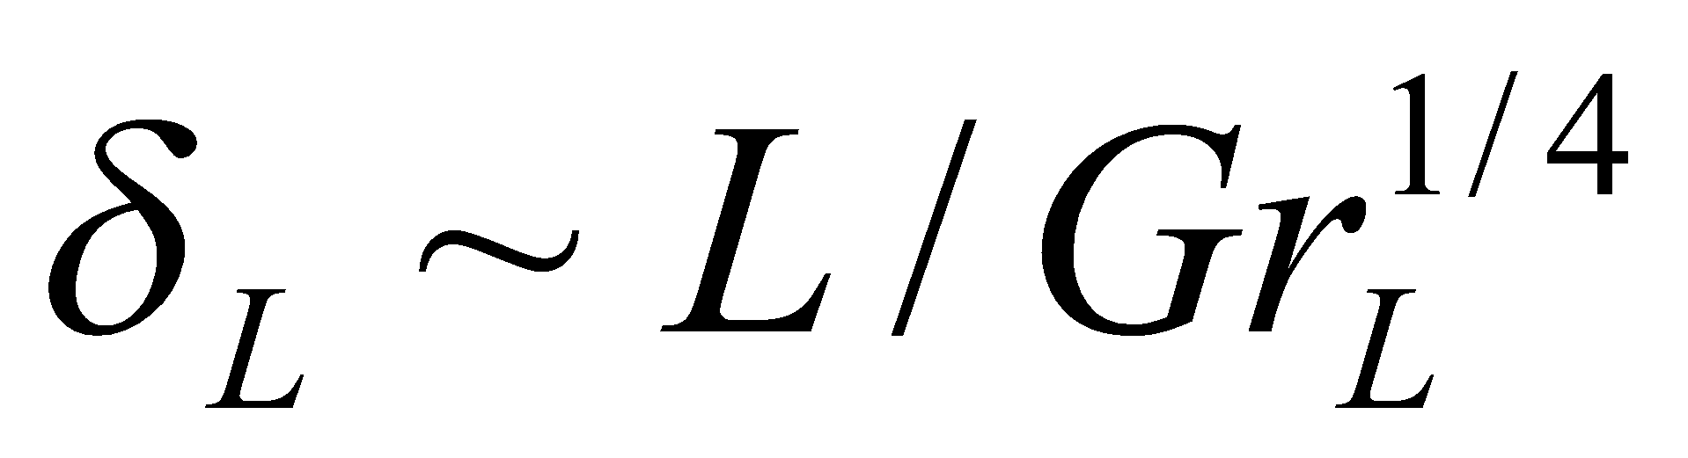
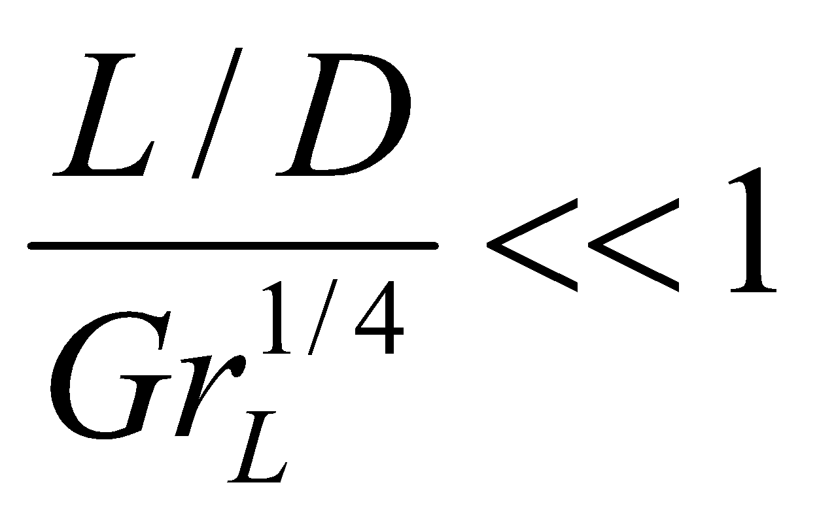
Background Theory
Theory
Schematic Diagram
For vertical cylinders with large radius, correlations for vertical plates can be used
For cylinders with small radius (slender cylinders), a correction factor is necessary
How to determine “smallness” of radius?
  By comparing boundary layer thickness (δ_{L}) (transverse length scale in gaseous medium) with radius (R) (transverse length scale of cylinder)
  Radius considered large if R>> δ_{L}
  Since cylinder radius can be considered large if

Slide 8
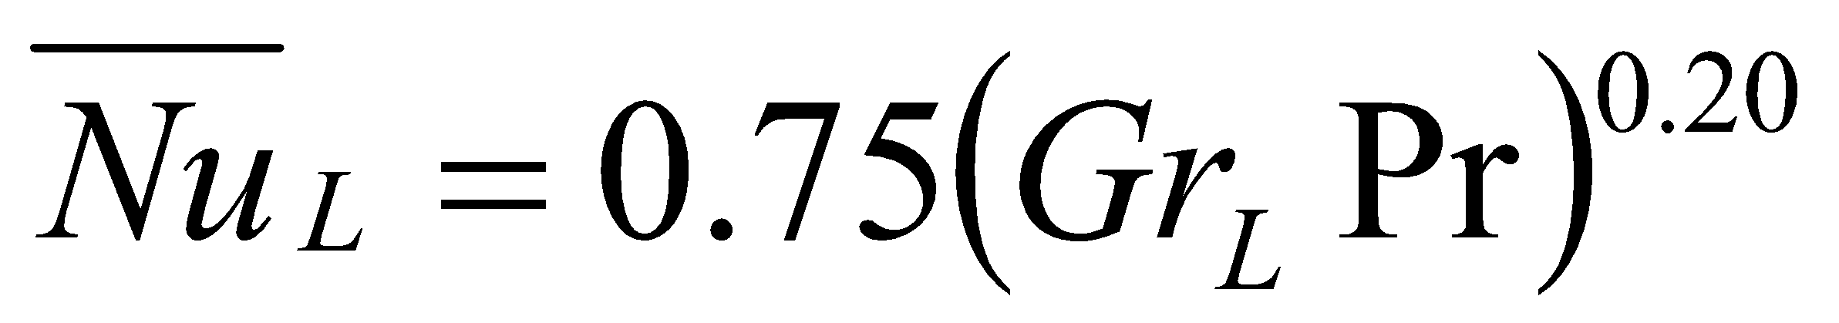
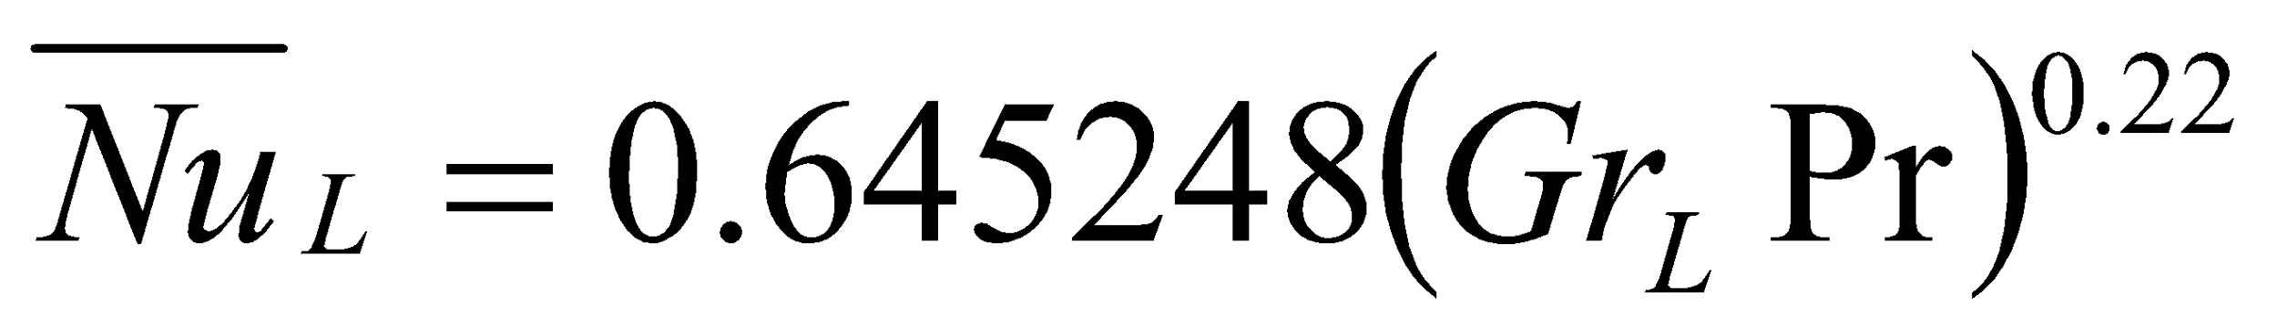
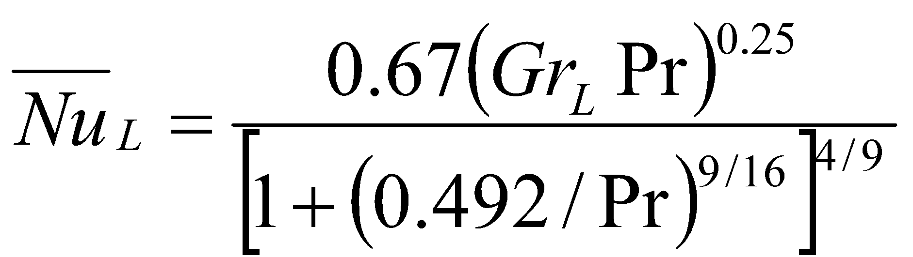
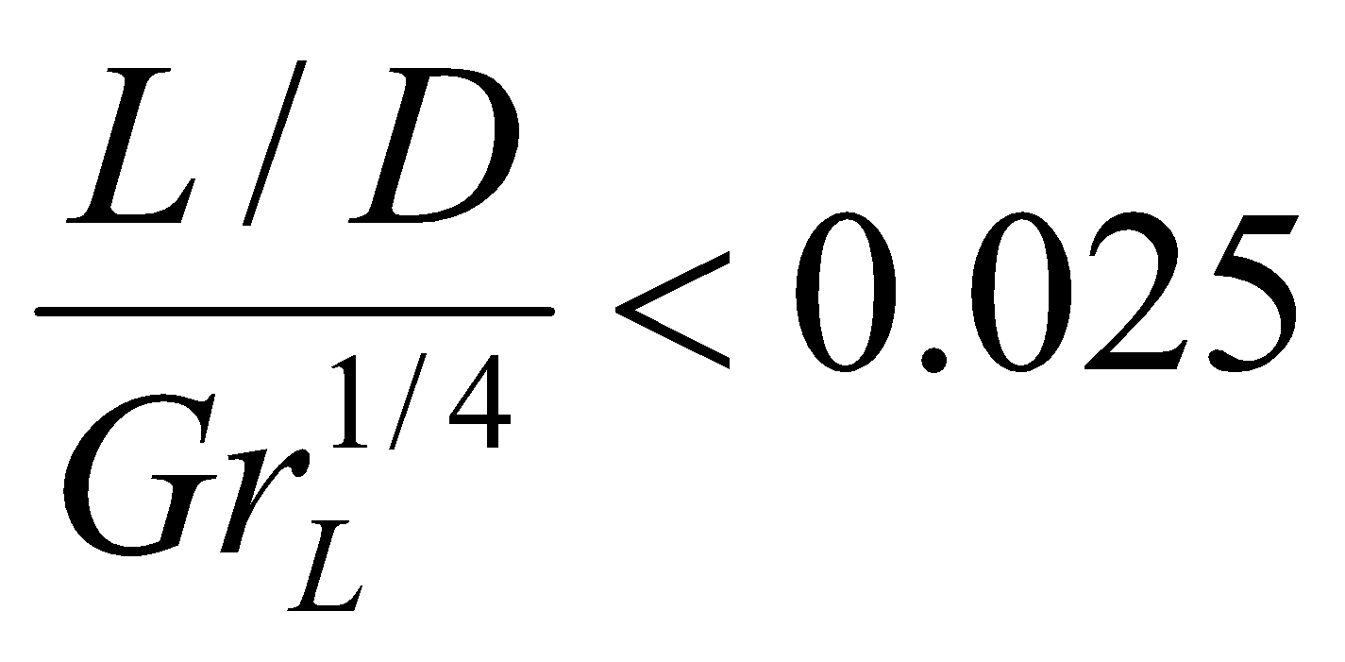
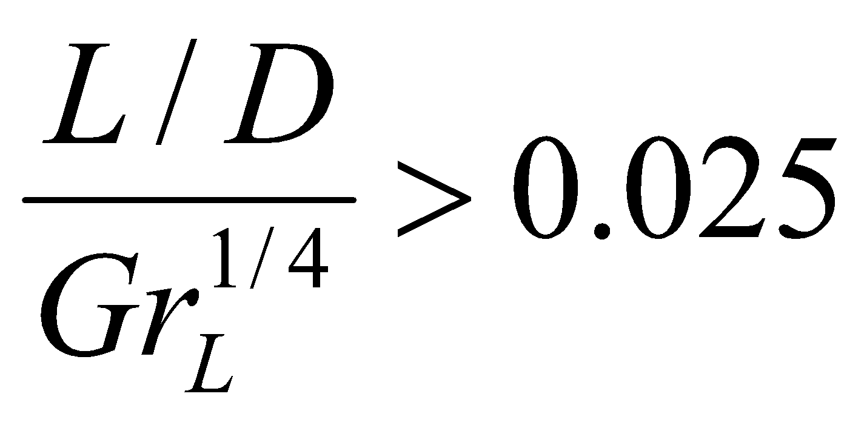
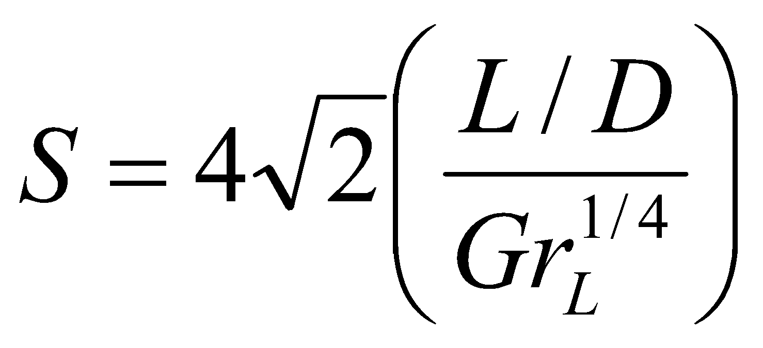
Background Theory
Correlations:
  Laminar Regime (10⁵≤Gr_{L}Pr≤10¹¹):
  Turbulent Regime (2×10¹³≤Gr_{L}Pr≤10¹⁶):
  Transition Regime:
  For fluids having Pr equal to 0.7 or higher, a vertical cylinder can be considered as a vertical flat plate if
  If calculate
  Determine correction factor ( ratio of Nusselt number for vetical cylinder to that of vertical flat plate) as a function of S

Slide 9
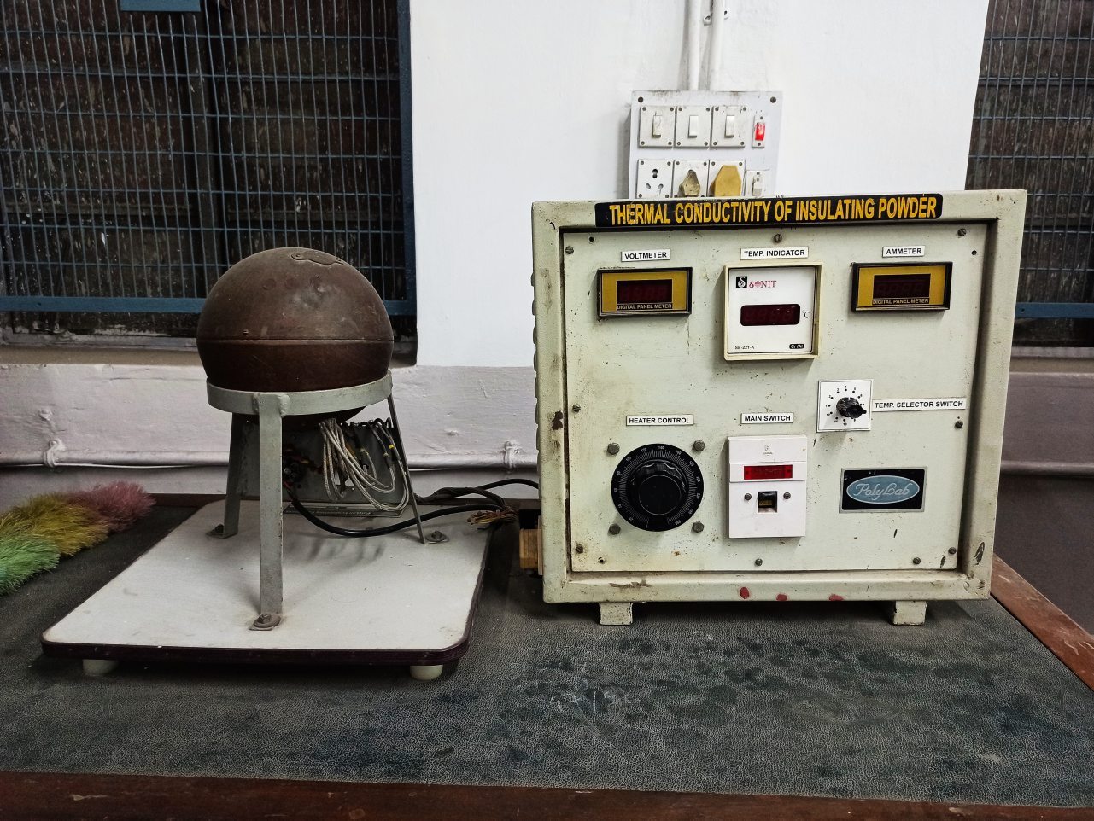
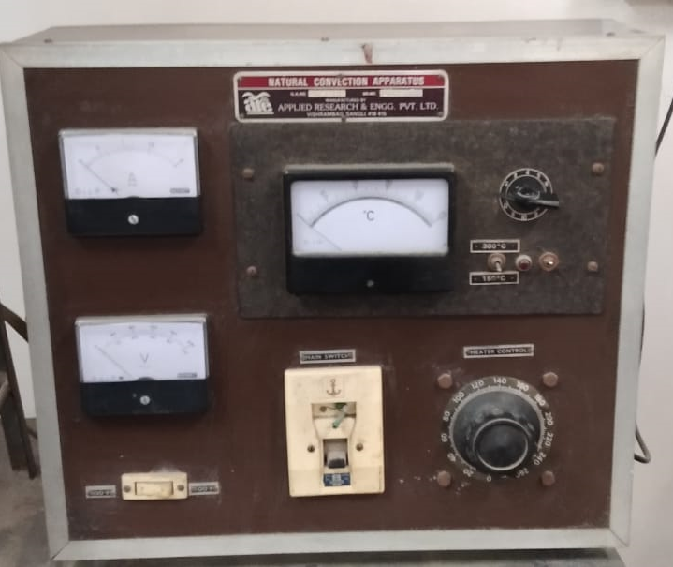
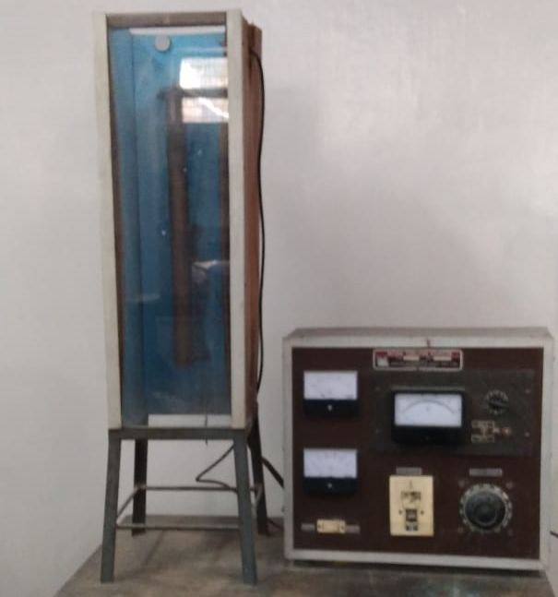
Experimental Setup
Selector Switch
Ammeter
Temperature Indicator
Voltmeter
Heater Control
Cylinder

Slide 10
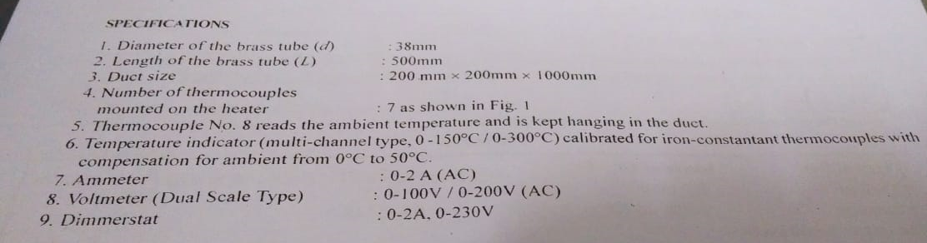
Specifications

Slide 11
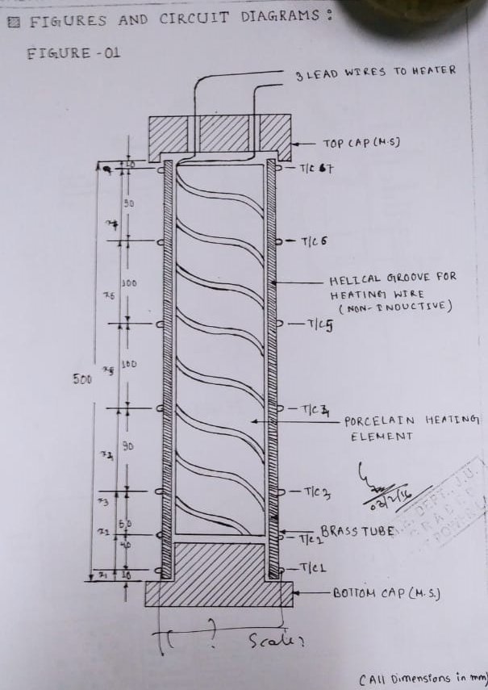
Cylinder Details

Slide 12
Procedure
Put on the supply and adjust the dimmerstat to obtain the required heat input (40 W, 60 W, 70 W)
Wait till the steady state is reached, which is confirmed from the steadiness of the fastest increasing temperature
Measure the temperatures T1 to T7
Note the ambient temperature
Repeat the experiment at different heat inputs not exceeding 80 W

Slide 13
Precautions
Put off all the fans in the room and ensure a quiescent atmosphere
Keep the dimmerstat at zero volt before putting on the main switch and increase the voltage slowly
Use the proper range of indicator and voltmeter to avoid error
Operate the changeover switch of the temperature indicator gently from one position to another
Never exceed 80 W

Slide 14
Observations
Run No. | Voltage | Current | Temperature (°C)
 | V | I | T₁ | T₂ | T₃ | T₄ | T₅ | T₆ | T₇ | T₈ =T∞

Slide 15
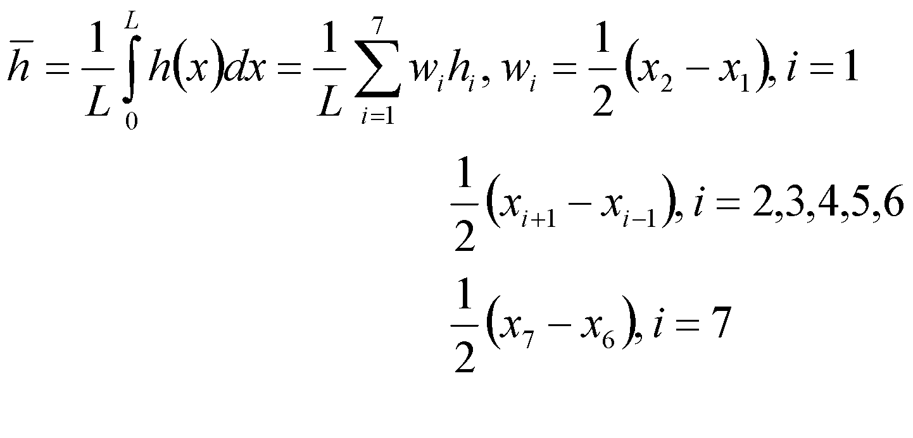
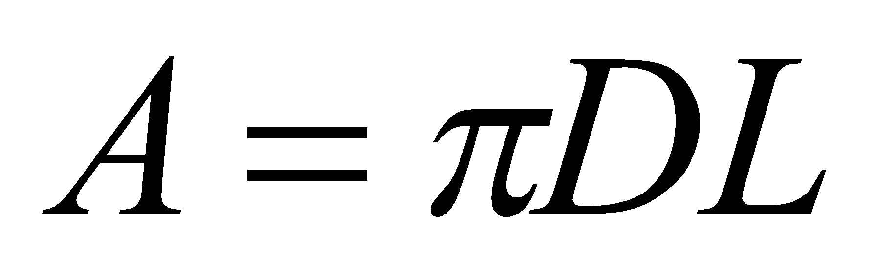
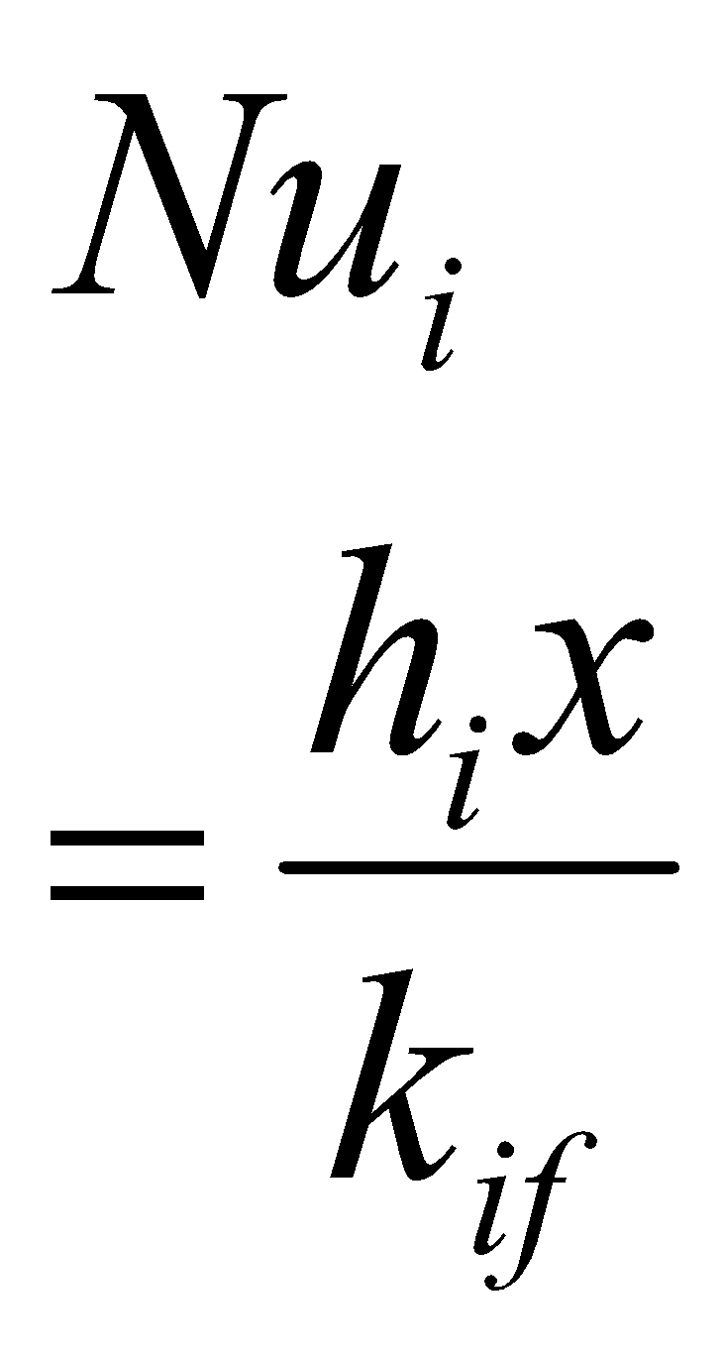
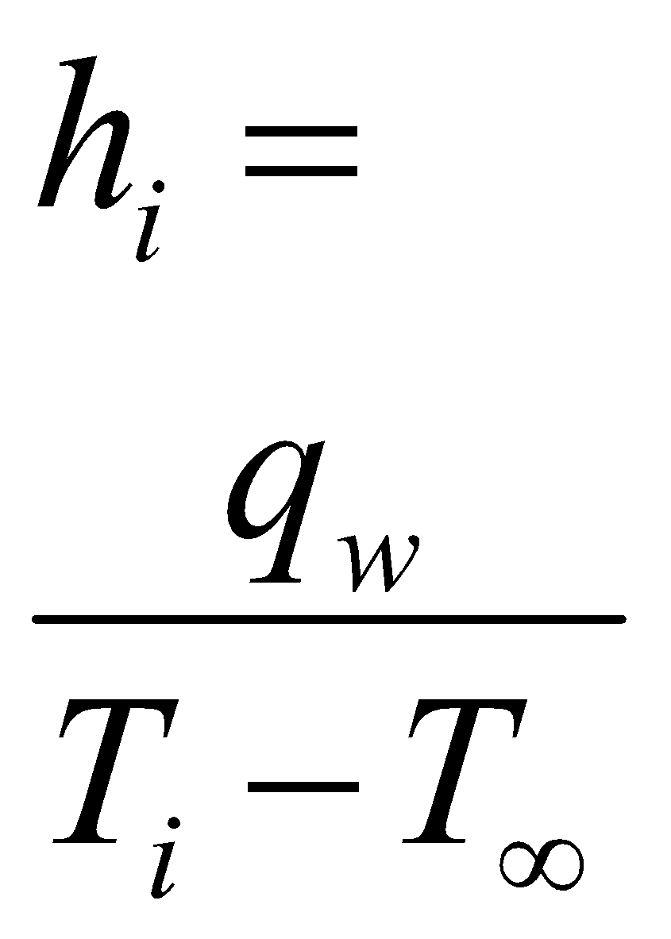
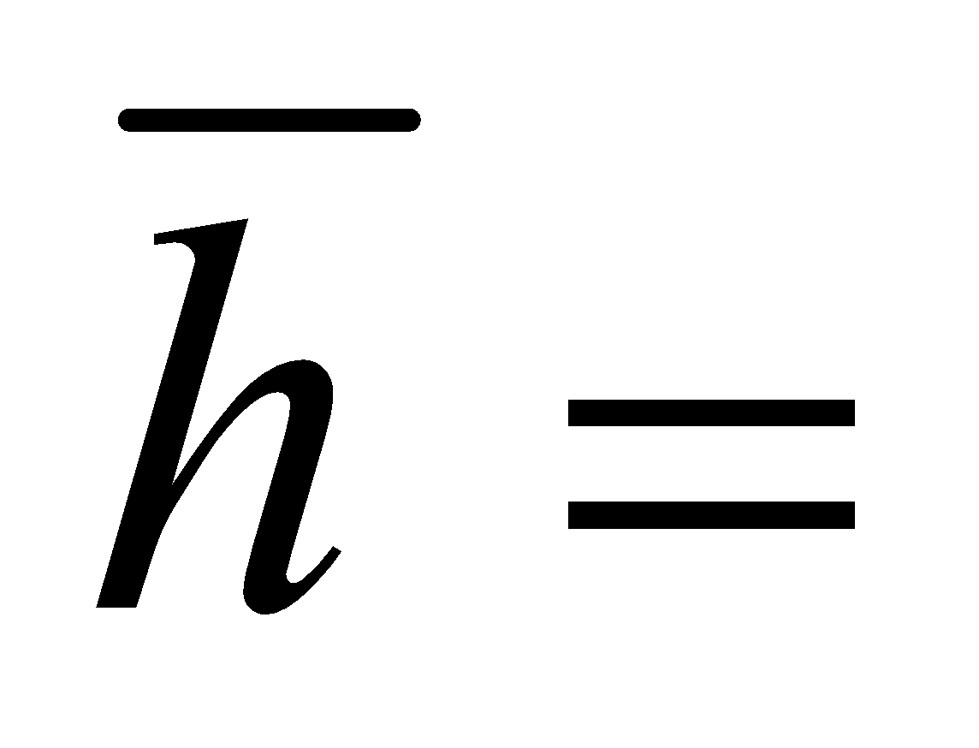
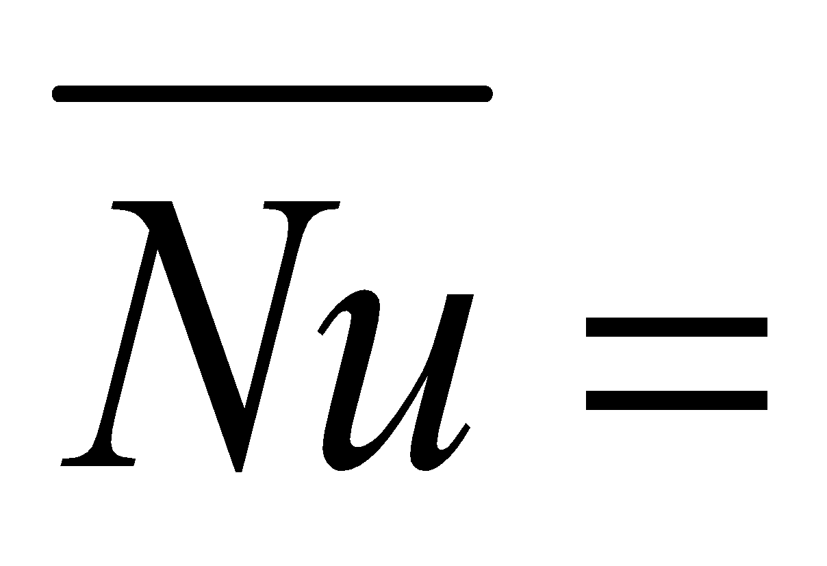
Calculations
Input to heater
Surface area of cylinder
Wall heat flux of heater
For each run:
Node (i) | x_{i} (m) | T_{i} (°C) |  | T_{if} = (T_{i} + T∞)/2 | k_{if}
1 | 0.01
2 | 0.05
3 | 0.10
4 | 0.20
5 | 0.30
6 | 0.40
7 | 0.49

Slide 16
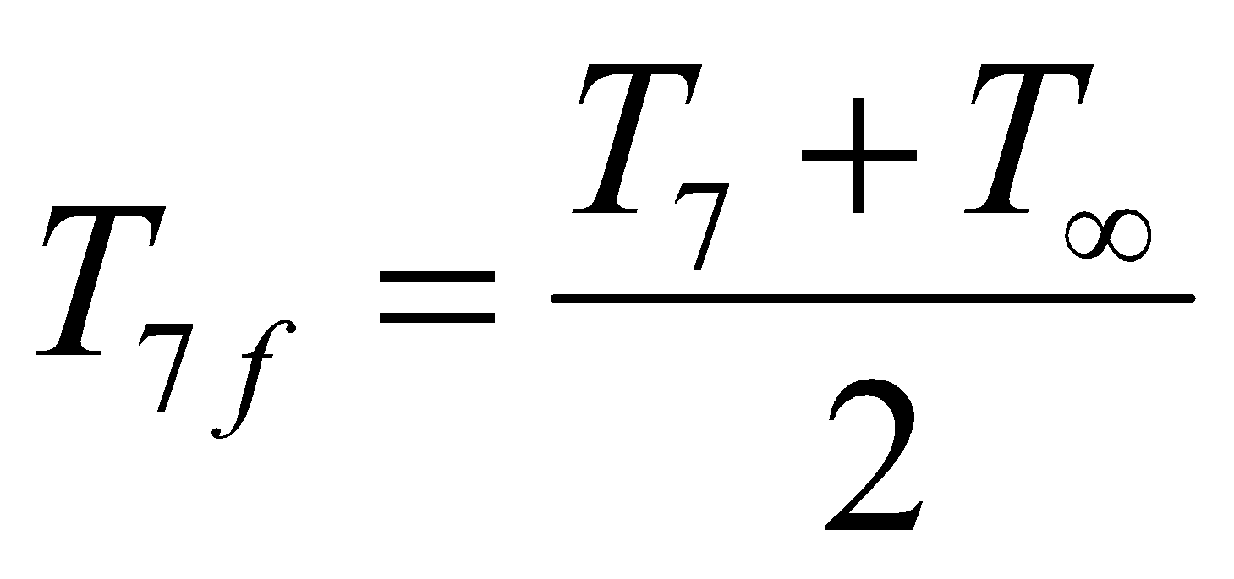
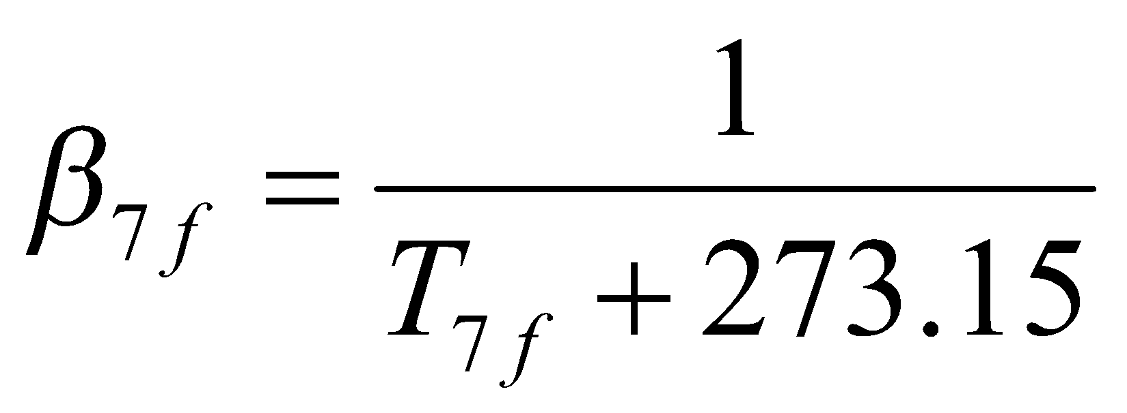
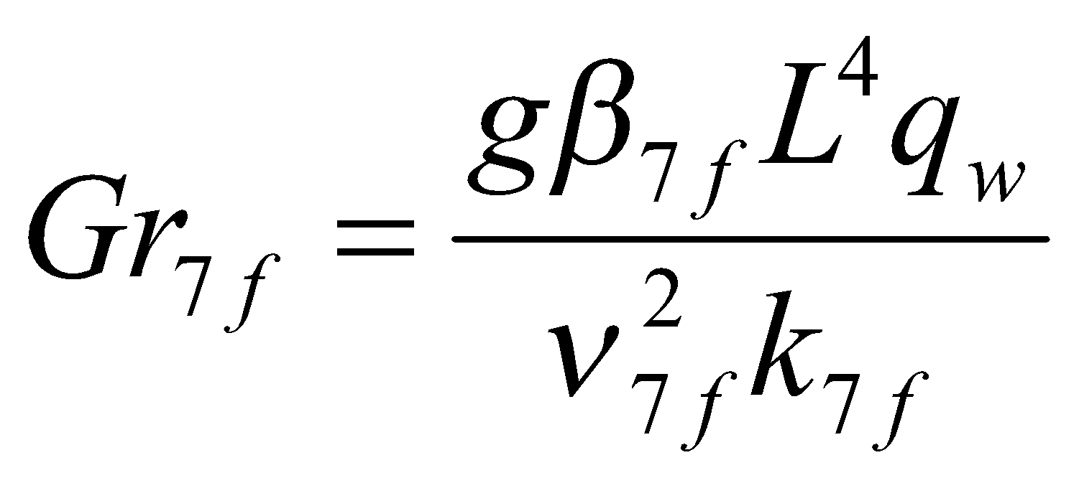
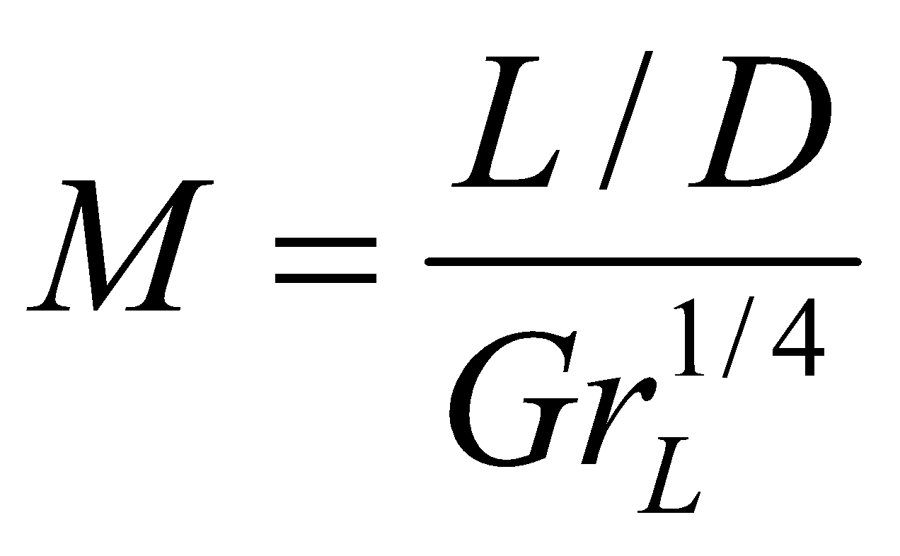
Calculations
Calculate
Calculate
Calculate all fluid properties at T_{7f}
Calculate
Estimate Nu from correlations
Compare Nu obtained from experiments with that obtained from correlations
Plot h(x) (on x-axis) vs. x (on y-axis)
Run No. |  | If M<0.025, calculate Nu from flat plate correlations | If M>0.025, calculate | Determine Nu with correction if M>0.025

Slide 17
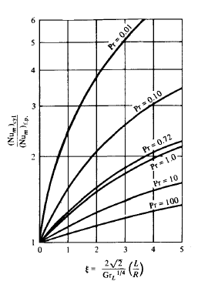
Correction for Slender Cylinder
Ref.: Heat Transfer: A Basic Approach, M. Necati Ozisik, McGraw Hill, 1985

