Slide 1
Determination of Thermal Conductivity of Insulating Powder
Heat Power Laboratory I (Thermodynamics and Heat Transfer)
ME II Sec A₃
2020-21 2nd Semester
Prof. Achintya Mukhopadhyay

Slide 2
Title:
Thermal Conductivity of an Insulating Powder
Objective:
To determine the thermal conductivity of an insulating powder (Asbestos powder)

Slide 3
Background Theory
Theory
Schematic Diagram
For 1-dimensional steady state heat transfer in spherical coordinate
At steady state, rate of heat transfer = rate of heat input from electrical heater where
Outer Sphere
(Radius: R₀; Temperature: T₀)
Electrical Heater
Inner Sphere
(Radius: R_{i}; Temperature: T_{i})
Insulating Powder

Slide 4
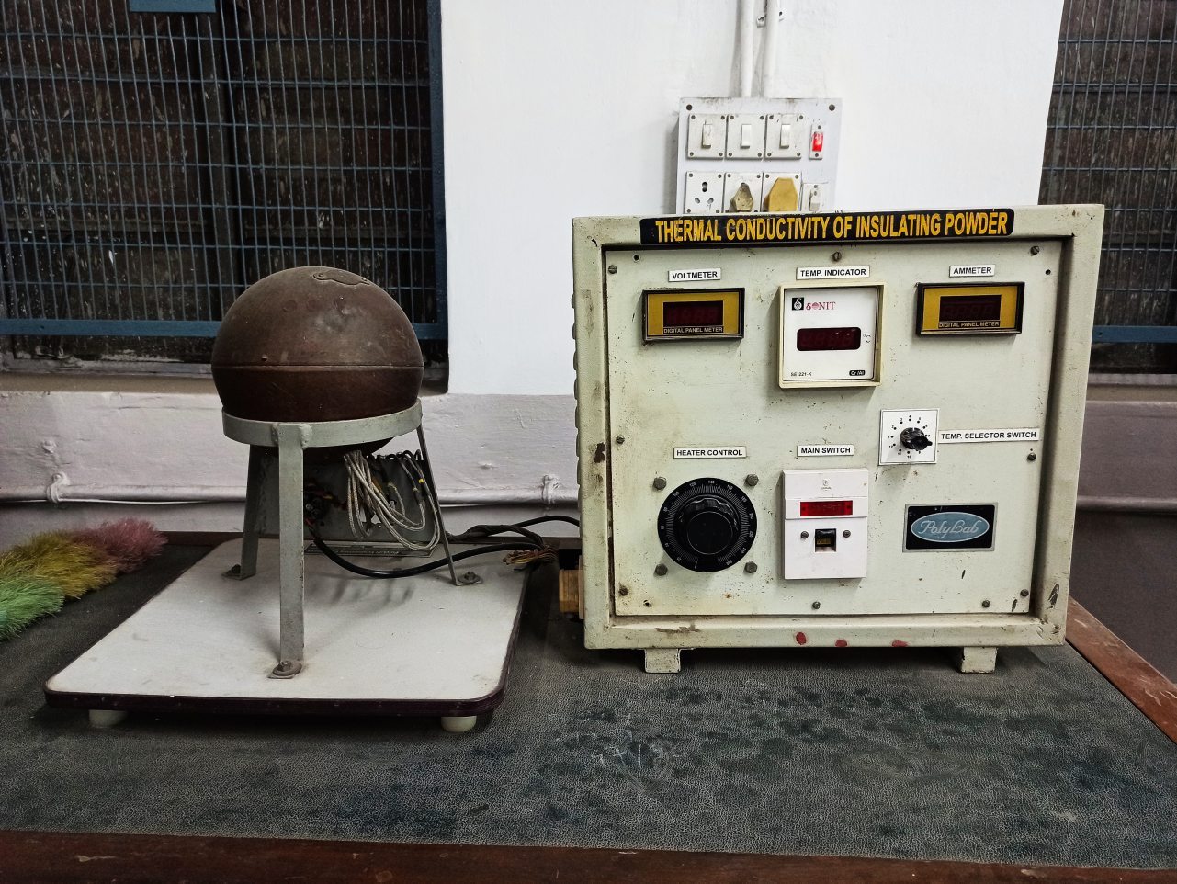


Experimental Setup
Voltmeter
Ammeter
Sphere
Temperature Indicator
Heater Control
Temperature Selector Switch

Slide 5
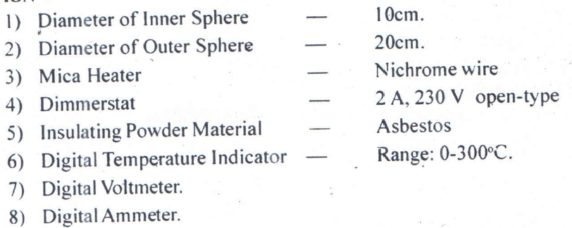
Specifications

Slide 6
Procedure
Put on the main switch
Apply input (power) by operating dimmerstat (Power should not exceed 40 W to prevent burnout)
Wait until a steady state condition is reached
Note down readings in observation table
Repeat the experiment for different heat input
After the experiment is over, put dimmerstat to zero position
Put off the main switch

Slide 7
Observations
Outer Sphere
(Temperatures: T₅ – T₁₀)
Electrical Heater
Inner Sphere
(Temperatures: T₁ – T₄)
Sl. No. | Vol-tage (V) | Cur-rent (A) | Inner Sphere Temp (°C) |  |  |  | Inner Sphere Temp (°C)
 |  |  | T₁ | T₂ | T₃ | T₄ | T₅ | T₆ | T₇ | T₈ | T₉ | T₁₀

Slide 8
Calculations
Average temperature for inner surface
Average temperature for outer surface
Heat Input
Thermal Conductivity
Experimental Observations
Given
Calculated

Slide 9
Results
Sl No. | Average temperature for inner surface (°C) | Average temperature for inner surface (°C) | Heat Input (W) | Thermal Conductivity (W/m-K)
Complete the tables
Show all the steps for one run as sample Calculations
Plot k as a function of T_{i}

