Slide 1
Heat Transfer in a Single Tube Cross Flow Heat Exchanger
Heat Power Laboratory I (Thermodynamics and Heat Transfer)
ME II Sec A₃
2020-21 2nd Semester
Prof. Achintya Mukhopadhyay

Slide 2
Title:
Heat Transfer in a Single Tube Cross Flow Heat Exchanger
Objective:
To determine the heat transfer coefficient in a single tube cross flow heat exchanger

Slide 3
Crossflow Heat Exchanger
Heat exchanger in which hot and cold fluids flow perpendicular to each other
Very often, hot fluid flows through a single or bundle of tubes while the cold fluid flows over the tubes
  Convective heat transfer due to flow over a heated cylinder
In the present experiment, the tube carrying hot fluid simulated by an electrically heated cylindrical tube
  Flow configuration similar to that of the pin fin experiment but objectives are different

Slide 4
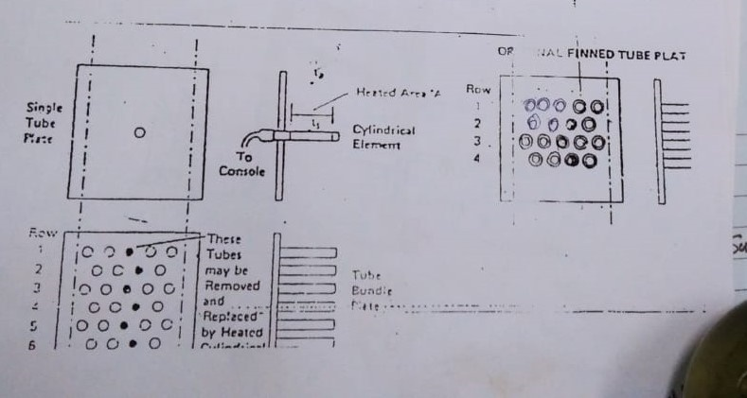
Crossflow Heat exchanger
Present setup can have crossflow over
  A single heated tube (active tube)
  An array of tubes (dummy tubes) around a single heated tube (active tube)
  Array of dummy tubes with multiple active tubes

Slide 5
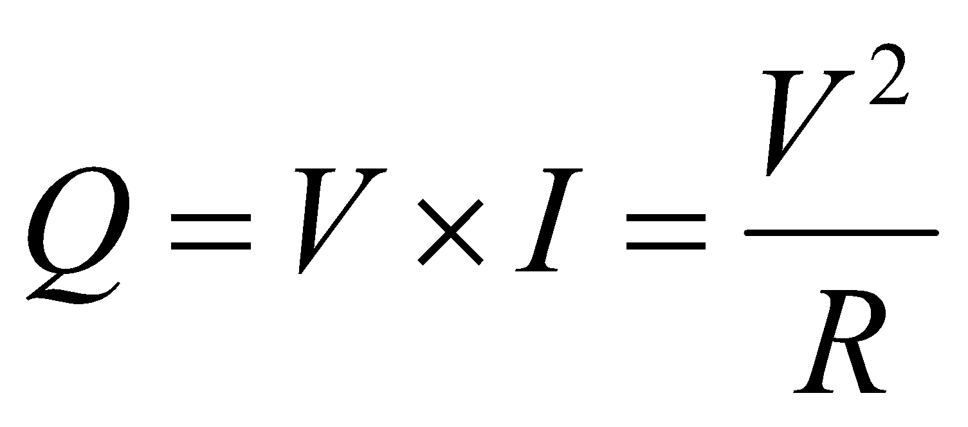
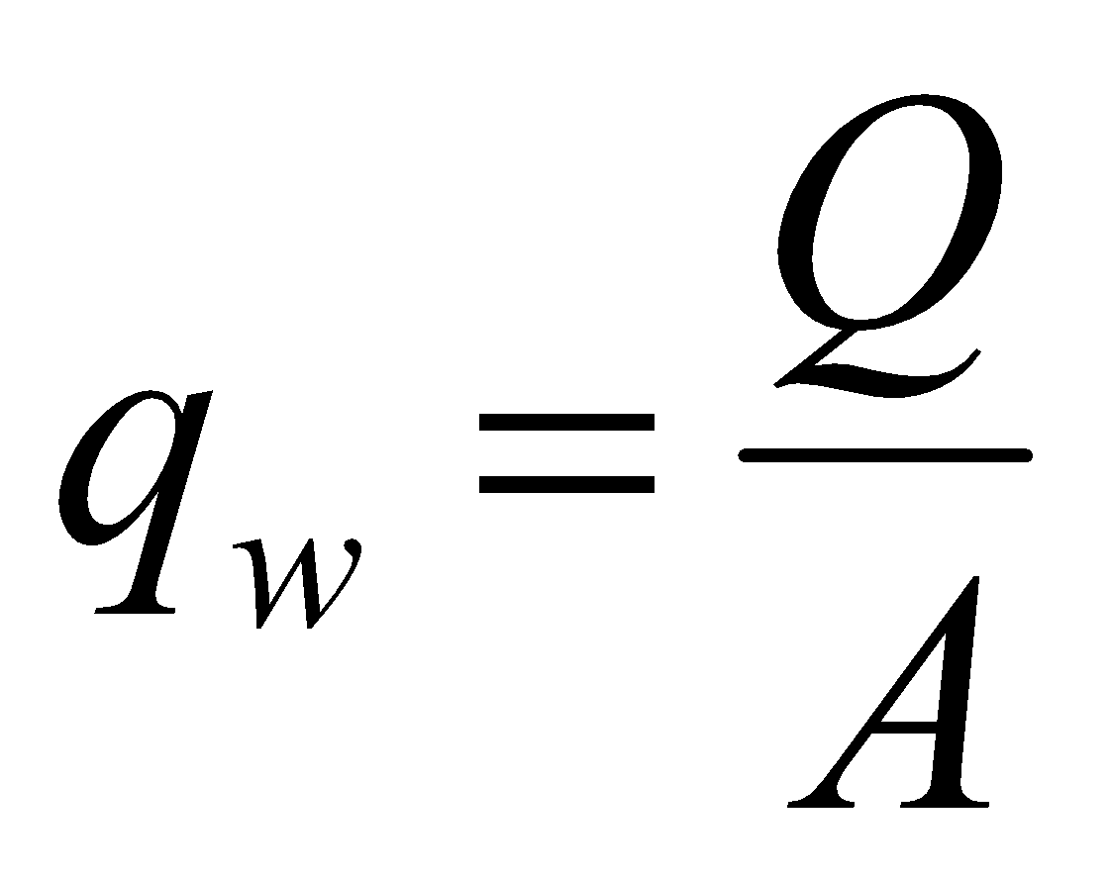
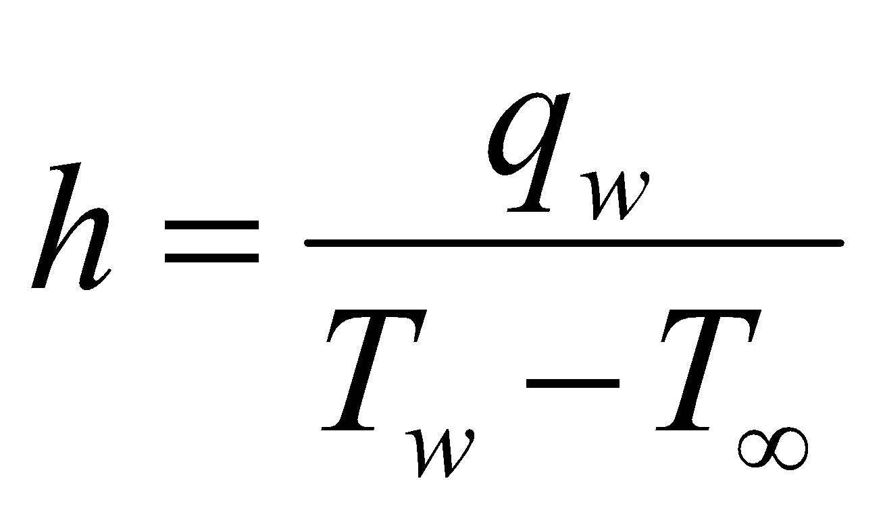
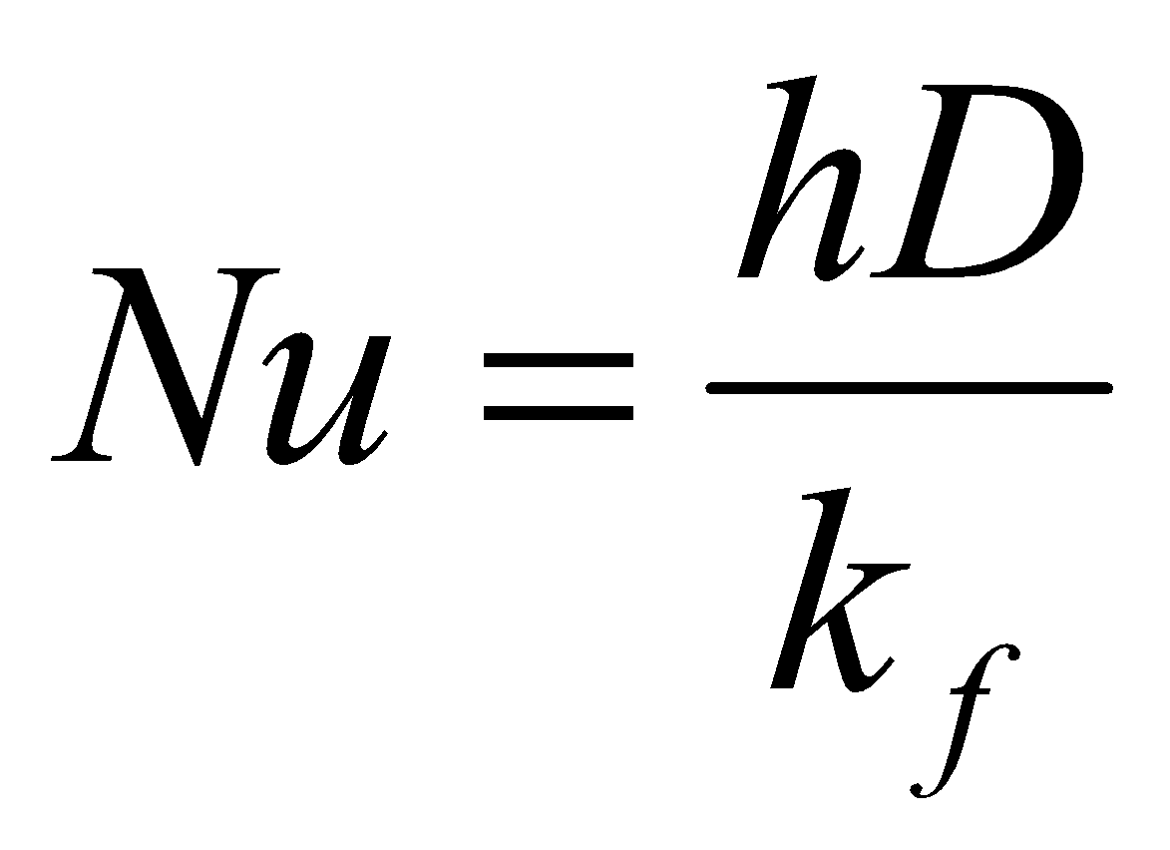
Background Theory
Theory
Schematic Diagram
For an electrically heated cylinder of diameter D and length L
  Total power input (V= voltage, I = current , R = resistance)
  Heat flux (constant)
  Heat transfer coefficient
  Nusselt number
T_{w}
T∞

Slide 6


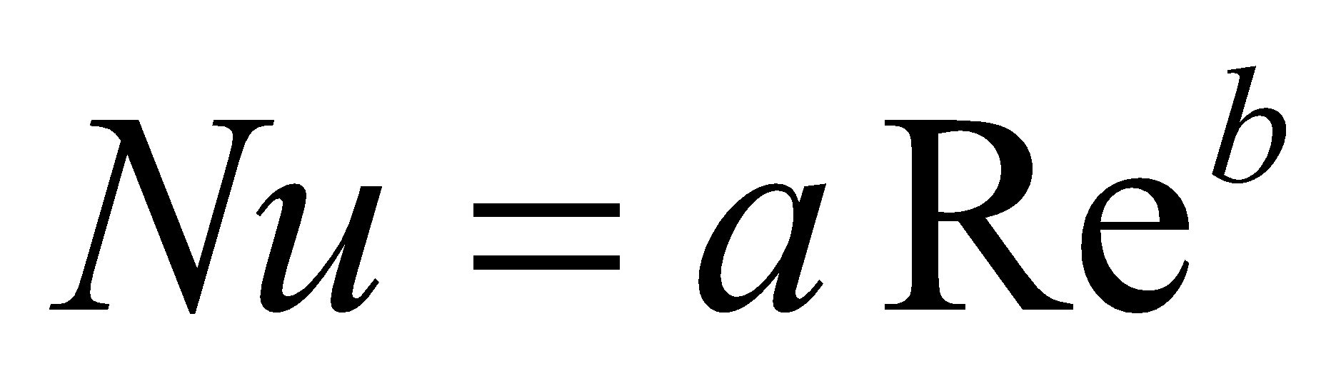
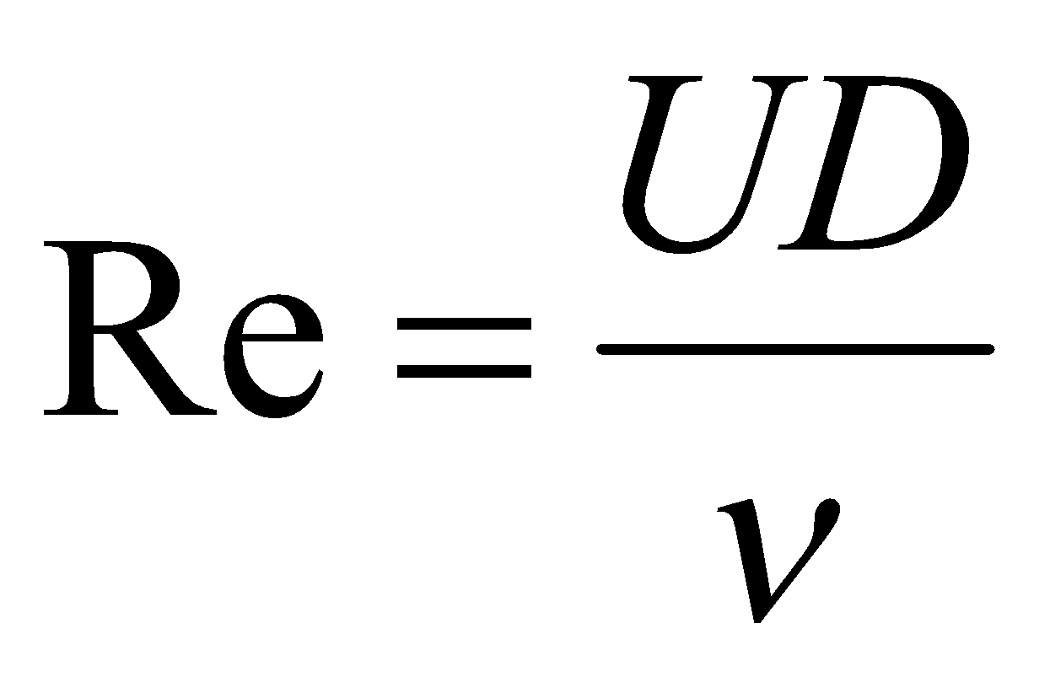
Background Theory
Comparison with correlations
For forced convection, convective heat transfer coefficient is expressed in terms of dimensionless parameters as
in the form
For a given fluid, Pr is fixed and hence
Reynolds number is defined as
How to obtain duct air velocity?

Slide 7
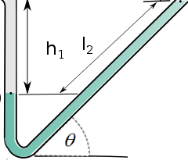
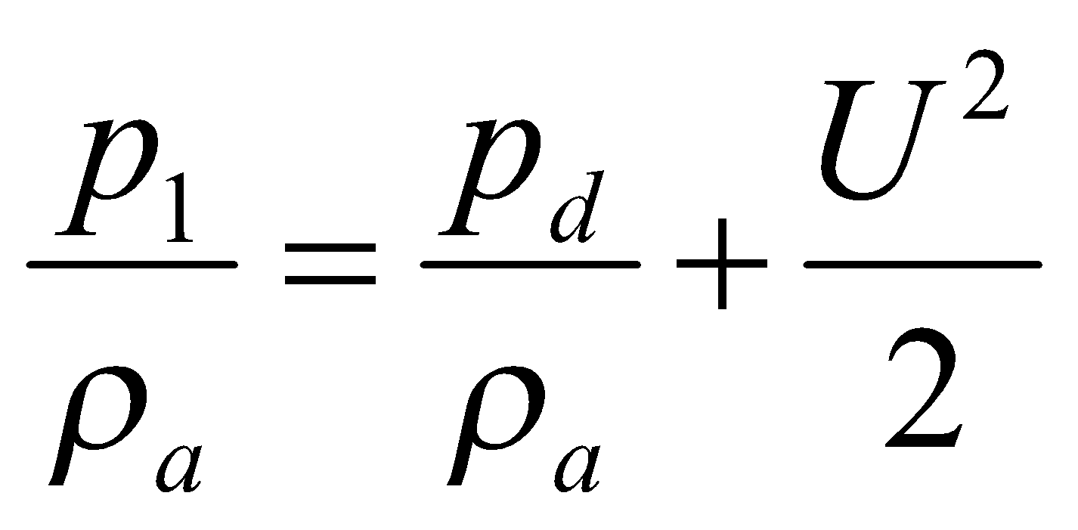
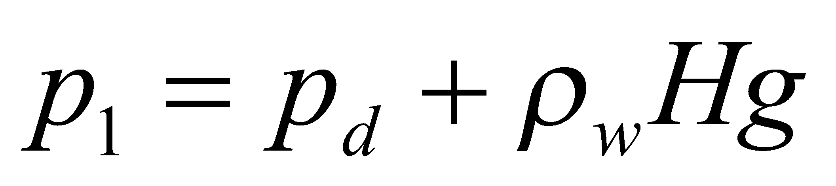
Background Theory
Theory
Schematic Diagram
Duct air velocity obtained using manometer
Inclined tube manometer used to increase the sensitivity
One limb of the manometer connected to the duct while the other end open to atmosphere
Applying Bernoulli’s equation between inlet to duct and point of pressure tapping,
Again, for the manometer
Combining
Open to atmosphere
Connected to duct
d
H
1
Inclined Tube Manometer
https://en.wikiversity.org/wiki/File:Inclined_manometer_tube_renew_02.svg

Slide 8
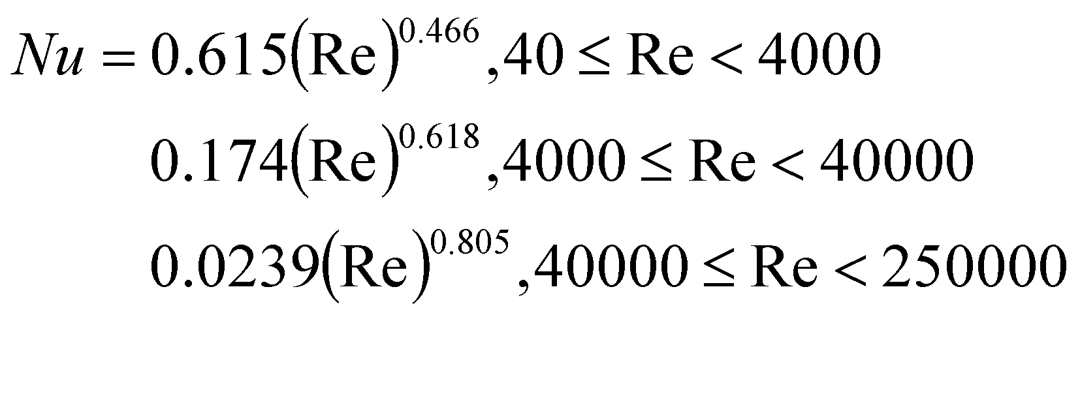
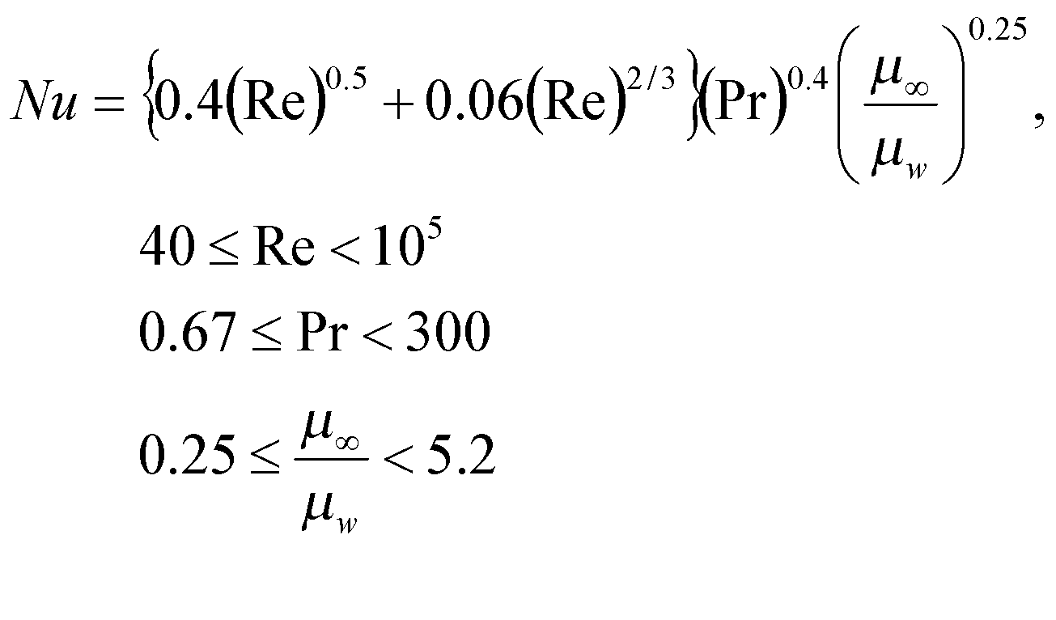
Background Theory
To be compared with two correlations
Correlation 1
Correlation 2

Slide 9
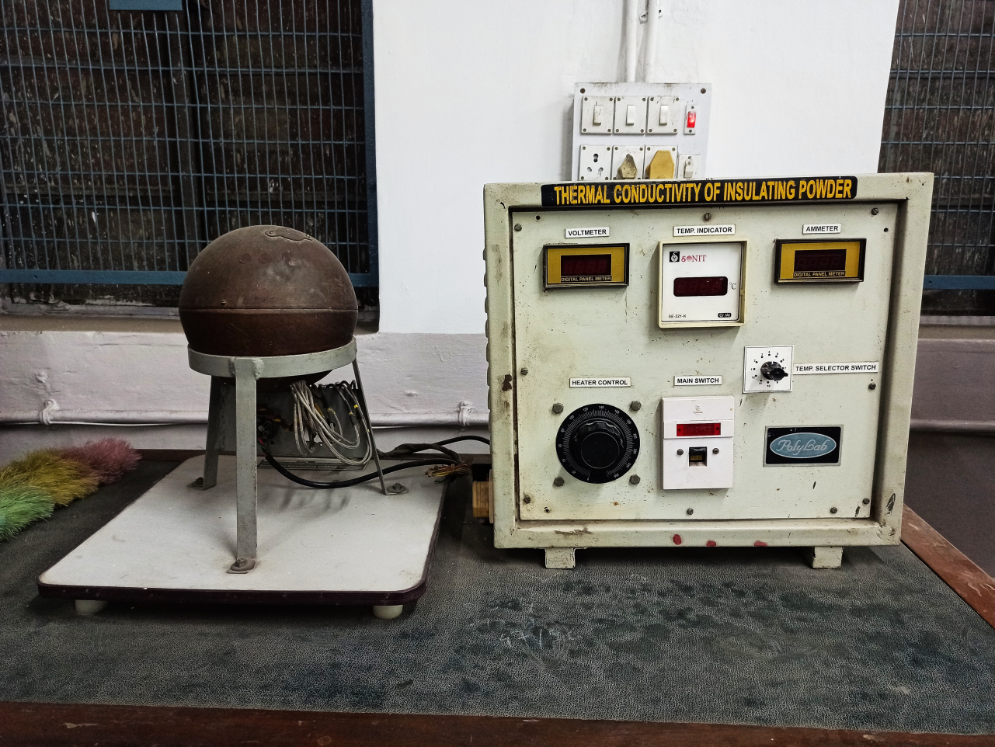
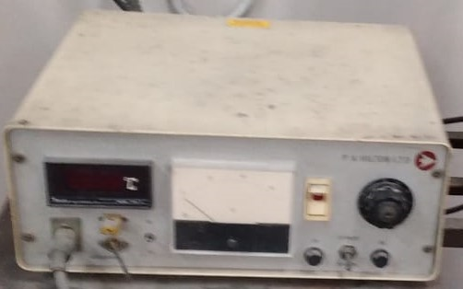
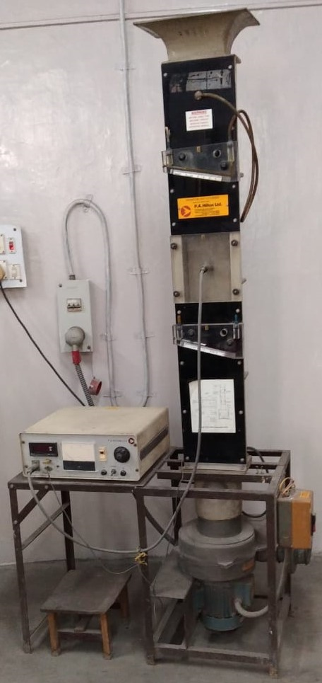
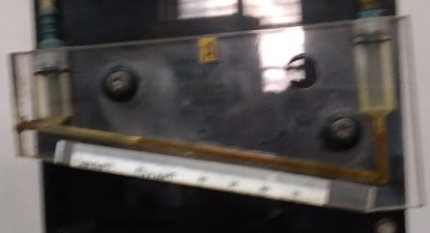
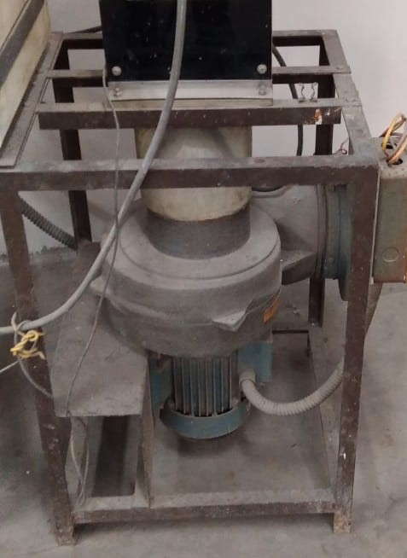
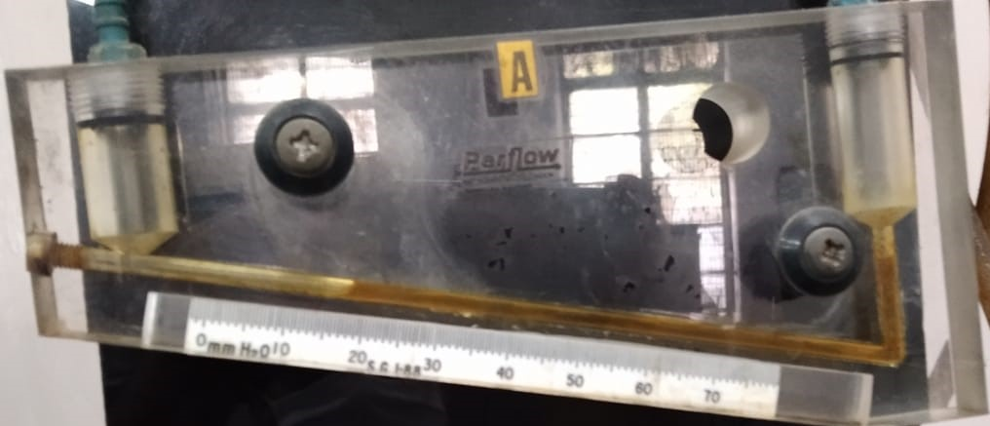
Experimental Setup
Temperature Indicator
Inclined Tube Manometer (Lower Range)
Heater Control
Voltmeter
Control Unit
Heated Element
Cylinder
Inclined Tube Manometer (Higher Range)
Blower

Slide 10
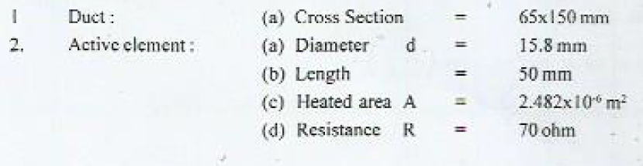
Specifications

Slide 11
Procedure
Put the active element in position and connect it to the console. Connect the pressure tapping to manometer A.
Start the fan keeping the damper at minimum opening to reduce the starting load on the motor
Set the variac at zero position and switch the console on
Increase voltage supply to the heater element through the variac. Adjust the variac position (voltage) to achieve a steady mean surface temperature of the active element at a predetermined temperature (e.g., 95°C)
Take the readings for T_{w}, V and H
Press the bias switch (maximum for 15 s) to take the reading for T∞
Increase the damper opening to repeat the same operation

Slide 12
Observations
Run No | Active Element Temperature (T_{w})°C | Duct Air Temperature (Ta) | Manometer Depression H (mm water) | Voltage Reading V (volts)

Slide 13
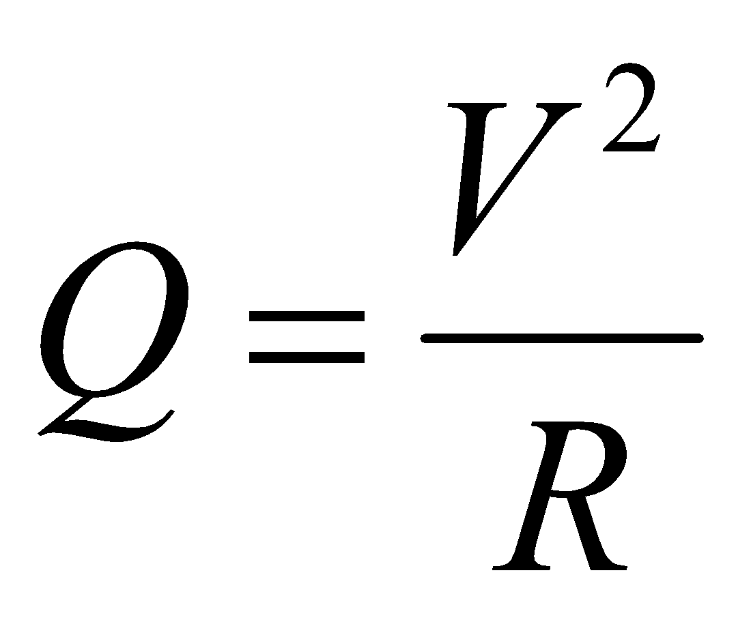
Calculations
Input to heater
Wall heat flux of heater
For each run:
Run No | Active Element Temperature (T_{w})°C | Duct Air Temperature (Ta) | Manometer Depression H (mm water) | Voltage Reading V (volts) | Heat Flux q (W/m²) | Heat Transfer Coefficient h (W/m²K) | Duct Air Velocity U (m/s) | Reynolds number Re∞ at T∞ | Reynolds number Re_{f} at T_{f} | Nusselt number Nu | Nusselt number from correlation Nu₁ | Nusselt number from second correlation Nu₂

