Slide 1
Image Segmentation

Slide 2

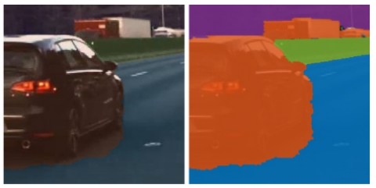
Chapter 10
Image Segmentation

Slide 3
Contents
Fundamentals
Point, Line, and Edge Detection
Thresholding
Region based Segmentation
Segmentation using Morphological Watersheds
Use of Motion in Segmentation

Slide 4
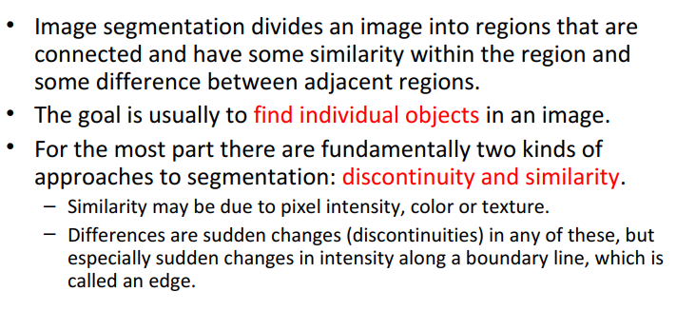
Image Segmentation

Slide 5
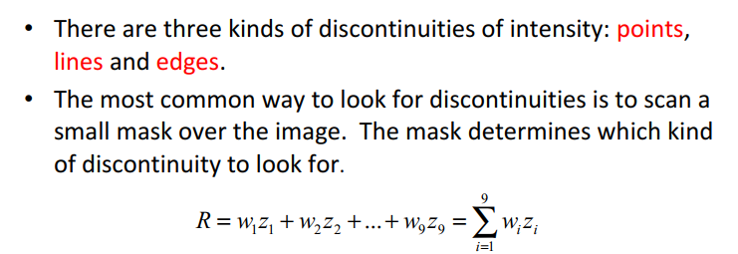
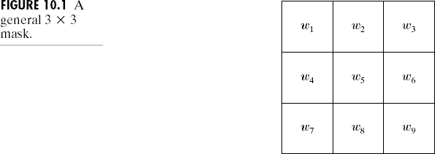
Detection of Discontinuities
9

Slide 6
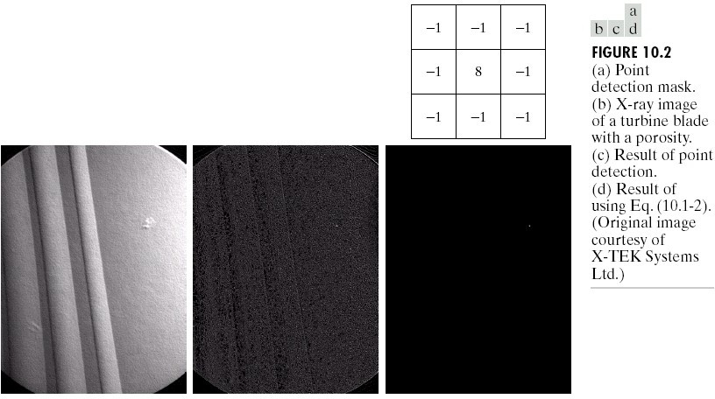
Detection of Discontinuities: Point Detection
R ≥ T
Where T : a non-negative threshold

Slide 7
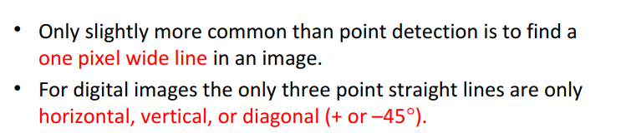
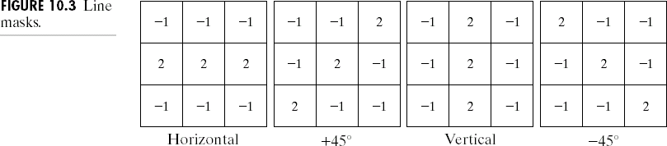
Detection of Discontinuities: Line Detection

Slide 8
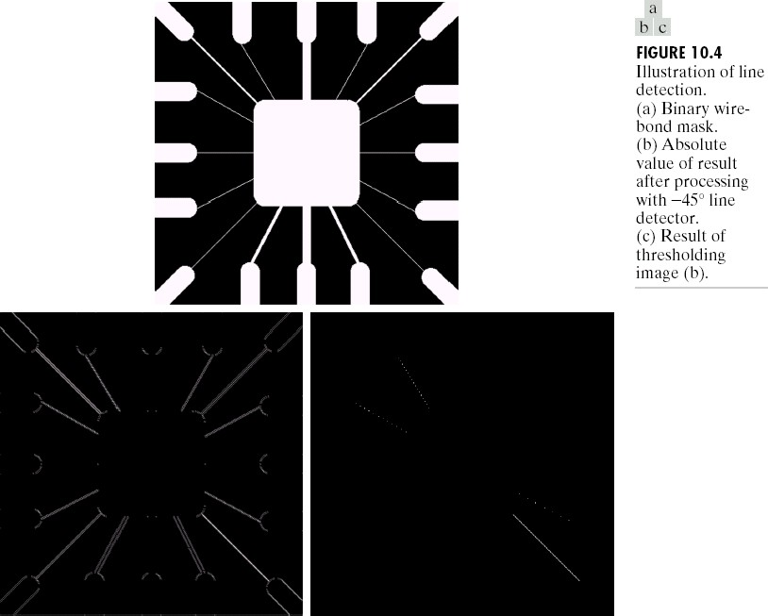
Detection of Discontinuities: Line Detection

Slide 9
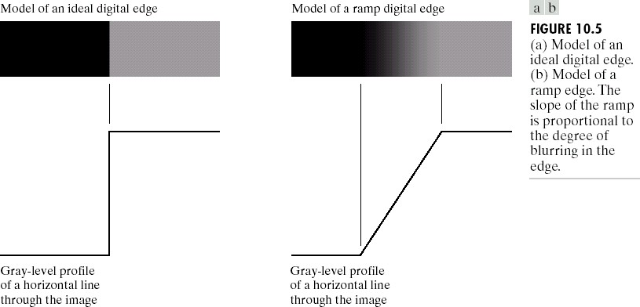
Detection of Discontinuities: Edge Detection

Slide 10

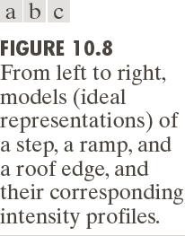
Detection of Discontinuities: Edge Detection

Slide 11
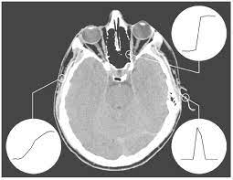
Detection of Discontinuities: Edge Detection
A 1508x1970 image showing actual ramp
(bottom left), step (top right) and roof edge profiles.
The profile are from dark to light, in the areas indicated by short lines shown in the small circles.
The ramp and srep profiles span 9 pixels and 2 pixels.
(Image by Dr. David R Pickens, Vanderbilt University)

Slide 12
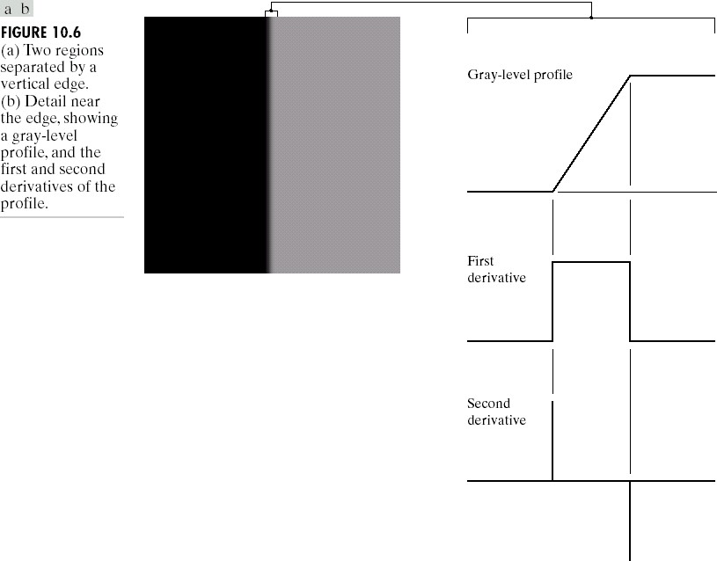
Detection of Discontinuities Edge Detection

Slide 13
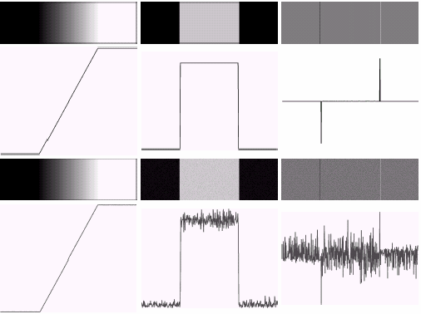

Detection of Discontinuities Edge Detection

Slide 14
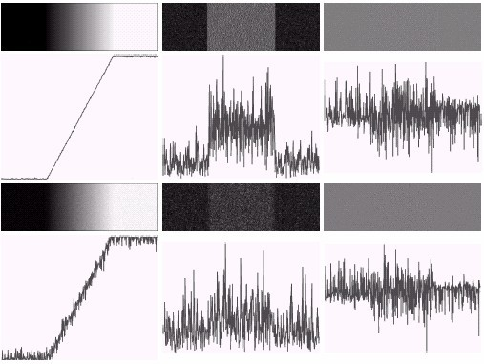
Detection of Discontinuities Edge Detection

Slide 15
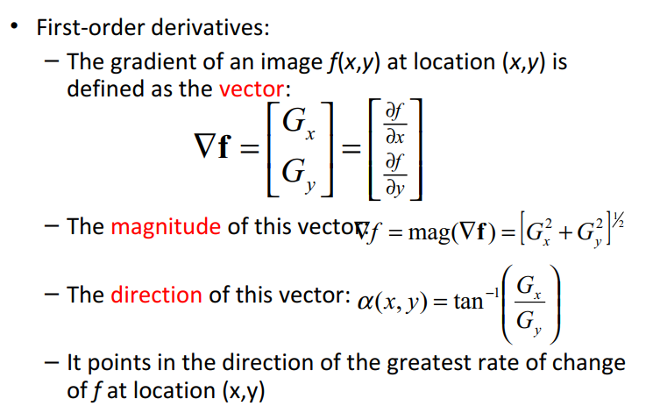
Detection of Discontinuities Gradient Operators

Slide 16
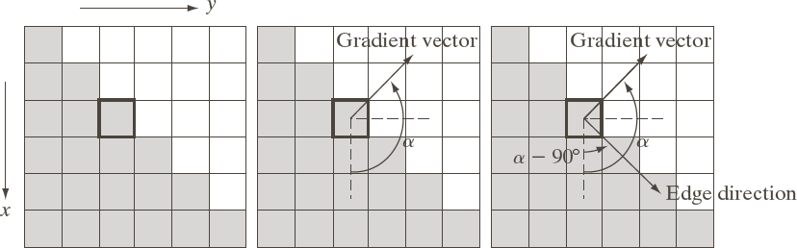

Detection of Discontinuities Gradient Operators

Slide 17
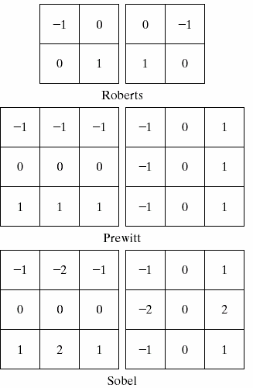
Detection of Discontinuities Gradient Operators
Roberts cross-gradient operators
Prewitt operators
Sobel operators

Slide 18
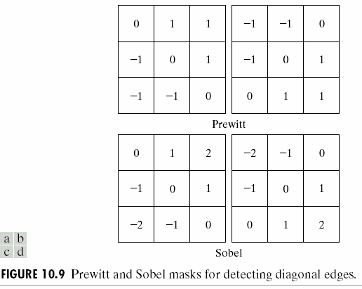
Detection of Discontinuities Gradient Operators
Prewitt masks for detecting diagonal edges
Sobel masks for detecting diagonal edges

Slide 19
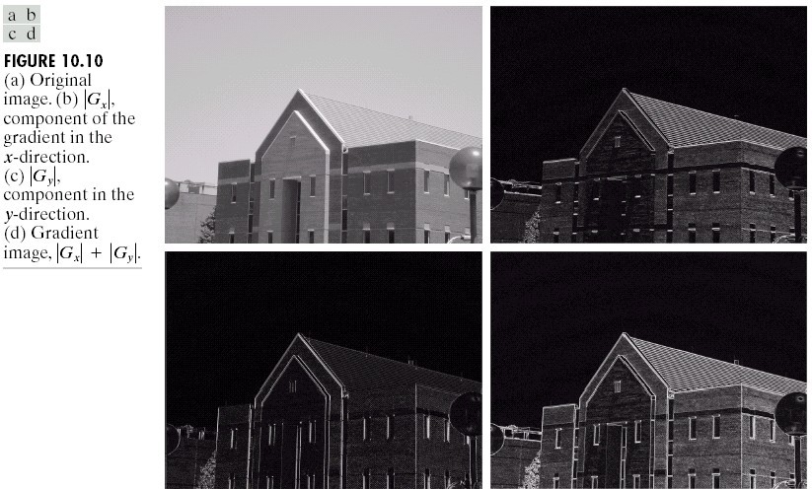
Detection of Discontinuities Gradient Operators:
Example
∇f ≈ G_{x} + G_{y}

Slide 20
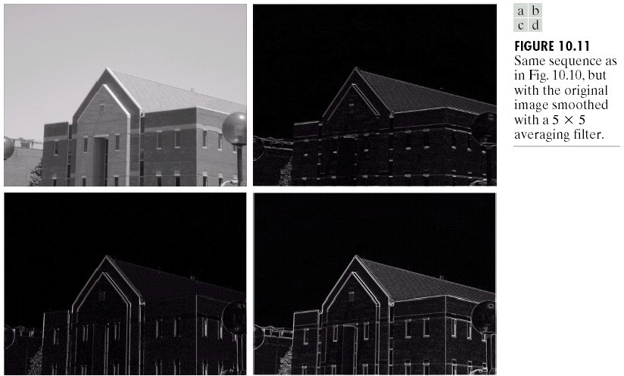
Detection of Discontinuities Gradient Operators:
Example

Slide 21
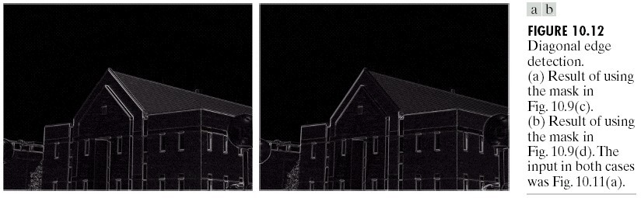
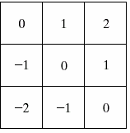
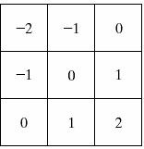
Detection of Discontinuities Gradient Operators:
Example

Slide 22
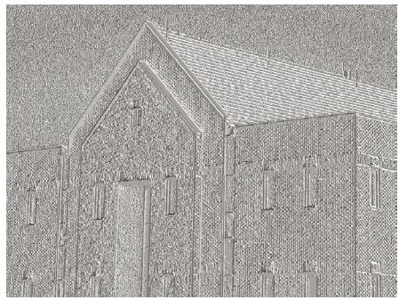
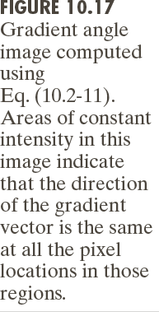
Detection of Discontinuities Gradient Operators:
Example

Slide 23
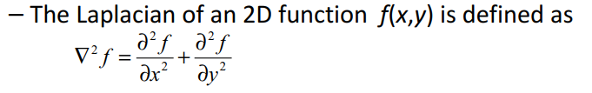
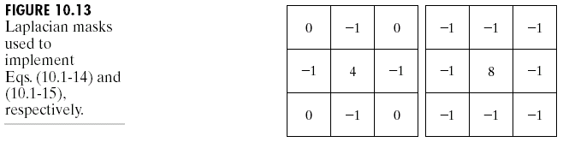
Detection of Discontinuities Gradient Operators
Second-order derivatives: (The Laplacian)
•
– Two forms in practice:

Slide 24
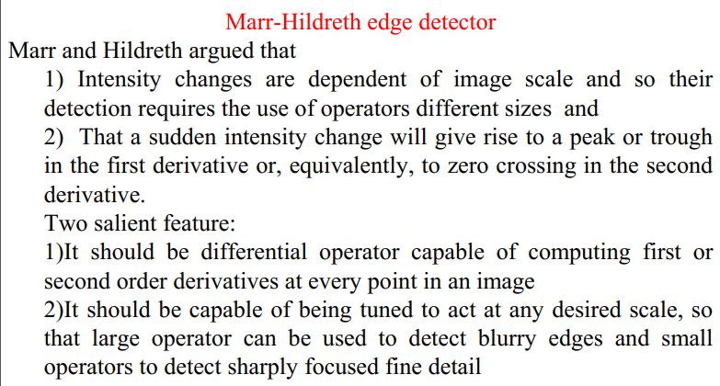
More Advanced Techniques for Edge Detection

Slide 25
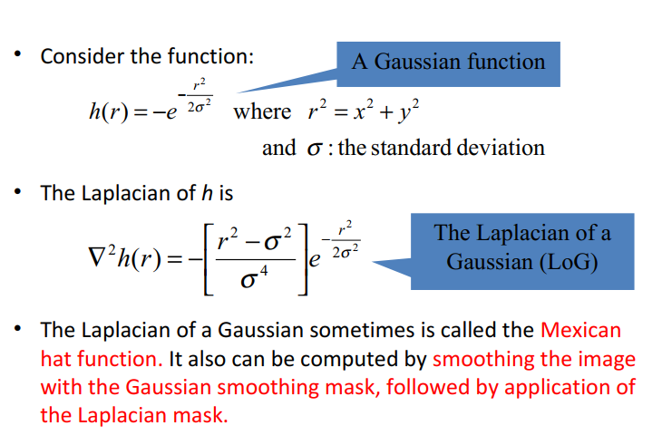
More Advanced Techniques for Edge Detection

Slide 26
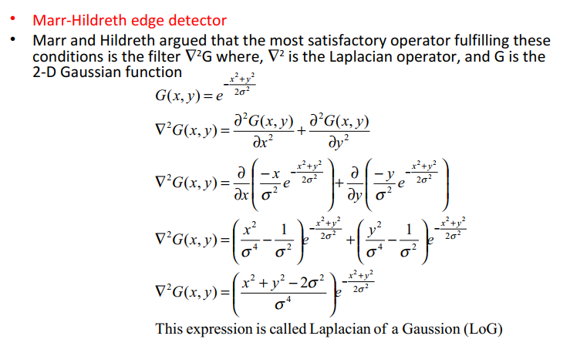
More Advanced Techniques for Edge Detection

Slide 27
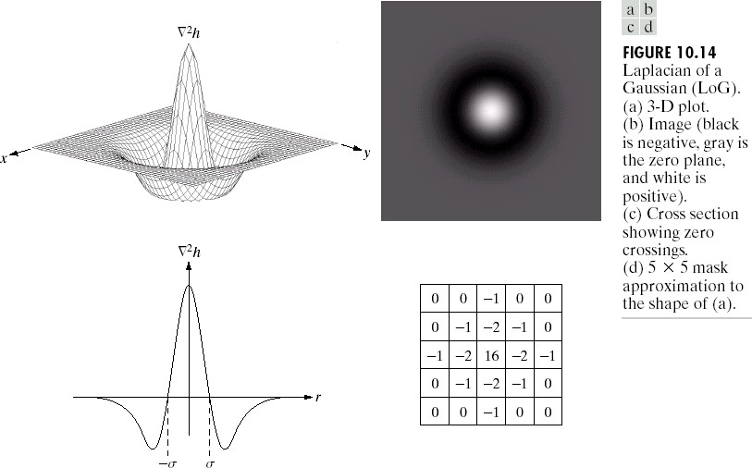
More Advanced Techniques for Edge Detection

Slide 28
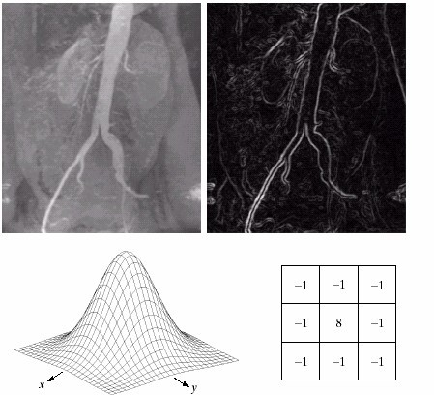
Detection of Discontinuities Gradient Operators:
Example
Sobel gradient
Gaussian smooth function
Laplacian mask

Slide 29
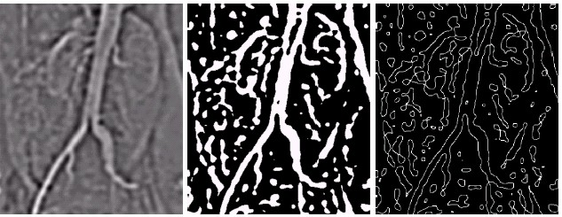
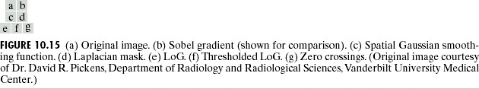
Detection of Discontinuities Gradient Operators: Example

Slide 30
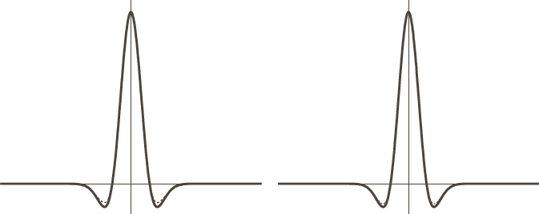
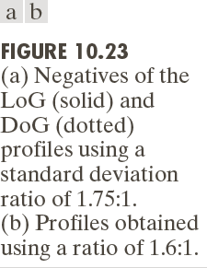
Detection of Discontinuities Gradient Operators: Example

Slide 31
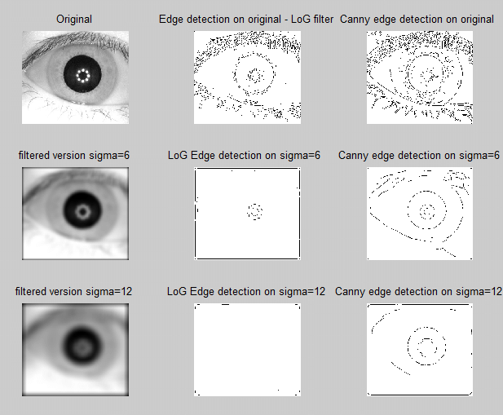
Edge Detection by Canny and LoG

Slide 32
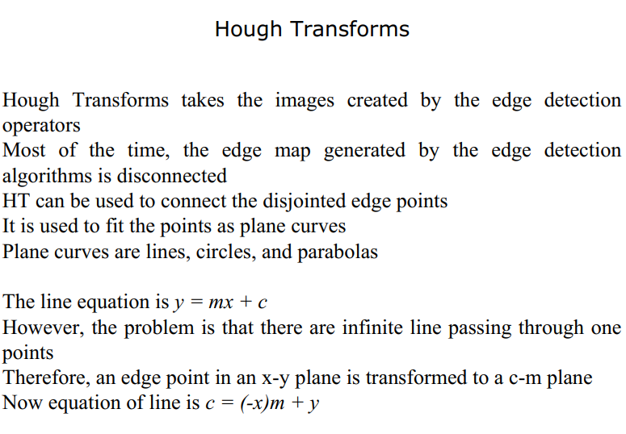

Slide 33
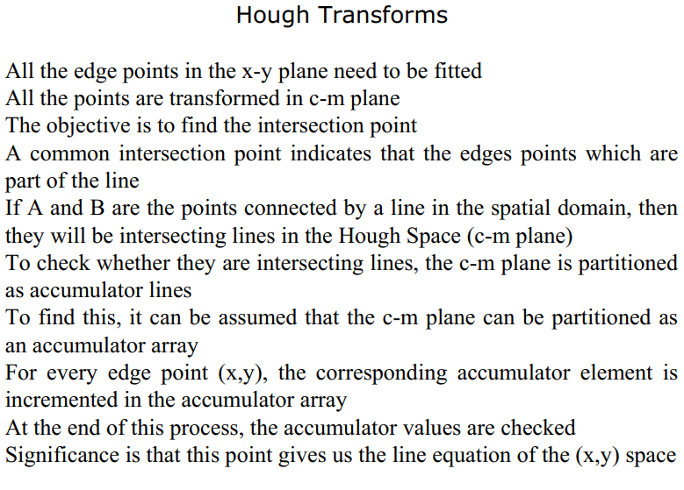

Slide 34
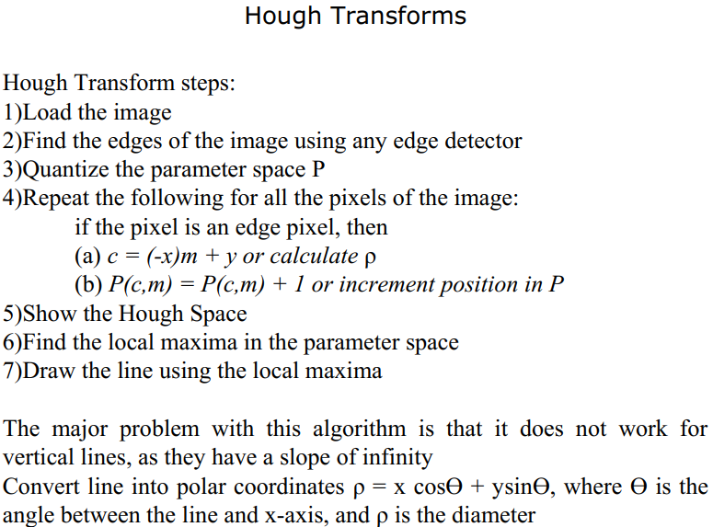

Slide 35
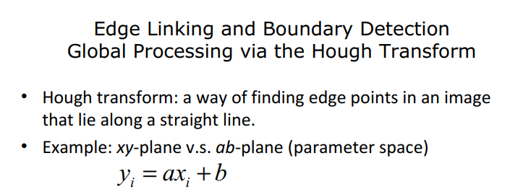
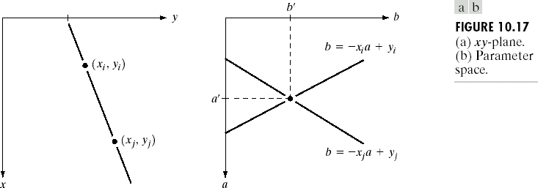

Slide 36
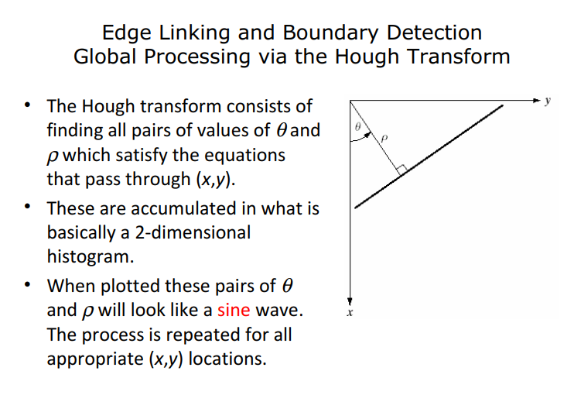

Slide 37
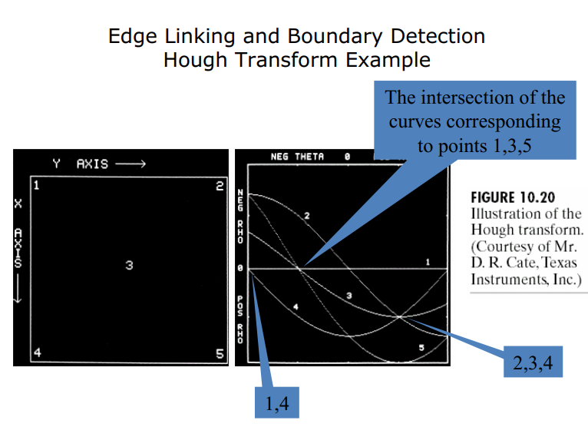

Slide 38
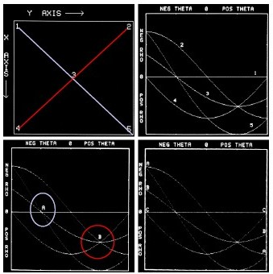

Slide 39
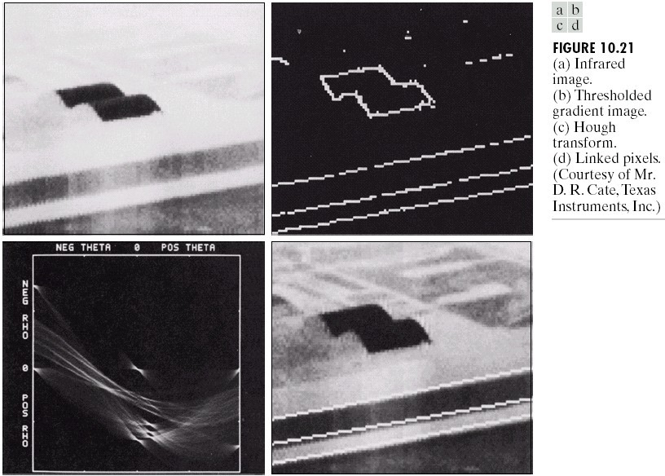
Edge Linking and Boundary Detection Hough Transform Example

Slide 40
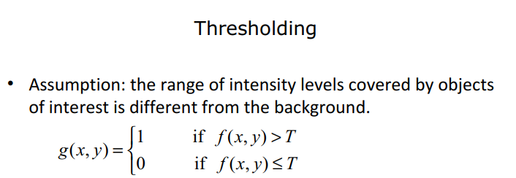
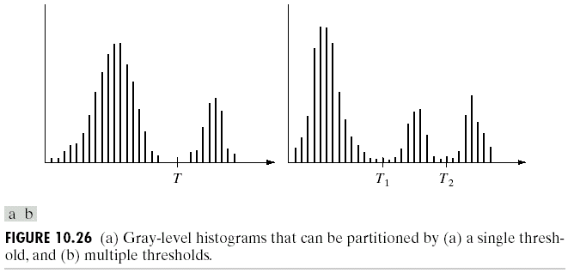
Single threshold
Multiple threshold

Slide 41
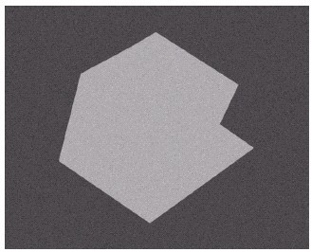
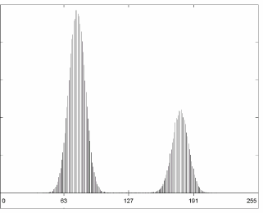

Thresholding
The Role of Illumination

Slide 42



Thresholding
The Role of Illumination
(a)
(c)
r(x, y)
i(x, y)
(d)
(e)
f (x, y) = i(x, y)r(x,y)

Slide 43

Thresholding:Basic Global Thresholding

Slide 44

Basic Global Thresholding

Slide 45

Basic Adaptive Thresholding

Slide 46



Thresholding
Basic Adaptive Thresholding
How to solve this problem?

Slide 47


Thresholding
Basic Adaptive Thresholding
Answer: subdivision

Slide 48

Optimal Global and Adaptive Thresholding

Slide 49



Slide 50

Thresholding
Use of Boundary Characteristics

Slide 51

Thresholding
Thresholds Based on Several Variables
Color image

Slide 52



Slide 53
Region-Based Segmentation
Edges and thresholds sometimes do not give good results for segmentation.
Region-based segmentation is based on the connectivity of similar pixels in a region.
Each region must be uniform.
Connectivity of the pixels within the region is very important.
There are two main approaches to region-based segmentation: region growing and region splitting.
•
•
•

Slide 54


Slide 55


Slide 56


Slide 57

Region Growing Algorithm
•
Consider image shown in figure:
Assume seed point indicated by underlines. Let the seed pixels 1 and 9 represent the regions C and D, respectively
Subtract pixel from seed value
If the difference is less than or equal to 4 (i.e. T=4), merge the pixel with that region. Otherwise, merge the pixel with the other region.

Slide 58
Split and Merge Algorithm
•
Region growing algorithm is slow
•
So seed point can be extended to a seed region
•
Instead of a single pixel, a node of a Regional adjacency graph (RAG)
a region itself is now considered as a starting point.
The split process can be stated as follows:
1)Segment the image into regions R1, R2,….Rn using a set of thresholds 2)Create RAG. Use a similarity measure and formulate a homogeneity test
The homogeneity test is designed based on the similarity criteria such as intensity or any image statistics
Repeat step 3 until no further region exits that requires merging

Slide 59


Split and Merge Algorithm
•
8 | 8 | 8
8 | 8 | 8

Slide 60


Region-Based Segmentation Region Growing
Fig. 10.41 shows the histogram of Fig. 10.40 (a). It is difficult to segment the defects by thresholding methods. (Applying region growing methods are better in this case.)
•
Figure 10.40(a)
Figure 10.41

Slide 61

Region-Based Segmentation Region Growing

Slide 62
Split and Merge using Quadtree
Entire image is assumed as a single region. Then the homogeneity test is applied. If the conditions are not met, then the regions are split into four quadrants.
This process is repeated for each quadrant until all the regions meet the required homogeneity criteria. If the regions are too small, then the division process is stopped.
1) Split and continue the subdivision process until some stopping criteria is fulfilled. The stopping criteria often occur at a stage where no further splitting is possible.
2) Merge adjacent regions if the regions share any common criteria. Stop the process when no further merging is possible

Slide 63


Slide 64


Slide 65



Slide 66

The End

