Slide 1
Image Compression

Slide 2
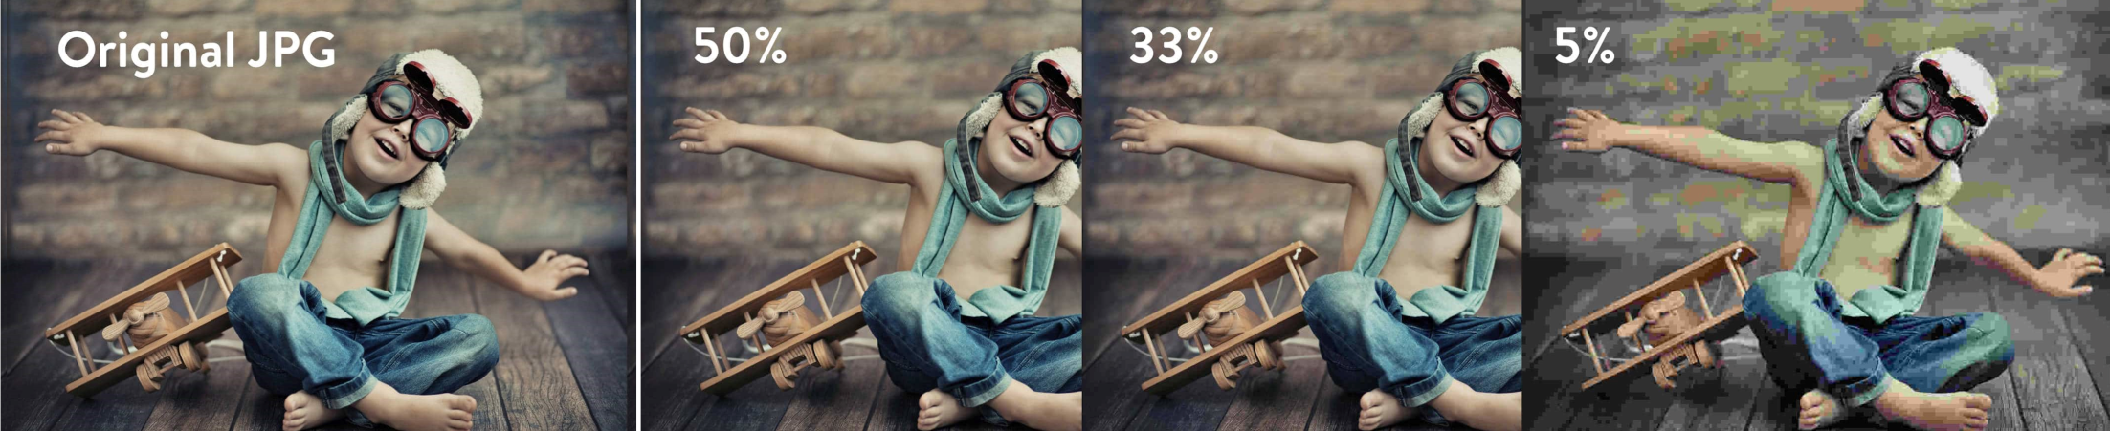
Chapter 8
Image Compression

Slide 3
Contents
Fundamentals
Basic Compression Methods

Slide 4
Data Compression
The process of reducing the amount of data required to represent
a given quantity of information is called data compression
Data is the means to convey information.
Let a and b denote the number of bits in two representations
of the same data.
Then the relative data redundancy R=1-1/C
where C=a/b the compression ratio.

Slide 5
Image Compression
Compression can take place only if we have redundant information
Image compression
Coding redundancy
  Fewer bits to represent frequent symbols
  Huffman coding : Lossless
Interpixel redundancy
  Neighboring pixels have similar values
  Predictive coding : Lossless
Psychovisual redundancy
  Quantization : Lossy
  Remove information that human visual system cannot perceive
  Removal of high frequency data : Lossy

Slide 6
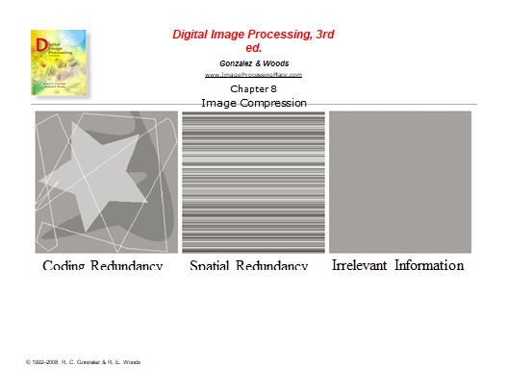
Examples of Redundancy

Slide 7
Image Compression
Lossy Image Compression
  Information is lost during compression
  Consumer TV signals
  Consumer images : Web, Digital cameras
Lossless Image Compression
  Information is preserved during compression
  Medical imaging
  Compression ratio will be different for the two cases

Slide 8
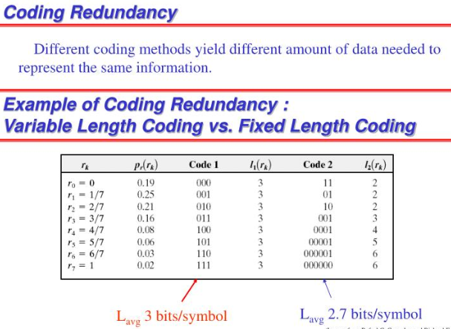
Image Compression

Slide 9

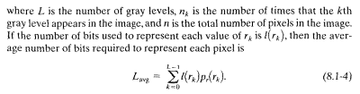

Image Compression

Slide 10
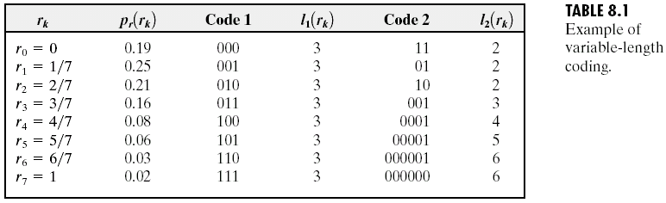
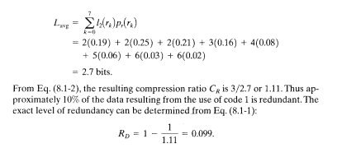
Image Compression

Slide 11
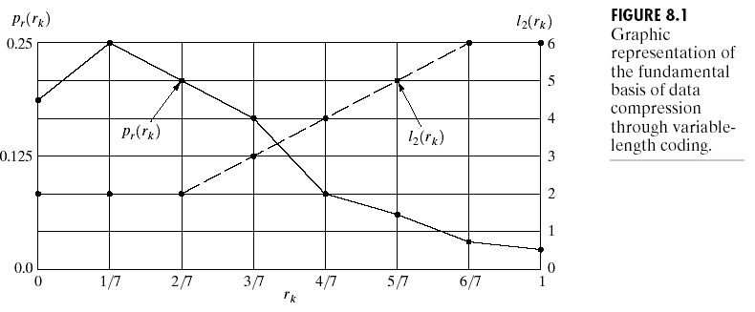

Image Compression

Slide 12
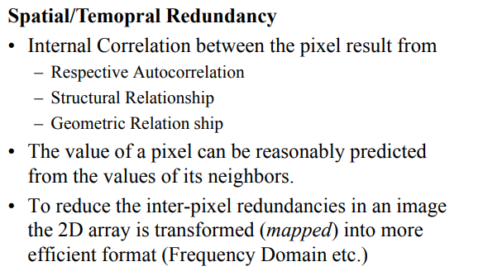
Image Compression

Slide 13
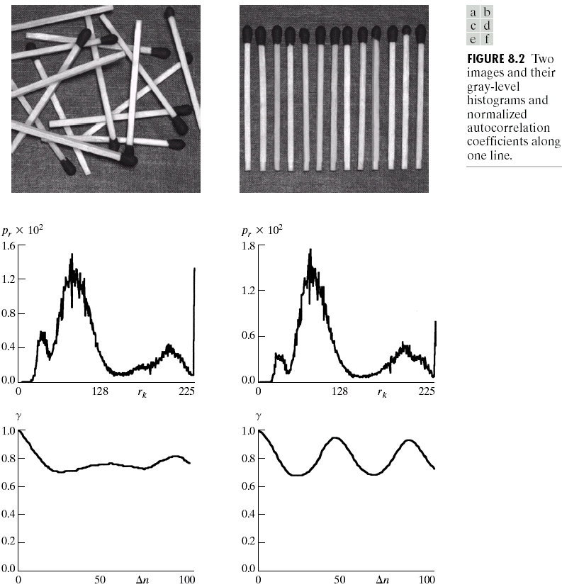
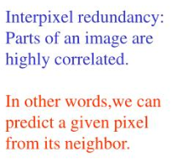
Image Compression

Slide 14
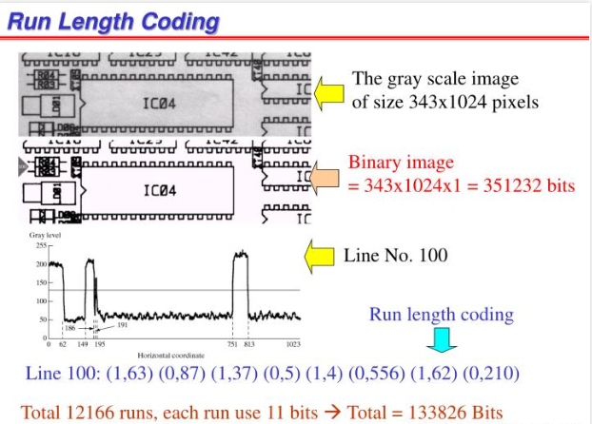
Image Compression

Slide 15
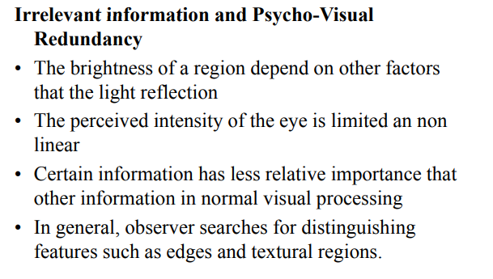
Image Compression

Slide 16
Image Compression
Irrelevant information and Psycho-Visual Redundancy
The brightness of a region depends on many factors like light reflection
The perceived intensity of the eye is limited and non-linear
Certain information has less relative information in normal visual processing
In general, observer searches for distinguishing features such as edges and textural region

Slide 17
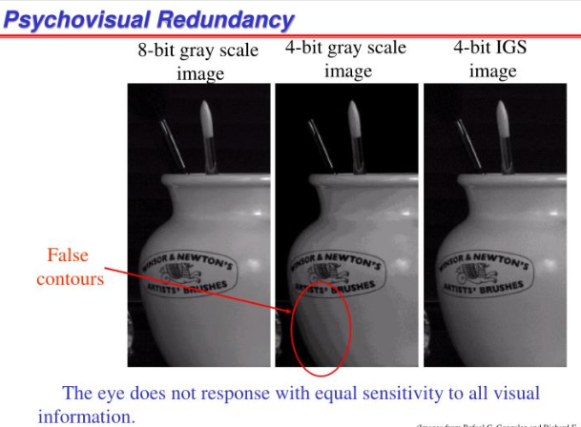

Slide 18
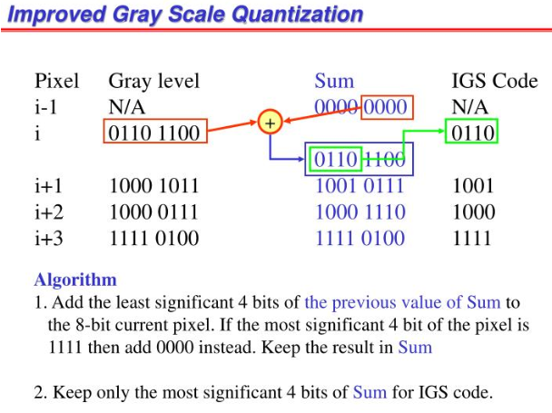

Slide 19
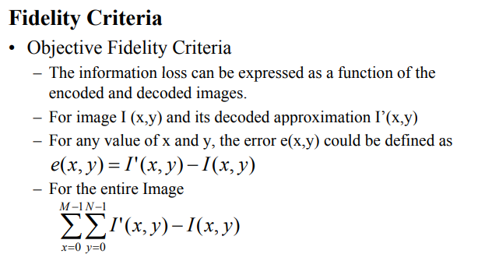
Image Compression

Slide 20
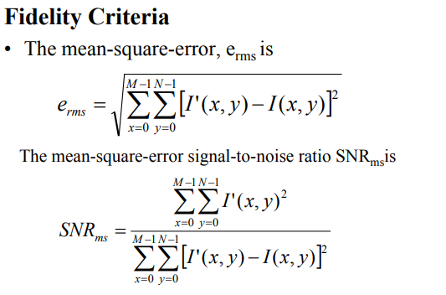
Image Compression

Slide 21
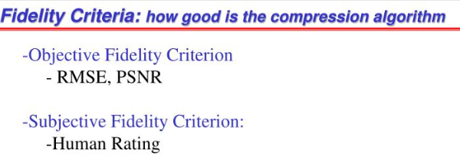
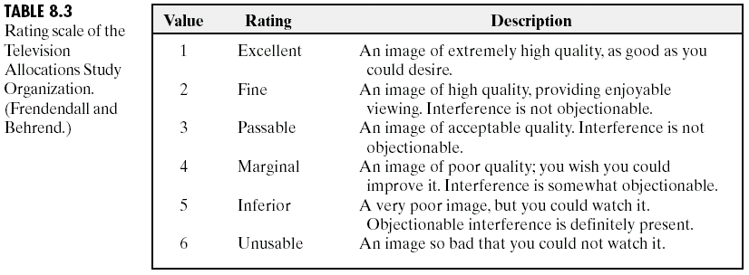
Image Compression

Slide 22
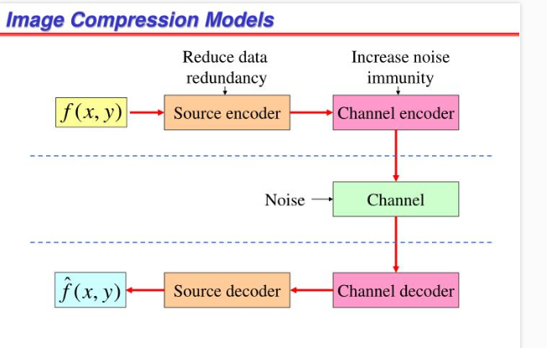
Image Compression

Slide 23
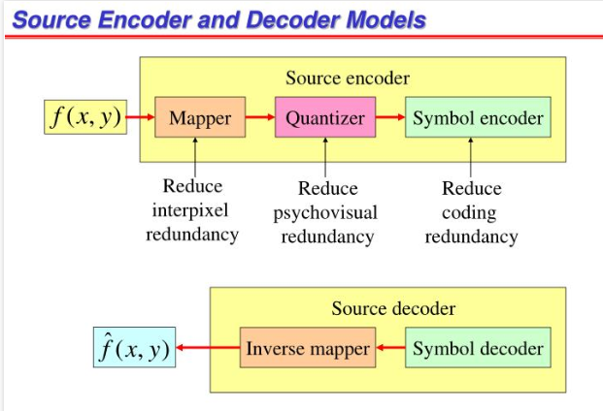

Slide 24
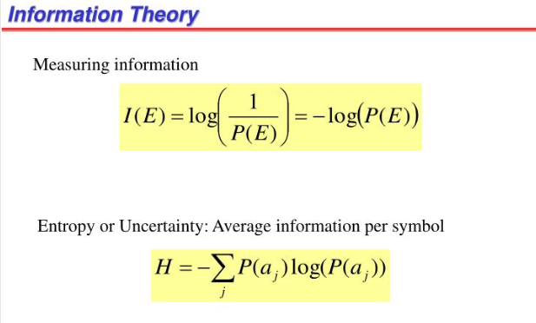

Slide 25
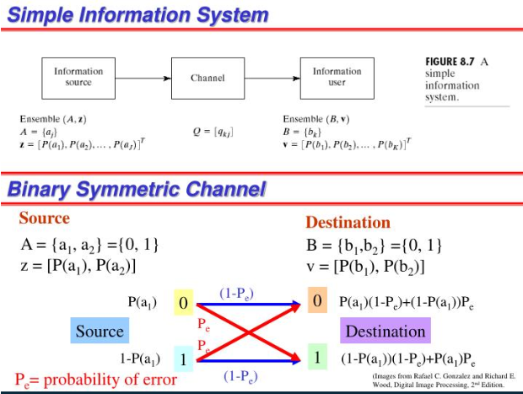
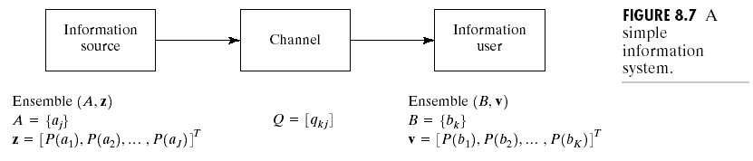

Slide 26
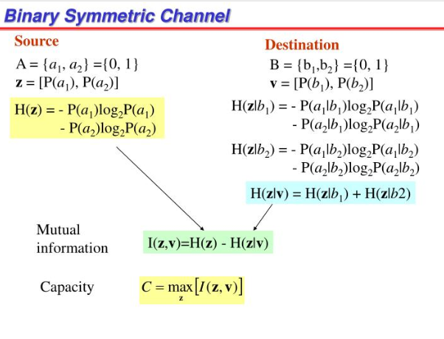
Image Compression

Slide 27
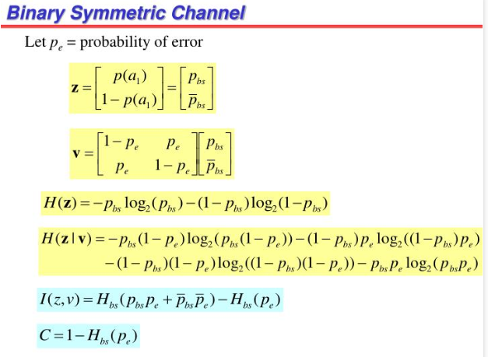

Slide 28
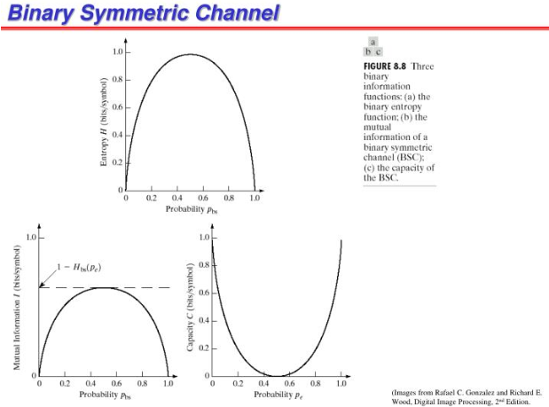

Slide 29
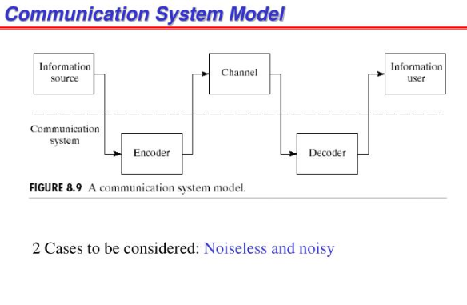

Slide 30
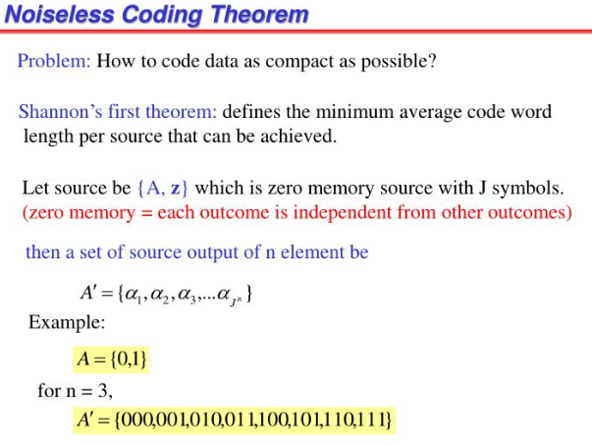

Slide 31
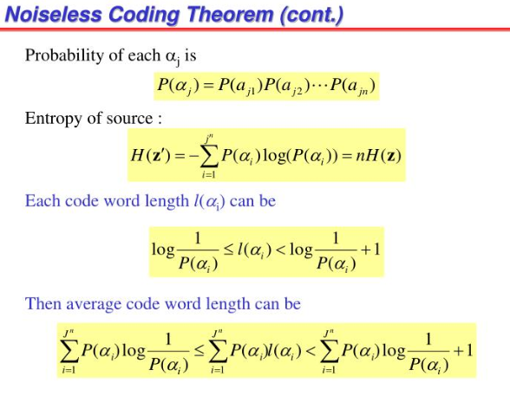

Slide 32
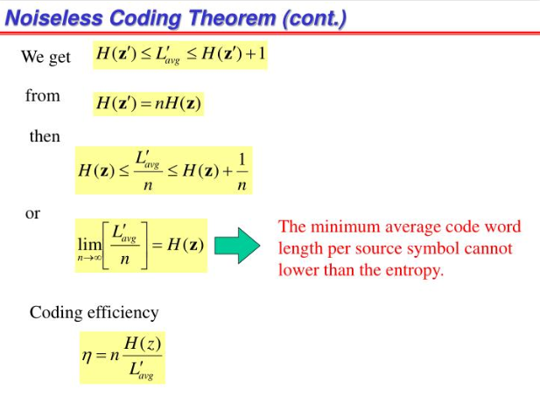
Image Compression

Slide 33
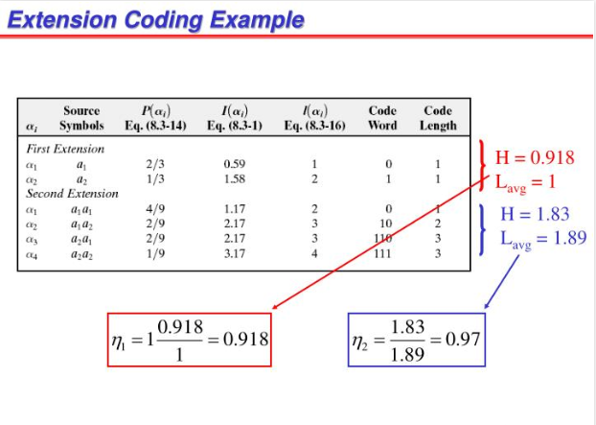

Slide 34
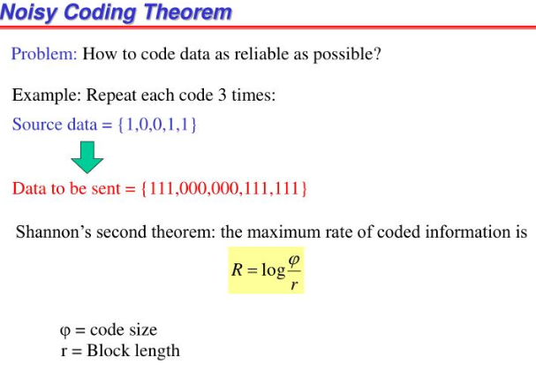

Slide 35
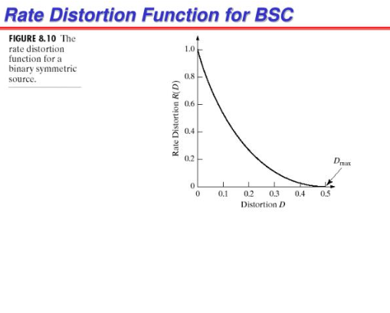
Image Compression

Slide 36
Image Compression
There are 5 main types of Digital Image Formats:
TIFF
JPEG
GIF
PNG
RAW

Slide 37
Image Compression
TIFF (also known as TIF), file types ending in .tif
TIFF stands for Tagged Image File Format. TIFF images create very large file sizes. TIFF images are uncompressed and thus contain a lot of detailed image data (which is why the files are so big) TIFFs are also extremely flexible in terms of color (they can be grayscale, or CMYK for print, or RGB for web) and content (layers, image tags).
TIFF is the most common file type used in photo software (such as Photoshop), as well as page layout software (such as Quark and InDesign), again because a TIFF contains a lot of image data.

Slide 38
Image Compression
JPEG (also known as JPG), file types ending in .jpg
JPEG stands for Joint Photographic Experts Group, which created this standard for this type of image formatting. JPEG files are images that have been compressed to store a lot of information in a small-size file. Most digital cameras store photos in JPEG format, because then you can take more photos on one camera card than you can with other formats.
A JPEG is compressed in a way that loses some of the image detail during the compression in order to make the file small (and thus called “lossy” compression).
JPEG files are usually used for photographs on the web, because they create a small file that is easily loaded on a web page and also looks good.
JPEG files are bad for line drawings or logos or graphics, as the compression makes them look “bitmappy” (jagged lines instead of straight ones).

Slide 39

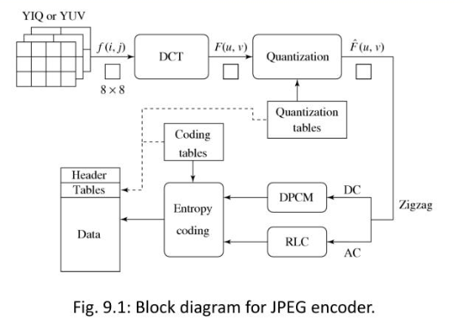
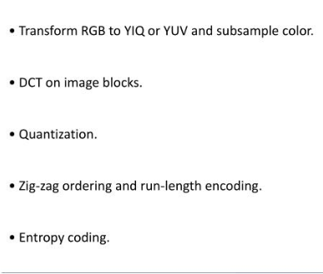
Image Compression

Slide 40
Image Compression
GIF, file types ending in .gif
GIF stands for Graphic Interchange Format. This format compresses images but, as different from JPEG, the compression is lossless (no detail is lost in the compression, but the file can’t be made as small as a JPEG).
GIFs also have an extremely limited color range suitable for the web but not for printing. This format is never used for photography, because of the limited number of colors. GIFs can also be used for animations.

Slide 41
Image Compression
PNG, file types ending in .png
PNG stands for Portable Network Graphics. It was created as an open format to replace GIF, because the patent for GIF was owned by one company and nobody else wanted to pay licensing fees. It also allows for a full range of color and better compression.
It’s used almost exclusively for web images, never for print images. For photographs, PNG is not as good as JPEG, because it creates a larger file. But for images with some text, or line art, it’s better, because the images look less “bitmappy.”
When you take a screenshot on your Mac, the resulting image is a PNG–probably because most screenshots are a mix of images and text.

Slide 42
Image Compression
Raw image files
Raw image files contain data from a digital camera (usually). The files are called raw because they haven’t been processed and therefore can’t be edited or printed yet. There are a lot of different raw formats–each camera company often has its own proprietary format.
Raw files usually contain a vast amount of data that is uncompressed. Because of this, the size of a raw file is extremely large. Usually they are converted to TIFF before editing and color-correcting.
Most of this info is courtesy of Wikipedia, which is a great place to read more about all 5 file types.

Slide 43
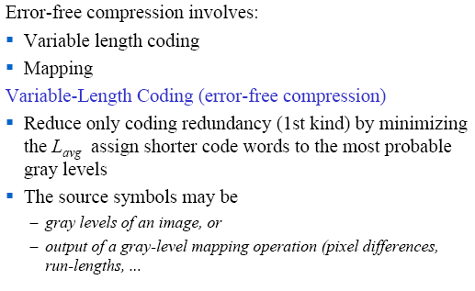
Error Free Compression

Slide 44
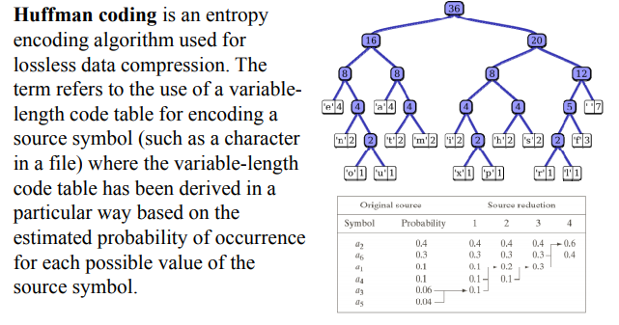
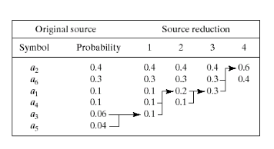
Image Compression: Huffman Coding

Slide 45
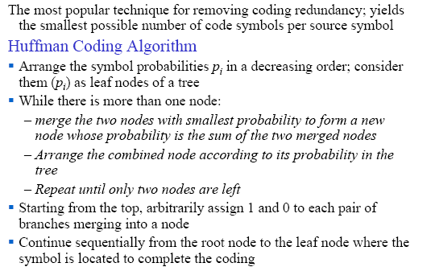
Image Compression: Huffman Coding

Slide 46
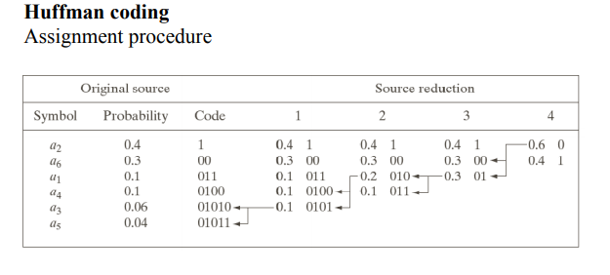

Image Compression: Huffman Coding

Slide 47
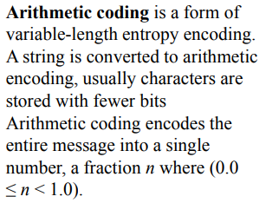
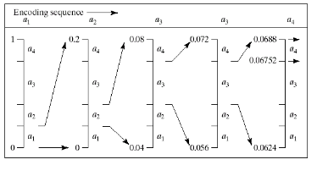
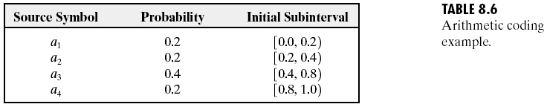
Image Compression: Arithmetic Coding

Slide 48
Image Compression: Arithmetic Coding
Adaptive Content Dependent Probability Estimates
Arithmetic coders are near optimal in the sense of minimizing the average number of code symbols required to represent the symbols being coded.
Inaccurate probability models can lead to non-optimal results.
A simple way to improve the accuracy of the probabilities employed is to use an adaptive, context dependent probability model that update symbol probabilities as symbols are coded or become known.
The probabilities adapt to the local statistics of the symbols being coded.
Context dependent models provide probabilities that are based on a predefined neighbourhood of pixels, called the context.
Both the Q-coder and MQ-coder (ISO/IEC [2000]) arithmetic coding techniques have been incorporated into the JBIG, JPEG-2000 and other compression standards.
The Q-coder dynamically updates symbol probabilities during the interval renormalizations that are part of the arithmetic coding process

Slide 49
Image Compression: Arithmetic Coding
Arithmetic coding is often used when binary symbols are to be coded.
Each symbol or bit begins the coding process and its context is formed in the Context determination block
The lower blocks show three possible contexts that can be used:
1.the immediately preceding symbol,
2. a group of preceding symbols,
3. some number of preceding symbols plus symbols on the previous scan line.
For all the cases the Probability estimation block must manage 2¹ (2), or 2⁸ (256) or 2⁵ (32) contexts and their associated probabilities.
The appropriate probabilities are then passed to the Arithmetic coding block as a function of the current context and drive the generation of the arithmetically coded output sequence.
The probabilities associated with the context involved in the current coding step are then updated to reflect the fact that another symbol within that context has been processed.

Slide 50
Image Compression: Arithmetic Coding
Update Probability
for Current Context
Context Determination
Probability Estimation
Arithmetic Coding
Input
Symbols
Symbol
and
Context
Symbol
Probability
a
Symbol being coded

Slide 51
LZW Coding
LZW builds a codebook (or dictionary) of symbol sequences (i.e., gray-level sequences) as it processes the image pixels.
Each symbol sequence is encoded by its dictionary location.
Dictionary Location Entry
0 …
1 …
… …
255 …
256 10-120-51
… …
511 -
For example, the sequence of gray-levels 10-120-51 (3 bytes) will be encoded by 256 (1 byte)

Slide 52
LZW Coding
Initially, the first 256 entries of the dictionary are assigned to the gray levels 0,1,2,..,255 (i.e., assuming 8 bits/pixel images)
Initial Dictionary
Dictionary Location Entry
0 0
1 1
… …
255 255
256 -
… …
511 -

Slide 53
LZW Coding
Example:
  As the encoder examines the image pixels, gray level sequences that are not in the dictionary are added to the dictionary.
39 39 126 126
39 39 126 126
39 39 126 126
39 39 126 126
Requires no prior knowledge of symbol probabilities.
Assigns sequences of source symbols to fixed length code words.
There is no one-to-one correspondence between source symbols and code words.Included in GIF, TIFF and PDF file formats
- Is 39 in the dictionary……..Yes
- What about 39-39………….No
* Add 39-39 at location 256
Dictionary Location Entry
Dictionary Location Entry
0 0
1 1
. .
255 255
256 -
511 -
39-39
So, 39-39 can be encoded by 256!

Slide 54
Run-Length Coding
Run-length coding (RLC) works by counting adjacent pixels with the same gray level value called the run-length, which is then encoded and stored.
RLC works best for binary, two-valued, images.
RLC can also work with complex images that have been preprocessed by thresholding to reduce the number of gray levels to two
RLC can be implemented in various ways, but the first step is to define the required parameters
Horizontal RLC (counting along the rows) or vertical RLC (counting along the columns) can be used

Slide 55
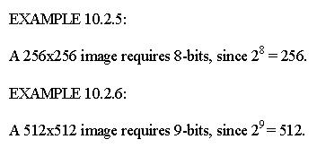
Run-Length Coding
In basic horizontal RLC, the number of bits used for the encoding depends on the number of pixels in a row
If the row has 2^{n} pixels, then the required number of bits is n, so that a run that is the length of the entire row can be encoded
The next step is to define a convention for the first RLC number in a row – does it represent a run of 0's or 1's?

Slide 56
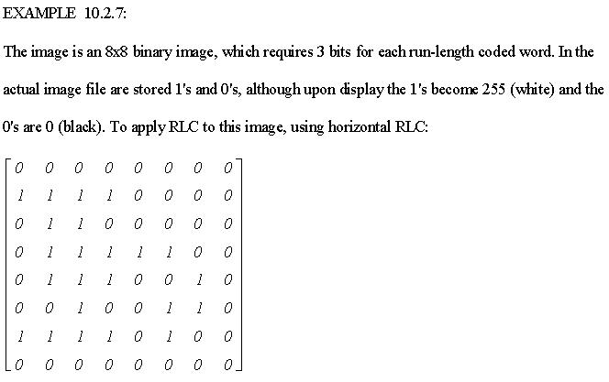
Run-Length Coding

Slide 57
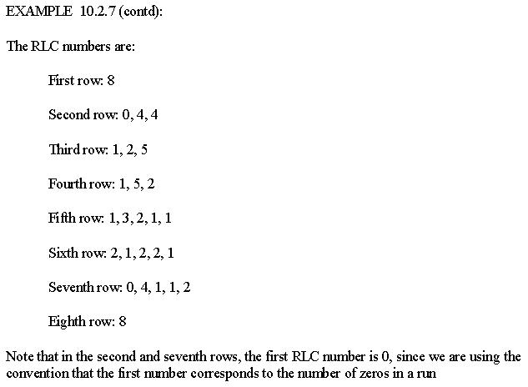
Run-Length Coding

Slide 58
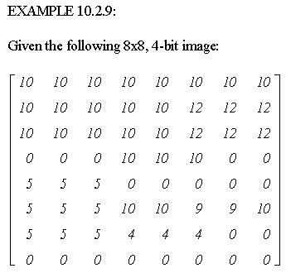
Run-Length Coding

Slide 59
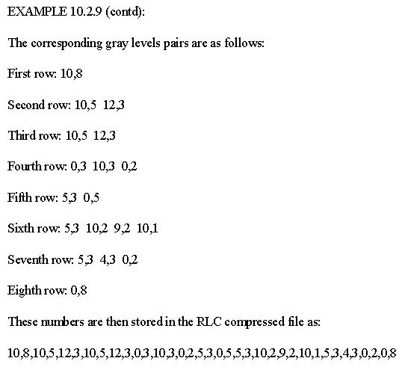
Run-Length Coding

Slide 60
Run-Length Coding
The decompression process requires the number of pixels in a row, and the type of encoding used
Standards for RLC have been defined by the International Telecommunications Union-Radio (ITU-R, previously CCIR)
These standards use horizontal RLC, but postprocess the resulting RLC with a Huffman encoding scheme
Newer versions of this standard also utilize a two-dimensional technique where the current line is encoded based on a previous line, which helps to reduce the file size
These encoding methods provide compression ratios of about 15 to 20 for typical documents

Slide 61
Lempel-Ziv-Welch Coding
The string table is updated as the file is read, with new codes being inserted whenever a new string is encountered
If a string is encountered that is already in the table, the corresponding code for that string is put into the compressed file
LZW coding uses code words with more bits than the original data

Slide 62
Lempel-Ziv-Welch Coding
For Example:
With 8-bit image data, an LZW coding method could employ 10-bit words
The corresponding string table would then have 2¹⁰ = 1024 entries
This table consists of the original 256 entries, corresponding to the original 8-bit data, and allows 768 other entries for string codes
The string codes are assigned during the compression process, but the actual string table is not stored with the compressed data
During decompression the information in the string table is extracted from the compressed data itself

Slide 63
Lempel-Ziv-Welch Coding
For the GIF (and TIFF) image file format the LZW algorithm is specified, but there has been some controversy over this, since the algorithm is patented by Unisys Corporation
Since these image formats are widely used, other methods similar in nature to the LZW algorithm have been developed to be used with these, or similar, image file formats
Similar versions of this algorithm include the adaptive Lempel-Ziv, used in the UNIX compress function, and the Lempel-Ziv 77 algorithm used in the UNIX gzip function

Slide 64
Gray-Level Run Length Coding
Gray-Level Run Length Coding
The RLC technique can also be used for lossy image compression, by reducing the number of gray levels, and then applying standard RLC techniques
As with the lossless techniques, preprocessing by Gray code mapping will improve the compression ratio

Slide 65
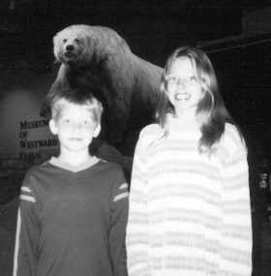

Lossy Bitplane Run Length Coding
Note: No compression occurs until reduction to 5 bits/pixel
a) Original image, 8 bits/pixel,
256 gray levels
b) Image after reduction to 7 bits/pixel,
128 gray levels, compression ratio 0.55,
with Gray code preprocessing 0.66

Slide 66


Lossy Bitplane Run Length Coding
c) Image after reduction to 6 bits/pixel,
64 gray levels, compression ratio 0.77,
with Gray code preprocessing 0.97
d) Image after reduction to 5 bits/pixel,
32 gray levels, compression ratio 1.20,
with Gray code preprocessing 1.60

Slide 67

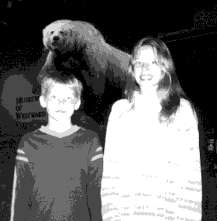
Lossy Bitplane Run Length Coding
e) Image after reduction to 4 bits/pixel,
16 gray levels, compression ratio 2.17,
with Gray code preprocessing 2.79
f) Image after reduction to 3 bits/pixel,
8 gray levels, compression ratio 4.86,
with Gray code preprocessing 5.82

Slide 68


Lossy Bitplane Run Length Coding
g) Image after reduction to 2 bits/pixel,
4 gray levels, compression ratio 13.18,
with Gray code preprocessing 15.44
h) Image after reduction to 1 bit/pixel,
2 gray levels, compression ratio 44.46,
with Gray code preprocessing 44.46

Slide 69
Lossy Bitplane Run Length Coding
A more sophisticated method is dynamic window-based RLC
This algorithm relaxes the criterion of the runs being the same value and allows for the runs to fall within a gray level range, called the dynamic window range
This range is dynamic because it starts out larger than the actual gray level window range, and maximum and minimum values are narrowed down to the actual range as each pixel value is encountered
This process continues until a pixel is found out of the actual range
The image is encoded with two values, one for the run length and one to approximate the gray level value of the run
This approximation can simply be the average of all the gray level values in the run

Slide 70

Lossy Bitplane Run Length Coding

Slide 71

Lossy Bitplane Run Length Coding

Slide 72

Lossy Bitplane Run Length Coding
This particular algorithm also uses some preprocessing to allow for the run-length mapping to be coded so that a run can be any length and is not constrained by the length of a row

Slide 73
Block Truncation Coding
Block truncation coding (BTC) works by dividing the image into small subimages and then reducing the number of gray levels within each block
The gray levels are reduced by a quantizer that adapts to local statistics
The levels for the quantizer are chosen to minimize a specified error criteria, and then all the pixel values within each block are mapped to the quantized levels
The necessary information to decompress the image is then encoded and stored
The basic form of BTC divides the image into N * N blocks and codes each block using a two-level quantizer

Slide 74
Block Truncation Coding
The two levels are selected so that the mean and variance of the gray levels within the block are preserved
Each pixel value within the block is then compared with a threshold, typically the block mean, and then is assigned to one of the two levels
If it is above the mean it is assigned the high level code, if it is below the mean, it is assigned the low level code

Slide 75

Block Truncation Coding
If we call the high value H and the low value L, we can find these values via the following equations:
If n = 4, then after the H and L values are found, the 4x4 block is encoded with four bytes
Two bytes to store the two levels, H and L, and two bytes to store a bit string of 1's and 0's corresponding to the high and low codes for that particular block

Slide 76

Block Truncation Coding

Slide 77

Block Truncation Coding

Slide 78

Block Truncation Coding

Slide 79
Block Truncation Coding
This algorithm tends to produce images with blocky effects
These artifacts can be smoothed by applying enhancement techniques such as median and average (lowpass) filters

Slide 80

Block Truncation Coding

Slide 81

Block Truncation Coding

Slide 82
Transform Coding
Transform coding, is a form of block coding done in the transform domain
The image is divided into blocks, or subimages, and the transform is calculated for each block
Any of the previously defined transforms can be used, frequency (e.g. Fourier) or sequency (e.g. Walsh/Hadamard), but it has been determined that the discrete cosine transform (DCT) is optimal for most images
The newer JPEG2000 algorithms uses the wavelet transform, which has been found to provide even better compression

Slide 83
Transform Coding
After the transform has been calculated, the transform coefficients are quantized and coded
This method is effective because the frequency/sequency transform of images is very efficient at putting most of the information into relatively few coefficients, so many of the high frequency coefficients can be quantized to 0 (eliminated completely)
This type of transform is a special type of mapping that uses spatial frequency concepts as a basis for the mapping
The main reason for mapping the original data into another mathematical space is to pack the information (or energy) into as few coefficients as possible

Slide 84
Transform Coding
The simplest form of transform coding is achieved by filtering by eliminating some of the high frequency coefficients
However, this will not provide much compression, since the transform data is typically floating point and thus 4 or 8 bytes per pixel (compared to the original pixel data at 1 byte per pixel), so quantization and coding is applied to the reduced data
Quantization includes a process called bit allocation, which determines the number of bits to be used to code each coefficient based on its importance
Typically, more bits are used for lower frequency components where the energy is concentrated for most images, resulting in a variable bit rate or nonuniform quantization and better resolution

Slide 85

Transform Coding

Slide 86
Transform Coding
Then a quantization scheme, such as Lloyd-Max quantization is applied
As the zero-frequency coefficient for real images contains a large portion of the energy in the image and is always positive, it is typically treated differently than the higher frequency coefficients
Often this term is not quantized at all, or the differential between blocks is encoded
After they have been quantized, the coefficients can be coded using, for example, a Huffman or arithmetic coding method

Slide 87
Transform Coding
Two particular types of transform coding have been widely explored:
Zonal coding
Threshold coding
These two vary in the method they use for selecting the transform coefficients to retain (using ideal filters for transform coding selects the coefficients based on their location in the transform domain)

Slide 88
Zonal Coding
Zonal coding
It involves selecting specific coefficients based on maximal variance
A zonal mask is determined for the entire image by finding the variance for each frequency component
This variance is calculated by using each subimage within the image as a separate sample and then finding the variance within this group of subimages

Slide 89

Zonal Coding
The zonal mask is a bitmap of 1's and 0', where the 1's correspond to the coefficients to retain, and the 0's to the ones to eliminate
As the zonal mask applies to the entire image, only one mask is required

Slide 90
Threshold Coding
It selects the transform coefficients based on specific value
A different threshold mask is required for each block, which increases file size as well as algorithmic complexity
In practice, the zonal mask is often predetermined because the low frequency terms tend to contain the most information, and hence exhibit the most variance
In this case we select a fixed mask of a given shape and desired compression ratio, which streamlines the compression process
In practice, the zonal mask is often predetermined because the low frequency terms tend to contain the most information, and hence exhibit the most variance
In this case we select a fixed mask of a given shape and desired compression ratio, which streamlines the compression process

Slide 91



Zonal Compression with DCT and Walsh Transforms
A block size of 64x64 was used, a circular zonal mask, and DC coefficients were not quantized
a) Original image, a view of
St. Louis, Missouri, from
the Gateway Arch
c) Error image comparing the
original and (b), histogram
stretched to show detail
b) Results from using the DCT
with a compression ratio = 4.27

Slide 92


Zonal Compression with DCT and Walsh Transforms
d) Results from using the DCT with
a compression ratio = 14.94
e) Error image comparing the original and
(d), histogram stretched to show detail,

Slide 93


Zonal Compression with DCT and Walsh Transforms
f) Results from using the Walsh Transform
(WHT) with a compression ratio = 4.27
g) Error image comparing the original and
(f), histogram stretched to show detail

Slide 94


Zonal Compression with DCT and Walsh Transforms
h) Results from using the WHT with
a compression ratio = 14.94
i) Error image comparing the original and
(h), histogram stretched to show detail

Slide 95
Zonal Compression with DCT and Walsh Transforms
One of the most commonly used image compression standards is primarily a form of transform coding
The Joint Photographic Expert Group (JPEG) under the auspices of the International Standards Organization (ISO) devised a family of image compression methods for still images
The original JPEG standard uses the DCT and 8x8 pixel blocks as the basis for compression
Before computing the DCT, the pixel values are level shifted so that they are centered at zero
EXAMPLE 10.3.7:
A typical 8-bit image has a range of gray levels of 0 to 255. Level shifting this range to be centered at zero involves subtracting 128 from each pixel value, so the resulting range is from -128 to 127

Slide 96
Zonal Compression with DCT and Walsh Transforms
After level shifting, the DCT is computed
Next, the DCT coefficients are quantized by dividing by the values in a quantization table and then truncated
For color signals JPEG transforms the RGB components into the YCrCb color space, and subsamples the two color difference signals (Cr and Cb), since we perceive more detail in the luminance (brightness) than in the color information
Once the coefficients are quantized, they are coded using a Huffman code
The zero-frequency coefficient (DC term) is differentially encoded relative to the previous block

Slide 97

Zonal Compression with DCT and Walsh Transforms
These quantization tables were experimentally determined by JPEG to take
advantage of the human visual system’s response to spatial frequency which
peaks around 4 or 5 cycles per degree

Slide 98

Zonal Compression with DCT and Walsh Transforms

Slide 99

Zonal Compression with DCT and Walsh Transforms

Slide 100


The Original DCT-based JPEG
Algorithm Applied to a Color Image
a) The original image
b) Compression ratio = 34.34

Slide 101


The Original DCT-based JPEG
Algorithm Applied to a Color Image
c) Compression ratio = 57.62
d) Compression ratio = 79.95

Slide 102


The Original DCT-based JPEG
Algorithm Applied to a Color Image
e) Compression ratio = 131.03
f) Compression ratio = 201.39

Slide 103

Image Compression

Slide 104



Image Compression

Slide 105


Image Compression

Slide 106


Image Compression

Slide 107

Image Compression

Slide 108

Image Compression

Slide 109


Image Compression

Slide 110

Image Compression

Slide 111

Image Compression

Slide 112


Image Compression

Slide 113

Image Compression

Slide 114


Image Compression

Slide 115

Image Compression

Slide 116

Image Compression

Slide 117

Image Compression

Slide 118

Image Compression

Slide 119

Image Compression

Slide 120

Image Compression

Slide 121

Image Compression

Slide 122

Image Compression

Slide 123

Image Compression

Slide 124

Image Compression

Slide 125

Image Compression

Slide 126

Image Compression

Slide 127
Relation between DCT and Fourier Transform
DCT (Discrete Cosine Transform) is a simplified version of the Fourier Transform
It is the real portion of Fourier Transform.
It computationally easy.
It is effective for multimedia signal processing than Fourier transform as this only deals with the real term.

Slide 128




DCT Calculation
$$1−D DCT Calculation:F\left(u\right)=a(u){\left(\frac{2}{N}\right)}^{0.5}\sum_{i=0}^{N−1}{\operatorname{Acos}\left[\frac{π.u}{2N}\left(2i+1\right)\right]f(i)}$$
$$2−D DCT Calculation:F\left(u,v\right)=a\left(u\right)a(v){\left(\frac{2}{M}\right)}^{0.5}{\left(\frac{2}{N}\right)}^{0.5}\sum_{i=0}^{N−1}{\sum_{j=0}^{N−1}{\cos\left[\frac{πu}{2N}\left(2i+1\right)\right]\cos\left[\frac{πv}{2M}\left(2j+1\right)\right]f(i,j)}}$$
$$where a\left(u\right)=\begin{matrix}\frac{1}{\sqrt{2}} for u=0 \\ 1 for otherwise\end{matrix}$$
$$and a\left(v\right)=\begin{matrix}\frac{1}{\sqrt{2}} for v=0 \\ 1 for otherwise\end{matrix}$$

Slide 129
DCT Calculation
The input image is divided into N×M blocks.
f(i,j) is the intensity of the i^{th} row and j^{th} column pixel in one of the N × M blocks.
F(u,v) is the coefficient of the DCT matrix.
The values of the N × M block are shifted from a positive range to one centered on zero before computing the DCT. Each entry in the original block of an 8-bit image falls in the range [0,255]. The midpoint of the range 128 is subtracted from each entry to produce a data range centered on zero, so that the modified range is [-128,127]. This step reduces the dynamic range requirements for the subsequent DCT processing.
After the intensity value is centered around zero, DCT matrix was calculated.

Slide 130

Image Compression

Slide 131


Image Compression

Slide 132


Image Compression

Slide 133

Image Compression

Slide 134


Image Compression

Slide 135

Image Compression

Slide 136

Image Compression

Slide 137

Image Compression

Slide 138

Image Compression

Slide 139

Image Compression
Table 8.19 (Contd.)

Slide 140

Image Compression

Slide 141

Image Compression

Slide 142
Image Compression-Vector Quantization
Vector quantization (VQ) is a classical quantization technique from signal processing that allows the modeling of probability density functions by the distribution of prototype vectors.
The vector quantization method that has gained the most popularity was proposed by Linde, Buzo, and Gray. The algorithm was given the acronym LBG algorithm as a result.
The LBG algorithm can be considered as generalized Lloyd scalar algorithm. Consequently, it is also known as the generalized Lloyd algorithm (GLA).

Slide 143

Flowchart of LBG Algorithm

Slide 144

LBG Algorithm
The image is divided into non-overlapping equal sized blocks and then processed the image using these blocks. Let the size of every block is n×n.
Vector quantization process converts the blocks into one dimensional vector. The size of every image vector is n×n.
Initially, Nc image vectors were chosen at random to serve as codewords in a codebook of size Nc. The size of every codeword is similar to image vector.
Based on the Euclidian distance between the image vector and the codewords in the codebook, map the image vectors {I₁, I₂, ..., I_{M}}. The codeword {C₁, C₂, ..., C_{Nc}} with the lowest Euclidian distance is the one to which the image vector belongs.
$${FlagCluster}_{mi}= \begin{matrix}TRUE if difference\left(C_{i},I_{m}\right)<difference{\left(C_{j},I_{m}\right)}_{j∈1…N_{c}|j≠1} \\ FALSE otherwise \end{matrix}$$
The m^{th} row and i^{th} column of the (M×N_{C}) Boolean matrix FlagCluster are denoted as FlagCluster_{mi}. This position will be true when m^{th} image vector belongs to i^{th} cluster as the Euclidian distance between m^{th} image vector and i^{th} codeword is the minimum among all other codewords.
The codewords are updated by computing the centroid of the new clusters.
$$C_{i}^{′}=\frac{\sum_{m=1}^{M}{I_{m}×FlagCluster_{mi}}}{Count of image vector in i^{th}cluster.}$$
The algorithm will terminate when the overall mean square error between image vector and their respective codeword of present iteration is smaller than the mean square error of next iteration. Otherwise, the algorithm repeats the process from step 2.

Slide 145


Image and Image Vectors
4
4
$$N_{b}=4×4=16$$
Image divided into blocks
Image converted into vectors

Slide 146
Generation of codebook
Image Vector
Vector 1
Vector 2
Vector 3
Vector 4
Vector 5
Vector 6
Vector 7
Vector 8
Codebook
Codeword 1
Codeword 2
Codeword 3

Slide 147

Assign the image vector to codewords.
$${flag}_{mi}=\begin{matrix}true if {|C}_{i}−I_{m}\left|<{|C}_{j∈1,..,N_{c}⋮j≠i}−I_{m}\right| \\ false otherwise\end{matrix}$$

Slide 148

Calculate the new centroid
$$C_{i}^{′}= \frac{{\sum_{m=1}^{M}{I}}_{m}∗{flag}_{mi}}{Number of vectors in the cluster }$$

Slide 149

End of Lecture on Image Compression
Thank You

