Slide 1
Colour Image Fundamentals and Processing Techniques

Slide 2
Chapter 6
Colour Image Fundamentals and Processing Techniques

Slide 3
Contents
Colour Fundamentals
Colour Models
Pseudocolour Image Processing
Basics of Full-Colour Image Processing
Colour Image Processing
Image Smoothing and Image Sharpening
Image Segmentation based on Colour
Noise in Colour Images
Colour Image Compression

Slide 4
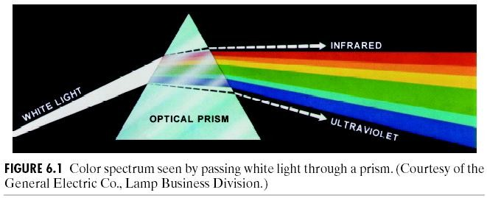
Spectrum of White Light
1666 Sir Isaac Newton, 24 year old, discovered white light spectrum.

Slide 5
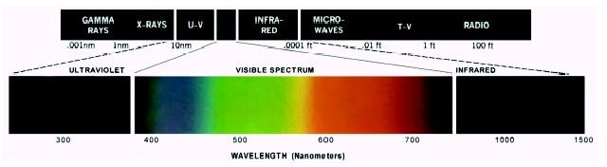
Electromagnetic Spectrum
Visible light wavelength: from around 400 to 700 nm
For an achromatic (monochrome) light source,
there is only 1 attribute to describe the quality: intensity
For a chromatic light source, there are 3 attributes to describe the quality:
Radiance = total amount of energy flow from a light source (Watts) Luminance = amount of energy received by an observer (lumens) Brightness = intensity

Slide 6
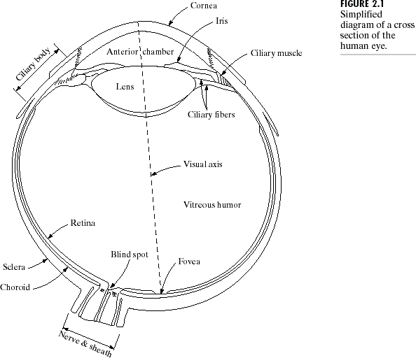
Cross section illustration of the Human Eye

Slide 7
Types of Photoreceptors at Retina
Rods
  Long and thin
  Large quantity (~ 100 million)
  Provide scotopic vision (i.e., dim light vision or at low illumination)
  Only extract luminance information and provide a general overall picture
Cones
  Short and thick, densely packed in fovea (center of retina)
  Much fewer (~ 6.5 million) and less sensitive to light than rods
  Provide photopic vision (i.e., bright light vision or at high illumination)
  Help resolve fine details as each cone is connected to its own nerve end
  Responsible for color vision
  Mesopic Vision is provided at intermediate illumination by both rod and cones
Our Interest
(well-lighted display)

Slide 8
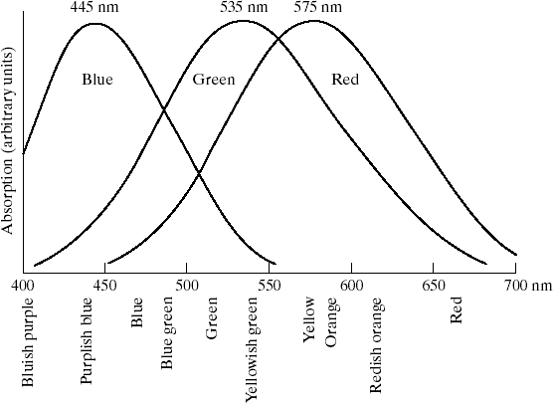
Sensitivity of Cones in the Human Eye
  millions cones in a human eye
    65% sensitive to Red light
    33% sensitive to Green light
    2 % sensitive to Blue light
Primary colors: Defined CIE in 1931
Red = 700 nm Green = 46.1nm
Blue = 435.8 nm
CIE = Commission Internationale de l’Eclairage (The International Commission on Illumination)

Slide 9

Luminance vs. Brightness
Same lum. Different brightness
Different lum. Similar brightness
Luminance (or intensity)
  Independent of the luminance of surroundings
I(x,y,λ) -- spatial light distribution
V(λ) -- relative luminous efficiency func. of visual system ~ bell shape (different for scotopic vs. photopic vision;
highest for green wavelength, second for red, and least for blue )
Brightness
  Perceived luminance
  Depends on surrounding luminance

Slide 10

Luminance vs. Brightness (cont’d)
Example: visible digital watermark
– How to make the watermark appear at the same graylevel all over the image?
from IBM Watson web page “Vatican Digital Library”

Slide 11
Look into Simultaneous Contrast Phenomenon
Human perception more sensitive to luminance contrast than absolute luminance
Weber’s Law: | L_{s} – L₀ | / L₀ = const
  Luminance of an object (L₀) is set to be just noticeable from luminance of surround (L_{s})
  For just-noticeable luminance difference ΔL:
ΔL / L ≈ d( log L ) ≈ 0.02 (const)
    equal increments in log luminance are perceived as equally different
Empirical luminance-to-contrast models
– Assume L ∈ [1, 100], and c ∈ [0, 100]
  c = 50 log₁₀ L (logarithmic law, widely used)
  c = 21.9 L^{1/3} (cubic root law)

Slide 12
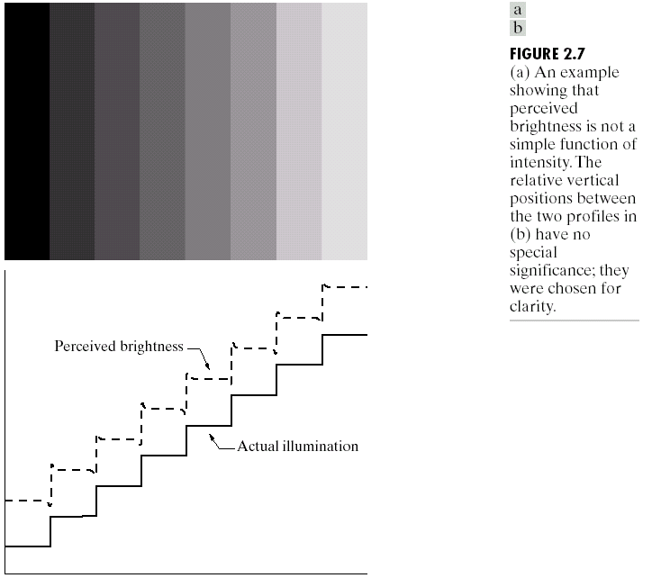
Mach Bands
Figure is from slides at Gonzalez/ Woods DIP book website (Chapter 2)
Visual system tends to undershoot or overshoot around the boundary of regions of different intensities
Demonstrates the perceived brightness is not a simple function of light intensity

Slide 13

Color of Light
Perceived color depends on spectral content (wavelength composition)
– e.g., 700nm ~ red.
  “spectral color”
    A light with very narrow bandwidth
“Spectrum” from http://www.physics.sfasu.edu/astro/color.html
A light with equal energy in all visible bands appears white

Slide 14
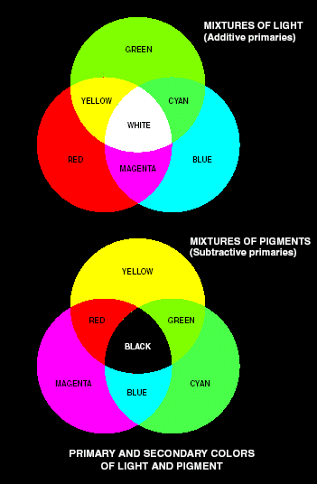
Primary and Secondary Colors
Additive primary colors: RGB used in the case of light sources such as colour monitors
RGB add together to get white
Subtractive primary colors: CMY use in the case of pigments in printing devices
White subtracted by CMY to get Black

Slide 15
Representation by Three Primary Colors
Any color can be reproduced by mixing an appropriate set of three primary colors (Thomas Young, 1802)
Three types of cones in human retina
  Absorption response S_{i}(Ζ) has peaks around 450nm (blue), 550nm (green), 620nm (yellow-green)
  Color sensation depends on the spectral response {α₁(C), α₂(C),
α₃(C) } rather than the complete light spectrum C(Ζ)
( S₁(Ζ) C(Ζ) d Ζ
α₁(C)
C(Ζ)
color light
( S (Ζ) C(Ζ) d Ζ
α (C)
Identically perceived colors if α_{i} (C₁) = α_{i} (C₂)
2
2
( S₃(Ζ) C(Ζ) d Ζ
α₃(C)

Slide 16
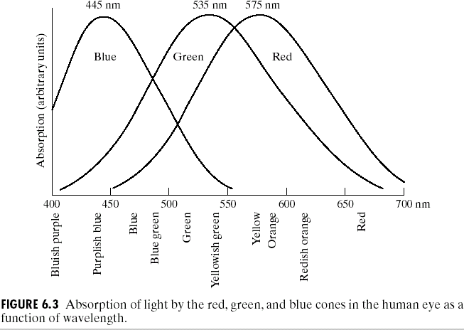
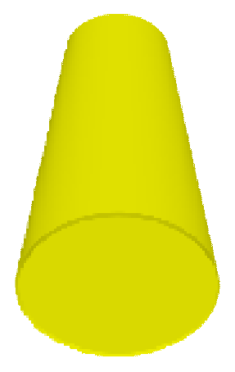


Example:Seeing Yellow Without Yellow
570nm
520nm
630nm
=
Green and red light are mixed to obtain perception of yellow, without shining a single yellow photon
“Seeing Yellow” figure is from B.Liu ELE330 S’01 lecture notes @ Princeton; R/G/B cone response is from slides at Gonzalez/ Woods DIP book website

Slide 17
Color Matching and Reproduction
Mixture of three primaries: C = Sum(⎭_{k} P_{k} (Ζ) )
To match a given color C₁
– adjust ⎭_{k} such that α_{i} (C₁) = α_{i} (C), i = 1,2,3.
Tristimulus values T_{k} (C)
  T_{k} (C) = ⎭_{k} / w_{k}
w_{k} – the amount of k^{th} primary to match the reference white
Chromaticity t_{k} = T_{k} / (T₁+T₂+T₃)
– t₁+t₂+t₃ = 1
  visualize (t₁, t₂ ) to obtain chromaticity diagram

Slide 18
Color Characterization
Hue:
Dominant color corresponding to a dominant wavelength of mixture light wave
Relative purity or amount of white light mixed with a
hue (inversely proportional to amount of white light added)
Intensity
Saturation:
Brightness
Hue Saturation
Chromaticity
amount of red (X), green (Y) and blue (Z) to form any particular color is called tristimulus.

Slide 19
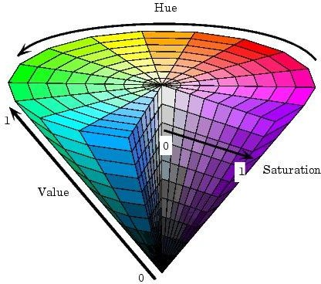
Perceptual Attributes of Color
Value of Brightness (perceived luminance)
Chrominance
  Hue
    specify color tone (redness, greenness, etc.)
    depend on peak wavelength
  Saturation
    describe how pure the color is
    depend on the spread (bandwidth) of light spectrum
    reflect how much white light is added
HSV circular cone is from online documentation of Matlab image processing toolbox
http://www.mathworks.com/access
/helpdesk/help/toolbox/images/col or10.shtml
RGB □ HSV Conversion ~ nonlinear

Slide 20
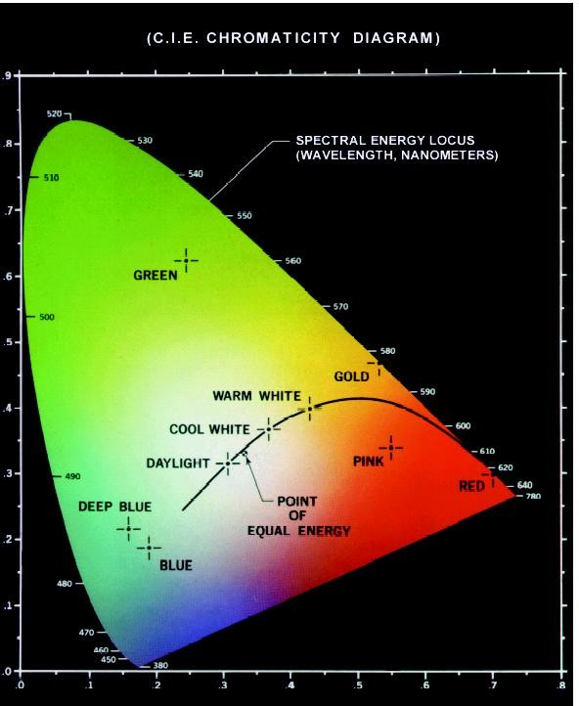
CIE Chromaticity Diagram
Trichromatic coefficients:
X
X + Y + Z
x =
Y
X + Y + Z
y =
y
Z
X + Y + Z
z =
x + y + z = 1
Points on the boundary are fully saturated colors
x

Slide 21
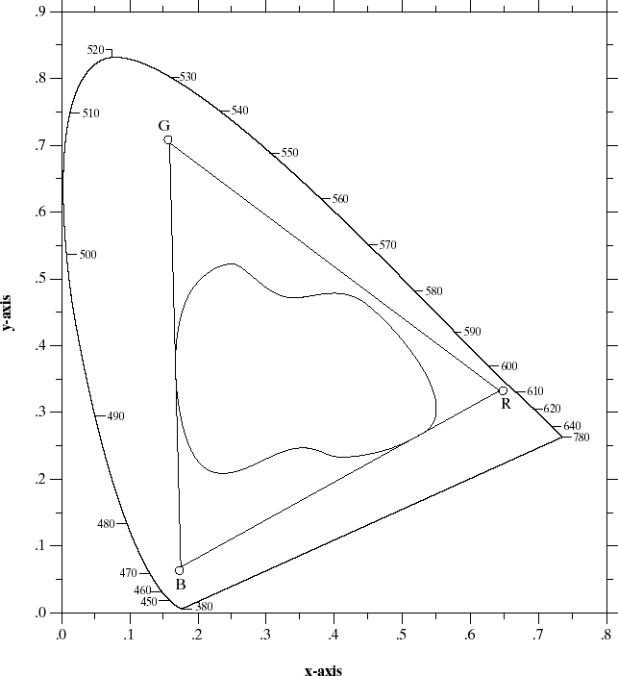
Color Gamut of Color Monitors and Printing Devices
Color Monitors
Printing devices

Slide 22

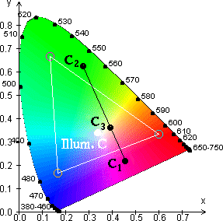
CIE Color Coordinates (cont’d)
CIE XYZ system
  hypothetical primary sources to yield all-positive spectral tristimulus values
  Y ~ luminance
Color gamut of 3 primaries
  Colors on line C1 and C2 can be produced by linear mixture of the two
  Colors inside the triangle gamut
can be reproduced by three primaries

Slide 23
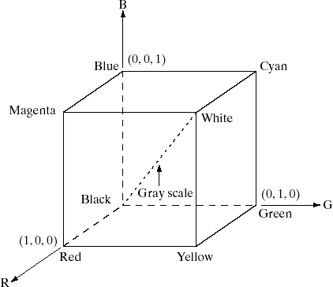
RGB Color Model
Purpose of color models: to facilitate the specification of colors in some standard
RGB color models:
- based on cartesian coordinate system

Slide 24
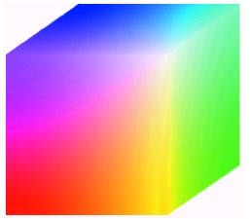
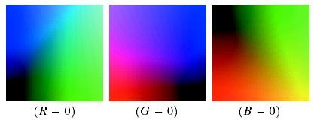
RGB Color Cube
R = 8 bits G = 8 bits B = 8 bits
Color depth 24 bits
= 16777216 colors
Hidden faces of the cube

Slide 25
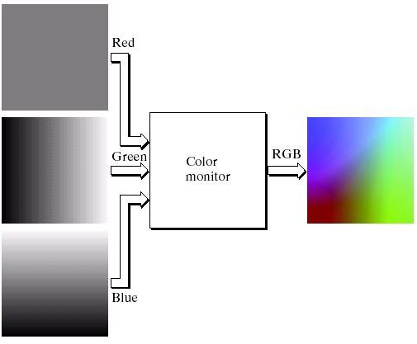
RGB Color Model
Red fixed at 127

Slide 26
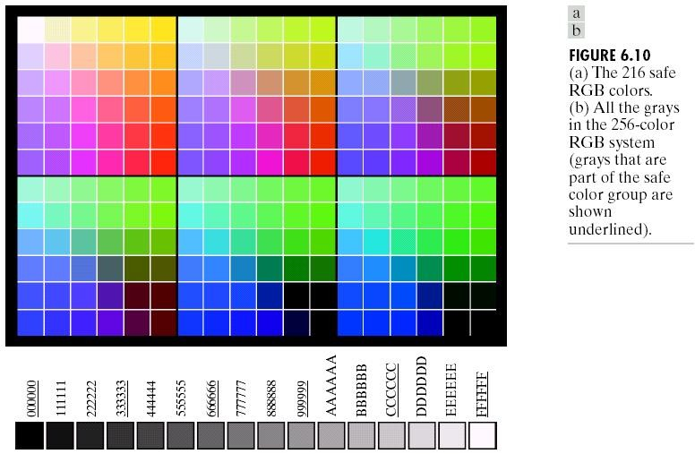
Safe RGB Colors
Safe RGB colors: a subset of RGB colors.
There are 216 colors common in most operating systems.

Slide 27
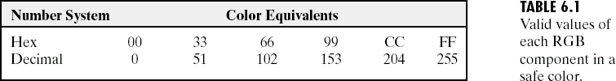
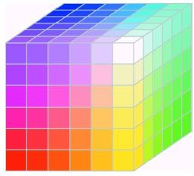
RGB Safe-color Cube
The RGB Cube is divided into 6 intervals on each axis to achieve the total 6³ = 216 common colors.
However, for 8 bit color representation, there are the total 256 colors. Therefore, the remaining 40 colors are left to OS.

Slide 28
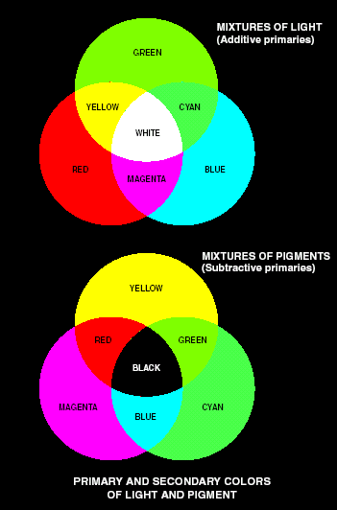
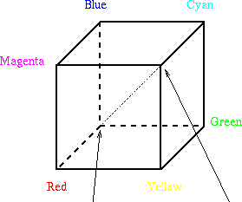
CMY and CMYK Color Models
Primary colors for pigment
  Defined as one that subtracts/absorbs a primary color of light & reflects the other two
CMY – Cyan, Magenta, Yellow
  Complementary to RGB
  Proper mix of them produces black
C=Cyan M = Magenta
Y = Yellow K = Black
⎡ C ⎤ ⎡1⎤ ⎡ R⎤
⎢_{M} ⎥ ₌ ⎢₁⎥ ₋ ⎢_{G}⎥
⎢ ⎥ ⎢ ⎥ ⎢ ⎥
⎢⎣1⎥⎦ ⎢⎣ B⎥⎦
⎢⎣ Y ⎥⎦

Slide 29
HSI Color Model
RGB, CMY models are not good for human interpreting
HSI Color model:
Hue: Dominant color
Saturation: Relative purity (inversely proportional to amount of white light added)
Intensity: Brightness
Color carrying information

Slide 30
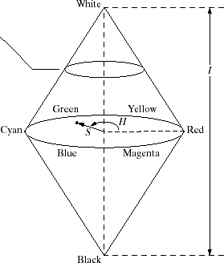
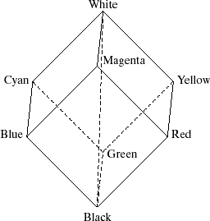
Relationship Between RGB and HSI Color Models
RGB
HSI

Slide 31
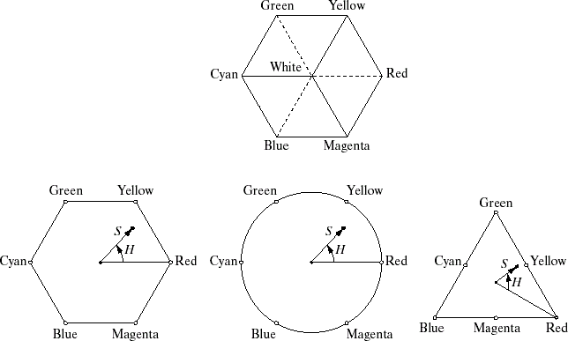
Hue and Saturation on Color Planes
A dot is the plane is an arbitrary color
Hue is an angle from a red axis.
Saturation is a distance to the point.

Slide 32
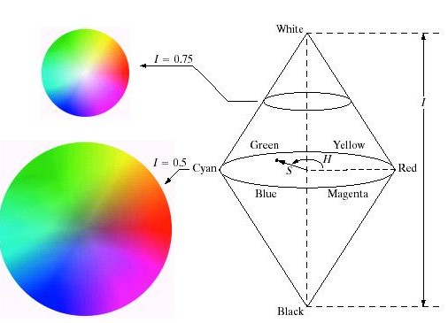
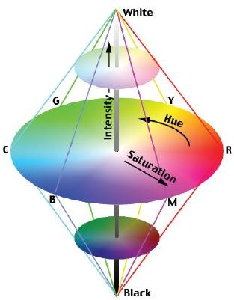
HSI Color Model (cont.)
Intensity is given by a position on the vertical axis.

Slide 33
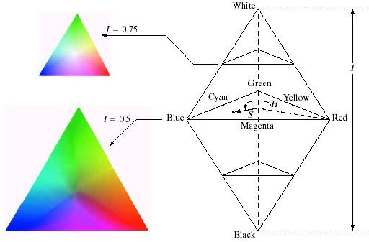
HSI Color Model
Intensity is given by a position on the vertical axis.

Slide 34
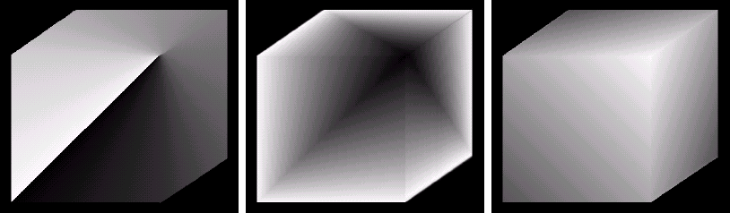
Example: HSI Components of RGB Cube
RGB Cube
Hue
Saturation

Slide 35

Converting Colors from RGB to HSI
if B ≤ G
if B > G
H = ^{⎧γ}
⎨360 − γ
⎩
$$Υ=$$
$\cos^{−1}[\{1/2 \{(R−G)+(R−B)\}\}/\{〖(R−G)〗^2+(R−B)(G−B)\}{}^{1/2}$]
3
R + G + B
S = 1 −
I = ¹ (R + G + B) 3

Slide 36
Converting Colors from HSI to RGB
RG sector: 0 ≤ H < 120 GB sector:120 ≤ H < 240
H = H − 120
S cos H ⎤
R = I ⎡ +
⎢1
⎣
o ⎥
R = I (1 − S )
cos(60 − H )
⎦
S cos H ⎤
B = I (1 − S )
G = I ⎡ +
⎢1
⎣
o ⎥
cos(60 − H )
⎦
G = 1 − (R + B)
B = 1 − (R + G)
BR sector: 240 ≤ H ≤ 360
H = H − 240
S cos H ⎤
B = I ⎡ +
1
⎣
o ⎥
cos(60 − H )
⎦
G = I (1 − S )
R = 1 − (G + B)

Slide 37
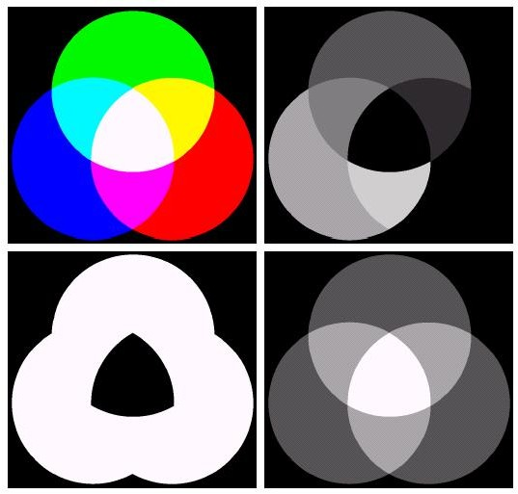
Example: HSI Components of RGB Colors
RGB
Image
Hue
Saturation
Intensity
(Images from Rafael C. Gonzalez and Richard E. Wood, Digital Image Processing, 2nd Edition.

Slide 38
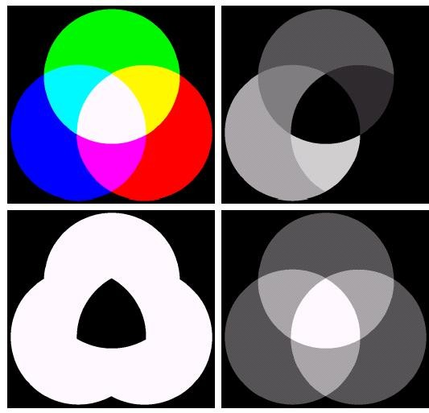
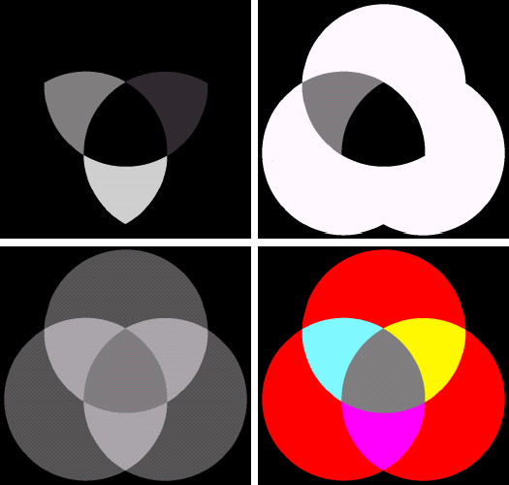
Example: Manipulating HSI Components
RGB
Image
Hue
Hue
Saturation
Saturation
Intensity
Intensity
RGB
Image
(Images from Rafael C. Gonzalez and Richard E. Wood, Digital Image Processing, 2nd Edition.

Slide 39


Color Coordinates Used in TV Transmission
Facilitate sending color video via 6MHz mono TV channel
YIQ for NTSC (National Television Systems Committee)
transmission system
  Use receiver primary system (R_{N}, G_{N}, B_{N}) as TV receivers standard
  Transmission system use (Y, I, Q) color coordinate
    Y ~ luminance, I & Q ~ chrominance
    I & Q are transmitted in through orthogonal carriers at the same freq.
YUV (YCbCr) for PAL and digital video
– Y ~ luminance, Cb and Cr ~ chrominance

Slide 40
Color Coordinates
RGB of CIE
XYZ of CIE
RGB of NTSC
YIQ of NTSC
YUV (YCbCr)
CMY

Slide 41
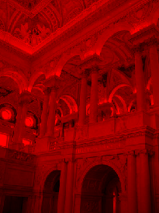
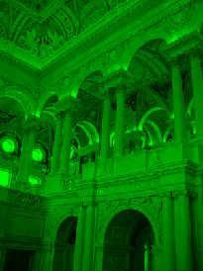
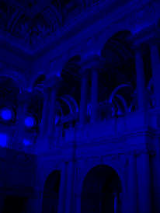
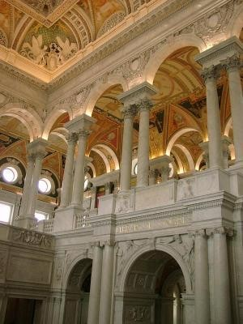
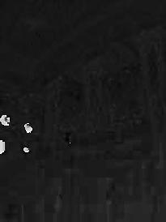
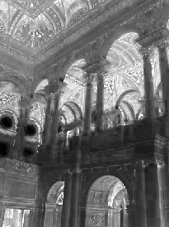
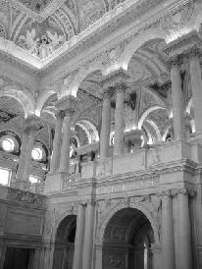
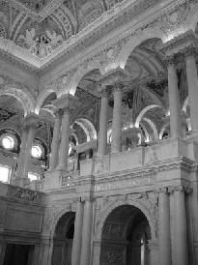
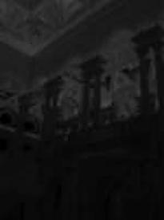

Examples
RGB
HSV
YUV

Slide 42
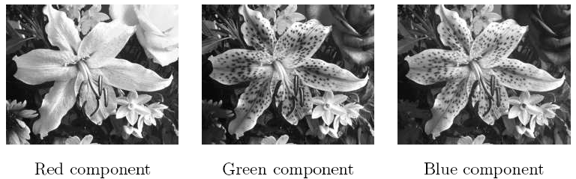
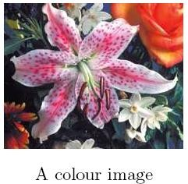
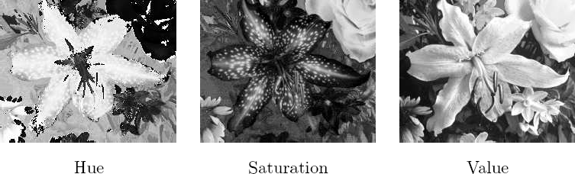
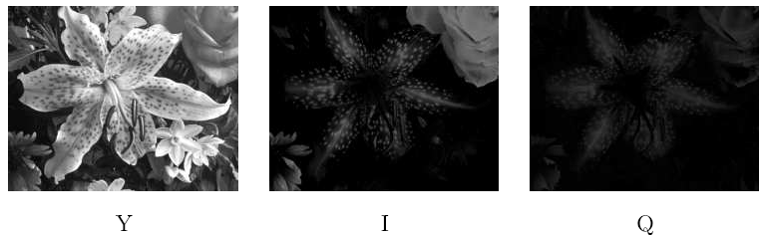
Examples
RGB
HSV
YIQ

Slide 43
Summary
Monochrome human vision
  visual properties: luminance vs. brightness, etc.
  image fidelity criteria
Color
  Color representations and three primary colors
  Color coordinates

Slide 44
Color Image Processing
There are 2 types of color image processes
Pseudocolor image process: Assigning colors to gray
values based on a specific criterion. Gray scale images to be processed may be a single image or multiple images such as multispectral images
Full color image process: The process to manipulate real color images such as color photographs.

Slide 45
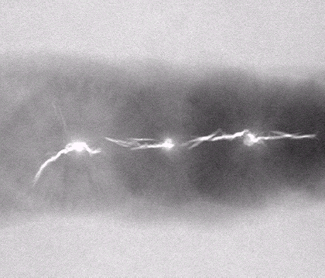
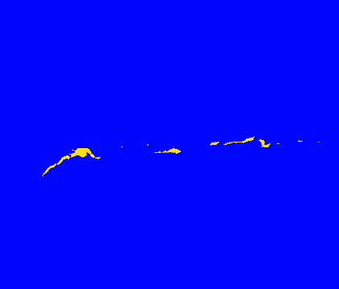
Pseudocolor Image Processing
Pseudo color = false color : In some case there is no “color” concept for a gray scale image but we can assign “false” colors to an image.
Why we need to assign colors to gray scale image?
Answer: Human can distinguish different colors better than different shades of gray.
(Images from Rafael C. Gonzalez and Richard E. Wood, Digital Image Processing, 2nd Edition.

Slide 46
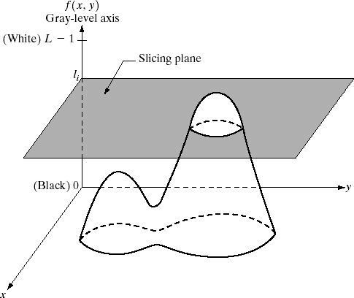
Intensity Slicing or Density Slicing
Formula:
⎧
C
if f ( x, y) ≤ T
if f ( x, y) > T
C₁ = Color No. 1
C₂ = Color No. 2
g( x, y) =
⎨
1
⎩^{C}2
Color
T
C₂
C₁
0
T
Intensity
L-1
A gray scale image viewed as a 3D surface.

Slide 47
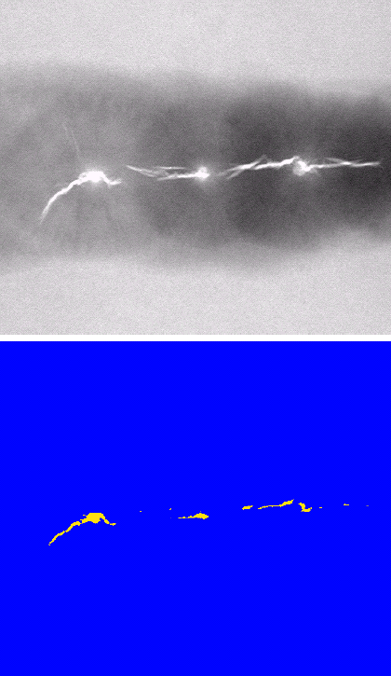
Intensity Slicing Example
An X-ray image of a weld with cracks
After assigning a yellow color to pixels with value 255 and a blue color to all other pixels.

Slide 48

Multi Level Intensity Slicing
g( x, y) = C_{k} for l_{k −1} < f ( x, y) ≤ l_{k}
C_{k} = Color No. k
l_{k} = Threshold level k
Color
C_{k}
^{C}k-1 C₃
C₂ C
1
0
l₁
l₂
l₃
Intensity
l_{k}
^{l}k-1
L-1

Slide 49
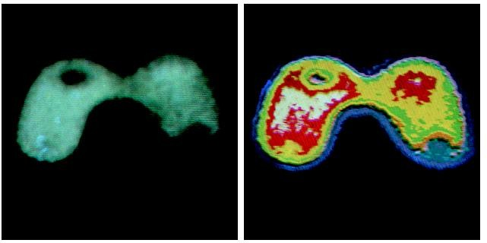
Multi Level Intensity Slicing Example
g( x, y) = C_{k} for l_{k −1} < f ( x, y) ≤ l_{k}
C_{k} = Color No. k
l_{k} = Threshold level k
An X-ray image of the Picker Thyroid Phantom.
After density slicing into 8 colors

Slide 50

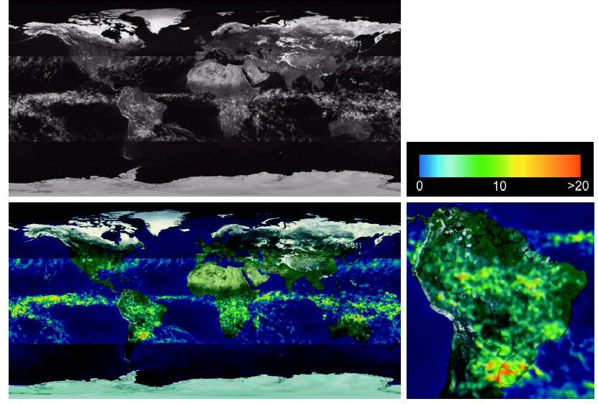
Color Coding Example
>20
Gray Scale
Color map
10
Gray-scale image of average monthly rainfall.
0
Color coded image
South America region
(Images from Rafael C. Gonzalez and Richard E. Wood, Digital Image Processing, 2nd Edition.

Slide 51

Gray Level to Color Transformation
Assigning colors to gray levels based on specific mapping functions
Red component
Gray scale image
Green component
Blue component
Therefore 3 independent transformations on the intensity of any input pixel is performed.
Then the 3 results are fed separately into the red, green and blue channels of a colour monitor
This produces a composite image whose colour content is modulated by the nature of the transformation functions.
They are not functions of position.

Slide 52

Colour Transformation

Slide 53

Colour Transformation

Slide 54

Colour Transformation

Slide 55

Colour Transformation

Slide 56

Colour Transformation

Slide 57

Colour Transformation

Slide 58

Colour Complements

Slide 59

Colour Complements

Slide 60

Colour Slicing

Slide 61

Colour Image Smoothing

Slide 62

Colour Image Smoothing

Slide 63

Colour Image Smoothing

Slide 64

Colour Image Smoothing

Slide 65

Colour Image Sharpening

Slide 66
End of Lecture
Chapter 6

