Slide 1
Image Restoration

Slide 2
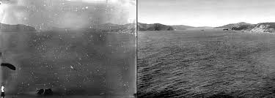
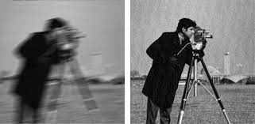
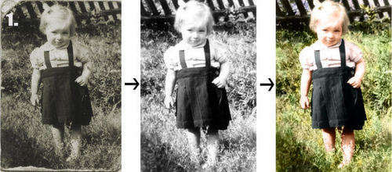
Chapter 5
Image Restoration

Slide 3
Contents
Model of the Image Degradation/Restoration Process
Noise Models
Restoration in the presence of Noise only-Spatial Filtering
Periodic Noise Reduction by Frequency Domain Filtering
Linear, Position-Invariant Degradations
Estimating the Degradation Function
Inverse Filtering
Wiener Filtering
Constrained Least Squares Filtering
Geometric Mean Filter

Slide 4
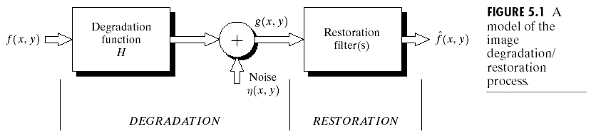
A Model of the Image Degradation/Restoration Process

Slide 5
A Model of the Image Degradation/Restoration Process
Degradation
  Degradation function H
  Additive noise
  Spatial domain
  Frequency domain

Slide 6
Restoration Model
Restoration

Slide 7
Noise Models
Sources of noise
  Image acquisition, digitization, transmission
White noise
  The Fourier spectrum of noise is constant
Assuming
  Noise is independent of spatial coordinates
  Noise is uncorrelated with respect to the image itself

Slide 8
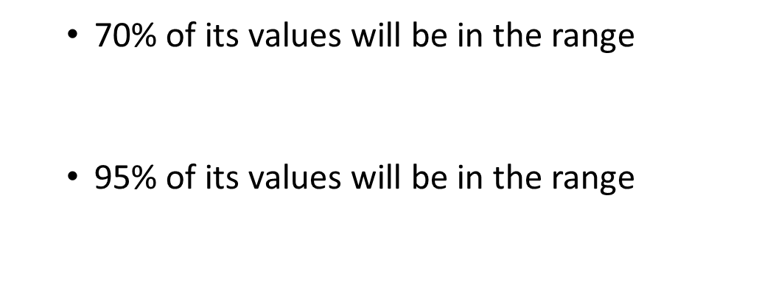
Gaussian Noise
Gaussian noise
  The PDF of a Gaussian random variable, z,
  Mean:µ
  Standard deviation:
  Variance:

Slide 9
Rayleigh Noise Model
Rayleigh noise
  The PDF of Rayleigh noise,
  Mean:
  Variance:

Slide 10
Erlang (Gamma) Noise
Erlang (Gamma) noise
  The PDF of Erlang noise, , is a positive integer,
  Mean:
  Variance:

Slide 11
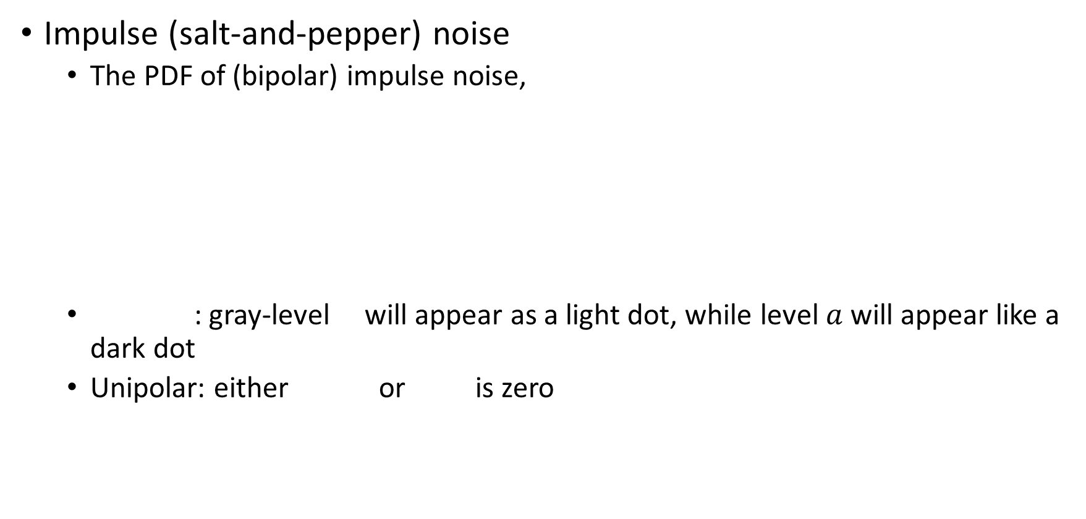
Salt and Pepper Noise
Impulse (salt-and-pepper) noise
  The PDF of (bipolar) impulse noise,
  : gray-level will appear as a light dot, while level $a$ will appear like a dark dot
  Unipolar: either or is zero
  Usually, for an 8-bit image, =0 (black) and =0 (white)

Slide 12
Noise Modelling
Modeling
  Gaussian
    Electronic circuit noise, sensor noise due to poor illumination and/or high temperature
  Rayleigh
    Range imaging
  Exponential and gamma
    Laser imaging
  Impulse
    Quick transients, such as faulty switching
  Uniform
    Least descriptive
    Basis for numerous random number generators

Slide 13
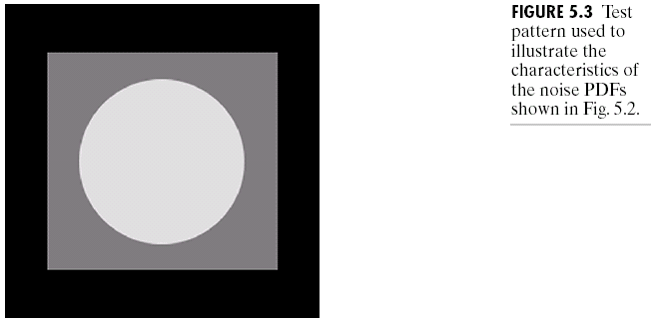
Test Pattern for observing Effect of Noise Models

Slide 14
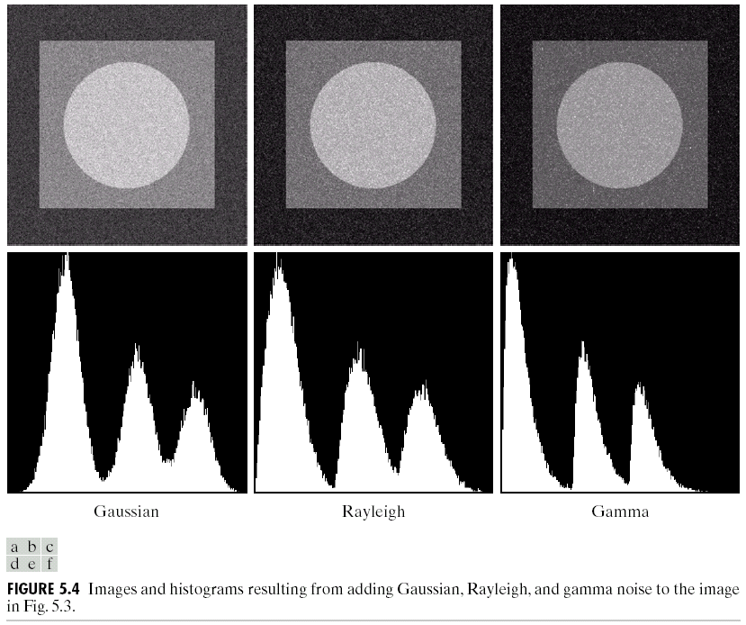

Slide 15
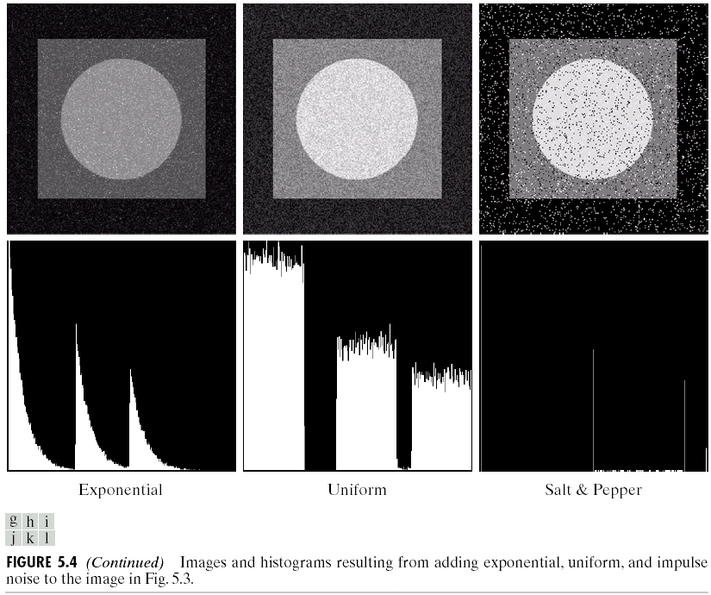

Slide 16
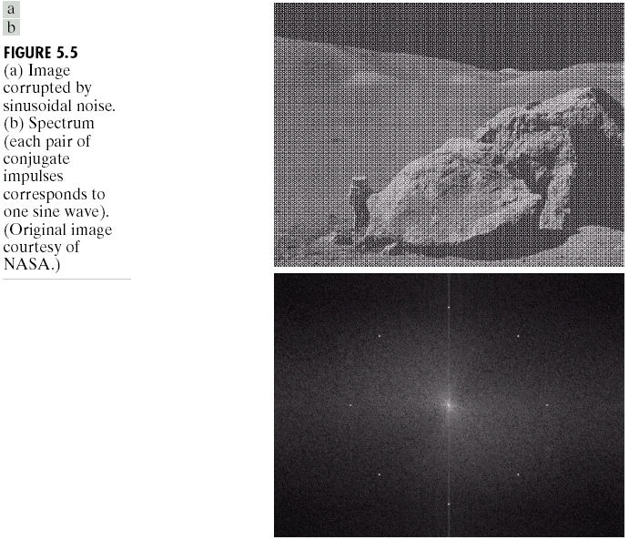
Periodic Noise
Periodic noise
  Arises typically from electrical or electromechanical interference
  Reduced significantly via frequency domain filtering

Slide 17
Noise Parameter Estimation
Estimation of noise parameters
  Inspection of the Fourier spectrum
  Small patches of reasonably constant gray level
    For example, 150*20 vertical strips
    Calculate , , , from

Slide 18
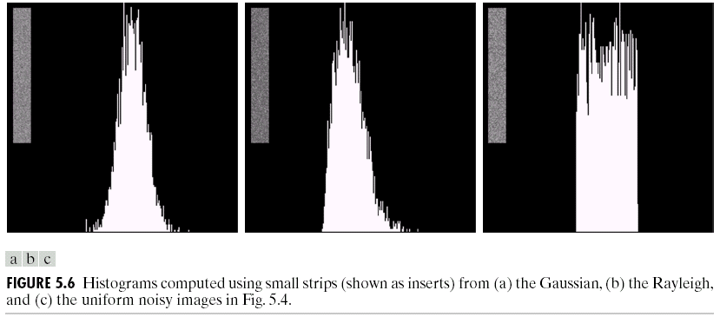
Histograms of Noisy Images

Slide 19
Restoration in the Presence of Noise Only-Spatial Filtering
Degradation
  Spatial domain
  Frequency domain

Slide 20
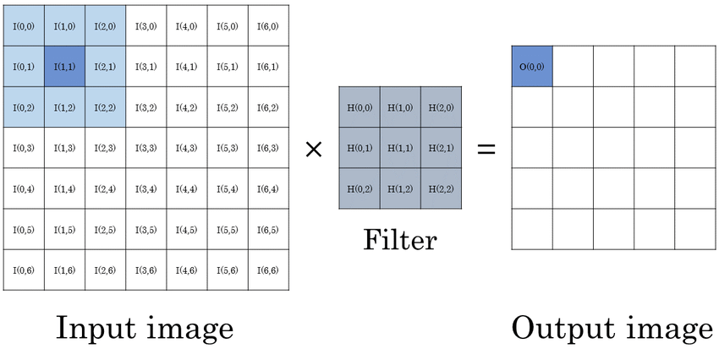
Sliding Window example

Slide 21
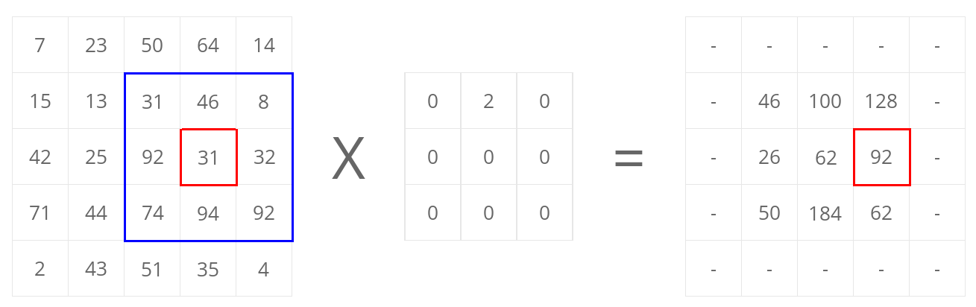
Sliding Window example

Slide 22
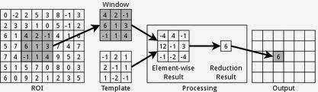
Sliding Window example

Slide 23
Mean Filter
Mean filters
  Arithmetic mean filter
  Geometric mean filter

Slide 24
Mean Filter
Usage
  Arithmetic and geometric mean filters: suited for Gaussian or uniform noise
  Harmonic and Contraharmonic filters: suited for impulse noise

Slide 25
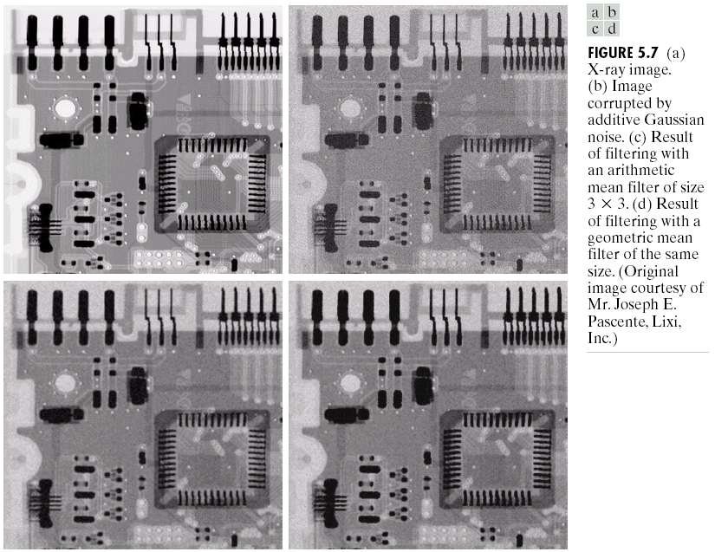

Slide 26
Harmonic Mean Filter
  Harmonic mean filter
    Works well for salt noise, but fails for pepper noise

Slide 27
Contraharmonic Mean Filter
  Contraharmonic mean filter
    : eliminates pepper noise
    : eliminates salt noise
    Q is the order of the filter.
    This filter becomes the arithmetic mean filter if Q=0 and the harmonic mean filter if Q=-1.

Slide 28
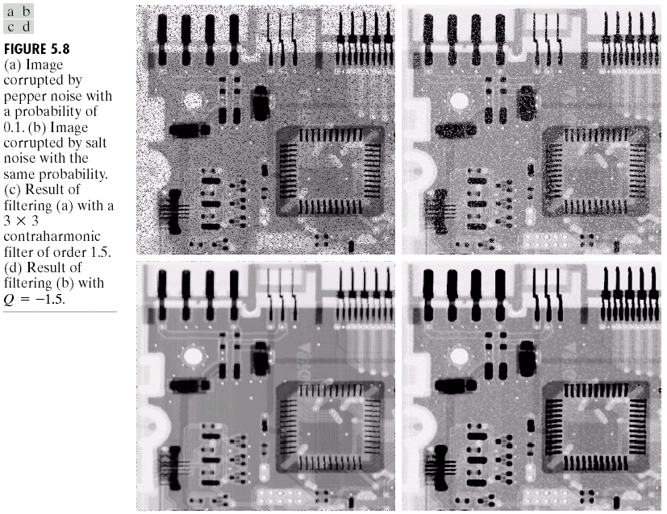

Slide 29
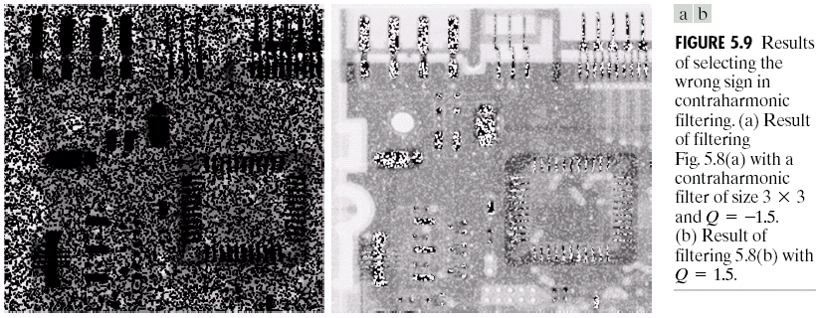
Selection of Parameters for Contraharmonic Filter

Slide 30
Median Filter
Order-statistics filters
  Median filter
    Effective in the presence of both bipolar and unipolar impulse noise

Slide 31
Max and Min Filters
  Max and min filters
    max filters reduce pepper noise
    min filters reduce salt noise

Slide 32
Midpoint filter
  Midpoint filter
    Works best for randomly distributed noise, like Gaussian or uniform noise

Slide 33
Alpha-trimmed mean filter
  Alpha-trimmed mean filter
    Delete the d/2 lowest and the d/2 highest gray-level values
    Useful in situations involving multiple types of noise, such as a combination of salt-and-pepper and Gaussian noise

Slide 34
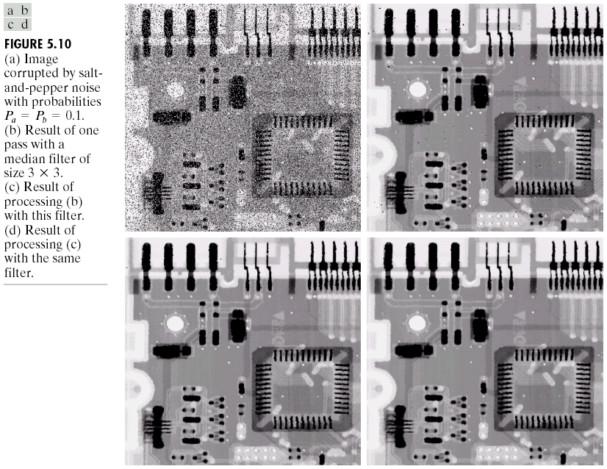

Slide 35
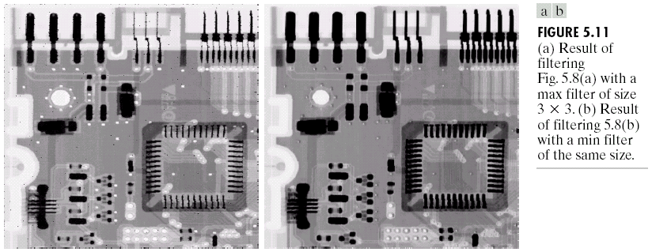
Max and Min Filter

Slide 36
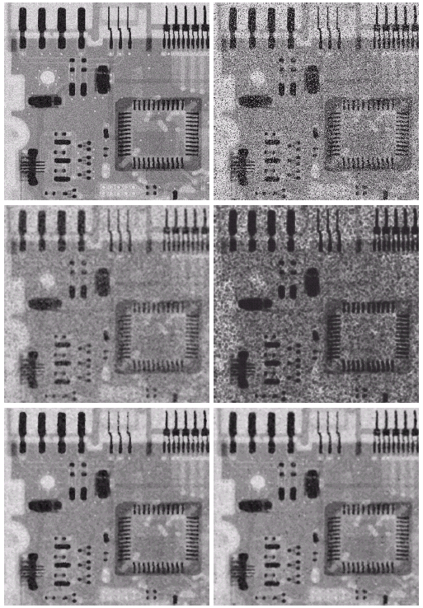


Slide 37
Adaptive Filter
Adaptive, local noise reduction filter whose behavior changes based on the statistical characteristics of the image inside the filter region.
  If is zero, return simply the value of
  If , return a value close to
  If , return the arithmetic mean value

Slide 38
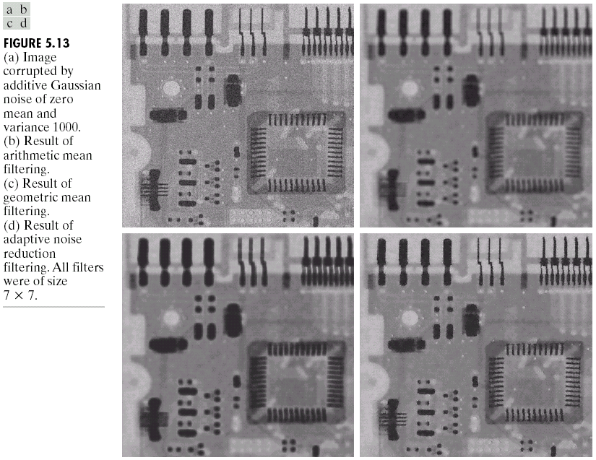

Slide 39
Adaptive Median Filter
Adaptive median filter
  = minimum gray level value in
  = maximum gray level value in
  = median of gray levels in
  = gray level at coordinates
  = maximum allowed size of

Slide 40
Adaptive Median Filter
  Algorithm: Works in two stages
  Level A: A1=
  A2=
  If A1>0 and A2<0, go to level B
  Else increase the window size
  If window size repeat level A
  Else output
  Level B: B1=
  B2=
  If B1>0 AND B2<0, output
  Else output

Slide 41
Adaptive Median Filter
  Purposes of the algorithm
    Remove salt-and-pepper (impulse) noise
    Provide smoothing
    Reduce distortion, such as excessive thinning or thickening of object boundaries

Slide 42
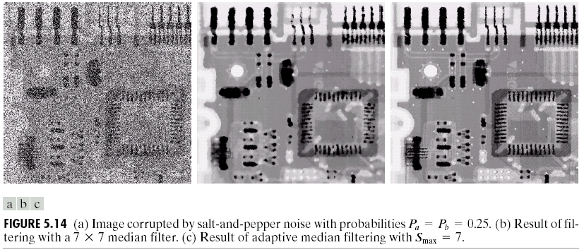
Adaptive Median Filter

Slide 43
Periodic Noise Reduction by Frequency Domain Filtering
Bandreject filters
  Ideal Bandreject filter

Slide 44
Band Reject Filter
  Butterworth bandreject filter of order n
  Gaussian bandreject filter

Slide 45
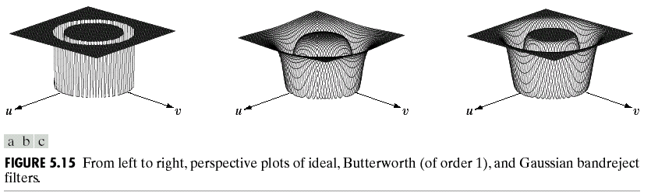
Band Reject Filter

Slide 46
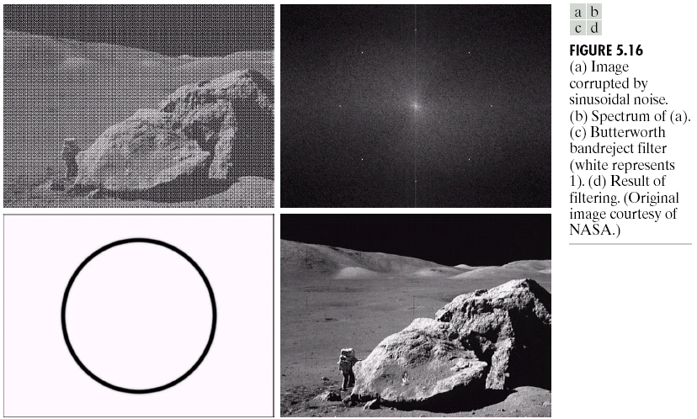
Band Reject Filter

Slide 47
Band Pass Filters
Bandpass filters

Slide 48
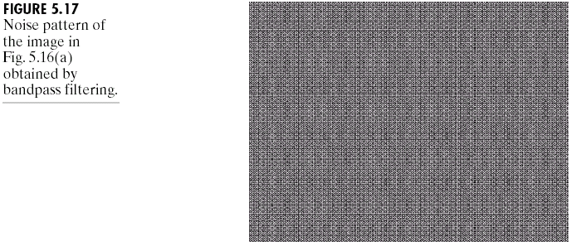
Band Pass Filters

Slide 49
Notch Filters
Notch filters- Filters that reject or pass frequencies in pre-defined neighbourhoods about a centre frequency.
  Ideal notch reject filter

Slide 50
Notch Filters
Butterworth notch reject filter of order n

Slide 51
Notch Filters
Gaussian notch reject filter

Slide 52
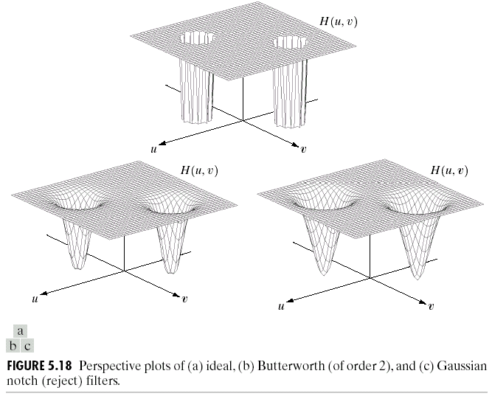
Different Notch Filters

Slide 53
Notch Filters
Notch pass filter

Slide 54
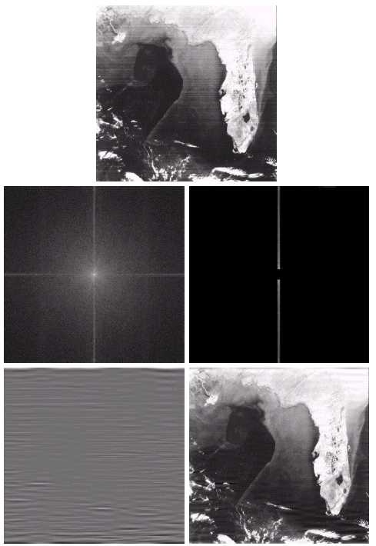
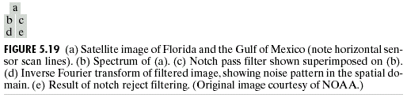
Notch Filters

Slide 55
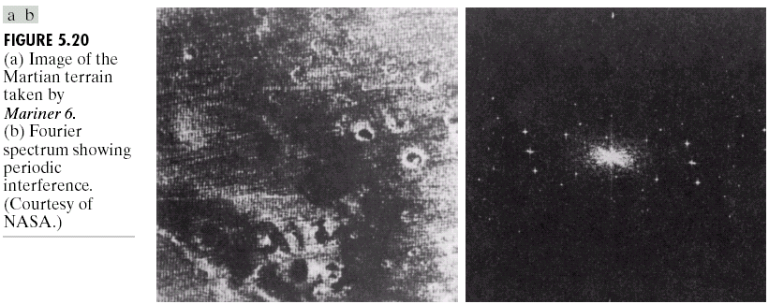
Notch Filters
Optimum notch filtering

Slide 56
Interference in Noise Pattern
  Interference noise pattern
  Interference noise pattern in the spatial domain
  Subtract from a weighted portion of to obtain
  an estimate of

Slide 57
Interference in Noise Pattern
  Minimize the local variance of
  The detailed steps are listed in Page 251 (page 341)
  Result

Slide 58
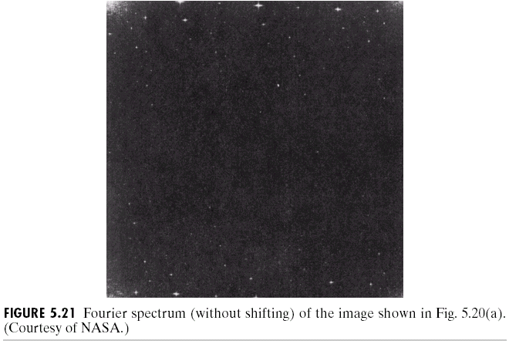
Interference in Noise Pattern

Slide 59
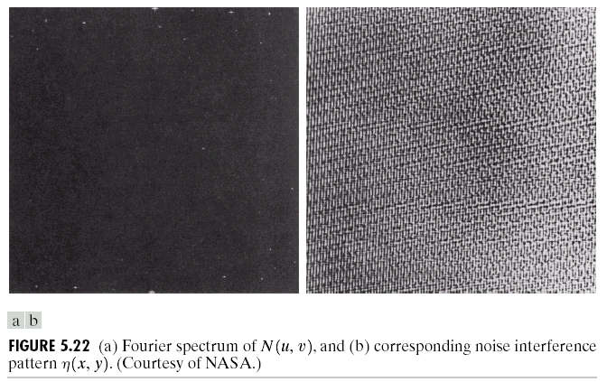
Interference in Noise Pattern

Slide 60
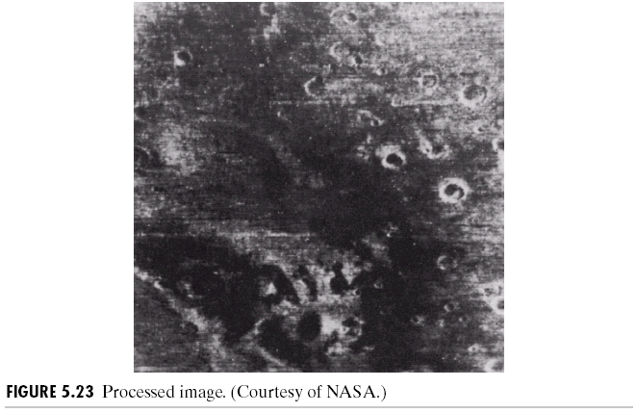
Interference in Noise Pattern

Slide 61
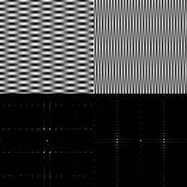
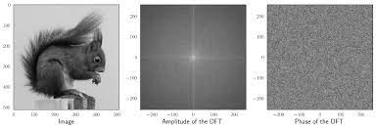
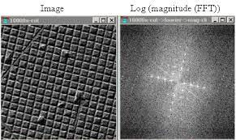
Example of Fourier Transform

Slide 62
Linear, Position-Invariant Degradations
Input-output relationship

Slide 63
Linear, Position-Invariant Degradations
H is linear if
  Additivity

Slide 64
Linear, Position-Invariant Degradations
  Homogeneity
  Position (or space) invariant, if
  for any f(x,y) and any α and ß
  This shows that the response at any point in the image depends only on the input at that point and not on its position.

Slide 65
Linear, Position-Invariant Degradations
  In terms of a continuous impulse function

Slide 66
Linear, Position-Invariant Degradations

Slide 67
Linear, Position-Invariant Degradations
  Impulse response of H
  In optics, the impulse becomes a point of light
  Point spread function (PSF)
  All physical optical systems blur (spread) a point of light to some degree

Slide 68
Linear, Position-Invariant Degradations
  Superposition (or Fredholm) integral of the first kind
  It states that if the response of H to an impulse is known, the response to any input f(α,ß) can be calculated
  So it can be said that a linear system H is completely characterized by its impulse response.

Slide 69
Linear, Position-Invariant Degradations
  If H is position invariant
  Convolution integral

Slide 70
Linear, Position-Invariant Degradations
In the presence of additive noise
  If H is position invariant

Slide 71
Linear, Position-Invariant Degradations
  If H is position invariant
  Restoration approach
    Image deconvolution
    Deconvolution filter

Slide 72
Estimating the Degradation Function
Estimation by image observation
  In order to reduce the effect of noise in our observation, we would look for areas of strong signal content

Slide 73
Estimating the Degradation Function
Estimation by experimentation
  Obtain the impulse response of the degradation by imaging an impulse (small dot of light) using the same system settings
  Observed image
  The strength of the impulse

Slide 74
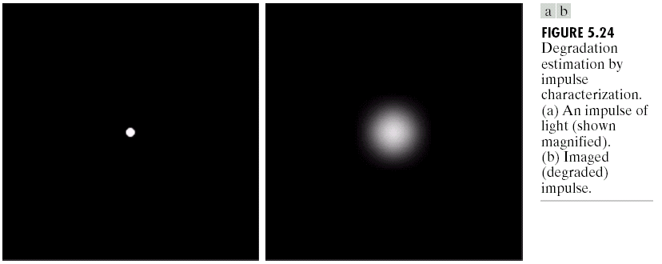
Estimating the Degradation Function

Slide 75
Estimating the Degradation Function
Estimation by modeling
  Hufnagel and Stanley
  Physical characteristic of atmospheric turbulence

Slide 76
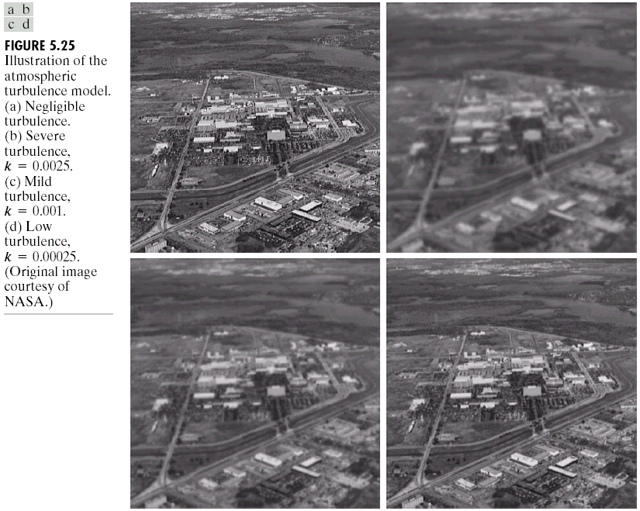

Slide 77
Estimating the Degradation Function
  Image motion

Slide 78
Estimating the Degradation Function

Slide 79
Estimating the Degradation Function
  Where

Slide 80
Degradation due to Linear Motion
  If and

Slide 81
Degradation due to Linear Motion
  If and

Slide 82
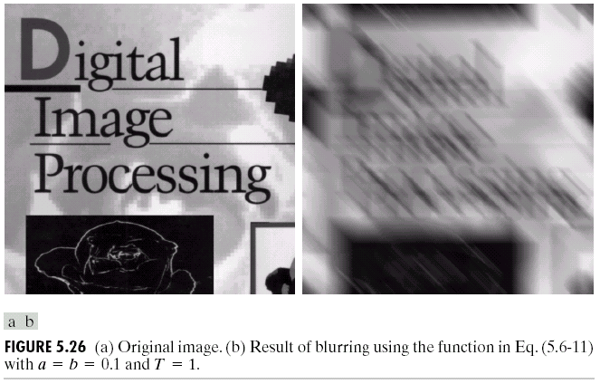

Slide 83
Inverse Filtering
Direct inverse filtering: Simplest approach to restoration where an estimate of the transform is computed as follows. is substituted for in the next line :
  This expression tells us that even if the degradation function is known the undegraded image cannot be recovered[the inverse Fourier transform of F(u,v)] as N(u,v) is unknown.
  If the degradation function has zero or very small values then the ratio N(u,v)/H(u,v) could easily dominate the estimate
  This can be prevented by limiting the filter frequencies to values near the origin as H(0,0) is usually the highest value of H(u,v) in frequency domain.

Slide 84
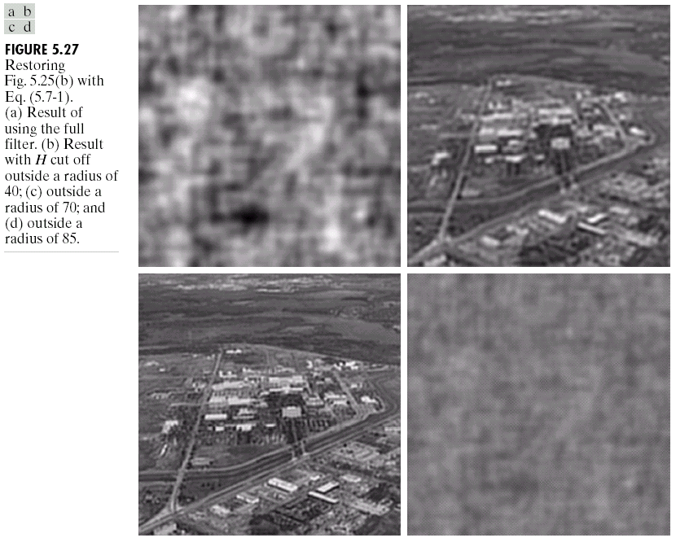

Slide 85
Minimum Mean Square Error (Wiener) Filtering
Minimize
Terms
  = degradation function
  = complex conjugate of
  =
  = power spectrum of the noise
  = power spectrum of the undegraded image

Slide 86
Wiener Filter
Wiener filter
Using the property that the product of a complex quantity with its conjugate=the magnitude of the complex quantity squared.
The result was first proposed by N. Wiener in 1942 and the Wiener filter consists of the terms inside the bracket, also came to be known as minimum mean square error or least square error filter.

Slide 87
Wiener Filter
  Dealing with spectrally white noise, the spectrum is a constant.
  However the power spectrum of the undegraded image is seldom known.
  The following expression is used when these quantities are not known.
  K is a specified constant that is added to all the terms of

Slide 88
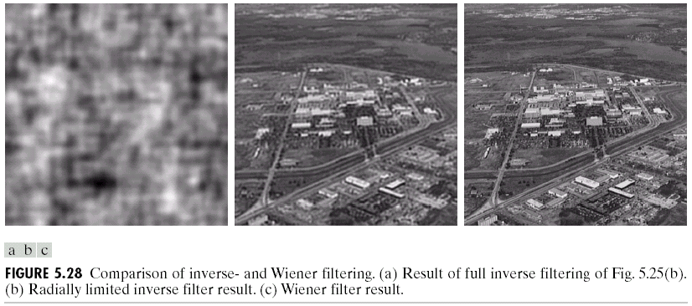
Inverse and Wiener Filter Results

Slide 89
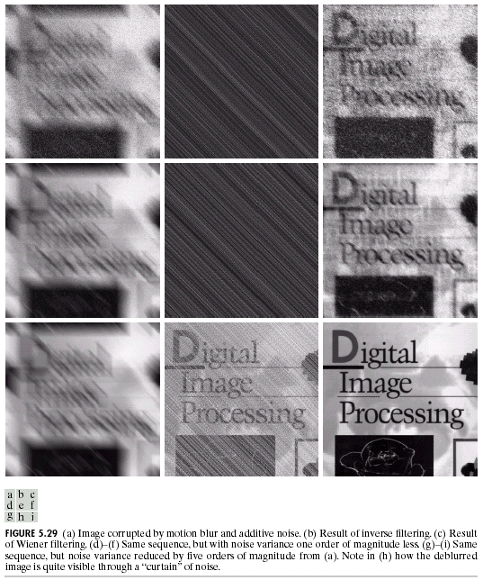
Effect of Wiener Filter on Motion Blur and Noise

Slide 90
Constrained Least Squares Filtering
In the absence of the power spectra and noise of the undegraded image approximations or estimates are used in Wiener filter with good results.
But a constant estimate of the ratio of the power spectra is not always satisfactory.
Also the Wiener filter is based on minimizing a statistical criterion and hence gives an optimal solution in an average sense
The Constrained Least Squares Filter yields an optimal solution for each image to which it is applied.
Vector-matrix form
, , :
:
Therefore the restoration problem reduces to simple matrix manipulations.

Slide 91
Constrained Least Squares Filtering
Restoration is constrained by the parameters of the problems
Minimize
  Subject to
  Where is the Euclidean vector norm and f^ is the estimate of the undegraded image.

Slide 92
Constrained Least Squares Filtering
The solution to this optimization problem is
  Where is the Fourier transform of the function
  And the parameter 𝛶 is adjusted to satisfy the above constraint. For 𝛶=0, this equation reduces to inverse filtering.

Slide 93
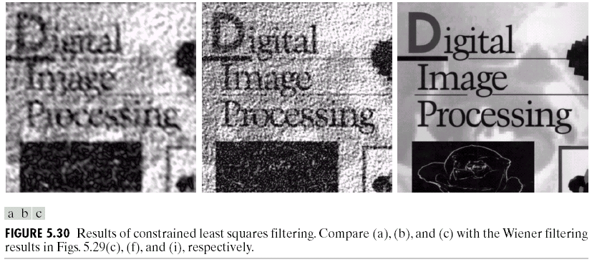
Constrained Least Squares Filtering

Slide 94
Constrained Least Squares Filtering
Computing by iteration (where a residual vector r is defined)
  Adjust so that
  Where is an accuracy factor.

Slide 95
Constrained Least Squares Filtering
  Computation

Slide 96
Constrained Least Squares Filtering
  Algorithm
  1: Specify an initial value of
  2: Compute
  3: Stop if is satisfied; otherwise return to Step 2 after increasing if or
  decreasing if .
  Use a new value of to recompute the optimum estimate

Slide 97
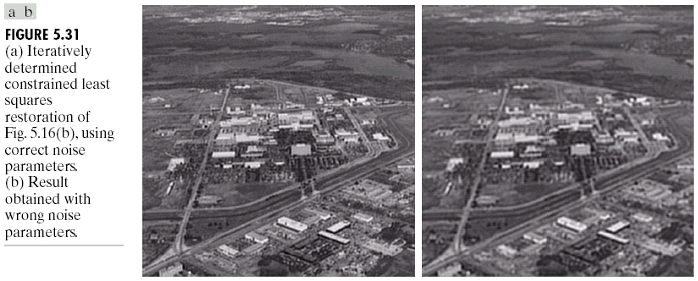
Constrained Least Squares Filtering

Slide 98
Geometric Mean Filter
Generalization of the Wiener filter results in the following filter:
With α and ß being positive real constants.
When α=1 this filter reduces to inverse filter.
When α=0 this filter reduces to parametric Wiener filter and becomes the standard Wiener filter with ß=1.
If α=1/2, the filter becomes a product of the two quantities raised to the same power,i.e. the Geometric mean
With α=1/2 and ß=1, the filter is commonly referred to as the Spectrum Equalization Filter

Slide 99
Geometric Transformations
Almost all image capturing processes involve unwanted geometric
transforms.
They are caused by
Perspective distortions
Optical distortions due to lens errors or aberration
Capturing process inherent limitations , and so forth
Geometric transforms permit to eliminate, to a large extent,
these distortions.
Only after correcting these errors it would be possible to
Derive accurate metric measurements from the images
Compare the same or similar objects in different images

Slide 100
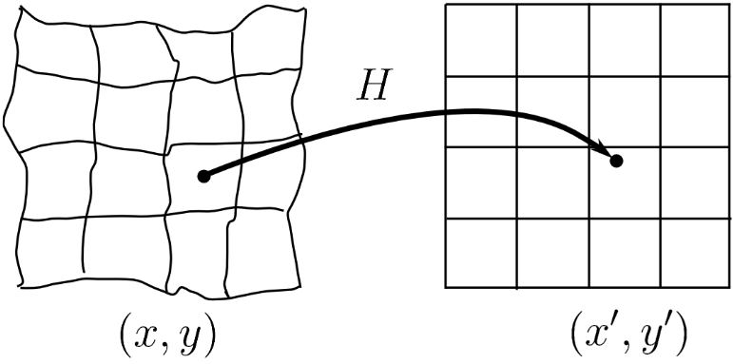
Geometric Transformations
A geometric transform is a vector function H that maps all the pixels (x,y)in the source image to a new (x´,y´) position in the rectified coordinate system with (x´,y´) = H (x´,y´)
Fig 5.1: Geometrical transform
The transformation H is either known in advance or can be determined from several known pixel correspondences in an original and transformed image pair.
Depending on the geometrical distortion one has to select the most appropriate geometrical transformation from a class of transformations.

Slide 101
Basic Steps of a Geometric Transform
Such geometric transforms consist of two basic steps:
Determining the pixel coordinates in the transformed image
Mapping of the coordinates (x,y) in the input image to
the point (x´,y´) in the output image
The output coordinates generally don't fall onto exact pixel coordinates
Determining the point in the digital raster which matches the transformed point and determining its brightness/colour
Brightness/colour is usually computed as an interpolation of several points in the neighbourhood

Slide 102
The Hierarchy of Geometric Transformations
The projective transformations form in a mathematical sense a group known as the projective linear group. This group can be split into various sub-groups with special properties and increasing complexity (degrees-of-freedom DOF).
Class I: Isometries (translation, rotation, rigid) Class II: Similarity transformations
Class III: Aﬀine transformations Class IV: Projective transformations
The most general case of geometric transformation is the Free-form or curved transformation
It, however, doesn't ﬁt in the nice mathematical framework of the projective linear group.

Slide 103
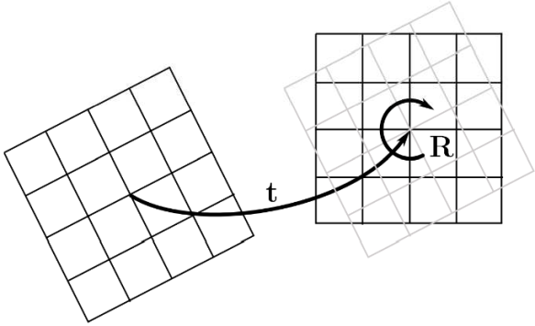
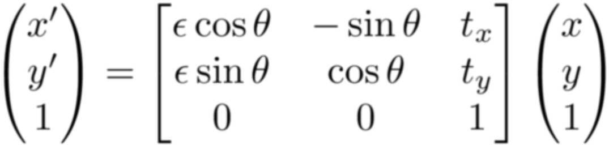



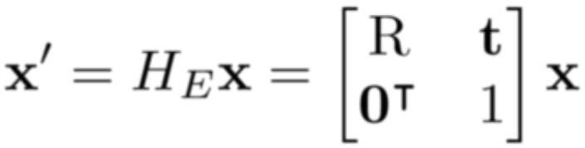
Class I: Isometries
Isometries are transformations of the plane that preserve Euclidean distance thus the term isometry (from iso = same, metric = measure).
Fig 5.3: Isometry =
Translation + Rotation
Fig.(5.1)
where . If then the isometry is orientation- preserving and is composed of a translation and rotation. If then the isometry reverses orientation.
The above equation can be written more concisely in block form as Fig. (5.2)
where R is a 2x2 (orthogonal) rotation matrix, t, a translation vector, and 0 a null vector.

Slide 104
Class I: Isometries
Degrees of Freedom
Isometries have 3 degrees-of-freedom (DOF): one for rotation (Ø ) and two for translation(tx, ty), The Isometry can be computed from two point correspondences
Invariants
Lengths (distance between two points) Angles (angle between two lines)
Area

Slide 105
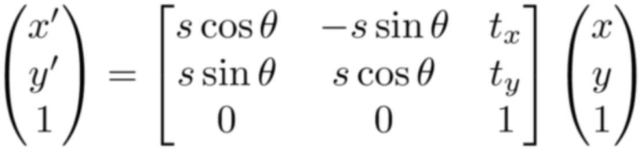
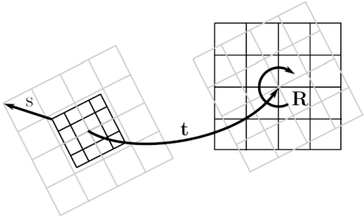
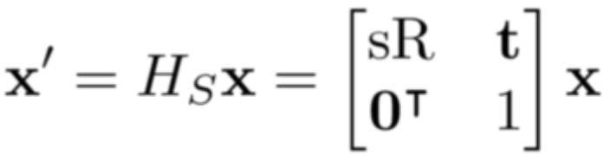
Class II: SimilarityTransformations
A similarity transformation is an isometry composed with an isotropic scaling, i.e. Fig. (5.4)
Fig 5.6: Similarity =
Translation + Rotation + Isotropic Scaling
The above equation can be written more concisely in block form as
(5.5)
where R is a 2x2 (orthogonal) rotation matrix, t, a translation vector, and 0 a null vector

Slide 106
Class II: Similarity Transformations (2)
Degrees of Freedom
Similarity Transformations have 4 DOF: one for rotation , two for translation , and one for scaling
A similarity can be computed from two point correspondences
Invariants
Angles (angle between two lines)
Parallel lines are mapped to parallel lines
The length between two points is not invariant, but the ratio of two lengths is
Similarly the ratio of areas is invariant (because the squared scaling cancels out)

Slide 107






Class II: Similarity Transformations Example
Similarity transformation with
Fig 5.7: Original image
Fig 5.8: Image after similarity transformation
yielding a transformation matrix

Slide 108



Class II: Practical Issues
The matrix elements of H should not be estimated directly
Estimate the Euler angle scaling s, and translation parameters instead.

Slide 109




Class III: Aﬀine Transformations
An aﬀine transformation is a
non-singular linear transformation (rotation, scaling and skewing) followed by a translation, i.e.
fFig 5.9: Aﬀine =
Non-singular linear transformation + Translation
The above equation can be written more concisely in block form as
(5.8)
fFig 5.9: Aﬀine =
Non-singular linear transformation + Translation
Where A is a 2x2 non-singular matrix, t a translation vector
and 0a null vector.
An aﬀinity is orientation-preserving or -reversing if
Is positive or negative respectively .

Slide 110

Class III: Aﬀine Transformations
Degrees of Freedom
Aﬀine Transformations have 6 DOF: four for the non-singular matrix A , and two for translation
An aﬀinity can be computed from three point correspondences
Invariants
Parallel lines are mapped to parallel lines Ratio of lengths of parallel line segments Ratio of areas

Slide 111





Class III: AﬀineTransformation
Aﬀine transformation with
yielding a transformation matrix
Fig 5.10: Original image
Fig 5.11: Image after aﬀine transformation

Slide 112

Class III: Practical Issues
The use of the aﬀine transform rather than the similarity transform (rigid) does not greatly increase its applicability in medicine, as there are no organs that only stretch or shear.
Tissues normally deform in more complex non-rigid ways.
There are, however, scanner introduced errors than can result in skewing terms
Tilted gantry in CT acquisitions
Tilted plane in optical image acquisitions such as microscope or endoscope
and aﬀine transforms are used to overcome these problems.
Nevertheless, the aﬀine transformation is often used
for registration, as no care has to be taken that form a proper rotation
matrix.

Slide 113







Class IV: Projective Transformations
A projective transformation is a general non-singular
linear transformation of homogeneous coordinates, i.e.
(5.9)
The above equation is often written more concisely in block form as
(5.10)
Fig. 5.12: General non-singular
linear transformation
where is a vector , a non-singular matrix, T a translation vector, and the scaling parameters.

Slide 114
Class IV: Projective Transformations
Degrees of Freedom
Projective Transformations have 8 DOF
A projective transformation can be computed from four point correspondences (with no three collinear on either plane)
Invariants
The most fundamental projective invariant is the cross ratio (ratio of ratio) of four collinear points

Slide 115



Class IV: Projective Transformation Example
Projective transformation with a transformation matrix
Fig 5.13: Original image
Fig 5.14: Image after projective transformation

Slide 116

Geometric Transformations
Spatial transformations
  Tiepoints

Slide 117

Geometric Transformations

Slide 118


Geometric Transformations

Slide 119


Slide 120

End of Lecture
Chapter 5

