Slide 1
Intensity Transforms

Slide 2
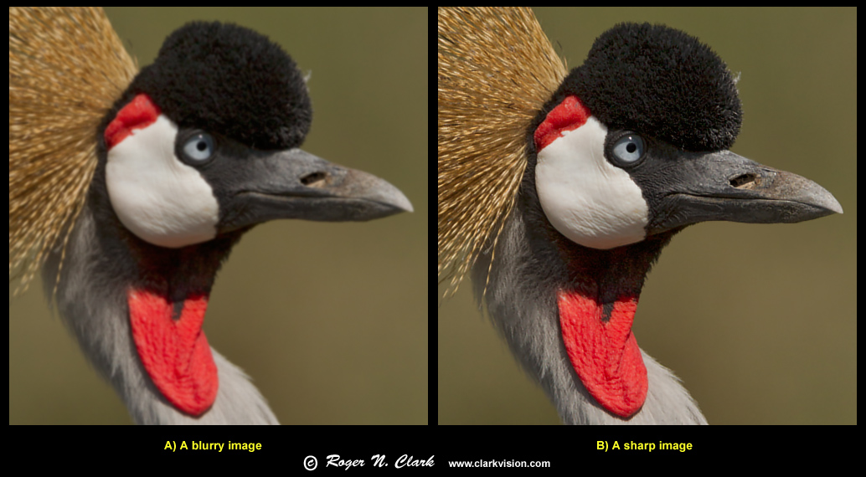
Chapter 3
Lecture 4: Intensity Transforms

Slide 3
Contents
Basic Intensity Transformation Functions
Histogram Processing
Fundamentals of Spatial Filtering
Combined Spatial Enhancement Methods

Slide 4
Image Enhancement (Spatial)
Image enhancement:
Improving the interpretability or perception of information in images for human viewers
Providing `better' input for other automated image processing techniques
Spatial domain methods:
Operate directly on pixels
Frequency domain methods:
Operate on the Fourier transform of an image

Slide 5
Point Processing
The simplest kind of range transformations are those independent of position x,y:
g = T(f)
This is called point processing.
Important: every pixel for itself – spatial information completely lost!

Slide 6
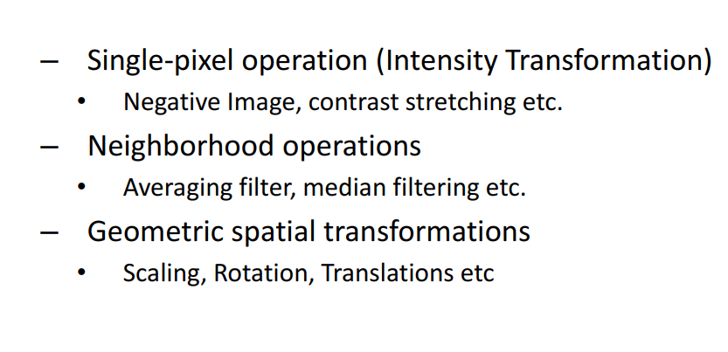
Spatial Operations

Slide 7
Point Processing
Spatial Domain methods operate directly on image pixels
G(x,y)=T[f(x,y)]
T operates only on one pixel
S=T(r)

Slide 8
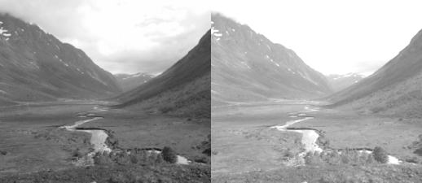
Single Pixel Operations
When changing the brightness of an image, a constant is added or subtracted from the luminance of all sample values. This is equivalent to shifting the contents of the histogram left (subtraction) or right (addition).

Slide 9
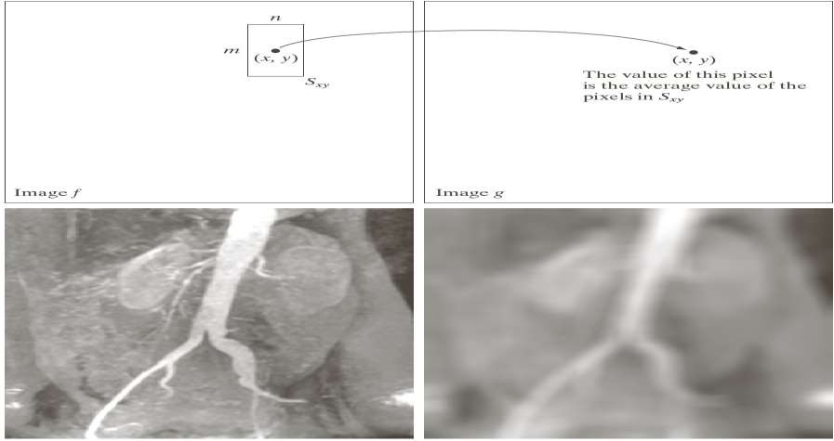
Neighborhood Operations

Slide 10
Image Enhancement
The objective of image enhancement is to process an image so that the result is more suitable than the original image for a specific application.
There are two main approaches:
  Image enhancement in spatial domain: Direct manipulation of pixels in an image
    Point processing: Change pixel intensities
    Spatial filtering
  Image enhancement in frequency domain: Modifying the Fourier transform of an image

Slide 11
Some Basic Intensity Transformation Functions
Image Negatives
s = L – 1 – r
  S is the output intensity value
  L is the highest intensity levels
  r is the input intensity value
  Particularly suited for enhancing white or gray detail embedded in dark regions of an image, especially when the black areas are dominant in size

Slide 12
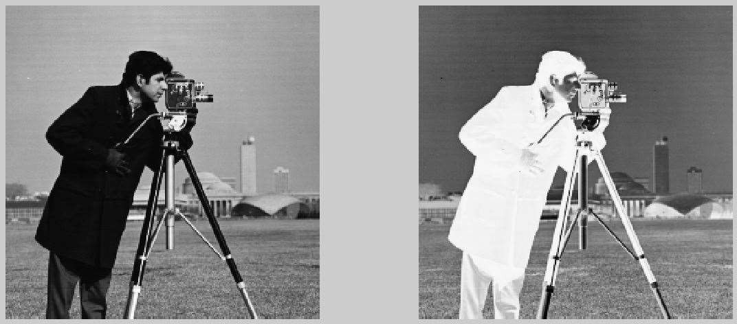
Some Basic Intensity Transformation Functions
Image Negatives

Slide 13
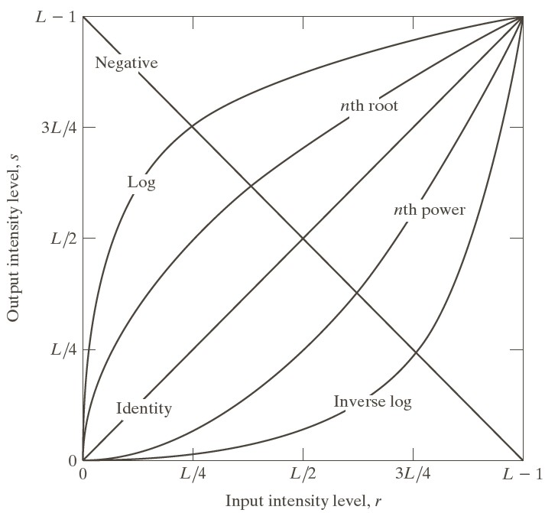
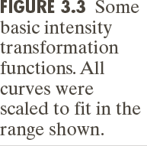
Some Basic Intensity Transformation Functions

Slide 14
Some Basic Intensity Transformation Functions
Log Transformations
  s = c log(1 + r)
    c is constant
  It maps a narrow range of low intensity values in the input into a wide range of output levels
  The opposite is true of higher values of input levels
  It expands the values of dark pixels in an image while compressing the higher level values
  It compresses the dynamic range of images with large variations in pixel values

Slide 15
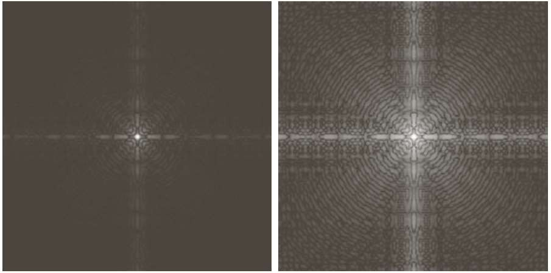
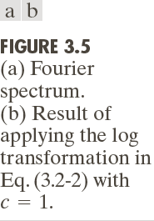
Some Basic Intensity Transformation Functions
Log Transformations

Slide 16
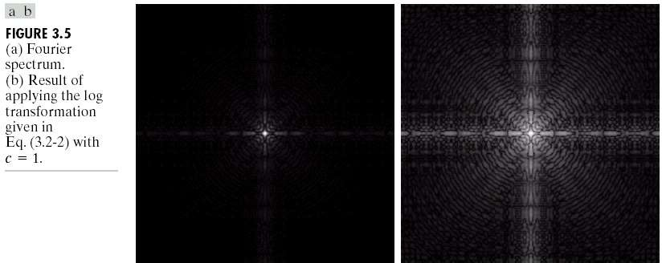
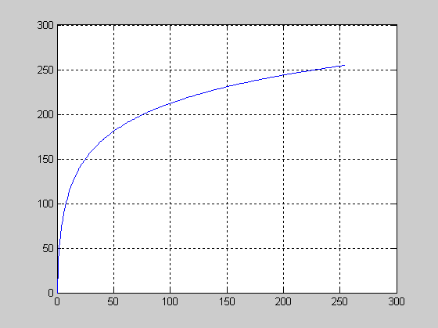
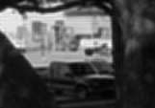
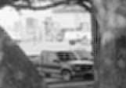
Log Transform
T (r) = c log(1+ r)

Slide 17
Some Basic Intensity Transformation Functions
Power Law (Gamma) Transformations
  s = c r^{γ}
    c and γ are both positive constants
  With fractional values(0<γ<1) of gamma map a narrow range of dark input values into a wider range of output values, with the opposite being true for higher values (γ >1)of input levels.
  C=gamma=1 means it is an identity transformations.
  Variety of devices used for image capture , printing, and display respond according to a power law.
  Process used to correct these power law response phenomena is called gamma correction.

Slide 18
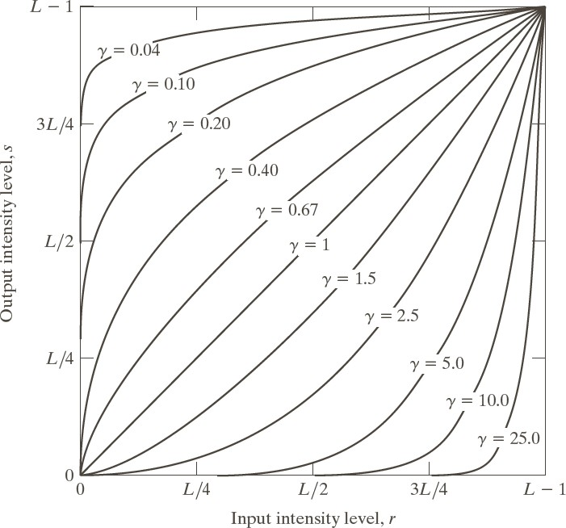
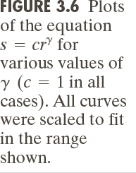
Some Basic Intensity Transformation Functions
Power Law (Gamma) Transformations

Slide 19
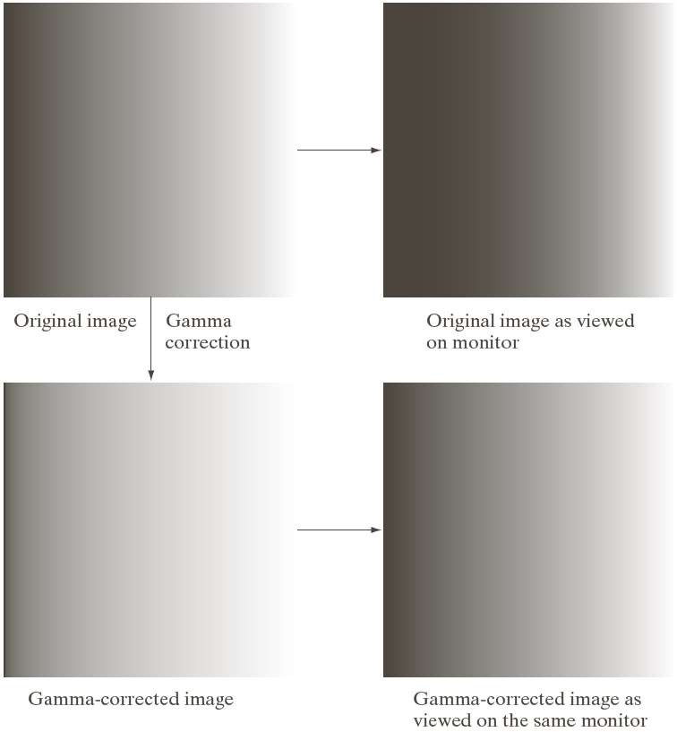
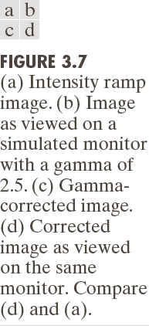
Some Basic Intensity Transformation Functions

Slide 20
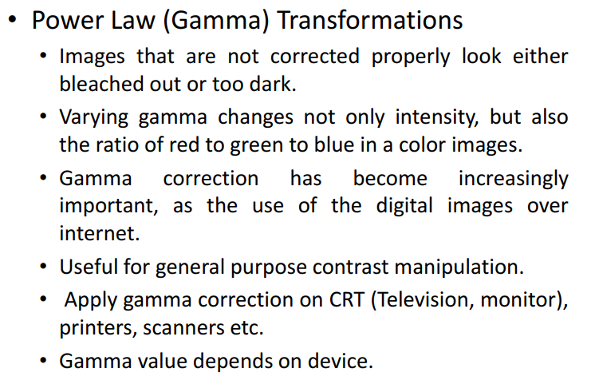
Some Basic Intensity Transformation Functions

Slide 21
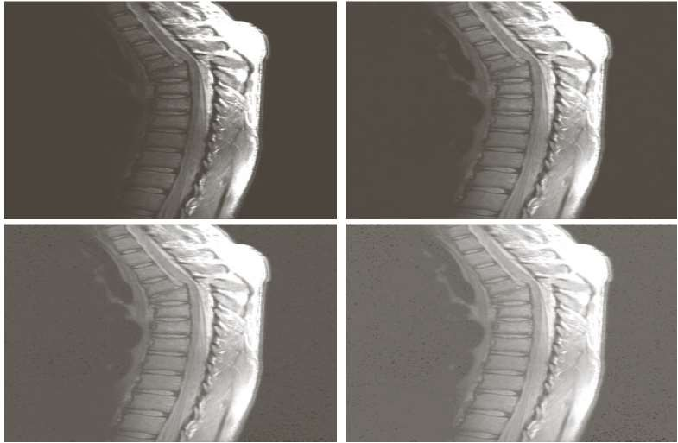
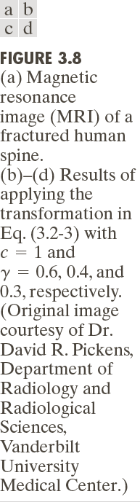
Some Basic Intensity Transformation Functions

Slide 22
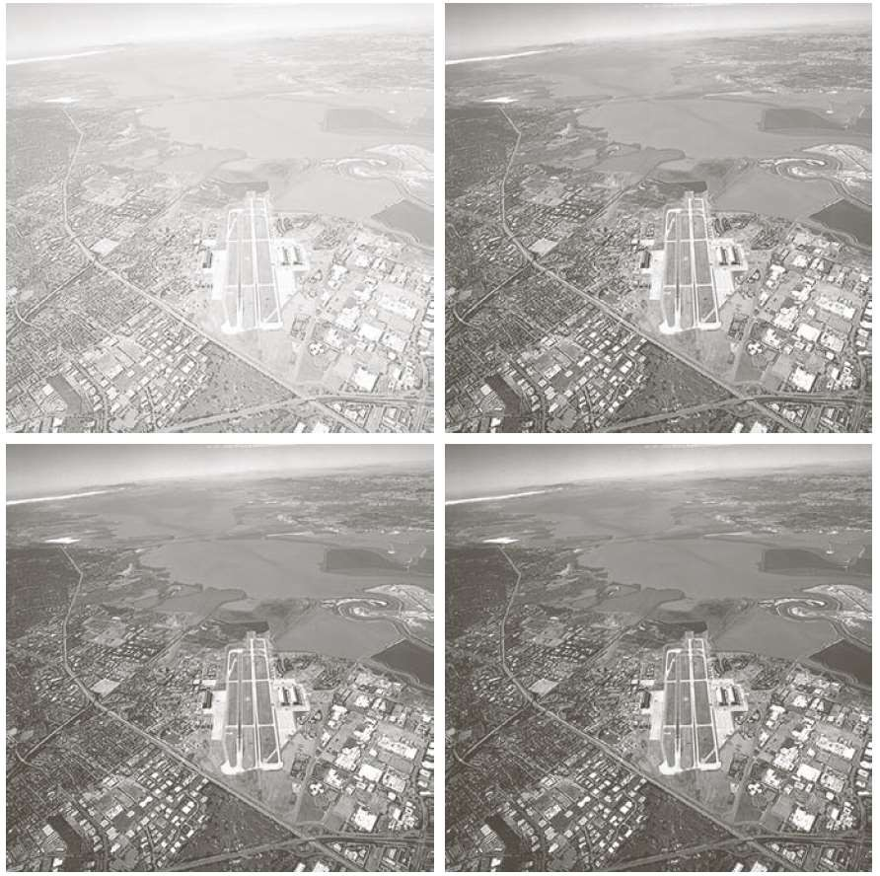
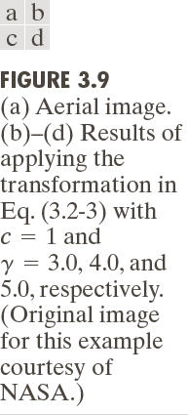
Some Basic Intensity Transformation Functions

Slide 23
Piecewise-Linear Transformation Functions
Contrast Stretching
  Low contrast images can result from poor illuminations.
  Lack of dynamic range in the imaging sensor, or even the wrong setting of a lens aperture during image acquisition.
  It expands the range of intensity levels in an image so that it spans the full intensity range of display devices.
  Contrast stretching is obtained by setting
  (r1,s1) = (r_{min} , 0) and (r2,s2) = (r_{max} , L-1)

Slide 24
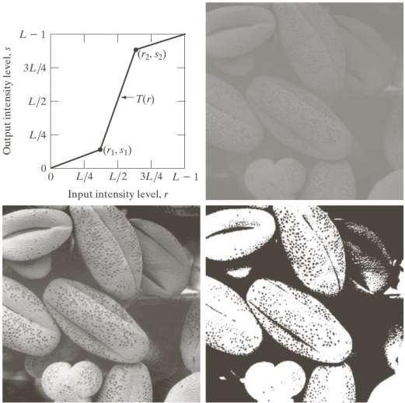
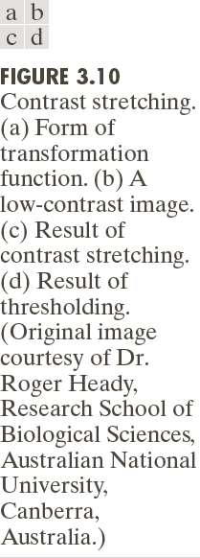
Piecewise-Linear Transformation Functions

Slide 25
Piecewise-Linear Transformation Functions
Intensity Level Slicing
  Highlighting specific range of intensities in an image.
  Enhances features such as masses of water in satellite imagery and enhancing flaws in X-ray images.
  It can be Implemented two ways:
  1) To display only one value (say, white) in the range of interest and rests are black which produces binary image.
  2) brightens (or darkens) the desired range of intensities but leaves all other intensity levels in the image unchanged.

Slide 26
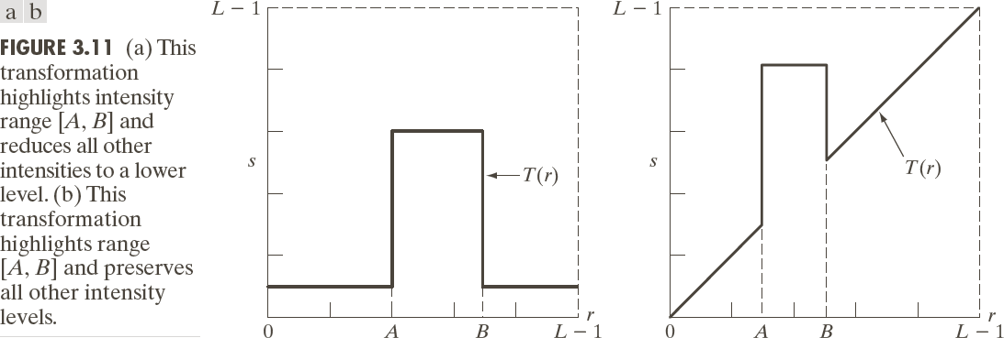
Piecewise-Linear Transformation Functions
Intensity Level Slicing

Slide 27
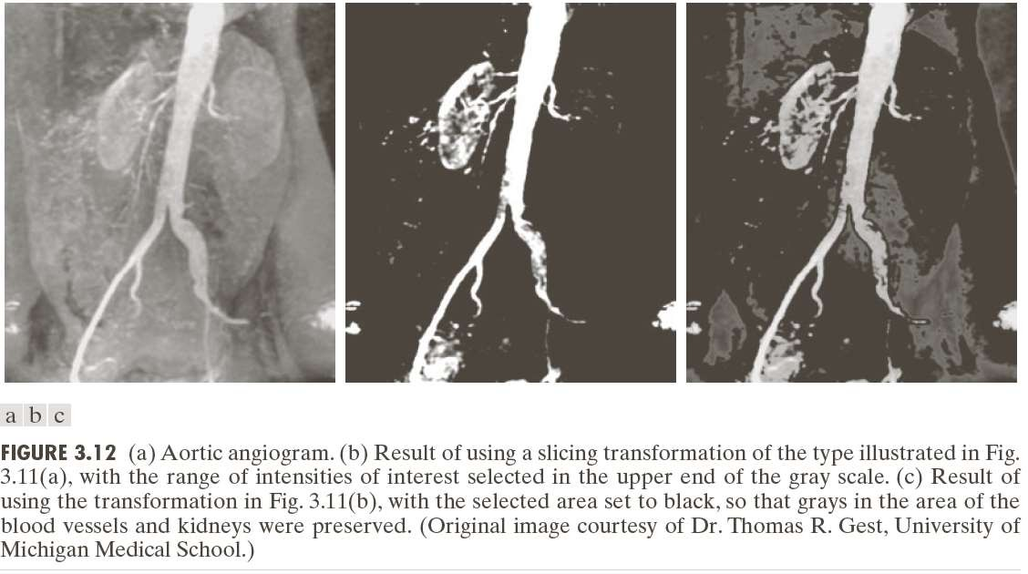
Piecewise-Linear Transformation Functions
Intensity Level Slicing

Slide 28
Piecewise-Linear Transformation Functions
Bit Plane Slicing
  Pixels are digital numbers composed of bits.
  256 gray scale image is composed of 8 bits.
  Instead of highlighting intensity level ranges, we could highlight the contribution made to total image appearance by specific bits.
  8-bit image may be considered as being composed of eight 1-bit planes, with plane 1 containing the lowest- order bit of all pixels in the image and plane 8 all the highest-order bits.

Slide 29
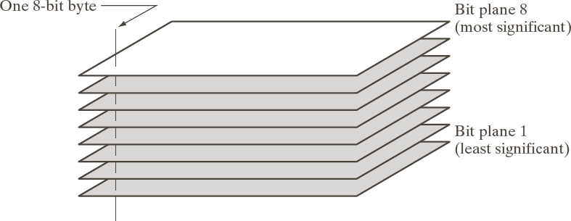
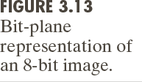
Piecewise-Linear Transformation Functions
Bit Plane Slicing

Slide 30
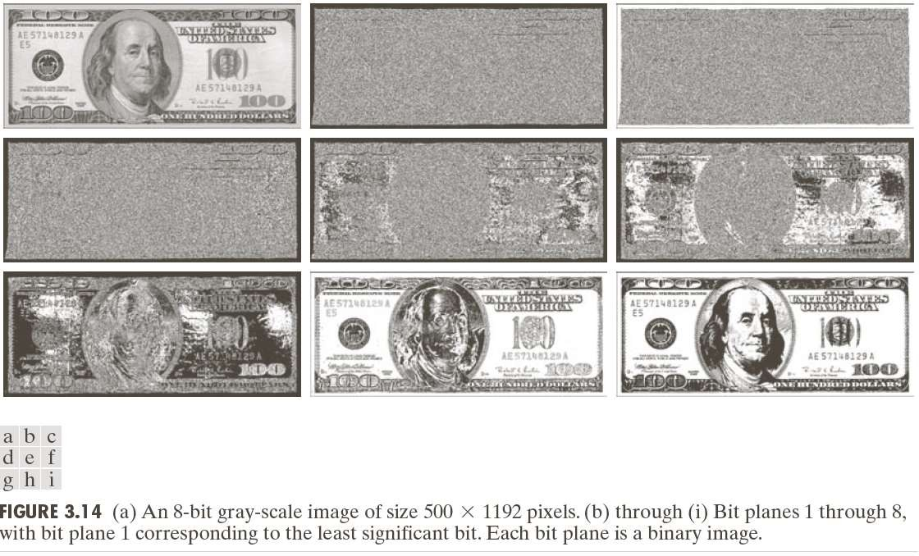
Piecewise-Linear Transformation Functions
Bit Plane Slicing

Slide 31
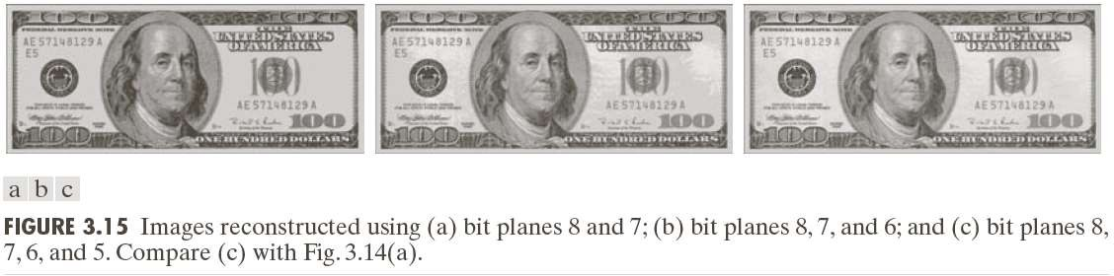
Piecewise-Linear Transformation Functions
Bit Plane Slicing

Slide 32
Histogram Processing
Histogram of a digital image with intensity levels in the range [0,L-1] is a discrete function h(r_{k}) = n_{k ,} where r_{k} is the kth intensity value and n_{k} is the number of pixels in the image with intensity r_{k}
Normalized histogram p(r_{k})=n_{k}/MN, for k = 0,1,2..….. L-1.
Histogram manipulation can be used for image enhancement.
Information inherent in histogram also is quite useful in other image processing applications, such as image compression and segmentation.

Slide 33
Histogram Equalization
Intensity mapping form
s = T (r), 0 ≤ r ≤ L −1
Conditions:
a) T(r) is a monotonically increasing function in the
interval [0, L-1] and
0 ≤ T (r) ≤ L −1 for0 ≤ r ≤ L −1
In some formulations, we use the inverse in which case
r = T ⁻¹ (s), 0 ≤ s ≤ 1
(a) change to
a’) T(r) is a strictly monotonically increasing function in the interval [0, L-1]
b)

Slide 34
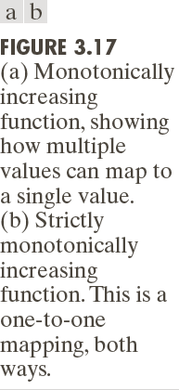
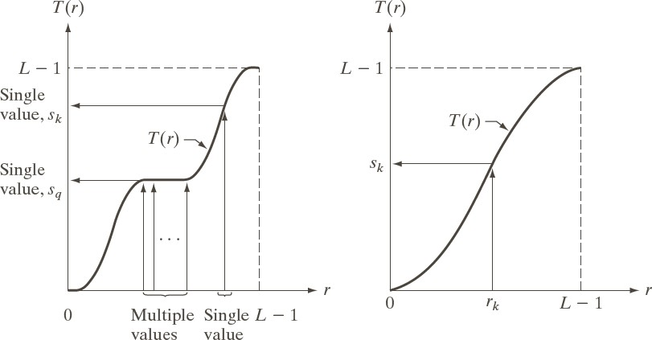
Histogram Processing

Slide 35
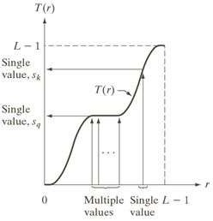
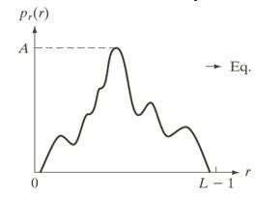
Histogram Processing

Slide 36
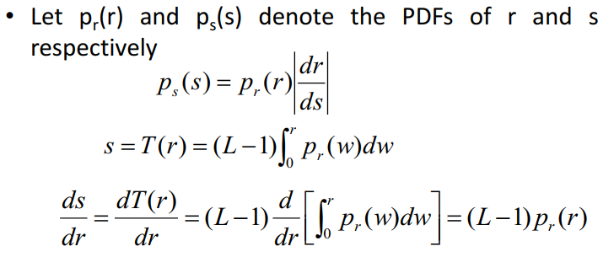
Histogram Equalization
Intensity levels in an image may be viewed as random variables in the interval [0,L-1]
Fundamental descriptor of a random variable is its probability density function (PDF)
r

Slide 37
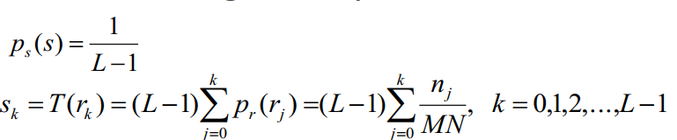
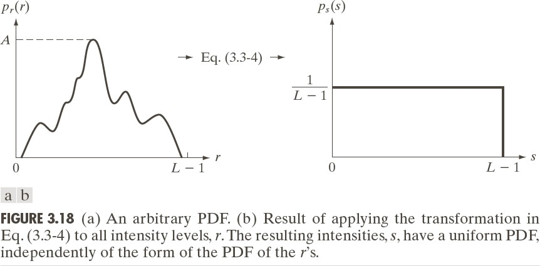
Histogram Processing

Slide 38
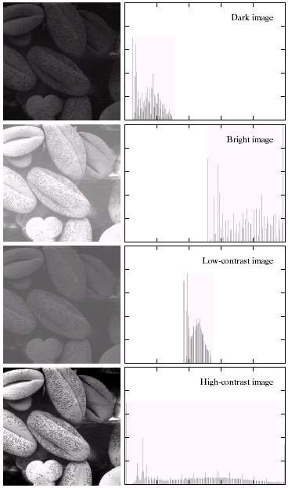
Histogram Processing

Slide 39
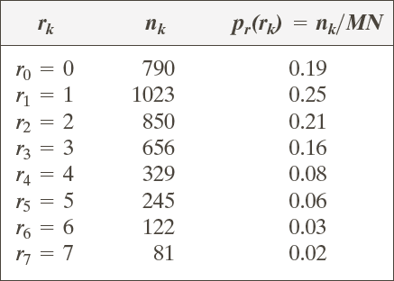
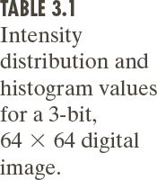
Histogram Equalization

Slide 40
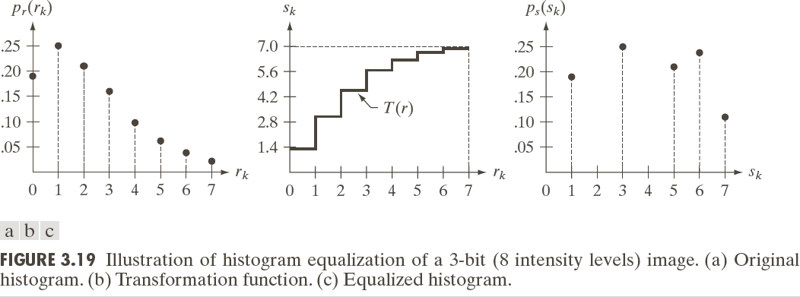
Histogram Processing

Slide 41
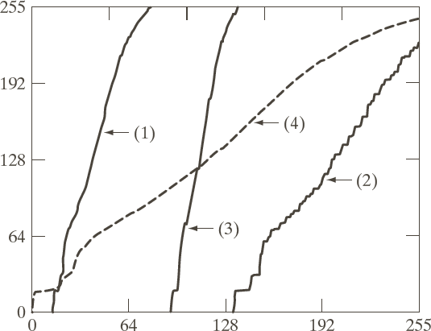
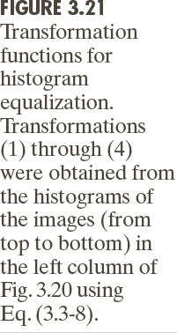
Histogram Processing
Transformation functions

Slide 42
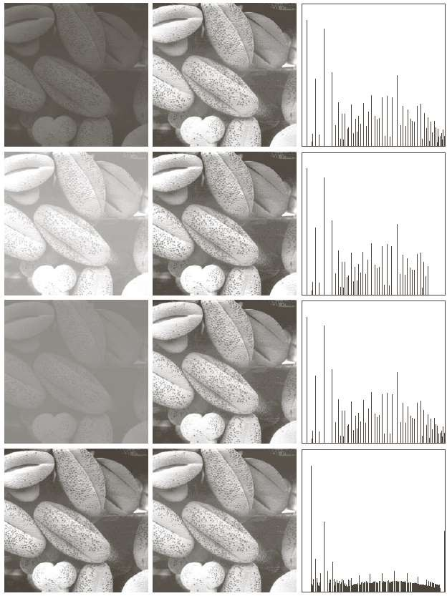
Histogram Equalization

Slide 43
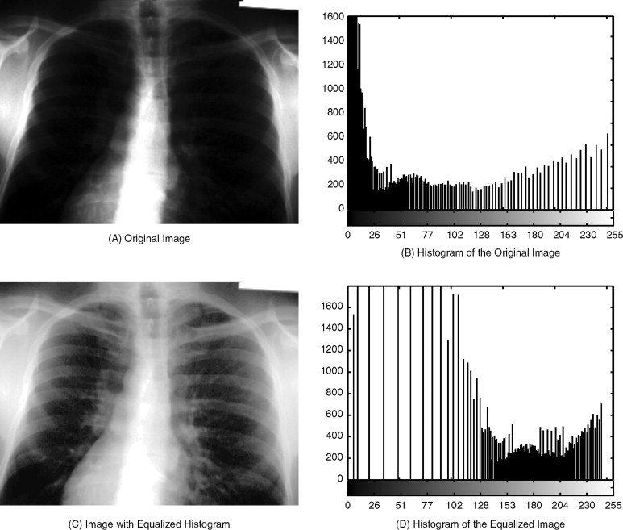
Histogram Equalization

Slide 44
Histogram Matching (Specification)
Histogram equalization automatically determines a transformation function produce uniform histogram
When automatic enhancement is desired, equalization is a good approach
There are some applications in which attempting to base enhancement on a uniform histogram is not the best approach
In particular, it is useful sometimes to be able to specify the shape of the histogram that we wish the processed image to have.
The method used to generate a processed image that has a specified histogram is called histogram matching or specification

Slide 45
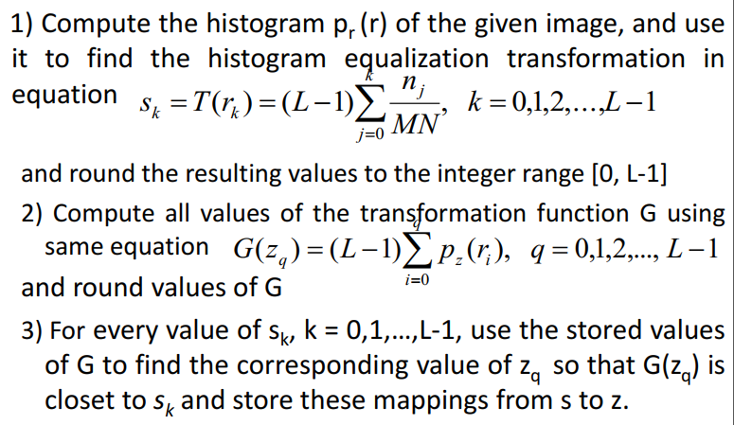
Histogram Matching (Specification)
Histogram Specification Procedure:

Slide 46
Histogram Matching (Specification)
Histogram Specification Procedure:
4) Form the histogram-specified image by first histogram- equalizing the input image and then mapping every equalized pixel value, s_{k} , of this image to the corresponding value z_{q} in the histogram-specified image using the mappings found in step 3.

Slide 47
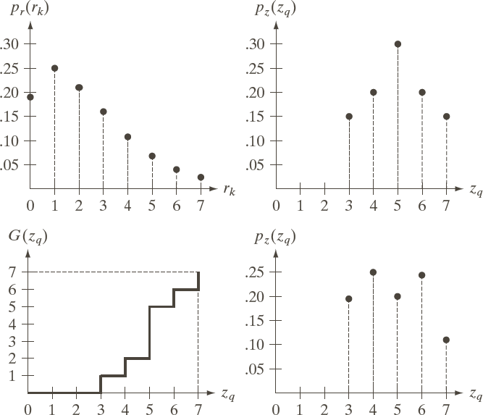
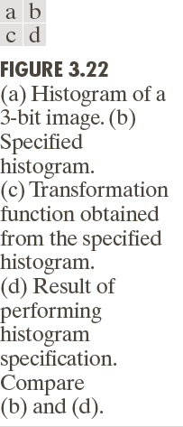
Histogram Matching

Slide 48
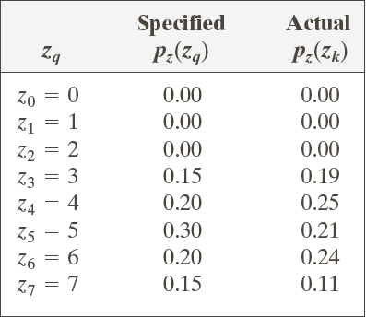
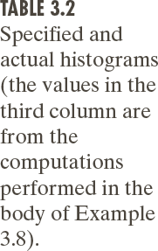
Histogram Matching

Slide 49





Histogram Matching
r_{k} | S_{k} | G(Z_{q})
0 | 1 | 0
1 | 3 | 0
2 | 5 | 0
3 | 6 | 1
4 | 6 | 2
5 | 7 | 5
6 | 7 | 6
7 | 7 | 7

Slide 50


Histogram Matching

Slide 51


Histogram Matching

Slide 52


Histogram Matching

Slide 53


Histogram Matching

Slide 54
Local Histogram Processing
Histogram Processing methods discussed in the previous two sections are Global, in the sense that pixels are modified by a transformation function based on the intensity distribution of an entire image.
There are some cases in which it is necessary to enhance detail over small areas in an image.
This procedure is to define a neighborhood and move its center pixel to pixel.
At each location, the histogram of the points in the neighborhood is computed and either a histogram equalization or histogram specification transformation function is obtained.
Map the intensity of the pixel centered in the neighborhood.
Center of the neighborhood region is then moved to an adjacent pixel location and the procedure is repeated.

Slide 55
Local Histogram Processing
This approach has obvious advantages over repeatedly computing the histogram of all pixels in the neighborhood region each time the region is moved one pixel location.
Another approach used sometimes to reduce computation is to utilize non overlapping regions, but this method usually produces an undesirable “blocky” effect.

Slide 56

Local Histogram Processing

Slide 57
Spatial Filtering
Also called spatial masks, kernels, templates, and windows.
It consists of (1) a neighborhood (typically a small window), and (2) a predefined operation that is performed on the image pixels encompassed by the neighborhood.
Filtering creates a new pixel with coordinates equal to the center of the neighborhood.
If operation is linear, then filter is called a linear spatial filter otherwise nonlinear.

Slide 58

Mechanics of Spatial Filtering

Slide 59
Spatial Correlation & Convolution
Correlation is the process of moving a filter mask over the image and computing the sum of the products at each location.
Convolution process is same except that the filter is first rotated by 180 degree.

Slide 60


Slide 61



Slide 62
Smoothing Spatial Linear Filters
Also called averaging filters or Lowpass filter.
By replacing the value of every pixel in an image by the average of the intensity levels in the neighborhood defined by the filter mask.
Reduced “sharp” transition in intensities.
Random noise typically consists of sharp transition.
Edges also characterized by sharp intensity transitions, so averaging filters have the undesirable side effect that they blur edges.
If all coefficients are equal in filter than it is also called a box filter.

Slide 63

Smoothing Spatial Linear Filters
Center points.
Strategy
point is more weighted than any other
behind weighing the center point the
highest and then reducing value of the coefficients as a function of increasing distance from the origin is simply an attempt to reduce blurring in the smoothing process.
Intensity of smaller object blends with background.

Slide 64


Smoothing Linear Filter

Slide 65


Slide 66


Slide 67
Order-Statistic (Nonlinear) Filters
Response is based on ordering (ranking) the pixels contained in the image area encompassed by the filter, and then replacing the value of the center pixel with the value determined by the ranking result.
Best-known filter is median filter.
Replaces the value of a center pixel by the median of the intensity values in the neighborhood of that pixel.
Used to remove impulse or salt-pepper noise.
Larger clusters are affected considerably less. ?
Median represents the 50th percentile of a ranked set of numbers while 100th or 0th percentile results in the so- called max filter or min filter respectively.

Slide 68

Median Filter (Nonlinear)

Slide 69


Median Filter (Nonlinear)

Slide 70

Sharpening Spatial Filters
Averaging is analogous to integration, so sharpening is analogous to spatial differentiation.
Thus, image differentiation enhances edges and other discontinuities (such as noise) and deemphasizes areas with slowly varying intensities.

Slide 71
Foundation
Definition for a first order derivative (1) must be zero in areas of constant intensity (2) must be nonzero at the onset of an intensity step or ramp and (3) must be nonzero along ramps.
For a second order derivatives (1) must be zero in constant areas (2) must be nonzero at the onset and (3) must be zero along ramps of constant slope.
First order derivative of a one dimensional function f(x) is the difference of f(x+1) – f(x).
Second order = f(x+1) + f(x-1) -2f(x)

Slide 72



Slide 73




Second Derivatives-The Laplacian

Slide 74


Second Derivatives - The Laplacian

Slide 75

Second Derivatives-The Laplacian

Slide 76



Slide 77


Unsharp Masking and High boost Filtering

Slide 78
Unsharp Masking and High boost Filtering
Unsharp Masking
  Read Original Image f(x,y)
  Blurred original image f’(x,y)
  Mask = f(x,y) – f’(x,y)
  g(x,y) = f(x,y) + Mask
High Boost Filtering
  Read Original Image f(x,y)
  Blurred original image f’(x,y)
  Mask = f(x,y) – f’(x,y)
  g(x,y) = f(x,y) + k*Mask, where k>1

Slide 79


Unsharp Masking and High boost Filtering

Slide 80



First Derivative – The Gradient

Slide 81



Slide 82



Slide 83


Combining Spatial Enhancement Methods

Slide 84


Combining Spatial Enhancement Methods

Slide 85


End of Lecture
Chapter 3 of Digital Image Processing by R.C. Gonzalez and R.E. Woods

