Slide 1
Chapter 12: I/O Systems
Sheli Sinha Chaudhuri
Professor
ETCE Department

Slide 2
I/O Systems
Overview
I/O Hardware
Application I/O Interface
Kernel I/O Subsystem
Transforming I/O Requests to Hardware Operations
STREAMS
Performance

Slide 3
Objectives
Explore the structure of an operating system’s I/O subsystem
Discuss the principles and complexities of I/O hardware
Explain the performance aspects of I/O hardware and software

Slide 4
Overview
I/O management is a major component of operating system design and operation
  Important aspect of computer operation
  I/O devices vary greatly
  Various methods to control them
  Performance management
  New types of devices frequent
Ports, busses, device controllers connect to various devices
Device drivers encapsulate device details
  Present uniform device-access interface to I/O subsystem

Slide 5
I/O Hardware
Incredible variety of I/O devices
  Storage
  Transmission
  Human-interface
Common concepts – signals from I/O devices interface with computer
  Port – connection point for device
  Bus - daisy chain or shared direct access
    PCI bus common in PCs and servers, PCI Express (PCIe)
    expansion bus connects relatively slow devices
    Serial-attached SCSI (SAS) common disk interface

Slide 6
I/O Hardware (Cont.)
  Controller (host adapter) – electronics that operate port, bus, device
    Sometimes integrated
    Sometimes separate circuit board (host adapter)
    Contains processor, microcode, private memory, bus controller, etc.
      Some talk to per-device controller with bus controller, microcode, memory, etc.

Slide 7
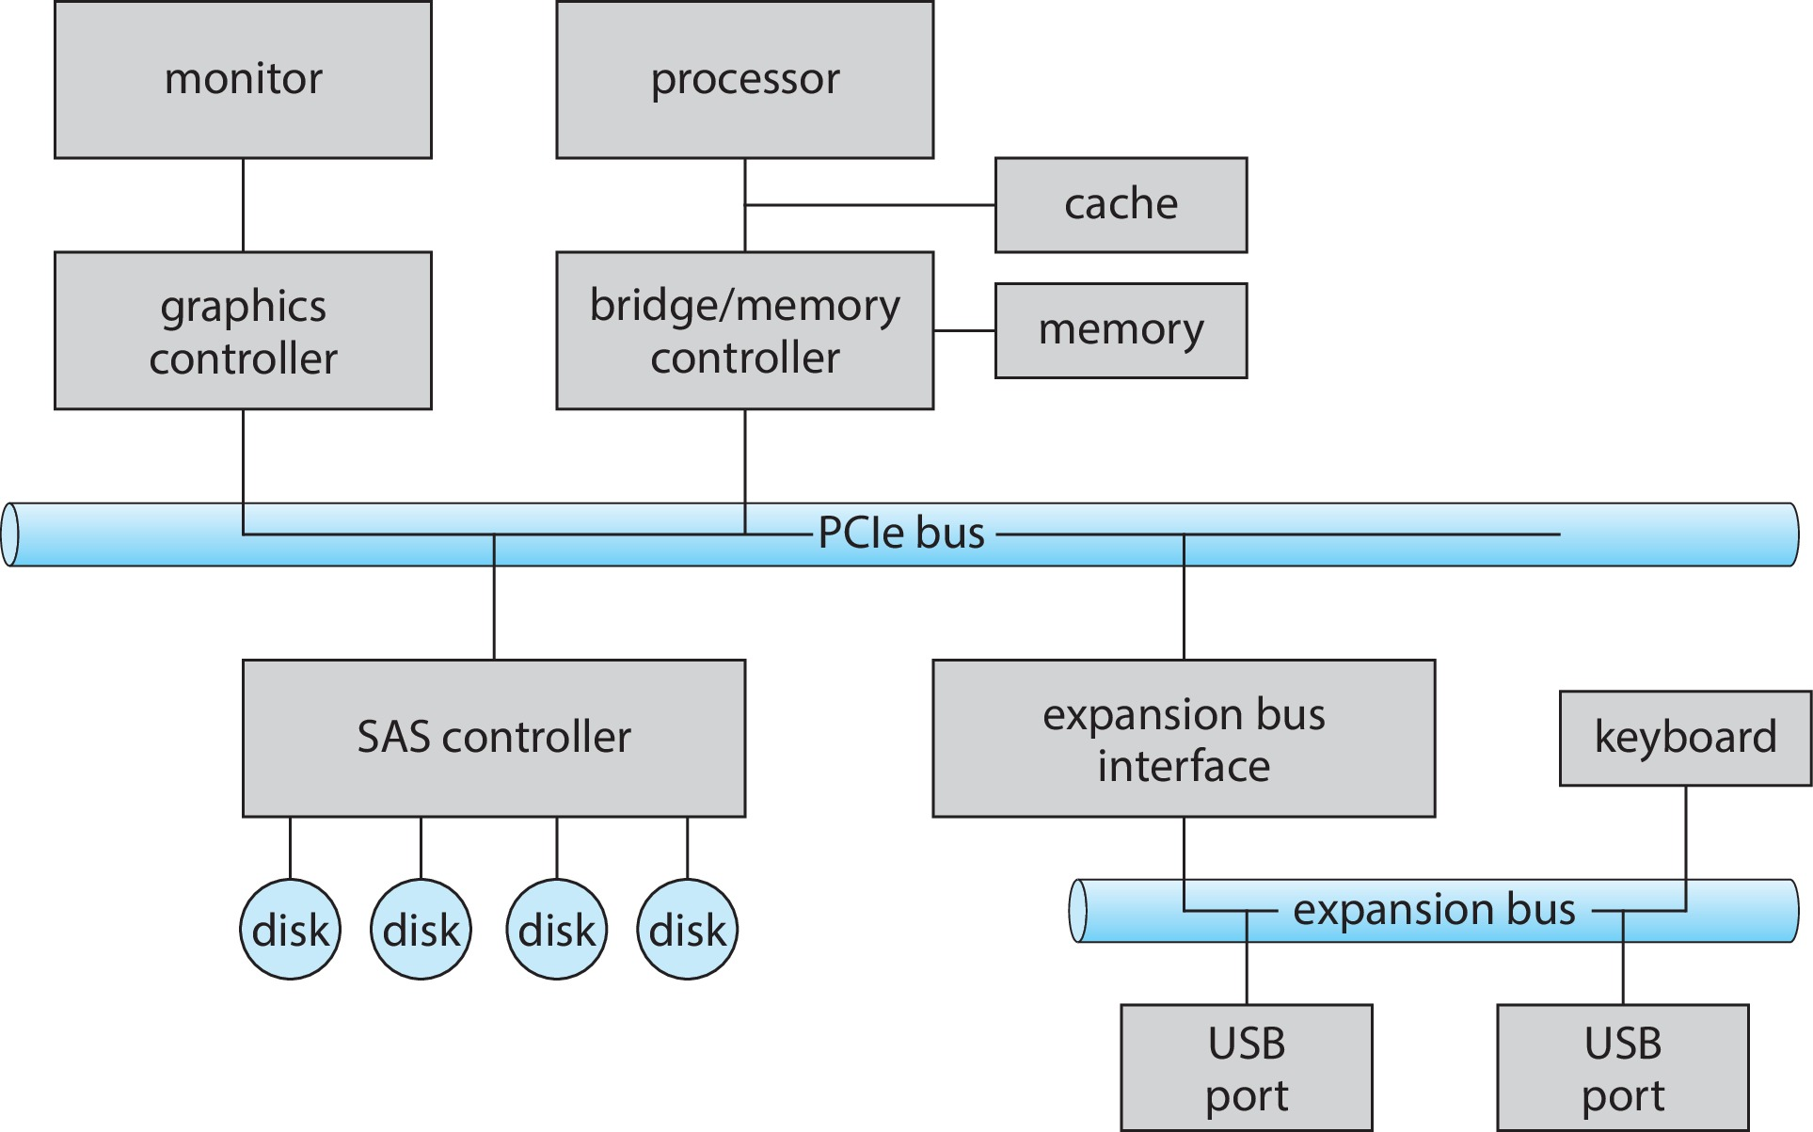
A Typical PC Bus Structure

Slide 8
I/O Hardware (Cont.)
Fibre channel (FC) is complex controller, usually separate circuit board (host-bus adapter, HBA) plugging into bus
I/O instructions control devices
Devices usually have registers where device driver places commands, addresses, and data to write, or read data from registers after command execution
  Data-in register, data-out register, status register, control register
  Typically 1-4 bytes, or FIFO buffer

Slide 9
I/O Hardware (Cont.)
Devices have addresses, used by
  Direct I/O instructions
  Memory-mapped I/O
    Device data and command registers mapped to processor address space
    Especially for large address spaces (graphics)

Slide 10
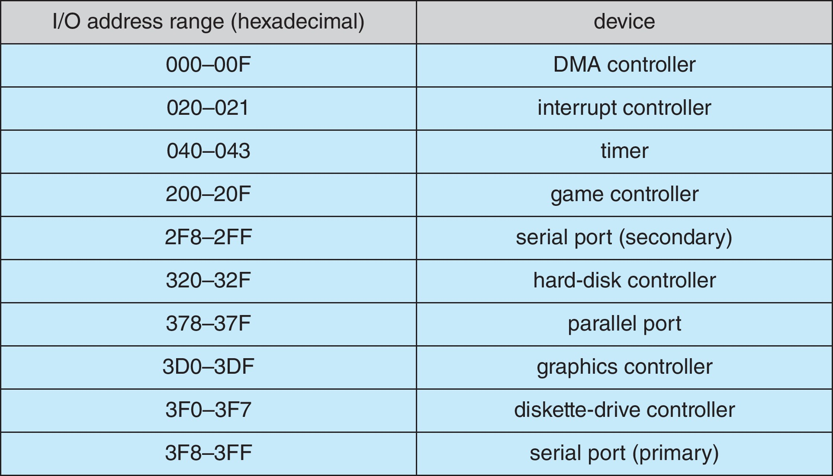
Device I/O Port Locations on PCs (partial)

Slide 11
Polling
For each byte of I/O
  Read busy bit from status register until 0
  Host sets read or write bit and if write copies data into data-out register
  Host sets command-ready bit
  Controller sets busy bit, executes transfer
  Controller clears busy bit, error bit, command-ready bit when transfer done
Step 1 is busy-wait cycle to wait for I/O from device
  Reasonable if device is fast
  But inefficient if device slow
  CPU switches to other tasks?
    But if miss a cycle data overwritten / lost

Slide 12
Interrupts
Polling can happen in 3 instruction cycles
  Read status, logical-and to extract status bit, branch if not zero
  How to be more efficient if non-zero infrequently?
CPU Interrupt-request line triggered by I/O device
  Checked by processor after each instruction
Interrupt handler receives interrupts
  Maskable to ignore or delay some interrupts
Interrupt vector to dispatch interrupt to correct handler
  Context switch at start and end
  Based on priority
  Some nonmaskable
  Interrupt chaining if more than one device at same interrupt number

Slide 13
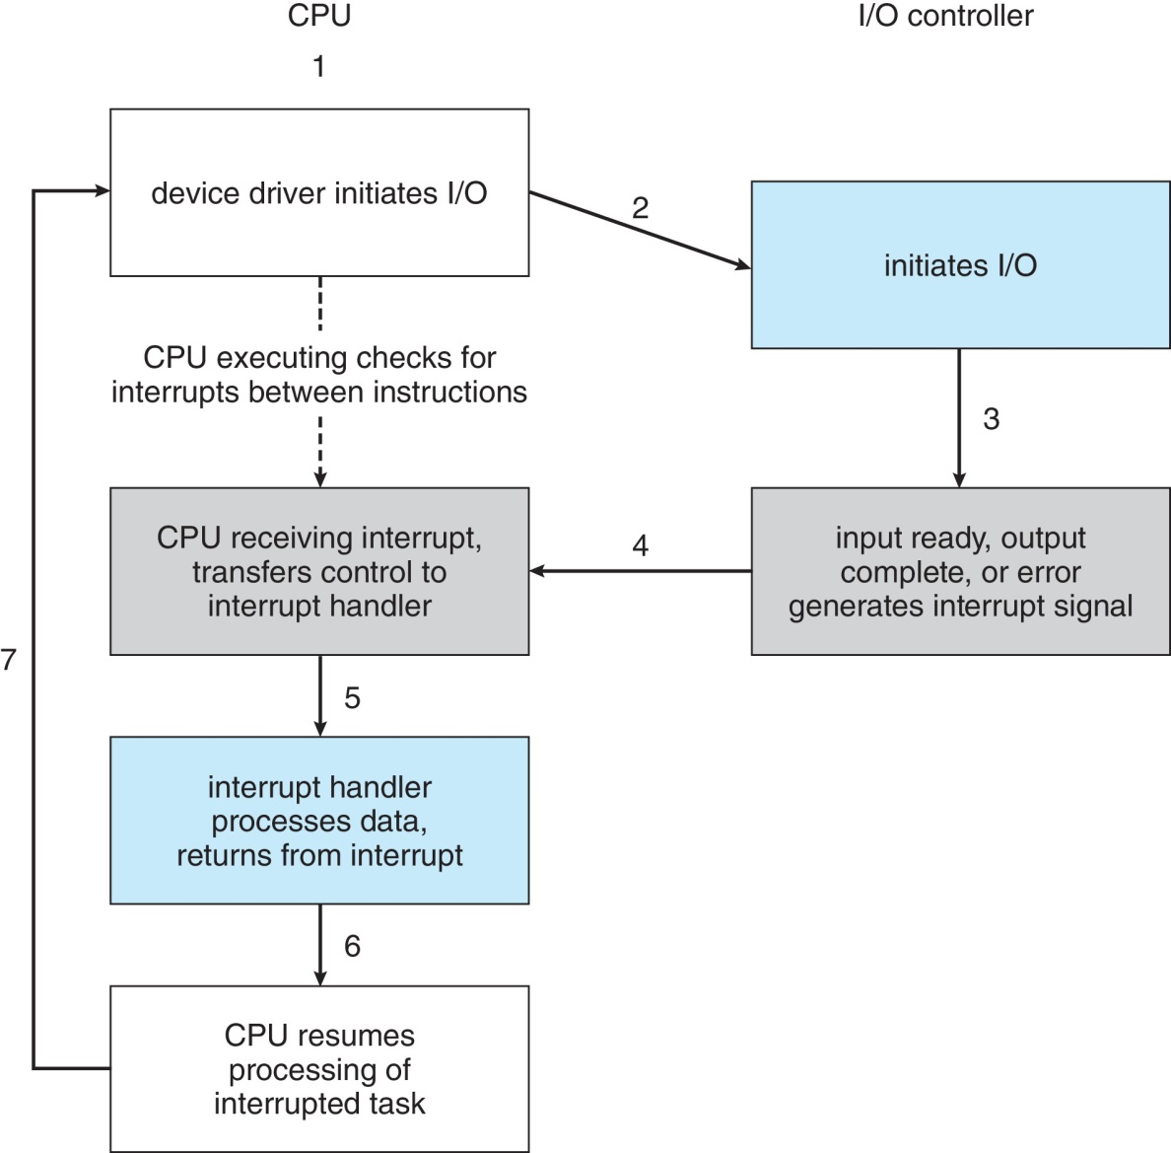
Interrupt-Driven I/O Cycle

Slide 14
Interrupts (Cont.)
Interrupt mechanism also used for exceptions
  Terminate process, crash system due to hardware error
Page fault executes when memory access error
System call executes via trap to trigger kernel to execute request
Multi-CPU systems can process interrupts concurrently
  If operating system designed to handle it
Used for time-sensitive processing, frequent, must be fast

Slide 15
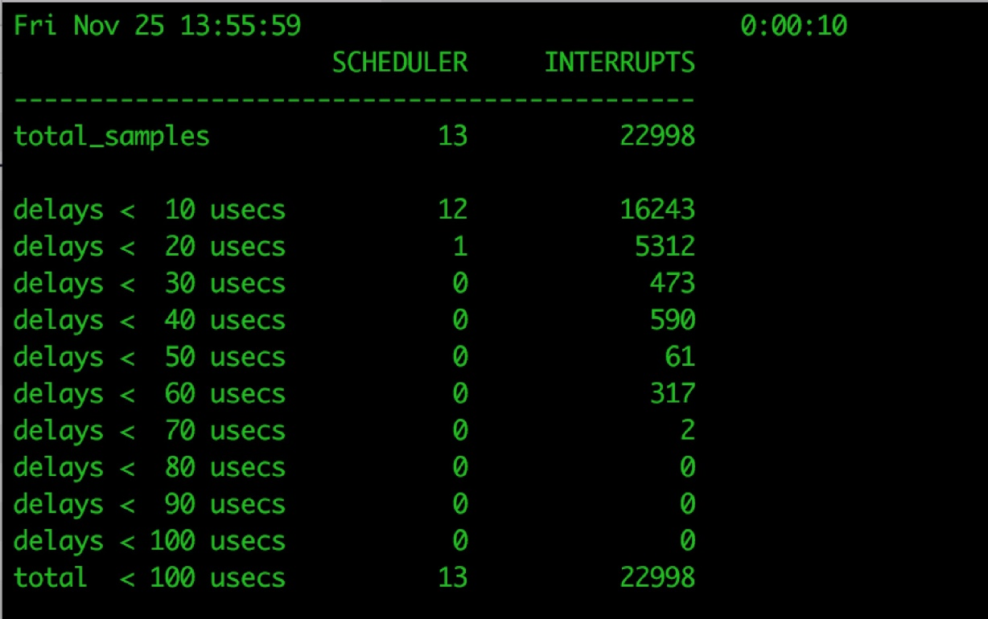
Latency
Stressing interrupt management because even single-user systems manage hundreds of interrupts per second and servers hundreds of thousands
For example, a quiet macOS desktop generated 23,000 interrupts over 10 seconds

Slide 16
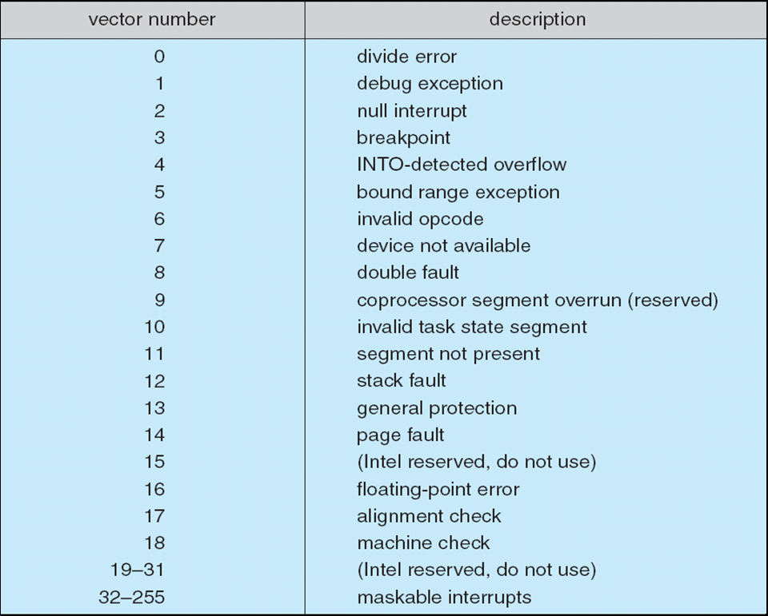
Intel Pentium Processor Event-Vector Table

Slide 17
Direct Memory Access
Used to avoid programmed I/O (one byte at a time) for large data movement
Requires DMA controller
Bypasses CPU to transfer data directly between I/O device and memory
OS writes DMA command block into memory
  Source and destination addresses
  Read or write mode
  Count of bytes
  Writes location of command block to DMA controller
  Bus mastering of DMA controller – grabs bus from CPU
    Cycle stealing from CPU but still much more efficient
  When done, interrupts to signal completion
Version that is aware of virtual addresses can be even more efficient - DVMA

Slide 18
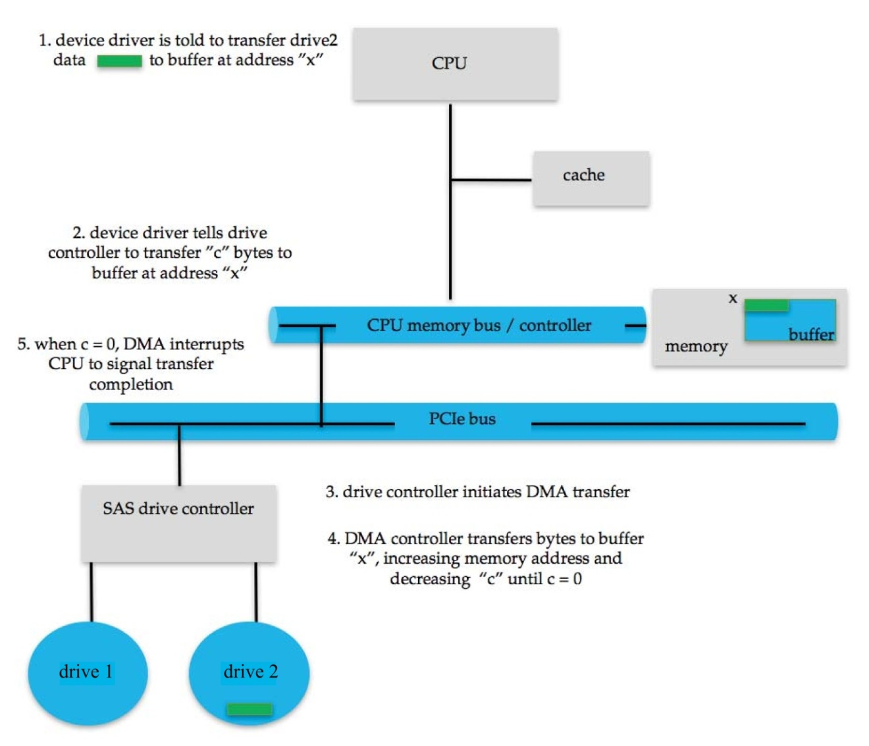
Six Step Process to Perform DMA Transfer

Slide 19
Application I/O Interface
I/O system calls encapsulate device behaviors in generic classes
Device-driver layer hides differences among I/O controllers from kernel
New devices talking already-implemented protocols need no extra work
Each OS has its own I/O subsystem structures and device driver frameworks
Devices vary in many dimensions
  Character-stream or block
  Sequential or random-access
  Synchronous or asynchronous (or both)
  Sharable or dedicated
  Speed of operation
  read-write, read only, or write only

Slide 20
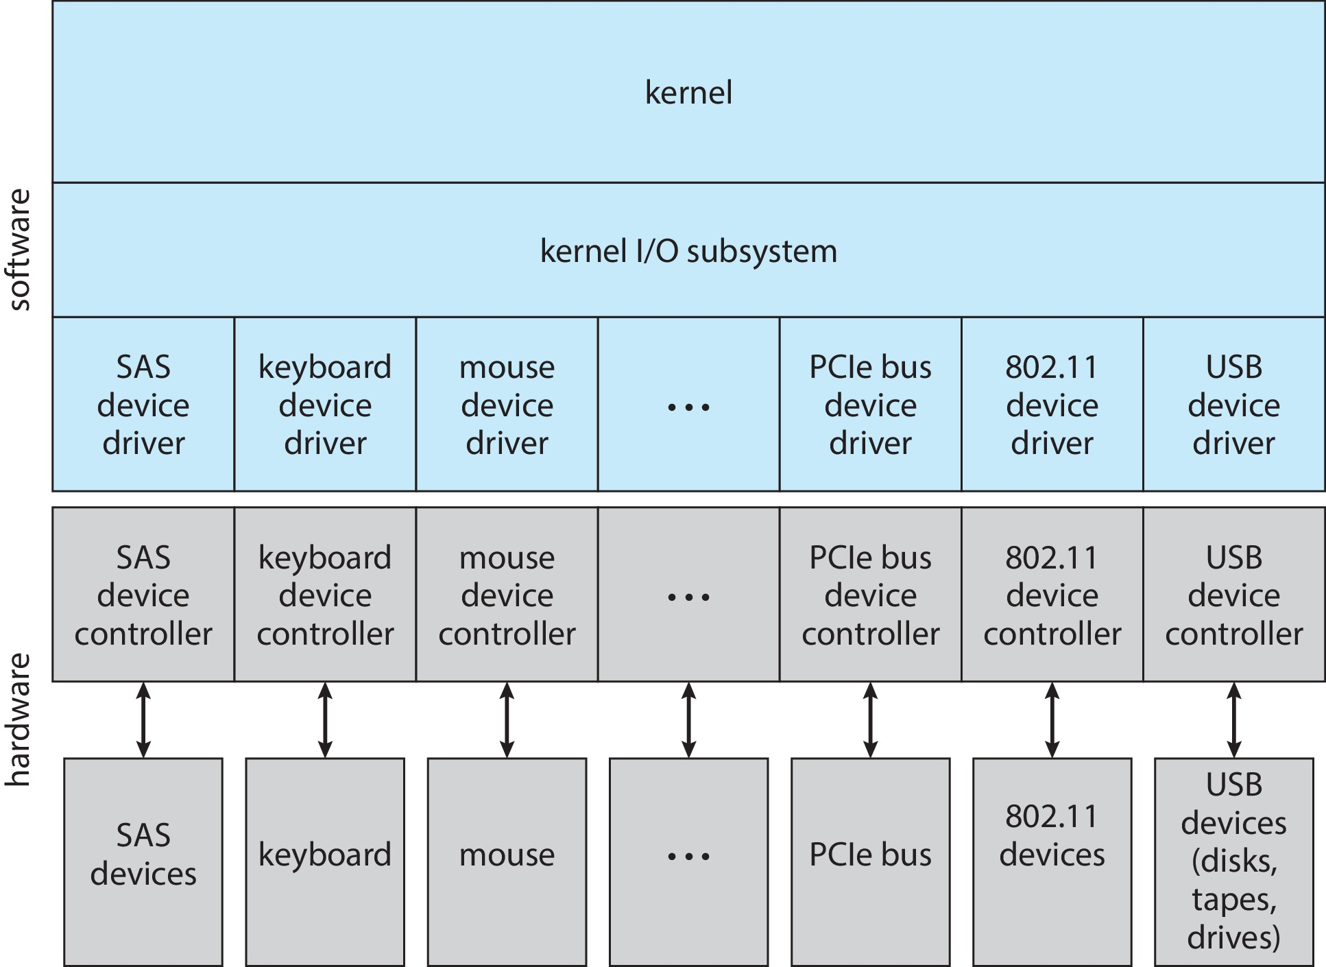
A Kernel I/O Structure

Slide 21
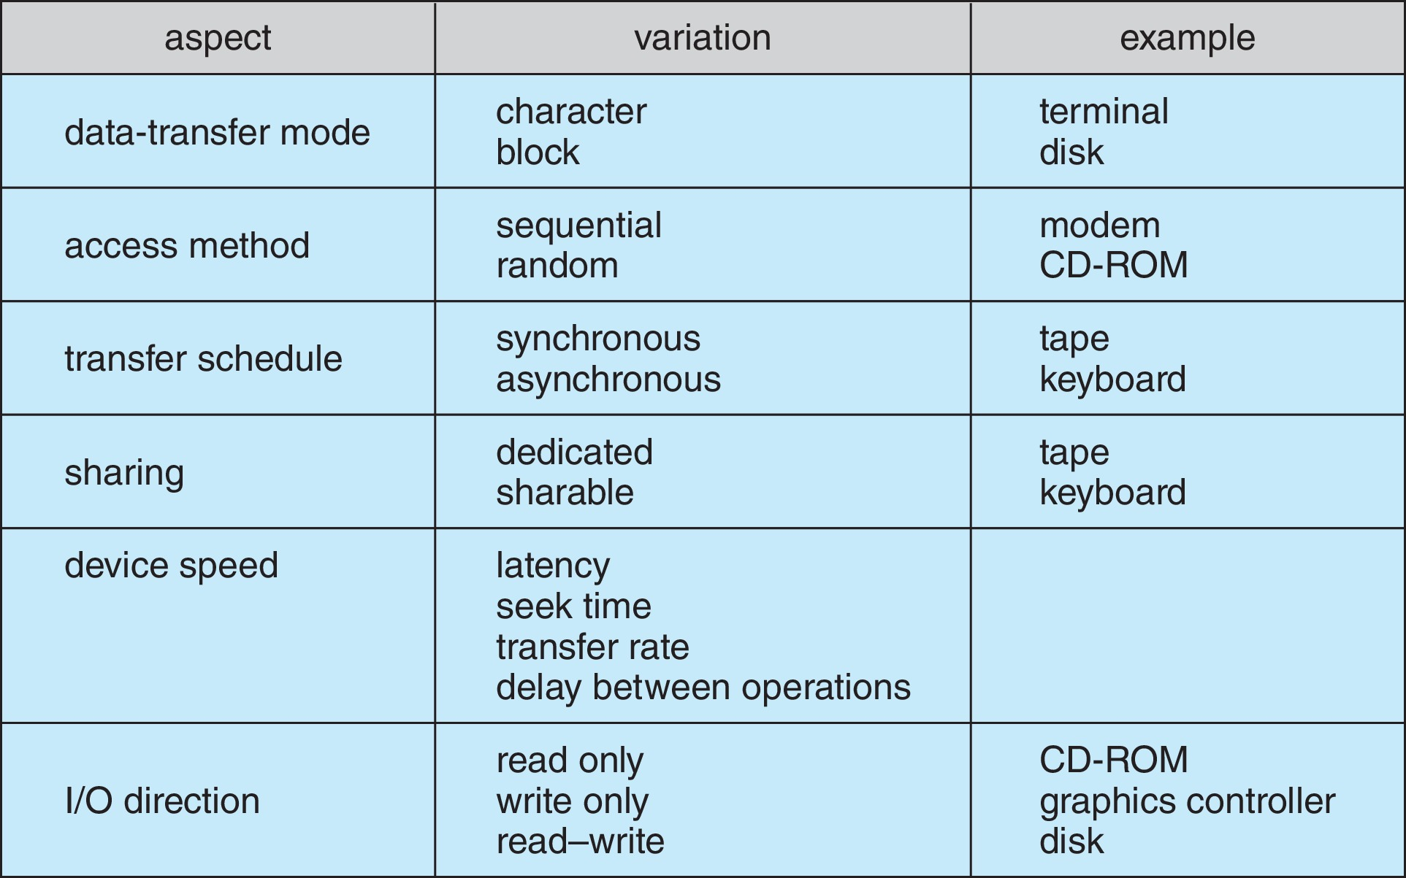
Characteristics of I/O Devices

Slide 22
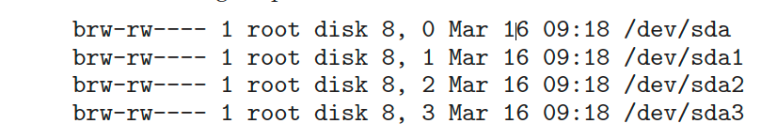
Characteristics of I/O Devices (Cont.)
Subtleties of devices handled by device drivers
Broadly I/O devices can be grouped by the OS into
  Block I/O
  Character I/O (Stream)
  Memory-mapped file access
  Network sockets
For direct manipulation of I/O device specific characteristics, usually an escape / back door
  Unix ioctl() call to send arbitrary bits to a device control register and data to device data register
UNIX and Linux use tuple of “major” and “minor” device numbers to identify type and instance of devices (here major 8 and minors 0-4)
% ls –l /dev/sda*

Slide 23
Block and Character Devices
Block devices include disk drives
  Commands include read, write, seek
  Raw I/O, direct I/O, or file-system access
  Memory-mapped file access possible
    File mapped to virtual memory and clusters brought via demand paging
  DMA
Character devices include keyboards, mice, serial ports
  Commands include get(), put()
  Libraries layered on top allow line editing

Slide 24
Network Devices
Varying enough from block and character to have own interface
Linux, Unix, Windows and many others include socket interface
  Separates network protocol from network operation
  Includes select() functionality
Approaches vary widely (pipes, FIFOs, streams, queues, mailboxes)

Slide 25
Clocks and Timers
Provide current time, elapsed time, timer
Normal resolution about 1/60 second
Some systems provide higher-resolution timers
Programmable interval timer used for timings, periodic interrupts
ioctl() (on UNIX) covers odd aspects of I/O such as clocks and timers

Slide 26
Nonblocking and Asynchronous I/O
Blocking - process suspended until I/O completed
  Easy to use and understand
  Insufficient for some needs
Nonblocking - I/O call returns as much as available
  User interface, data copy (buffered I/O)
  Implemented via multi-threading
  Returns quickly with count of bytes read or written
  select() to find if data ready then read() or write() to transfer
Asynchronous - process runs while I/O executes
  Difficult to use
  I/O subsystem signals process when I/O completed

Slide 27
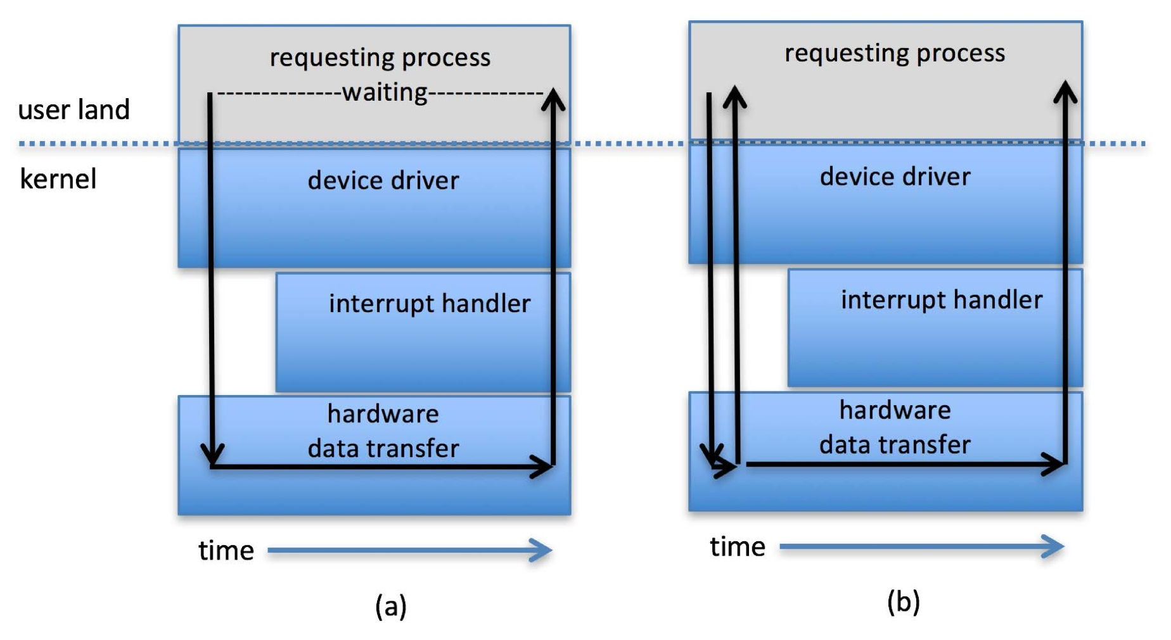
Two I/O Methods

Slide 28
Vectored I/O
Vectored I/O allows one system call to perform multiple I/O operations
For example, Unix readve() accepts a vector of multiple buffers to read into or write from
This scatter-gather method better than multiple individual I/O calls
  Decreases context switching and system call overhead
  Some versions provide atomicity
    Avoid for example worry about multiple threads changing data as reads / writes occurring

Slide 29
Kernel I/O Subsystem
Scheduling
  Some I/O request ordering via per-device queue
  Some OSs try fairness
  Some implement Quality Of Service (i.e. IPQOS)
Buffering - store data in memory while transferring between devices
  To cope with device speed mismatch
  To cope with device transfer size mismatch
  To maintain “copy semantics”
  Double buffering – two copies of the data
    Kernel and user
    Varying sizes
    Full / being processed and not-full / being used
    Copy-on-write can be used for efficiency in some cases

Slide 30
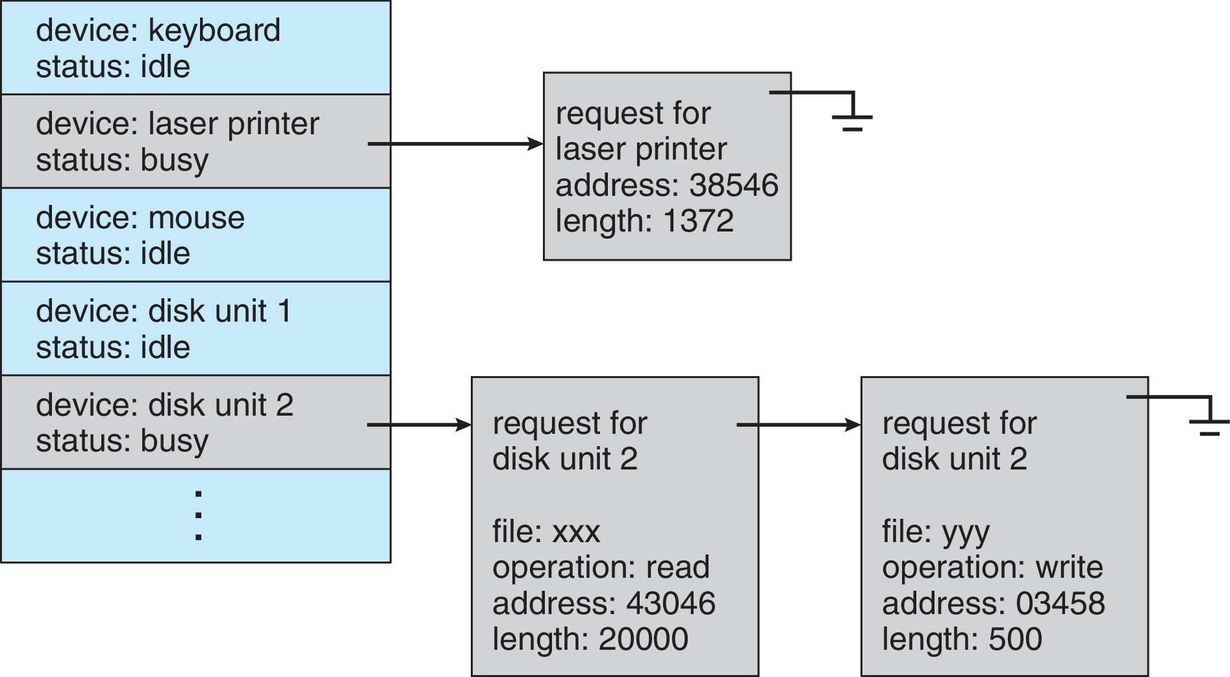
Device-status Table

Slide 31
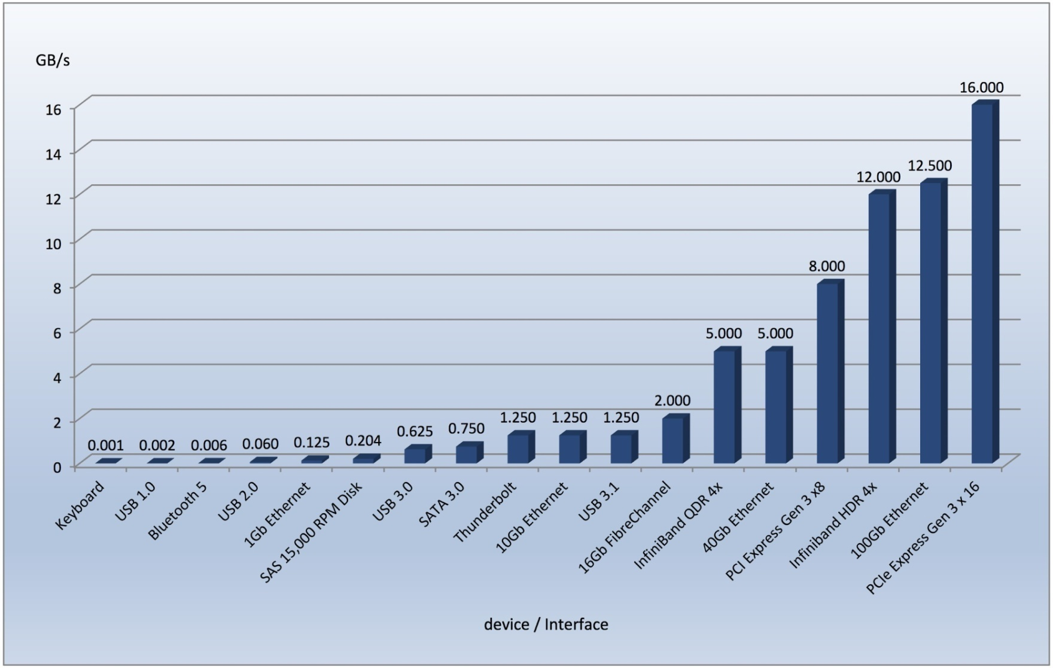
Common PC and Data-center I/O devices and Interface Speeds

Slide 32
Kernel I/O Subsystem
Caching - faster device holding copy of data
  Always just a copy
  Key to performance
  Sometimes combined with buffering
Spooling - hold output for a device
  If device can serve only one request at a time
  i.e., Printing
Device reservation - provides exclusive access to a device
  System calls for allocation and de-allocation
  Watch out for deadlock

Slide 33
Error Handling
OS can recover from disk read, device unavailable, transient write failures
  Retry a read or write, for example
  Some systems more advanced – Solaris FMA, AIX
    Track error frequencies, stop using device with increasing frequency of retry-able errors
Most return an error number or code when I/O request fails
System error logs hold problem reports

Slide 34
I/O Protection
User process may accidentally or purposefully attempt to disrupt normal operation via illegal I/O instructions
  All I/O instructions defined to be privileged
  I/O must be performed via system calls
    Memory-mapped and I/O port memory locations must be protected too

Slide 35
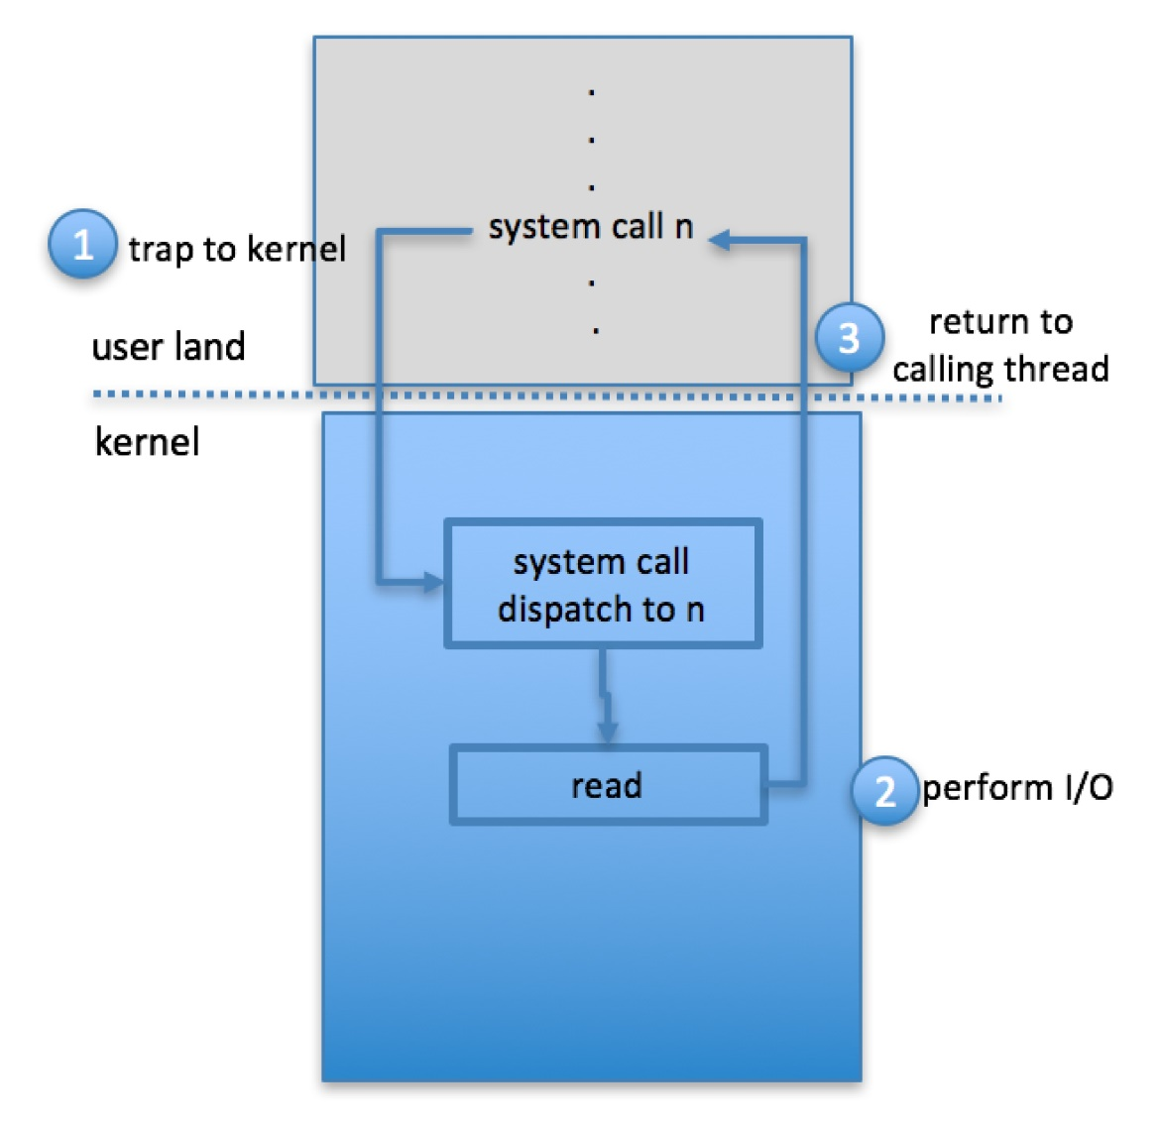
Use of a System Call to Perform I/O

Slide 36
Kernel Data Structures
Kernel keeps state info for I/O components, including open file tables, network connections, character device state
Many, many complex data structures to track buffers, memory allocation, “dirty” blocks
Some use object-oriented methods and message passing to implement I/O
  Windows uses message passing
    Message with I/O information passed from user mode into kernel
    Message modified as it flows through to device driver and back to process
    Pros / cons?

Slide 37
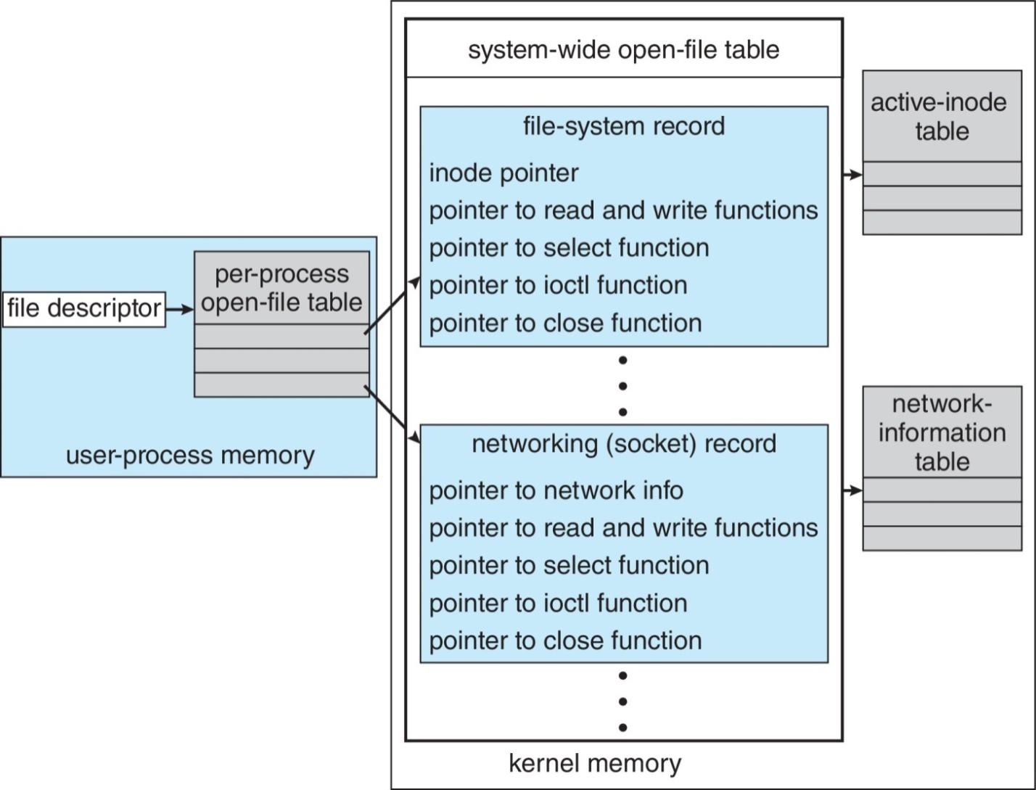
UNIX I/O Kernel Structure

Slide 38
Power Management
Not strictly domain of I/O, but much is I/O related
Computers and devices use electricity, generate heat, frequently require cooling
OSes can help manage and improve use
  Cloud computing environments move virtual machines between servers
    Can end up evacuating whole systems and shutting them down
Mobile computing has power management as first class OS aspect

Slide 39
Power Management (Cont.)
For example, Android implements
  Component-level power management
    Understands relationship between components
    Build device tree representing physical device topology
    System bus -> I/O subsystem -> {flash, USB storage}
    Device driver tracks state of device, whether in use
    Unused component – turn it off
    All devices in tree branch unused – turn off branch

Slide 40
Power Management (Cont.)
For example, Android implements (Cont.)
  Wake locks – like other locks but prevent sleep of device when lock is held
  Power collapse – put a device into very deep sleep
    Marginal power use
    Only awake enough to respond to external stimuli (button press, incoming call)
Modern systems use advanced configuration and power interface (ACPI) firmware providing code that runs as routines called by kernel for device discovery, management, error and power management

Slide 41
Kernel I/O Subsystem Summary
In summary, the I/O subsystem coordinates an extensive collection of services that are available to applications and to other parts of the kernel
  Management of the name space for files and devices
  Access control to files and devices
  Operation control (for example, a modem cannot seek())
  File-system space allocation
  Device allocation
  Buffering, caching, and spooling
  I/O scheduling
  Device-status monitoring, error handling, and failure recovery
  Device-driver configuration and initialization
  Power management of I/O devices
The upper levels of the I/O subsystem access devices via the uniform interface provided by the device drivers

Slide 42
Transforming I/O Requests to Hardware Operations
Consider reading a file from disk for a process:
  Determine device holding file
  Translate name to device representation
  Physically read data from disk into buffer
  Make data available to requesting process
  Return control to process

Slide 43
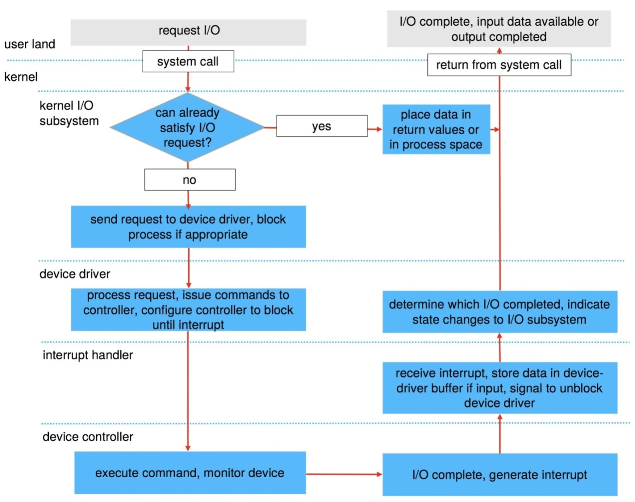
Life Cycle of An I/O Request

Slide 44
STREAMS
STREAM – a full-duplex communication channel between a user-level process and a device in Unix System V and beyond
A STREAM consists of:
  STREAM head interfaces with the user process
  driver end interfaces with the device
  zero or more STREAM modules between them
Each module contains a read queue and a write queue
Message passing is used to communicate between queues
  Flow control option to indicate available or busy
Asynchronous internally, synchronous where user process communicates with stream head

Slide 45
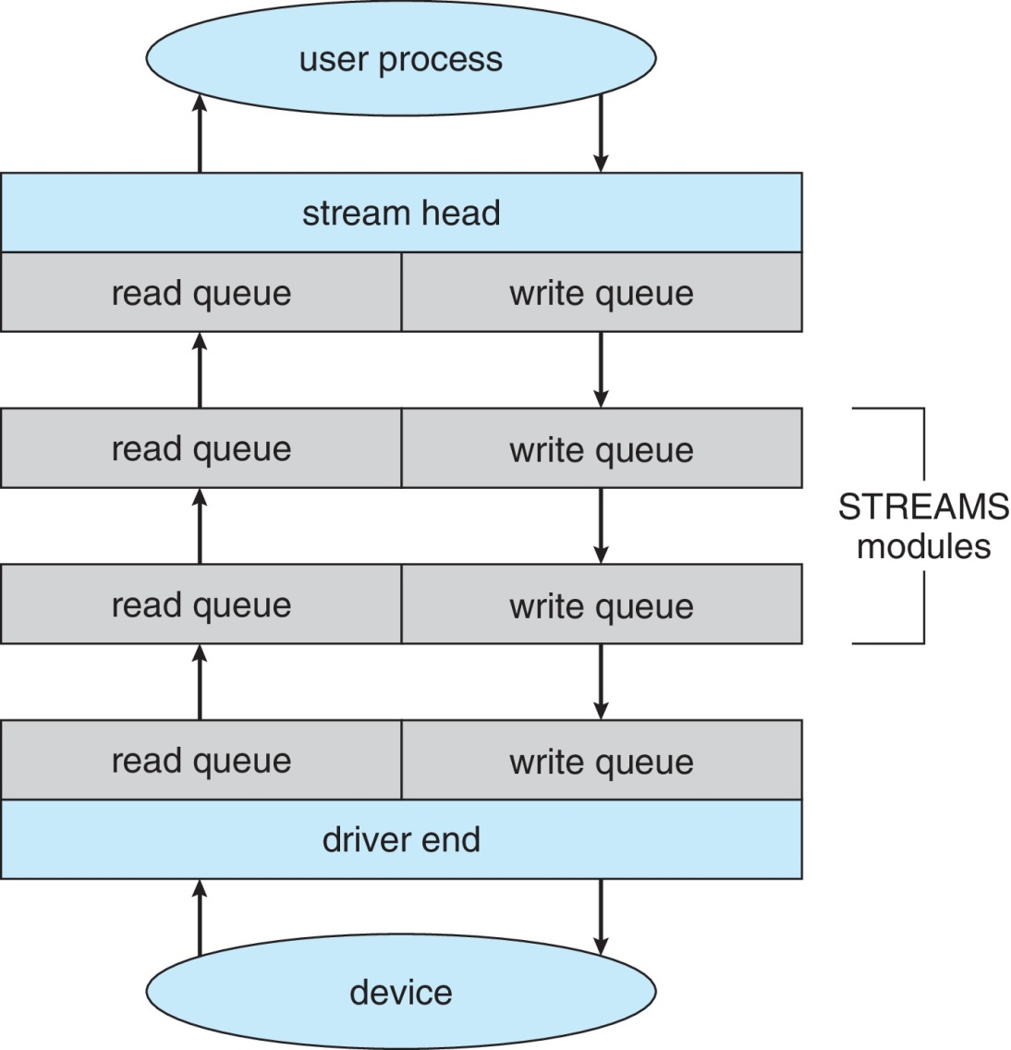
The STREAMS Structure

Slide 46
Performance
I/O a major factor in system performance:
  Demands CPU to execute device driver, kernel I/O code
  Context switches due to interrupts
  Data copying
  Network traffic especially stressful

Slide 47
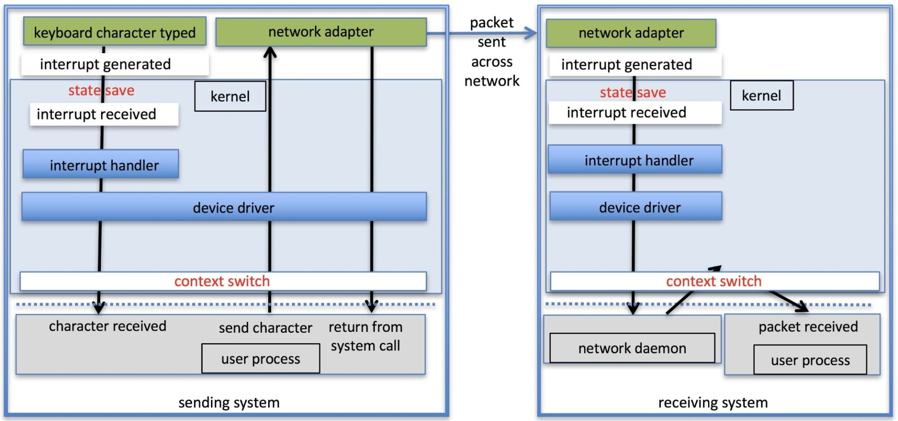
Intercomputer Communications

Slide 48
Improving Performance
Reduce number of context switches
Reduce data copying
Reduce interrupts by using large transfers, smart controllers, polling
Use DMA
Use smarter hardware devices
Balance CPU, memory, bus, and I/O performance for highest throughput
Move user-mode processes / daemons to kernel threads

Slide 49
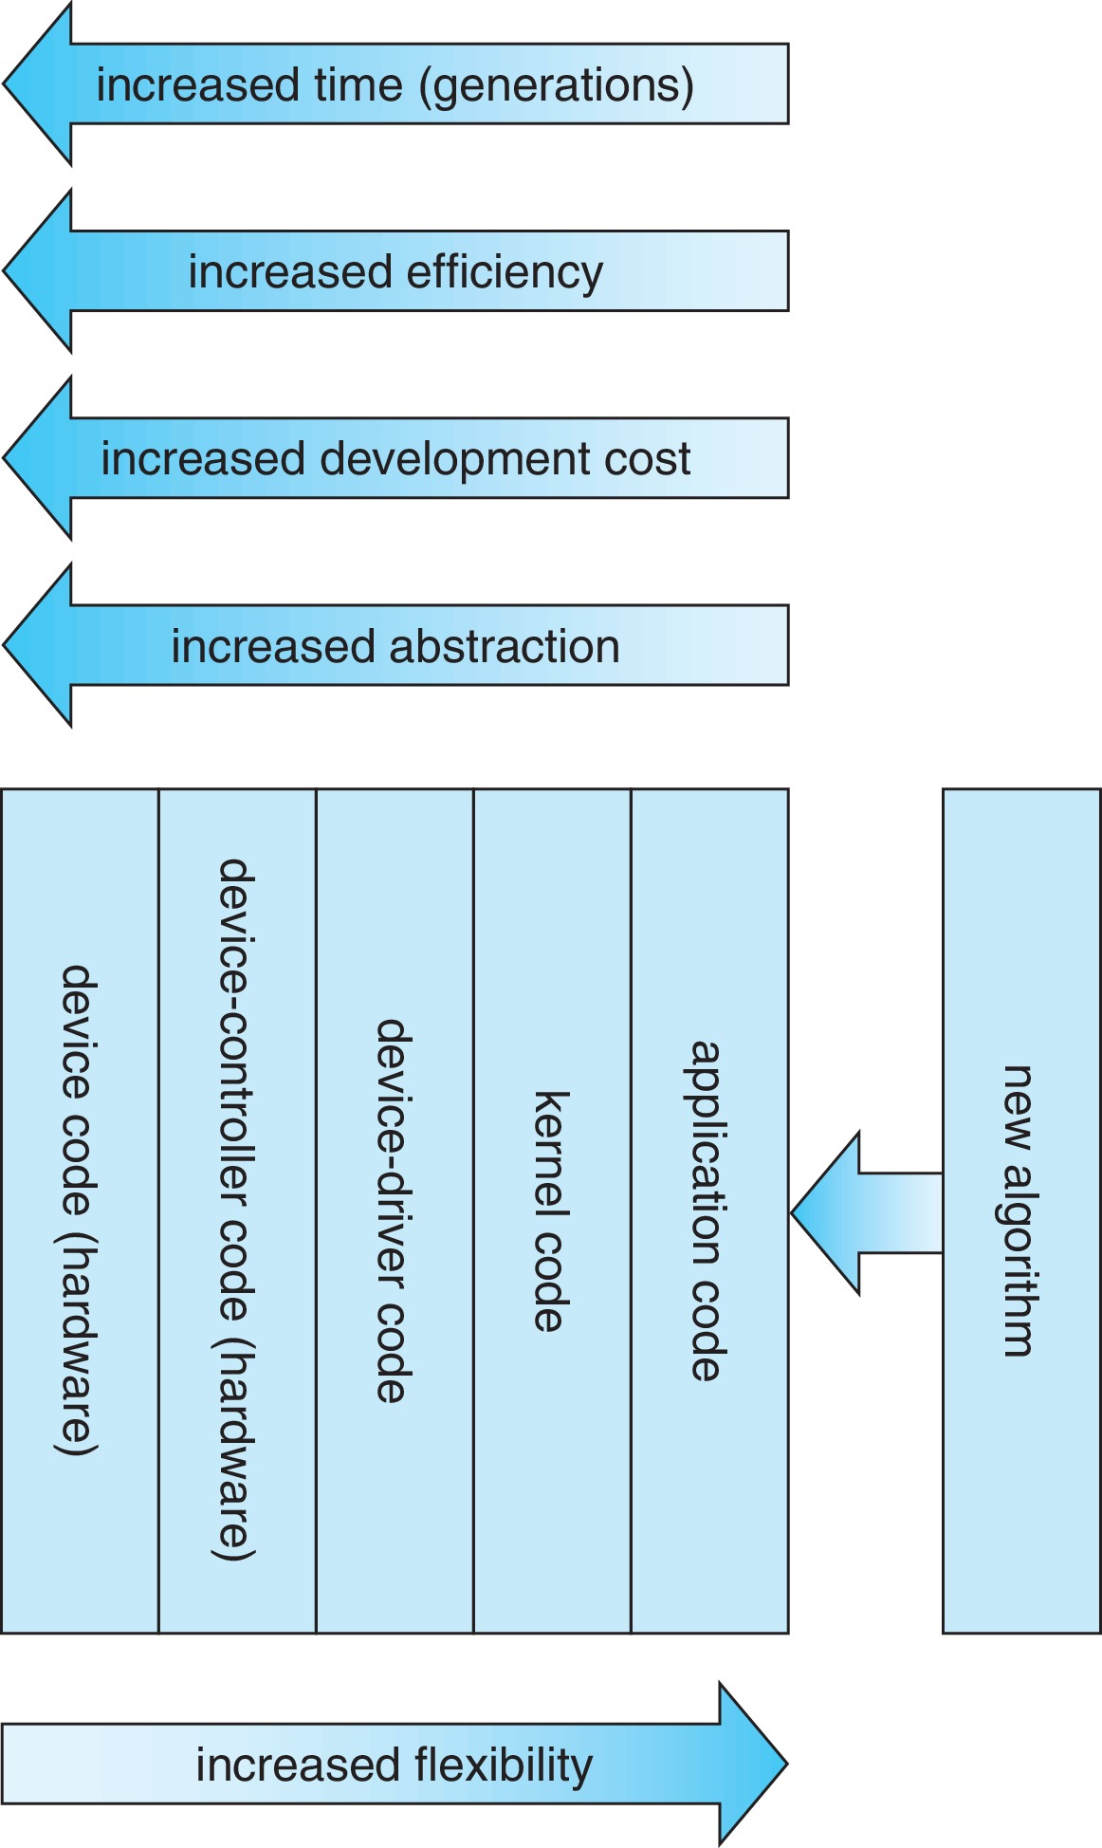
Device-Functionality Progression

Slide 50
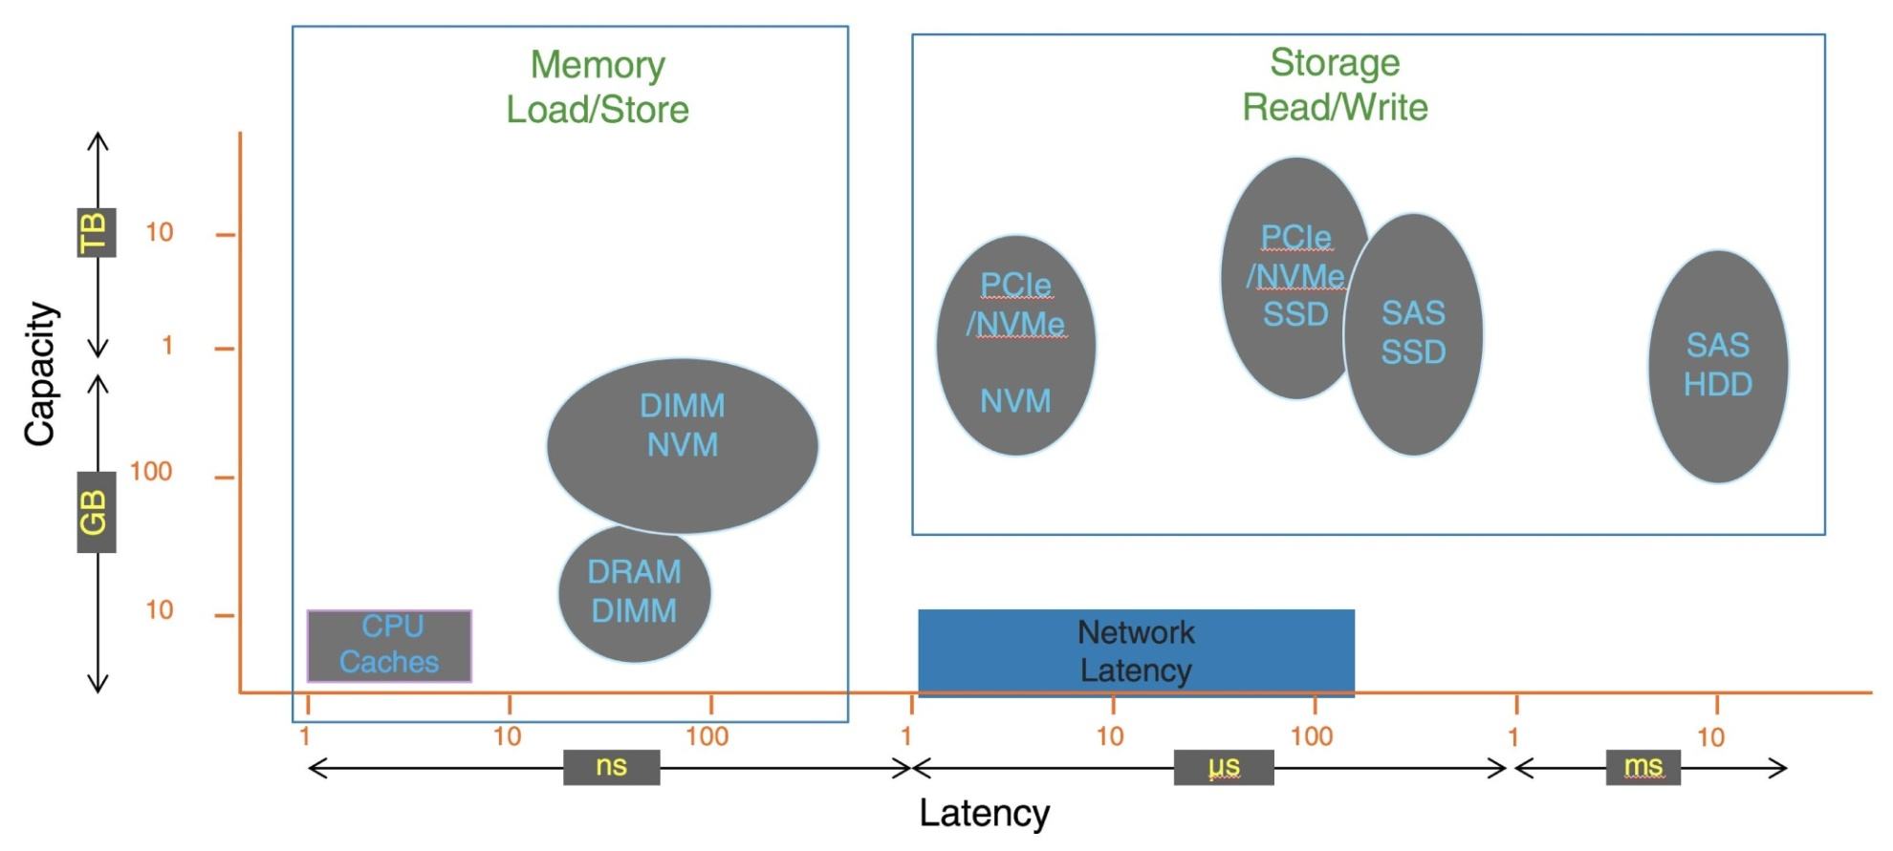
I/O Performance of Storage (and Network Latency)

Slide 51
End of Chapter 12

