Slide 1
Image Data Handling

Slide 2
Chapter 2
Lecture 2: Image Data Handling-I

Slide 3
Contents
Image Acquisition
Image File Formats
Interpolation

Slide 4
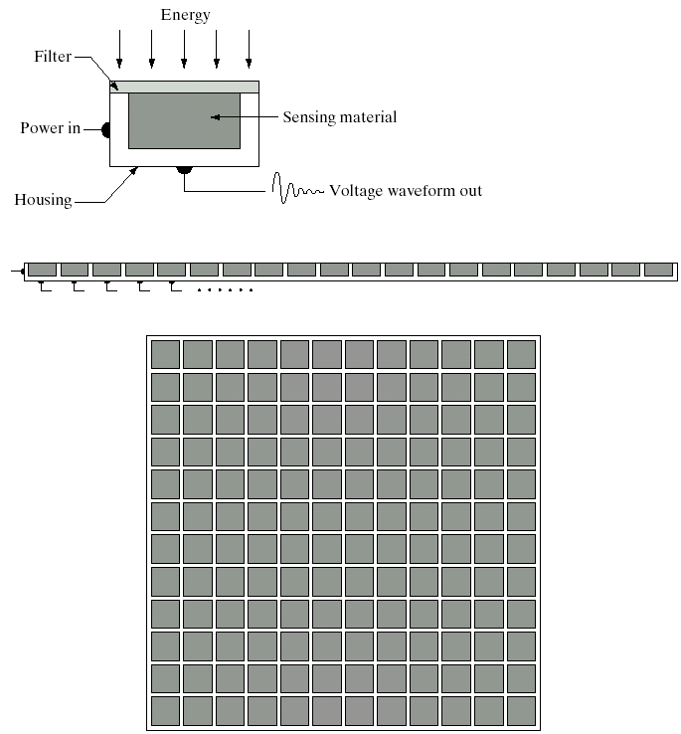
Image Sensing and Acquisition
Single sensor
Line sensor
Array sensor
(Images from Rafael C. Gonzalez and Richard Wood, Digital Image Processing, 2nd Edition.

Slide 5
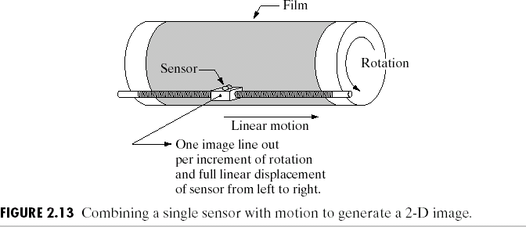
Image Sensors: Single Sensors
(Images from Rafael C. Gonzalez and Richard Wood, Digital Image Processing, 2nd Edition.

Slide 6
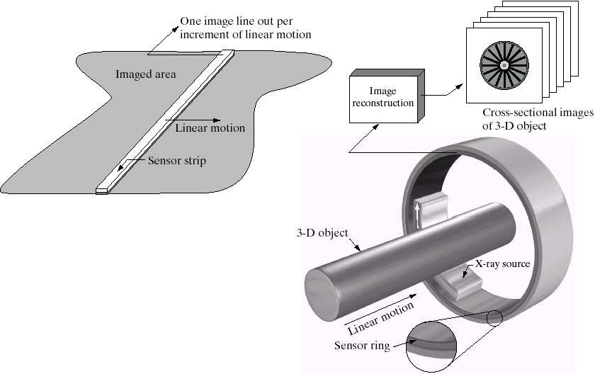
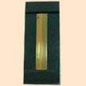
Image Sensors: Line Sensor
Fingerprint sweep sensor Computerized Axial Tomography
(Images from Rafael C. Gonzalez and Richard Wood, Digital Image Processing, 2nd Edition.

Slide 7
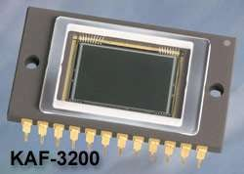
Image Sensors : Array Sensor
Charge-Coupled Device (CCD)
Used for convert a continuous
image into a digital image
Contains an array of light sensors
Converts photon into electric charges accumulated in each
sensor unit
CCD KAF-3200E from Kodak.
(2184 x 1472 pixels, Pixel size 6.8 microns²)

Slide 8
Image Sensor: How CCD works
i |  | h |  | g
f |  | e |  | d
c |  | b |  | a
Image pixel
i |  | h |  | g
f |  | e |  | d
c |  | b |  | a
i |  | h |  | g
f |  | e |  | d
 |  | c |  | b
Horizontal transport register
Vertical shift
a Output
Horizontal shift

Slide 9
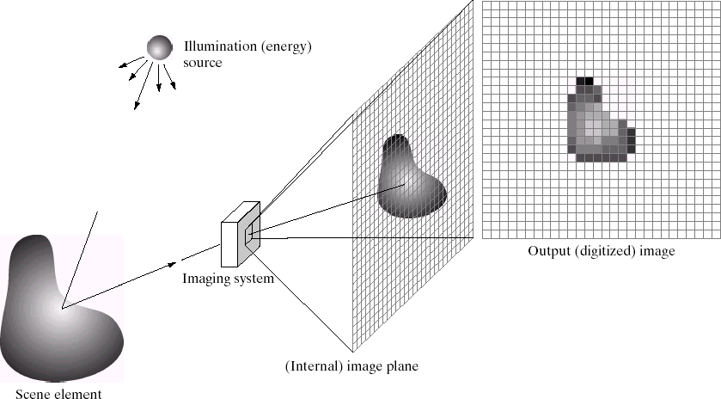
Digital Image Acquisition Process
(Images from Rafael C. Gonzalez and Richard Wood, Digital Image Processing, 2nd Edition.

Slide 10
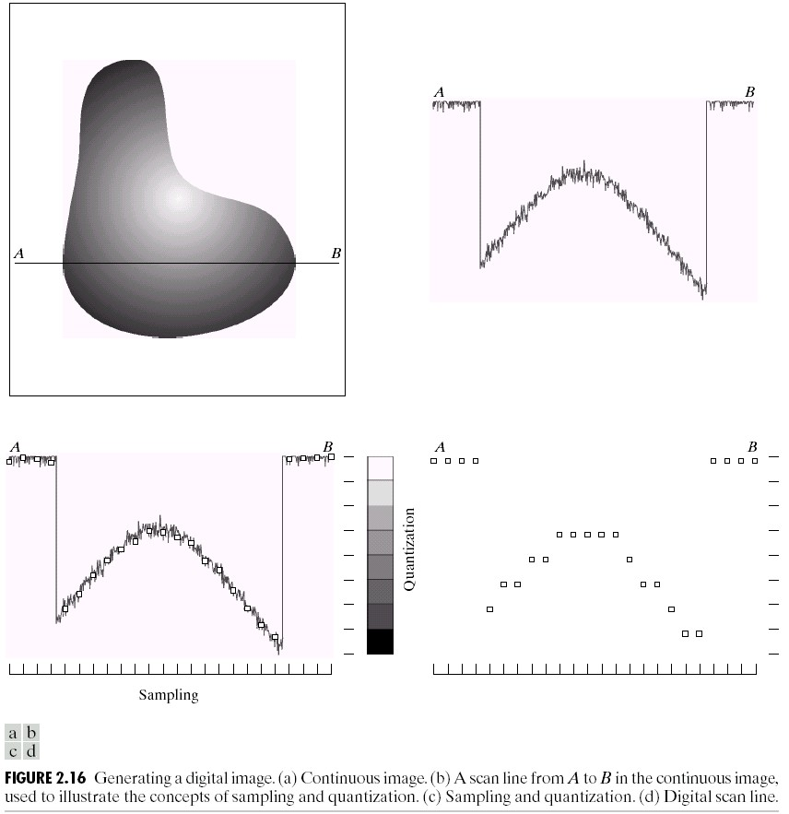
Generating a Digital Image

Slide 11
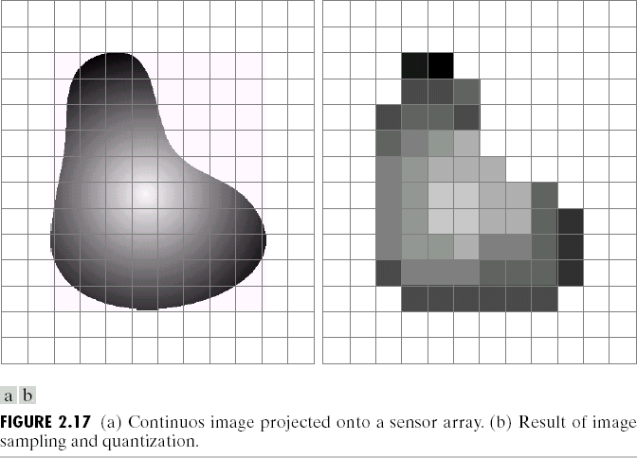
Image Sampling and Quantization
Image sampling: discretize an image in the spatial domain
Spatial resolution / image resolution: pixel size or number of pixels
(Images from Rafael C. Gonzalez and Richard Wood, Digital Image Processing, 2nd Edition.

Slide 12
Choice of Spatial Resolution
Spatial resolution
= Sampling locations
Original image
Sampled image
Under sampling, we lost some image details!

Slide 13
Choice of spatial resolution based on Nyquist Rate
Original image
Nyquist Rate:
Spatial resolution must be less or equal to half of the minimum period of the image or sampling frequency must be greater or equal to twice the maximum frequency
Sampled image
1mm
2mm
No detail is lost!
Minimum
Period
Spatial resolution
(sampling rate)
= Sampling locations

Slide 14
Aliased Frequency
x₁(t) = sin(2πt), f= 1
1
x₂ (t) = sin(12πt), f = 6
0.5
0
-0.5
-1
0
0.5
1
1.5
2
Sampling rate:
5 samples/sec
1
0.5
0
-0.5
-1
0
0.5 1 1.5
Two different frequencies but the same results !
2

Slide 15
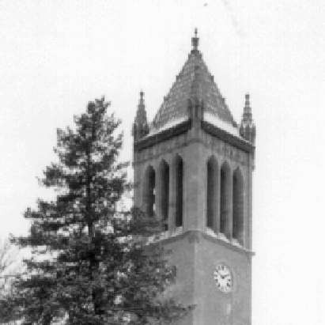
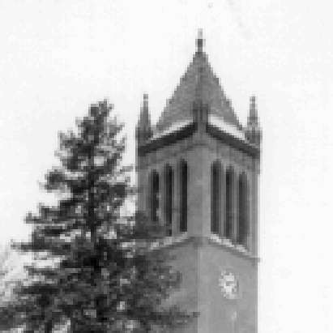

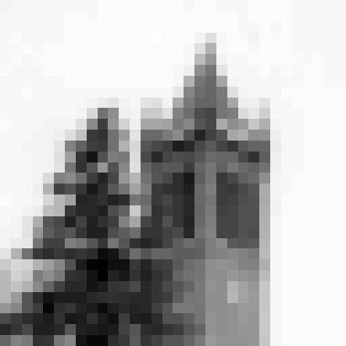
Effect of Spatial Resolution
256x256 pixels
128x128 pixels
64x64 pixels
32x32 pixels

Slide 16
Spatial Resolution
It is a measure of the smallest discernible detail in an image
Can be stated in line pairs per unit distance, and
dots(pixels) per unit distance
Dots per unit distance commonly used in printing and publishing industry (dots per inch)
Newspaper are printed with a resolution of 75 dpi, magazines at 133 dpi, and glossy brochures at 175 dpi
examples

Slide 17
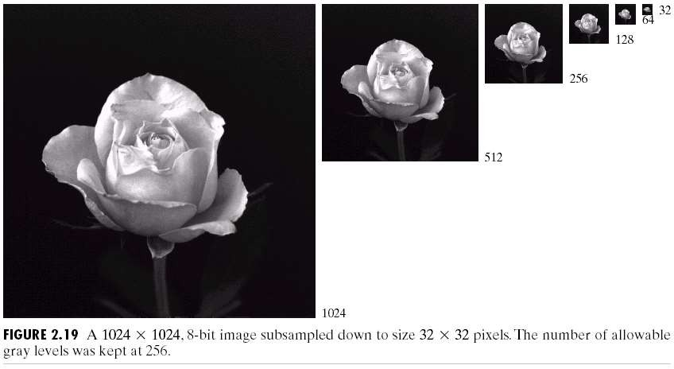
Effect of Spatial Resolution

Slide 18
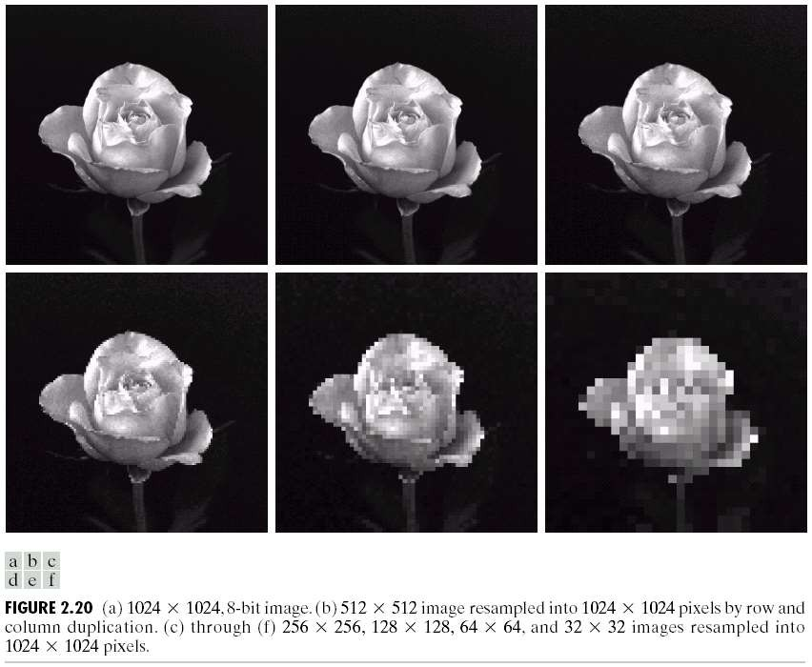
Effect of Spatial Resolution

Slide 19
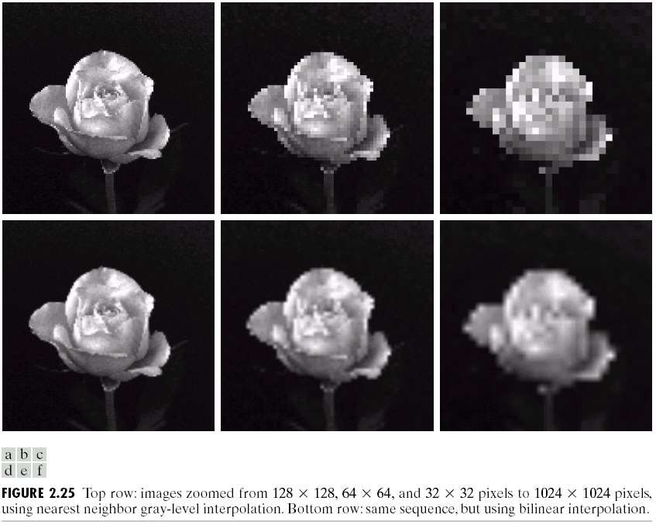
Effect of Interpolation on Spatial Resolution
Down sampling is an irreversible process.

Slide 20
Image Quantization
Image quantization:
discretize continuous pixel values into discrete numbers
Color resolution/ color depth/ levels:
No. of colors or gray levels or
No. of bits representing each pixel value
No. of colors or gray levels N_{c} is given by
N_{c}= 2
b
where b = no. of bits

Slide 21
Intensity Resolution
It refers to the smallest discernible change in intensity level
Number of intensity levels usually is an integer power of two
Also refers to number of bits used to quantize intensity as the intensity resolution
Which intensity resolution is good for human perception 8 bit, 16 bit, or 32 bit

Slide 22

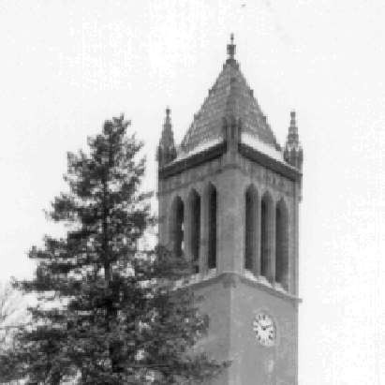
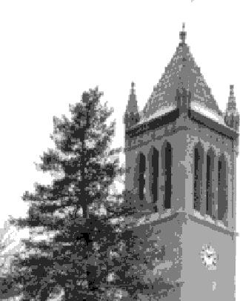
Effect of Quantization Levels or Intensity Resolution
256 levels
128 levels
64 levels
32 levels

Slide 23

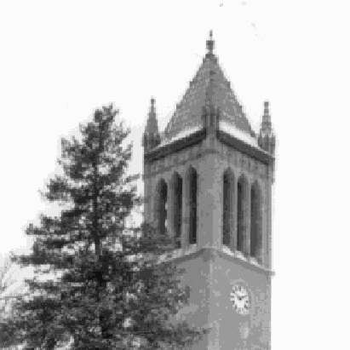
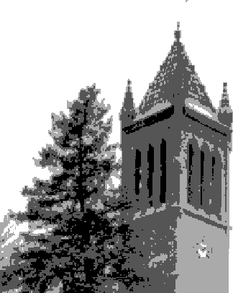

Effect of Quantization Levels or Intensity Resolution
16 levels
8 levels
In this image, it is easy to see false contour.
2 levels
4 levels

Slide 24
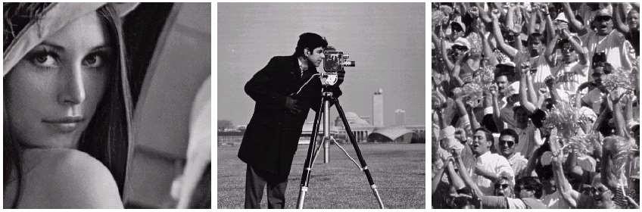
Selection of Suitable Size and Pixel Depth of Images
The word “suitable” is subjective: depending on “subject”.
Low detail image
Lena image
Medium detail image
Cameraman image
High detail image
Crowd image
To satisfy human mind
For images of the same size, the low detail image may need more pixel de
As an image size increase, fewer gray levels may be needed.

Slide 25
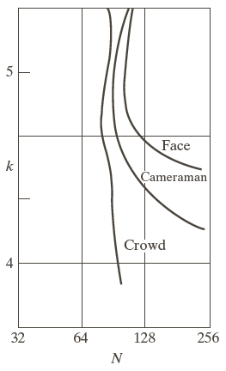
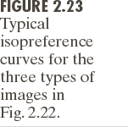
Isopreference Curve
Curves tend to become more vertical as the detail in the image increases
Image with a large amount of detail only a few intensity levels may be needed
These curves are:
Graphic representation of quantified values of image quality whose points all refer to images that are of a constant subjective quality.

Slide 26





Image Formats

Slide 27
RAW Image Files (.raw, .cr2, .nef, .orf, .sr2, and more)
RAW images are images that are unprocessed that have been created by a camera or scanner. Many digital SLR cameras can shoot in RAW, whether it be a .raw, .cr2, or .nef. These RAW images are the equivalent of a digital negative, meaning that they hold a lot of image information, but still need to be processed in an editor such as Adobe Photoshop or Lightroom.
Compression: None
Best For: Photography
Special Attributes: Saves metadata, unprocessed, lots of information

Slide 28
TIFF (.tif, .tiff)
TIFF or Tagged Image File Format are lossless image files.
They do not need to compress or lose any image quality or information
Thus they allow very high-quality images but of large size.
Hence are the most used file format by photographers and designers.
Images stored as TIFF files are best for post-processing.
TIFF files can be used with any photo editing software .
Compression: Lossless-no compression. Very high quality images
Best For: High quality prints, professional publication, archival copies
Special Attributes: Can save transparencies
When to Use TIFF Image Format:
For images to be stored without losing details.
For images to be reproduced or printed.

Slide 29
Bitmap (.bmp)
Bitmap (.bmp)
BMP or Bitmap Image File is a format developed by Microsoft for Windows. There is no compression or information loss with BMP files which allow images to have very high quality, but also very large file sizes. Due to BMP being a proprietary format, it is generally recommended to use TIFF files.
Compression: None
Best For: High quality scans, archival copies

Slide 30
JPEG (.jpeg or .jpg)
JPEG stands for Joint Photographic Experts Group, and it’s extension is widely written as .jpg.
This most used image file format is used to store photos all over the world, and is generally a default file format for saving images.
Most of the images you find online will download as .jpg files.
JPEG files come in different quality levels like low, medium and high. Low quality JPEGs are more compressed than high quality versions. So, for a high quality image, a less compressed JPEG option is required.
Most commonly, JPEG images are great for sharing on social media, via email and on websites. These files are relatively small, so they take up less space on your memory cards and computer storage.
Saving images as JPEGs can compromise the quality of that image.
When to Use JPEG Image Format:
Complex images with a lot of different colors, like photographs
To compress highly detailed images
For print

Slide 31
GIF (.gif)
GIF or Graphics Interchange Format files are widely used for web graphics, because they are limited to only 256 colors, can allow for transparency, and can be animated. GIF files are typically small is size and are very portable.
Compression: Lossless - compression without loss of quality
Best For: Web Images
Special Attributes: Can be Animated, Can Save Transparency
GIF stands for Graphics Interchange Format, and it’s quite similar to PNG in terms of its image quality preservation. With GIF image files, you can also create short animations for web.
This image format has a smaller color range, so it’s not suitable for all photos. Like PNG, GIF images can be transparent. But, unlike PNG, GIF doesn’t support partial transparency, which means you can’t use them to preserve shadow effects in your photos.
When to Use GIF Image Format:
For simple images with few colors, like icons
For animated images

Slide 32
PNG (.png)
PNG or Portable Network Graphics files are a lossless image format originally designed to improve upon and replace the GIF format. PNG files are able to handle up to 16 million colors, unlike the 256 colors supported by GIF.
Compression: Lossless - compression without loss of quality
Best For: Web Images
Special Attributes: Save Transparency
PNG stands for Portable Network Graphics. It’s an important file format that helps a lot in photo editing. You can use PNGs for completely transparent backgrounds or drop shadows (partial transparency) for the great effects.
This image format will not sacrifice the quality and details of the photos, but that means that they are typically larger in size than JPEGs. Thus, PNGs are best for small images like logos.
When to Use PNG Image Format:
Images with transparency
Small images, like logos
Online images
To retain the quality of a detailed image, provided that you have storage for a larger file size

Slide 33
PSD (.psd)
PSD stands for Photoshop Document. When an image is saved from Adobe Photoshop, the program’s default is to save that photo as a PSD file. That file can be used to edit the individual layers created in Photoshop at a later time.
This file format is not suitable for web, nor is it suitable for clients because it isn’t versatile.
It is one of the best image formats for maintaining the quality of the image over a long period of time.
The layers should not be merged before the PSD file is saved, or some of the editing capabilities will be lost.
The size of PSD files is quite large. But, the trade-off is access to the highest quality version of the images for printing.
When to Use PSD Image Format:
To save images that may need to be edited again in the future
To retain the quality and detail of images to be printed.

Slide 34
Interpolation
Image interpolation occurs when you resize or distort your image from one pixel grid to another. Image resizing is necessary when you need to increase or decrease the total number of pixels, whereas remapping can occur when you are correcting for lens distortion or rotating an image. Zooming refers to increase the quantity of pixels, so that when you zoom an image, you will see more detail.

Slide 35
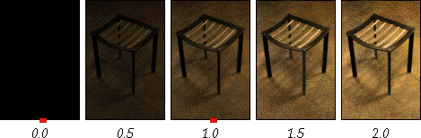
Interpolation
Interpolation works by using known data to estimate values at unknown points. Image interpolation works in two directions, and tries to achieve a best approximation of a pixel's intensity based on the values at surrounding pixels. Common interpolation algorithms can be grouped into two categories: adaptive and non-adaptive. Adaptive methods change depending on what they are interpolating, whereas non-adaptive methods treat all pixels equally. Non-adaptive algorithms include: nearest neighbour, bilinear, bicubic, spline, sinc, lanczos and others. Adaptive algorithms include many proprietary algorithms in licensed software such as: Qimage, PhotoZoom Pro and Genuine Fractals.

Slide 36
Image Interpolation
Used in image resizing (zooming and shrinking), rotating, and geometric corrections
Interpolation is the process of using known data to estimate values at unknown locations
Nearest Neighbor interpolation
  It assigns to each new location the intensity of its nearest
neighbor in the original image
  Produce undesirable artifacts, such as severe distortion of straight edges
Bilinear Interpolation
  We use the four nearest neighbors to estimate the
intensity
  V(x, y) = ax + by + cxy + d

Slide 37
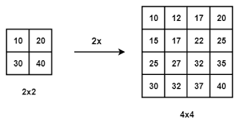


Bilinear Image Interpolation
$$·$$
10 2/3of10+1/3of20 1/3of10+2/3of20 20

Slide 38
Image Interpolation
Need to solve four equations
Better results than nearest neighbor interpolation, with a modest increase in computational burden
Bicubic Interpolation
  Involves sixteen neighbors to estimate intensity
  V(x, y) = ∑∑a_{ij} x^{i} y^{j} ( i, j = 0 to 3)
  Need to solve sixteen equations
  Gives better results than other methods
  More complex
  Used in Adobe Photoshop, and Corel Photopaint

Slide 39
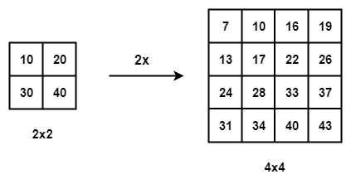
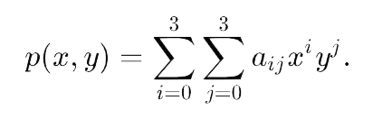
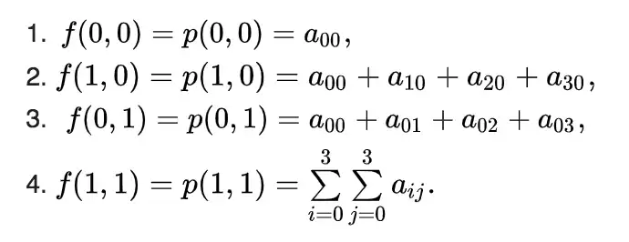
Bicubic Image Interpolation
Bilinear Interpolation method uses 4 nearest neighbours to determine the output while Bicubic method uses 16 neighbours.
Weight distribution in Bicubic method is done differently.
(0,0), (1,0), (0,1), (1,1) are the four corners of
the unit square and can be represented as: This requires the determination of 16 coefficients of p(x,y)
leading to the creation of interpolated surface of 2D image.
Bicubic interpolation works well at high resolution, but not beyond 24 MP
super high resolution. This is because addition of more pixels requires the
preservation of more details. Too much upscaling can be go wrong with bicubic interpolation. There are now super resolution techniques like SRCNN (Super Resolution Convolutional Neural Networks) or SRGAN (Super Resolution Generative Adversarial Networks) that do a better job at preserving details with sharpness.

Slide 40
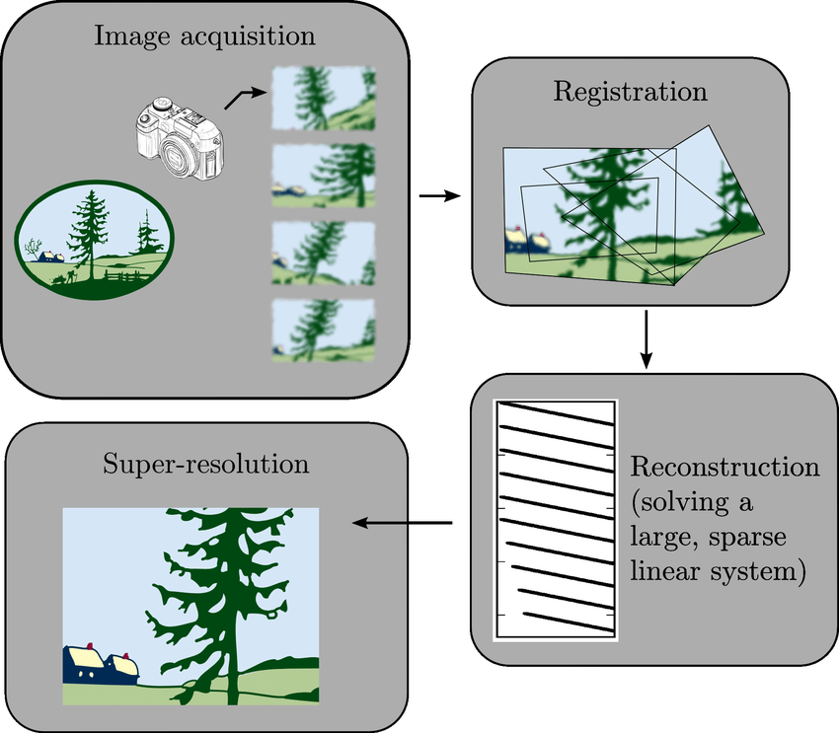
Super Resolution
Creation of a high resolution image from a sequence of low resolution images

Slide 41
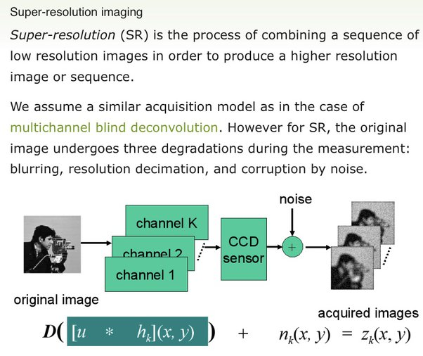
Super Resolution

Slide 42
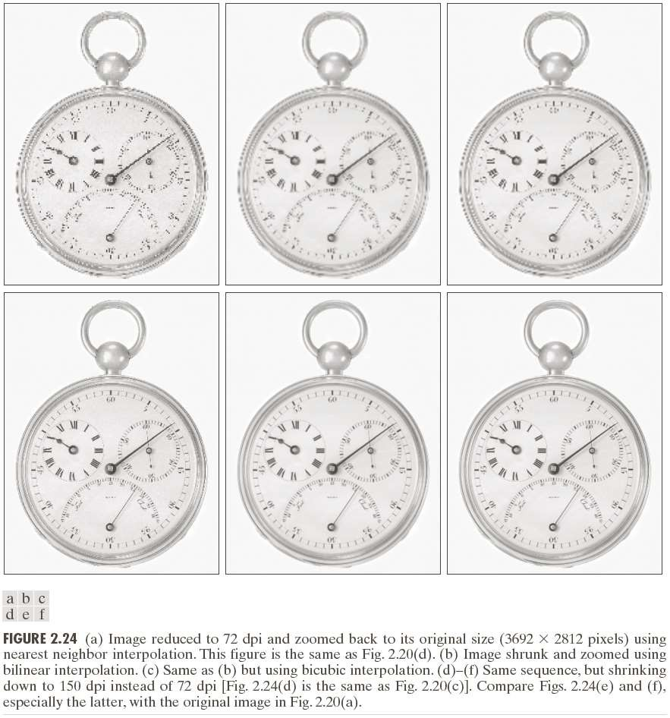

Slide 43
Chapter 2
End of Lecture 2

Slide 44
Chapter 2
Lecture 3: Image Data Handling-II

Slide 45
Contents
Relationships between pixels
Introduction to Mathematical Tools used in Digital Image Processing

Slide 46
Basic Relationship of Pixels
(0,0)
x
 | (x-1,y-1) | (x,y-1) | (x+1,y-1)
 | (x-1,y) | (x,y) | (x+1,y)
 | (x-1,y+1) | (x,y+1) | (x+1,y+1)
y
Conventional indexing method

Slide 47
Neighbors of a Pixel
Neighborhood relation is used to tell adjacent pixels. It is useful for analyzing regions.
 |  | (x,y-1)
 | (x-1,y) | p | (x+1,y)
 |  | (x,y+1)
4-neighbors of p:
(x−1,y)
(x+1,y)
(x,y−1)
(x,y+1)
N₄(p) =
4-neighborhood relation considers only vertical and horizontal neighbors.
Note: q ∈ N₄(p) implies p ∈ N₄(q)

Slide 48
Neighbors of a Pixel
 | (x-1,y-1) | (x,y-1) | (x+1,y-1)
 | (x-1,y) | p | (x+1,y)
 | (x-1,y+1) | (x,y+1) | (x+1,y+1)
8-neighbors of p:
(x−1,y−1)
(x,y−1)
(x+1,y−1)
(x−1,y)
(x+1,y)
(x−1,y+1)
(x,y+1)
(x+1,y+1)
N₈(p) =
8-neighborhood relation considers all neighbor pixels.

Slide 49
Neighbors of a Pixel
 | (x-1,y-1) |  | (x+1,y-1)
 |  | p
 | (x-1,y+1) |  | (x+1,y+1)
Diagonal neighbors of p:
(x−1,y−1)
(x+1,y−1)
(x−1,y+1)
(x+1,y+1)
N_{D}(p) =
Diagonal -neighborhood relation considers only diagonal neighbor pixels.

Slide 50
Connectivity
Connectivity is adapted from neighborhood relation. Two pixels are connected if they are in the same class (i.e. the same color or the same range of intensity) and they are neighbors of one another.
For p and q from the same class
4-connectivity: p and q are 4-connected if q  N₄(p)
8-connectivity: p and q are 8-connected if q  N₈(p)
mixed-connectivity (m-connectivity):
p and q are m-connected if q  N₄(p) or
q  N_{D}(p) and N₄(p)  N₄(q) = 

Slide 51
Adjacency
A pixel p is adjacent to pixel q is they are connected. Two image subsets S₁ and S₂ are adjacent if some pixel in S₁ is adjacent to some pixel in S₂
S₁
We can define type of adjacency: 4-adjacency, 8-adjacency or m-adjacency depending on type of connectivity.

Slide 52
Adjacency and Connectivity
Adjacency- Two pixels p and q are adjacent if q is in N(p) where N(p) is the neighborhood of p and they have closely related pixel values. Three common definitions of neighborhood are
(1) 4-adjacency. If p=(x,y), values are similar, but q is
either (x-1,y),(x+1,y),(x,y-1),(x,y+1)
(2) 8-adjacency. It is possible for q to be one of the diagonal points (x-1,y-1),(x-1,y+1),(x+1,y-1),(x+1,x+1).
(3) m-adjacency. Either q is 4-adjacent to p, or q is a diagonal point and the intersection of the four neighborhood of p and that of q have no similar pixel values.

Slide 53
Path
A path from pixel p at (x,y) to pixel q at (s,t) is a sequence of distinct pixels:
(x₀,y₀), (x₁,y₁), (x₂,y₂),…, (x_{n},y_{n})
such that
(x₀,y₀) = (x,y) and (x_{n},y_{n}) = (s,t)
and
(x_{i},y_{i}) is adjacent to (x_{i-1},y_{i-1}), i = 1,…,n
q
p
We can define type of path: 4-path, 8-path or m-path depending on type of adjacency.

Slide 54
Path
8-path
m-path
p
p
p
q
q
q
m-path from p to q
solves this ambiguity
8-path from p to q
results in some ambiguity

Slide 55
Distance
For pixel p, q, and z with coordinates (x,y), (s,t) and (u,v),
D is a distance function or metric if
D(p,q) ≥ 0 (D(p,q) = 0 if and only if p = q)
D(p,q) = D(q,p)
D(p,z) ≤ D(p,q) + D(q,z)
Example: Euclidean distance
D ( p, q)=
(x − s)²+ ( y −t)²
e

Slide 56
Distance
D₄-distance (city-block distance) is defined as
D₄ ( p, q) =x −s + y − t
 |  | 2
 | 2 | 1 | 2
2 | 1 | 0 | 1 | 2
 | 2 | 1 | 2
 |  | 2
Pixels with D₄(p) = 1 is 4-neighbors of p.

Slide 57
Introduction to Mathematical Operations in DIP
Array vs. Matrix Operation
Array product
operator
Array product
Matrix product
operator
Matrix product

Slide 58
Introduction to Mathematical Operations in DIP
Linear vs. Nonlinear Operation
H is said to be a linear operator;
H is said to be a nonlinear operator if it does not meet the above qualification.
Additivity
Homogeneity

Slide 59
Arithmetic Operations
Arithmetic operations between images are array operations. The four arithmetic operations are denoted as
s(x,y) = f(x,y) + g(x,y)
d(x,y) = f(x,y) – g(x,y)
p(x,y) = f(x,y) × g(x,y)
v(x,y) = f(x,y) ÷ g(x,y)

Slide 60
Example: Addition of Noisy Images for Noise Reduction
Noiseless image: f(x,y)
Noise: n(x,y) (at every pair of coordinates (x,y), the noise is uncorrelated and has zero average value)
Corrupted image: g(x,y)
g(x,y) = f(x,y) + n(x,y)
Reducing the noise by adding a set of noisy images, {g_{i}(x,y)}

Slide 61
Example: Addition of Noisy Images for Noise Reduction

Slide 62
Example: Addition of Noisy Images for Noise Reduction
In astronomy, imaging under very low light levels frequently causes sensor noise to render single images virtually useless for analysis.
In astronomical observations, similar sensors for noise reduction by observing the same scene over long periods of time. Image averaging is then used to reduce the noise.

Slide 63
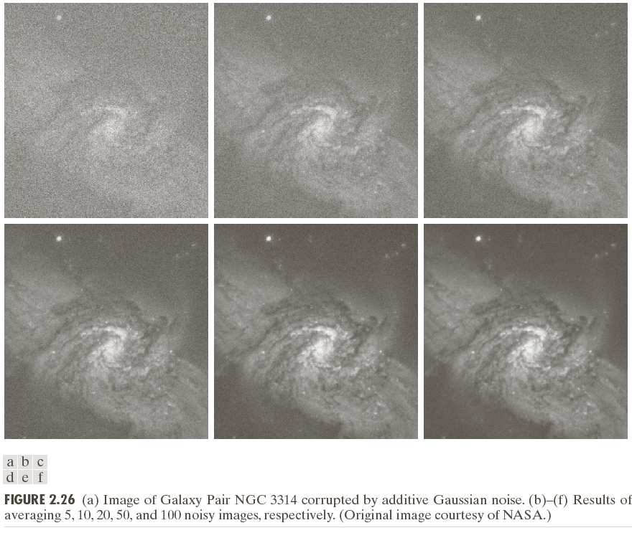

Slide 64
An Example of Image Subtraction: Mask Mode Radiography
Mask h(x,y): an X-ray image of a region of a patient’s body
Live images f(x,y): X-ray images captured at TV rates after injection of the contrast medium
Enhanced detail g(x,y)
g(x,y) = f(x,y) - h(x,y)
The procedure gives a movie showing how the contrast medium propagates through the various arteries in the area being observed.

Slide 65
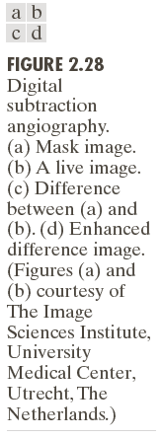

Slide 66
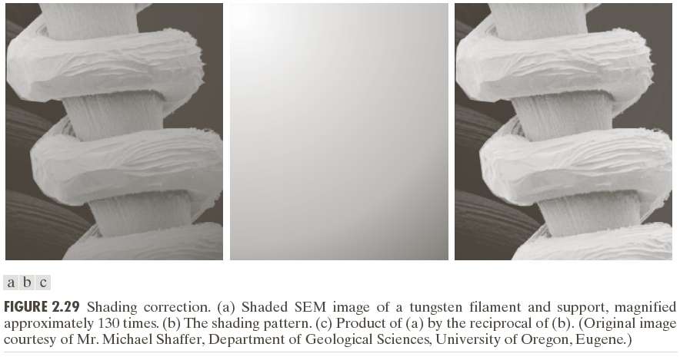
An Example of Image Multiplication

Slide 67
Set and Logical Operations

Slide 68
Set and Logical Operations
Let A be the elements of a gray-scale image
The elements of A are triplets of the form (x, y, z), where x and y are spatial coordinates and z denotes the intensity at the point (x, y).
The complement of A is denoted A^{c}

Slide 69
Set and Logical Operations
The union of two gray-scale images (sets) A and B is defined as the set

Slide 70
Set and Logical Operations

Slide 71
Set and Logical Operations

Slide 72
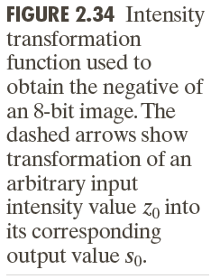
Spatial Operations
Single-pixel operations
Alter the values of an image’s pixels based on the intensity.
e.g.,

Slide 73
Spatial Operations
Neighborhood operations
The value of this pixel is determined by a specified operation involving the pixels in the input image with coordinates in S_{xy}

Slide 74
Geometric Spatial Transformations
Geometric transformation (rubber-sheet transformation)
— A spatial transformation of coordinates
— intensity interpolation that assigns intensity values to the spatially transformed pixels.
Affine transform

Slide 76
Image Registration
Input and output images are available but the transformation function is unknown.
Goal: estimate the transformation function and use it to register the two images.
One of the principal approaches for image registration is to use tie points (also called control points)
The corresponding points are known precisely in the input and output (reference) images.

Slide 77
Image Registration
A simple model based on bilinear approximation:

Slide 78
Image
Registration

Slide 79
Image Transform
A particularly important class of 2-D linear transforms, denoted T(u, v)

Slide 80
Image Transform
Given T(u, v), the original image f(x, y) can be recoverd using the inverse tranformation of T(u, v).

Slide 81
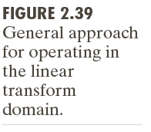
Image Transform

Slide 82
Example: Image Denoising by Using DCT Transform

Slide 83
Forward Transform Kernel

Slide 84
Kernels for 2-D Fourier Transform

Slide 85
2-D Fourier Transform

Slide 86
Probabilistic Methods

Slide 87
Probabilistic Methods

Slide 88
Example: Comparison of Standard Deviation Values

Slide 89
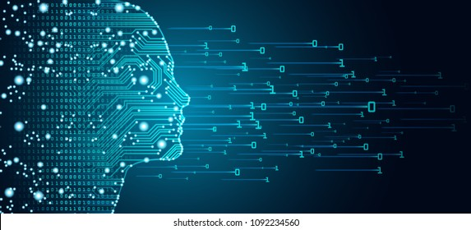
Thank You
End of Chapter 2

