Slide 1
Chapter 7: Synchronization Examples
Sheli Sinha Chaudhuri
Professor
ETCE Department

Slide 2
Outline
Explain the bounded-buffer synchronization problem
Explain the readers-writers synchronization problem
Explain and dining-philosophers synchronization problems
Describe the tools used by Linux and Windows to solve synchronization problems.
Illustrate how POSIX and Java can be used to solve process synchronization problems

Slide 3
Classical Problems of Synchronization
Classical problems used to test newly-proposed synchronization schemes
  Bounded-Buffer Problem
  Readers and Writers Problem
  Dining-Philosophers Problem

Slide 4
Bounded-Buffer Problem
n buffers, each can hold one item
Semaphore mutex initialized to the value 1
Semaphore full initialized to the value 0
Semaphore empty initialized to the value n

Slide 5
Bounded Buffer Problem (Cont.)
The structure of the producer process
while (true) {
...
/* produce an item in next_produced */
...
wait(empty);
wait(mutex);
...
/* add next produced to the buffer */
...
signal(mutex);
signal(full);
}

Slide 6
Bounded Buffer Problem (Cont.)
The structure of the consumer process
while (true) {
wait(full);
wait(mutex);
...
/* remove an item from buffer to next_consumed */
...
signal(mutex);
signal(empty);
...
/* consume the item in next consumed */
...
}

Slide 7
Readers-Writers Problem
A data set is shared among a number of concurrent processes
  Readers – only read the data set; they do not perform any updates
  Writers – can both read and write
Problem – allow multiple readers to read at the same time
  Only one single writer can access the shared data at the same time
Several variations of how readers and writers are considered – all involve some form of priorities

Slide 8
Readers-Writers Problem (Cont.)
Shared Data
  Data set
  Semaphore rw_mutex initialized to 1
  Semaphore mutex initialized to 1
  Integer read_count initialized to 0

Slide 9
Readers-Writers Problem (Cont.)
The structure of a writer process
while (true) {
wait(rw_mutex);
...
/* writing is performed */
...
signal(rw_mutex);
}

Slide 10
Readers-Writers Problem (Cont.)
The structure of a reader process
while (true){
wait(mutex);
read_count++;
if (read_count == 1) /* first reader */
wait(rw_mutex);
signal(mutex);
...
/* reading is performed */
...
wait(mutex);
read count--;
if (read_count == 0) /* last reader */
signal(rw_mutex);
signal(mutex);
}

Slide 11
Readers-Writers Problem Variations
The solution in previous slide can result in a situation where a writer process never writes. It is referred to as the “First reader-writer” problem.
The “Second reader-writer” problem is a variation the first reader-writer problem that state:
  Once a writer is ready to write, no “newly arrived reader” is allowed to read.
Both the first and second may result in starvation. leading to even more variations
Problem is solved on some systems by kernel providing reader-writer locks

Slide 12
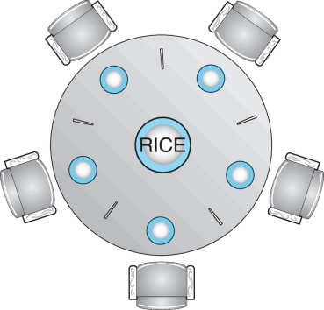
Dining-Philosophers Problem
N philosophers’ sit at a round table with a bowel of rice in the middle.
They spend their lives alternating thinking and eating.
They do not interact with their neighbors.
Occasionally try to pick up 2 chopsticks (one at a time) to eat from bowl
  Need both to eat, then release both when done
In the case of 5 philosophers, the shared data
    Bowl of rice (data set)
    Semaphore chopstick [5] initialized to 1

Slide 13
Dining-Philosophers Problem Algorithm
Semaphore Solution
The structure of Philosopher i :
    while (true){
    wait (chopstick[i] );
    wait (chopStick[ (i + 1) % 5] );
    /* eat for awhile */
    signal (chopstick[i] );
    signal (chopstick[ (i + 1) % 5] );
    /* think for awhile */
    }
What is the problem with this algorithm?

Slide 14
Monitor Solution to Dining Philosophers
monitor DiningPhilosophers
{
enum { THINKING; HUNGRY, EATING) state [5] ;
condition self [5];
void pickup (int i) {
state[i] = HUNGRY;
test(i);
if (state[i] != EATING) self[i].wait;
}
void putdown (int i) {
state[i] = THINKING;
// test left and right neighbors
test((i + 4) % 5);
test((i + 1) % 5);
}

Slide 15
Solution to Dining Philosophers (Cont.)
void test (int i) {
if ((state[(i + 4) % 5] != EATING) &&
(state[i] == HUNGRY) &&
(state[(i + 1) % 5] != EATING) ) {
state[i] = EATING ;
self[i].signal () ;
}
}
initialization_code() {
for (int i = 0; i < 5; i++)
state[i] = THINKING;
}
}

Slide 16
Solution to Dining Philosophers (Cont.)
Each philosopher “i” invokes the operations pickup() and putdown() in the following sequence:
DiningPhilosophers.pickup(i);
/** EAT **/
DiningPhilosophers.putdown(i);
No deadlock, but starvation is possible

Slide 17
Kernel Synchronization - Windows
Uses interrupt masks to protect access to global resources on uniprocessor systems
Uses spinlocks on multiprocessor systems
  Spinlocking-thread will never be preempted
Also provides dispatcher objects using which threads synchronize based on mutexes, semaphores, events, and timers.
  Events
    An event acts much like a condition variable
  Timers notify one or more thread when time expired
  Dispatcher objects either signaled-state (object available) or non-signaled state (thread will block)

Slide 18
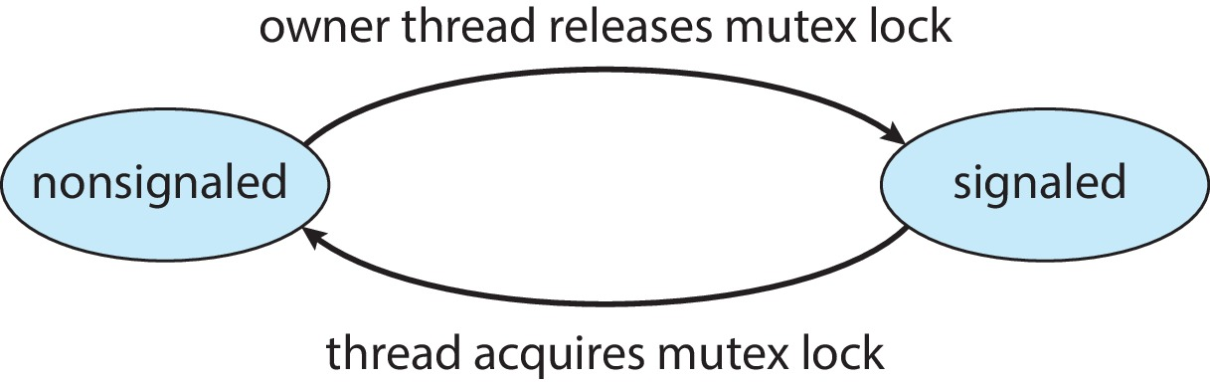
Kernel Synchronization - Windows
Mutex dispatcher object

Slide 19
Linux Synchronization
Linux:
  Prior to kernel Version 2.6, disables interrupts to implement short critical sections
  Version 2.6 and later, fully preemptive
Linux provides:
  Semaphores
  Atomic integers
  Spinlocks
  Reader-writer versions of both
On single-CPU system, spinlocks replaced by enabling and disabling kernel preemption

Slide 20
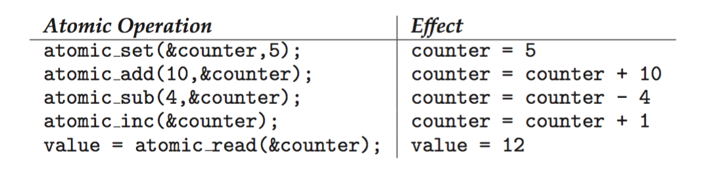
Linux Synchronization
Atomic variables
atomic_t is the type for atomic integer
Consider the variables
atomic_t counter;
int value;

Slide 21
POSIX Synchronization
POSIX API provides
  mutex locks
  semaphores
  condition variable
Widely used on UNIX, Linux, and macOS

Slide 22
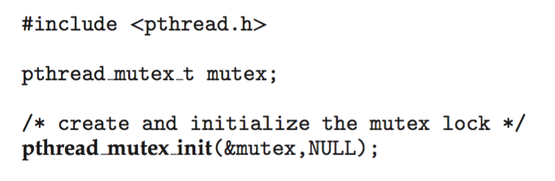
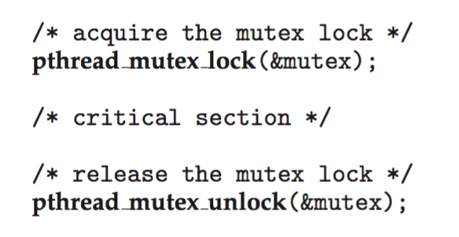
POSIX Mutex Locks
Creating and initializing the lock
Acquiring and releasing the lock

Slide 23
POSIX Semaphores
POSIX provides two versions – named and unnamed.
Named semaphores can be used by unrelated processes, unnamed cannot.

Slide 24
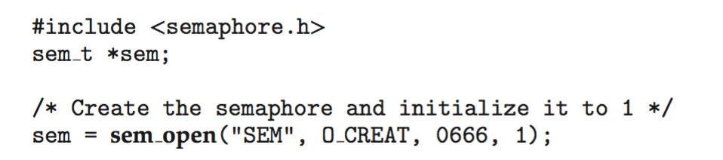
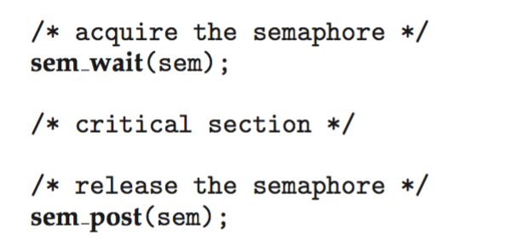
POSIX Named Semaphores
Creating an initializing the semaphore:
Another process can access the semaphore by referring to its name SEM.
Acquiring and releasing the semaphore:

Slide 25
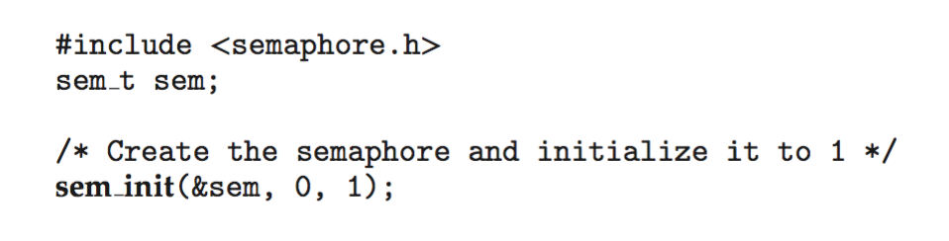
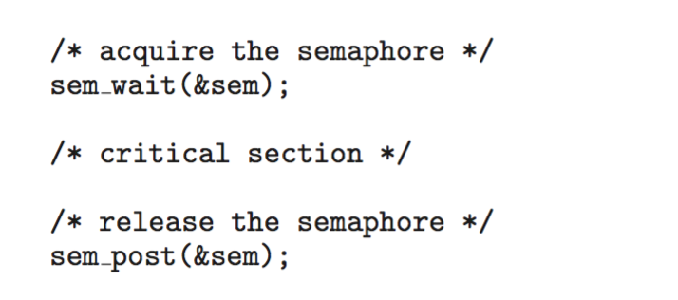
POSIX Unnamed Semaphores
Creating an initializing the semaphore:
Acquiring and releasing the semaphore:

Slide 26
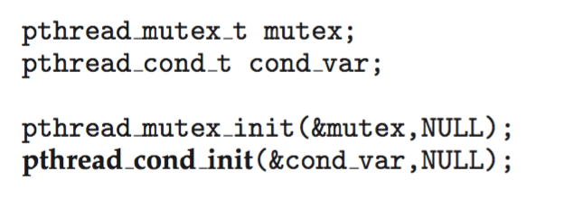
POSIX Condition Variables
Since POSIX is typically used in C/C++ and these languages do not provide a monitor, POSIX condition variables are associated with a POSIX mutex lock to provide mutual exclusion: Creating and initializing the condition variable:

Slide 27
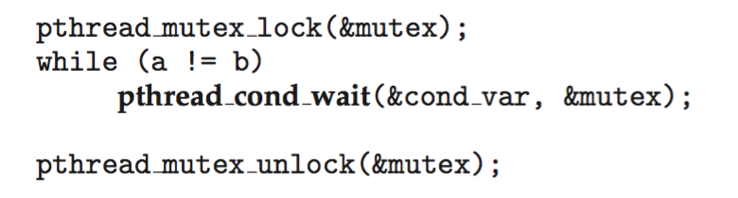
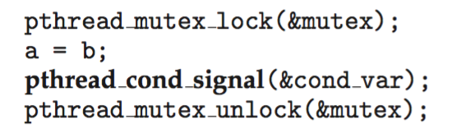
POSIX Condition Variables
Thread waiting for the condition a == b to become true:
Thread signaling another thread waiting on the condition variable:

Slide 28
Java Synchronization
Java provides rich set of synchronization features:
Java monitors
Reentrant locks
Semaphores
Condition variables

Slide 29
Java Monitors
Every Java object has associated with it a single lock.
If a method is declared as synchronized, a calling thread must own the lock for the object.
If the lock is owned by another thread, the calling thread must wait for the lock until it is released.
Locks are released when the owning thread exits the synchronized method.

Slide 30
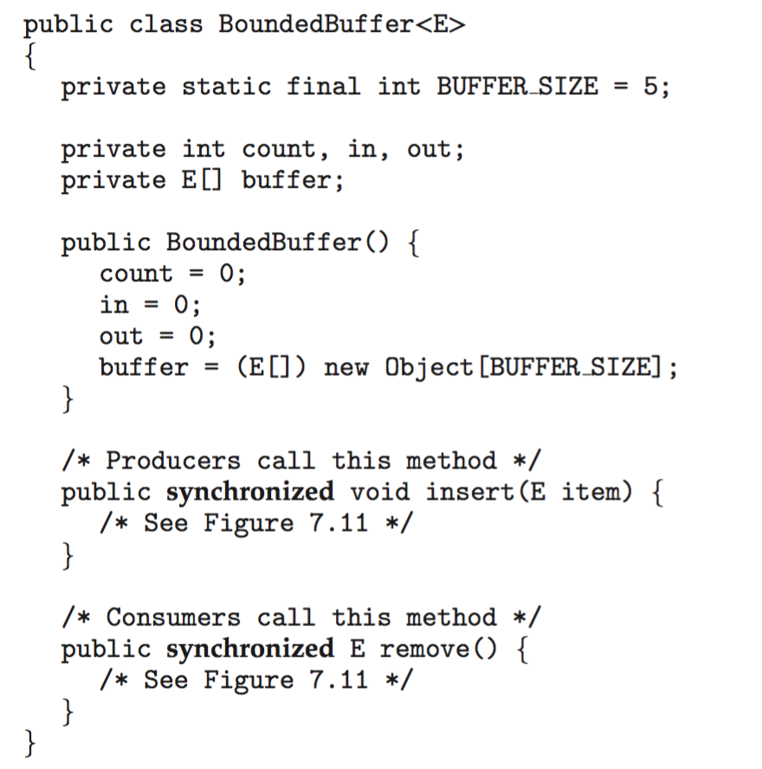
Bounded Buffer – Java Synchronization

Slide 31
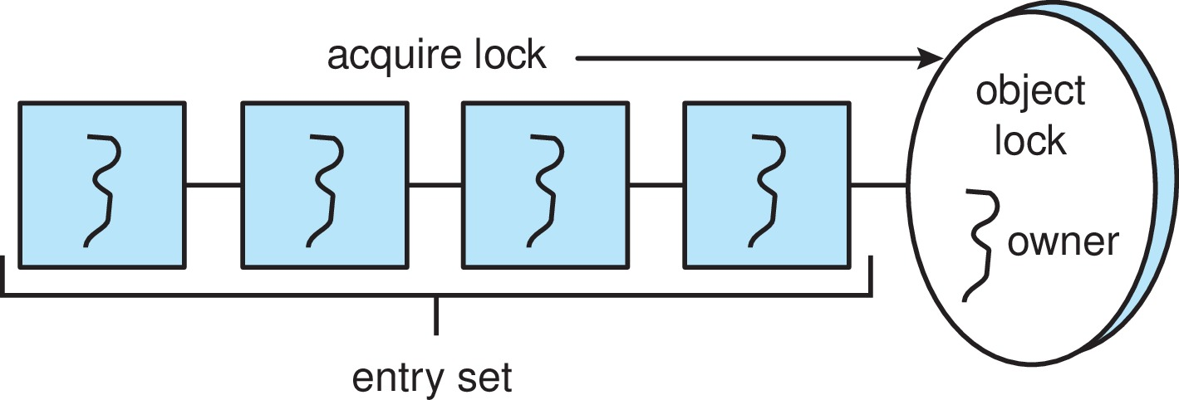
Java Synchronization
A thread that tries to acquire an unavailable lock is placed in the object’s entry set:

Slide 32
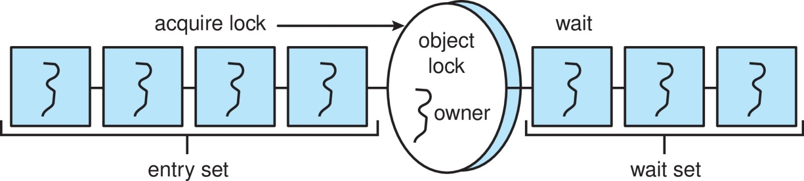
Java Synchronization
Similarly, each object also has a wait set.
When a thread calls wait():
  It releases the lock for the object
  The state of the thread is set to blocked
  The thread is placed in the wait set for the object

Slide 33
Java Synchronization
A thread typically calls wait() when it is waiting for a condition to become true.
How does a thread get notified?
When a thread calls notify():
  An arbitrary thread T is selected from the wait set
  T is moved from the wait set to the entry set
  Set the state of T from blocked to runnable.
T can now compete for the lock to check if the condition it was waiting for is now true.

Slide 34
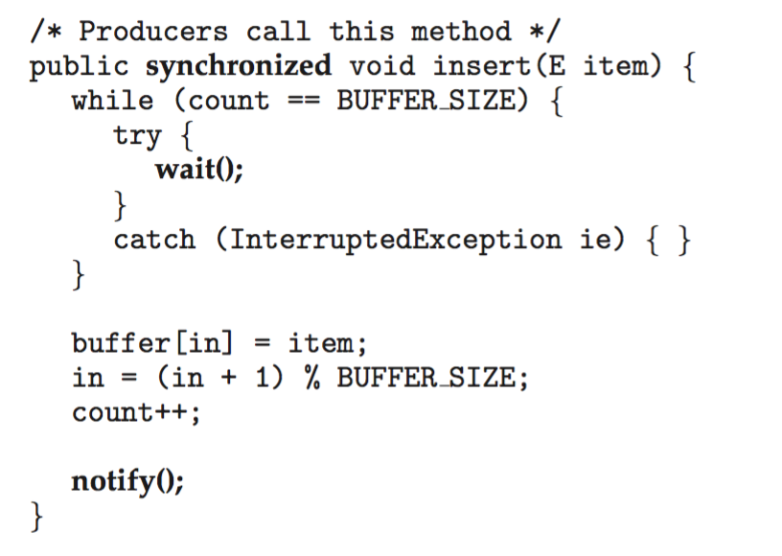
Bounded Buffer – Java Synchronization

Slide 35
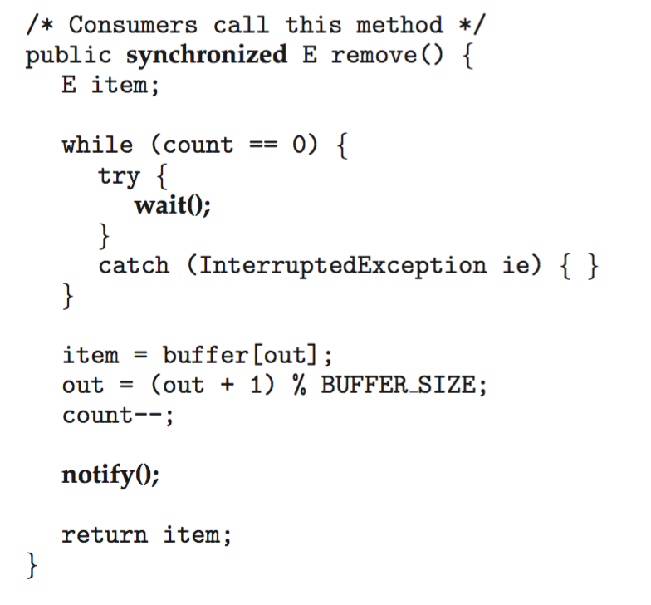
Bounded Buffer – Java Synchronization

Slide 36
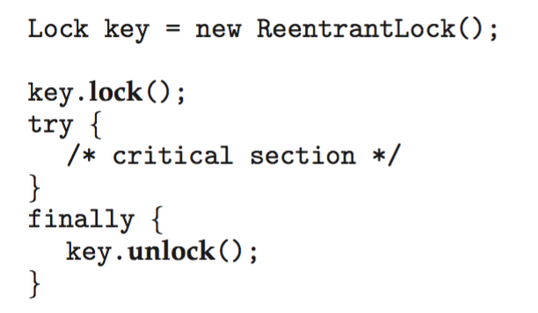
Java Reentrant Locks
Similar to mutex locks
The finally clause ensures the lock will be released in case an exception occurs in the try block.

Slide 37

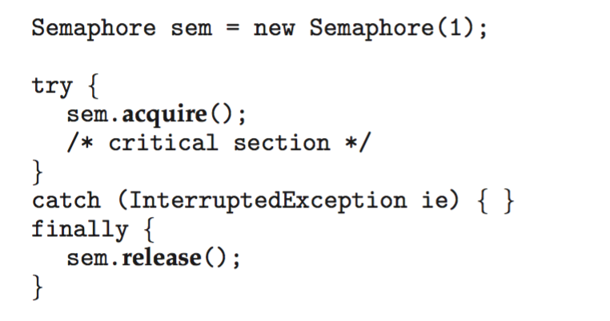
Java Semaphores
Constructor:
Usage:

Slide 38

Java Condition Variables
Condition variables are associated with an ReentrantLock.
Creating a condition variable using newCondition() method of ReentrantLock:
A thread waits by calling the await() method, and signals by calling the signal() method.

Slide 39
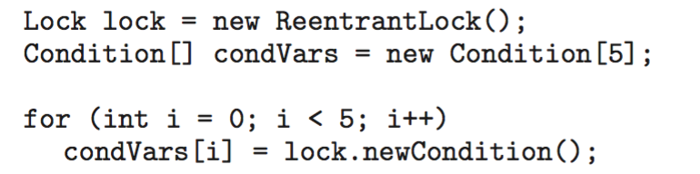
Java Condition Variables
Example:
Five threads numbered 0 .. 4
Shared variable turn indicating which thread’s turn it is.
Thread calls doWork() when it wishes to do some work. (But it may only do work if it is their turn.
If not their turn, wait
If their turn, do some work for awhile …...
When completed, notify the thread whose turn is next.
Necessary data structures:

Slide 40
Alternative Approaches
Transactional Memory
OpenMP
Functional Programming Languages

Slide 41
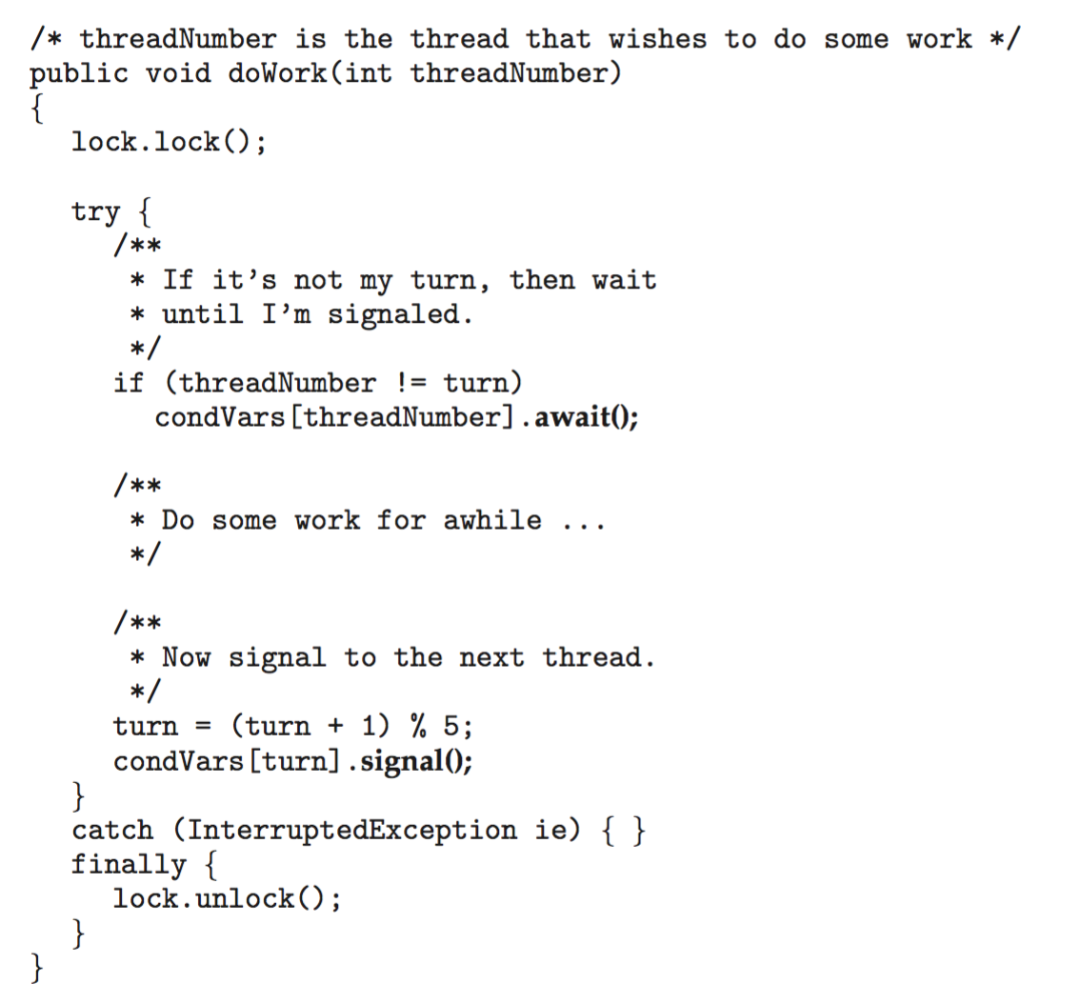
Java Condition Variables

Slide 42
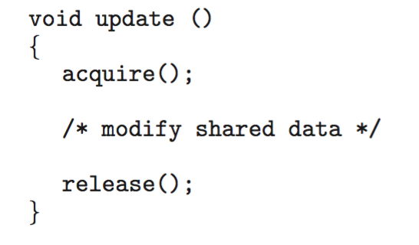
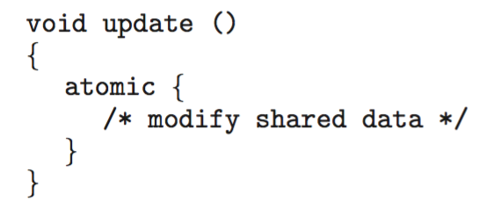
Transactional Memory
Consider a function update() that must be called atomically. One option is to use mutex locks:
A memory transaction is a sequence of read-write operations to memory that are performed atomically. A transaction can be completed by adding atomic{S} which ensure statements in S are executed atomically:

Slide 43
OpenMP
OpenMP is a set of compiler directives and API that support parallel progamming.
void update(int value)
{
#pragma omp critical
{
count += value
}
}
The code contained within the #pragma omp critical directive is treated as a critical section and performed atomically.

Slide 44
Functional Programming Languages
Functional programming languages offer a different paradigm than procedural languages in that they do not maintain state.
Variables are treated as immutable and cannot change state once they have been assigned a value.
There is increasing interest in functional languages such as Erlang and Scala for their approach in handling data races.

Slide 45
End of Chapter 7

