Slide 1
Chapter 6: Process Synchronizing Tools
Sheli Sinha Chaudhuri
Professor
ETCE Department

Slide 2
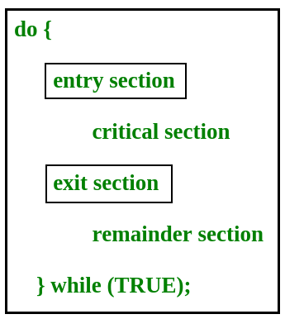
Critical Section Problem

Slide 3
Critical Section Problem
n cooperating processes are there all competing to use shared resources
Each process has a code segment, called critical segment, in which the shared data is accessed.
When one process is accessing its critical section, no other process is allowed to execute in its critical section

Slide 4
Solution to Critical Section Problem
The solution to critical section problem must satisfy the following three requirements:
1. Mutual Exclusion- Process P is executing in its critical section, then no other processes can be executing in their critical sections.
2. Progress- Process is executing in its critical section and some processes wish to enter their critical section, then only the processes not in their remainder sections can participate in deciding which will enter its critical section next and in definite time.
3. Bounded Waiting- There exists a bound, or limit, on the number of times that other processes are allowed to enter their critical sections after a process has made a request to enter its critical section and before that request is granted.

Slide 5
Solution to Critical Section Problem
Two general approaches are used to handle critical sections in operating systems:
  Preemptive kernels
  Allows a process to be preempted, while running in kernel mode
  Nonpreemptive kernels
  Does not allow a process running in kernel mode to be preempted; the process will run until it exits kernel mode, blocks, or voluntarily yields control of the CPU

Slide 6
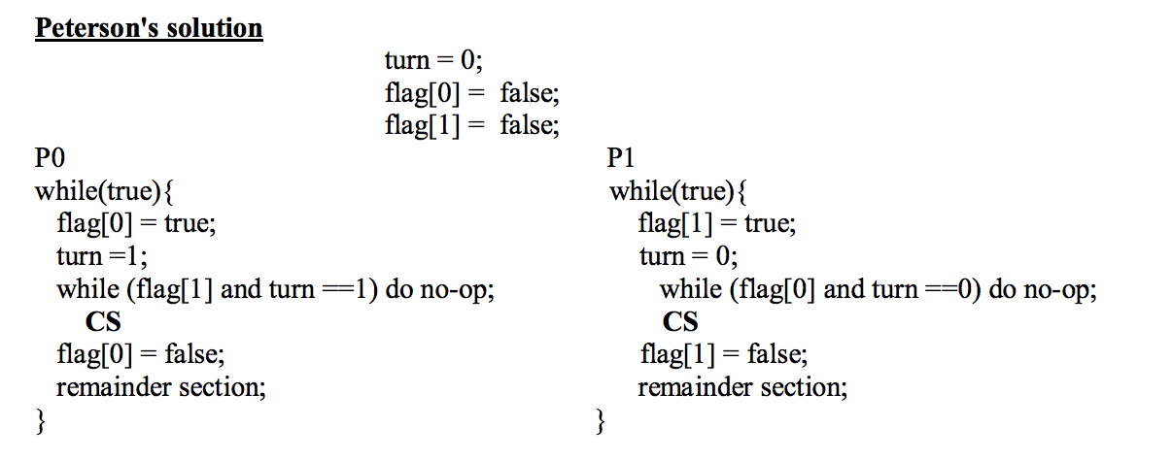
Peterson’s Solution
Peterson’s solution is restricted to two processes that alternate execution between their critical sections and remainder sections

Slide 7
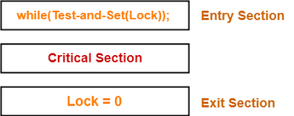
Solution to Critical Section Problem
Synchronization Hardware
-Solutions are based on the premise of locking, protecting critical sections through use of locks.
-Critical sections problem could be solved simply in a single processor environment if interrupts can be prevented from occurring while a shared variable was being modified.

Slide 8
Synchronization Hardware
Many systems provide hardware support for implementing the critical section code.
Uniprocessors – could disable interrupts
  Currently running code would execute without preemption
  Generally too inefficient on multiprocessor systems
    Operating systems using this not broadly scalable
We will look at three forms of hardware support:
1. Hardware instructions
2. Atomic variables

Slide 9
Synchronization Hardware
Special hardware instructions that allow us to either test-and-modify the content of a word, or to swap the contents of two words atomically (uninterruptedly.)
  Test-and-Set instruction
  Compare-and-Swap instruction

Slide 10
Solution to Critical Section Problem
Disabling interrupts on a multiprocessor environment can be time consuming, reducing system efficiency.
Modern computers provide special hardware instructions allowing:
  Test and modify the content of a or to swap the contents of two words atomically- as one uninterruptible unit.
  These special instructions are useful to solve the critical-section problem in a simple way

Slide 11
Solution to Critical Section Problem
Test and set () instruction is executed atomically
If two test and set () instructions are executed simultaneously they will be executed sequentially in some arbitrary order.
Using this instruction mutual exclusion can be implemented by declaring a boolean variable lock initialized to false.
Compare_and_swap () instruction operates on three operands. Operand value is set to new_value only if the expression (*value==executed) is true. Instruction is executed atomically.

Slide 12
Solution to Critical Section Problem
Definition
boolean test_and_set (boolean *target)
{
boolean rv = *target;
*target = true;
return rv:
}
Properties
  Executed atomically
  Returns the original value of passed parameter
  Set the new value of passed parameter to true

Slide 13
Solution to Critical Section Problem
Shared boolean variable lock, initialized to false
Solution:
do {
while (test_and_set(&lock))
; /* do nothing */
/* critical section */
lock = false;
/* remainder section */
} while (true);
Does it solve the critical-section problem?

Slide 14
Solution to Critical Section Problem
Definition
int compare_and_swap(int *value, int expected, int new_value)
{
int temp = *value;
if (*value == expected)
*value = new_value;
return temp;
}
Properties
  Executed atomically
  Returns the original value of passed parameter value
  Set the variable value the value of the passed parameter new_value but only if *value == expected is true. That is, the swap takes place only under this condition.

Slide 15
Solution to Critical Section Problem
Shared integer lock initialized to 0;
Solution:
while (true){
while (compare_and_swap(&lock, 0, 1) != 0)
; /* do nothing */
/* critical section */
lock = 0;
/* remainder section */
}
Does it solve the critical-section problem?

Slide 16
Solution to Critical Section Problem
Bounded Waiting with compare_and _swap
while (true) {
waiting[i] = true;
key = 1;
while (waiting[i] && key == 1)
key = compare_and_swap(&lock,0,1);
waiting[i] = false;
/* critical section */
j = (i + 1) % n;
while ((j != i) && !waiting[j])
j = (j + 1) % n;
if (j == i)
lock = 0;
else
waiting[j] = false;
/* remainder section */
}

Slide 17
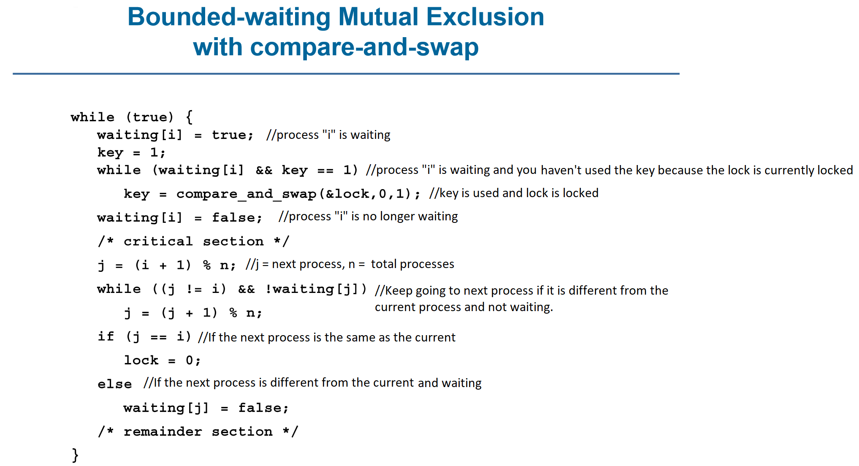
Solution to Critical Section Problem

Slide 18
Atomic Variables
Typically, instructions such as compare-and-swap are used as building blocks for other synchronization tools.
One tool is an atomic variable that provides atomic (uninterruptible) updates on basic data types such as integers and booleans.
For example:
  Let sequence be an atomic variable
  Let increment() be operation on the atomic variable sequence
  The Command:
  increment(&sequence);
  ensures sequence is incremented without interruption:

Slide 19
Atomic Variables
The increment() function can be implemented as follows:
void increment(atomic_int *v)
{
int temp;
do {
temp = *v;
}
while (temp != compare_and_swap(v,temp,temp+1));
}

Slide 20
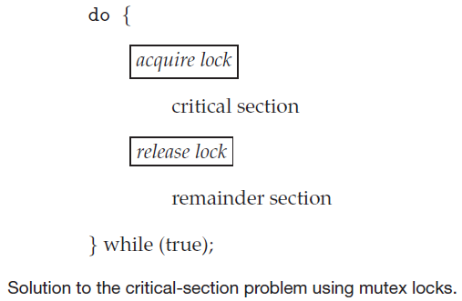
Mutex Locks
Mutex locks are software tools
-used to protect critical regions and prevent race conditions
-process must acquire the lock before entering a critical section; releases when it leaves the critical section
-calls to either acquire () or release() must be performed atomically

Slide 21
Mutex Locks
Main disadvantage of mutex lock implementation is busy waiting
This leads to processes waiting to enter critical section to loop continuously in the call to acquire ()
This type of mutex lock is also called spinlock
Spinlocks are not required when a process waits on a lock and a context switch takes time
Spinlocks are useful when locks are expected to be held for short times

Slide 22
Semaphores
Synchronization tool that provides more sophisticated ways (than Mutex locks) for processes to synchronize their activities.
Semaphore S – integer variable
Can only be accessed via two indivisible (atomic) operations
  wait() and signal()
    Originally called P() and V()
Definition of the wait() operation
  wait(S) {
  while (S <= 0)
  ; // busy wait
  S--;
  }
Definition of the signal() operation
  signal(S) {
  S++;
  }

Slide 23
Semaphores
Counting semaphore – integer value can range over an unrestricted domain
Binary semaphore – integer value can range only between 0 and 1
  Same as a mutex lock
Can implement a counting semaphore S as a binary semaphore
With semaphores we can solve various synchronization problems

Slide 24
Semaphores
Solution to the CS Problem
  Create a semaphore “mutex” initialized to 1
    wait(mutex);
    CS
    signal(mutex);
Consider P₁ and P₂ that with two statements S₁ and S₂ and the requirement that S₁ to happen before S₂
  Create a semaphore “synch” initialized to 0
    P1:
    S₁;
    signal(synch);
    P2:
    wait(synch);
    S₂;

Slide 25
Semaphores
Must guarantee that no two processes can execute the wait() and signal() on the same semaphore at the same time
Thus, the implementation becomes the critical section problem where the wait and signal code are placed in the critical section
Could now have busy waiting in critical section implementation
  But implementation code is short
  Little busy waiting if critical section rarely occupied
Note that applications may spend lots of time in critical sections and therefore this is not a good solution

Slide 26
Semaphore Implementation with no busy waiting
With each semaphore there is an associated waiting queue
Each entry in a waiting queue has two data items:
  Value (of type integer)
  Pointer to next record in the list
Two operations:
  block – place the process invoking the operation on the appropriate waiting queue
  wakeup – remove one of processes in the waiting queue and place it in the ready queue

Slide 27
Semaphore Implementation with no busy waiting
Waiting queue
typedef struct {
int value;
struct process *list;
} semaphore;

Slide 28
Semaphore Implementation with no busy waiting
wait(semaphore *S) {
S->value--;
if (S->value < 0) {
add this process to S->list;
block();
}
}
signal(semaphore *S) {
S->value++;
if (S->value <= 0) {
remove a process P from S->list;
wakeup(P);
}
}

Slide 29
Problems with Semaphores
Incorrect use of semaphore operations:
  signal(mutex) …. wait(mutex)
  wait(mutex) … wait(mutex)
  Omitting of wait (mutex) and/or signal (mutex)
These – and others – are examples of what can occur when semaphores and other synchronization tools are used incorrectly.

Slide 30
Monitors
A high-level abstraction that provides a convenient and effective mechanism for process synchronization
Abstract data type, internal variables only accessible by code within the procedure
Only one process may be active within the monitor at a time
Pseudocode syntax of a monitor:
    monitor monitor-name
    {
    // shared variable declarations
    procedure P1 (…) { …. }
    procedure P2 (…) { …. }
    procedure Pn (…) {……}
    initialization code (…) { … }
    }

Slide 31
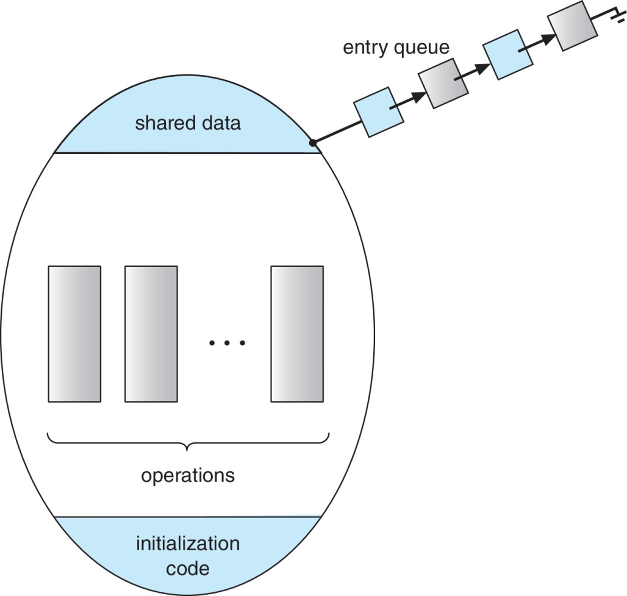
Schematic view of a Monitor

Slide 32
Monitor Implementation Using Semaphores
Variables
semaphore mutex
mutex = 1
Each procedure P is replaced by
wait(mutex);
…
body of P;
…
signal(mutex);
Mutual exclusion within a monitor is ensured

Slide 33
Condition Variables
condition x, y;
Two operations are allowed on a condition variable:
  x.wait() – a process that invokes the operation is suspended until x.signal()
  x.signal() – resumes one of processes (if any) that invoked x.wait()
    If no x.wait() on the variable, then it has no effect on the variable

Slide 34
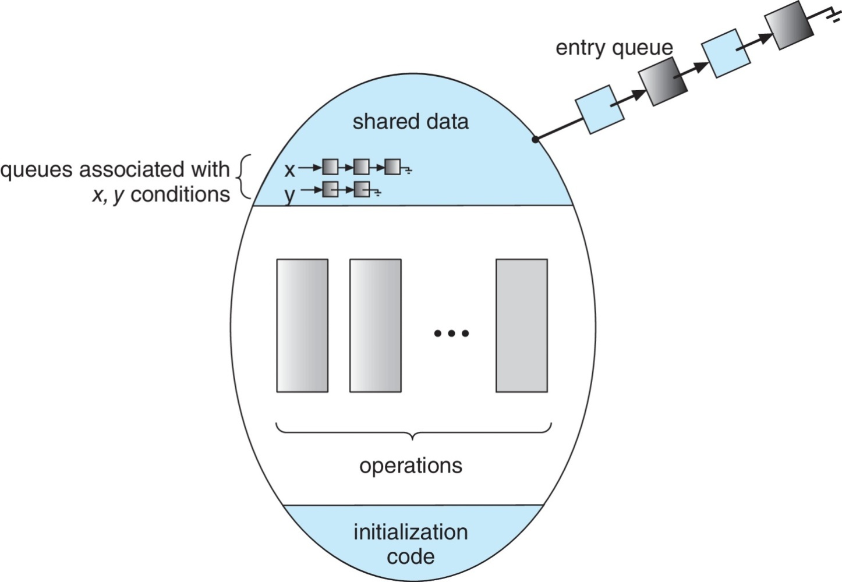
Monitor with Condition Variables

Slide 35
Usage of Condition Variable Example
Consider P₁ and P₂ that that need to execute two statements S₁ and S₂ and the requirement that S₁ to happen before S₂
  Create a monitor with two procedures F₁ and F₂ that are invoked by P₁ and P₂ respectively
  One condition variable “x” initialized to 0
  One Boolean variable “done”
  F1:
    S₁;
    done = true;
    x.signal();
  F2:
    if done = false
    x.wait()
    S₂;

Slide 36
Monitor Implementation Using Semaphores
Variables
semaphore mutex; // (initially = 1)
semaphore next; // (initially = 0)
int next_count = 0; // number of
processes waiting inside the monitor
Each function P will be replaced by
wait(mutex);
…
body of P;
…
if (next_count > 0)
signal(next)
else
signal(mutex);
Mutual exclusion within a monitor is ensured

Slide 37
Implementation – Condition Variables
For each condition variable x, we have:
semaphore x_sem; // (initially = 0)
int x_count = 0;
The operation x.wait() can be implemented as:
x_count++;
if (next_count > 0)
signal(next);
else
signal(mutex);
wait(x_sem);
x_count--;

Slide 38
Implementation (Cont.)
The operation x.signal() can be implemented as:
if (x_count > 0)
{
next_count++;
signal(x_sem);
wait(next);
next_count--;
}

Slide 39
Resuming Processes within a Monitor
If several processes queued on condition variable x, and x.signal() is executed, which process should be resumed?
FCFS frequently not adequate
Use the conditional-wait construct of the form
x.wait(c)
where:
  c is an integer (called the priority number)
  The process with lowest number (highest priority) is scheduled next

Slide 40
Deadlock Characterization
Deadlock can arise if four conditions hold simultaneously.
Mutual exclusion: only one process at a time can use a resource
Hold and wait: a process holding at least one resource is waiting to acquire additional resources held by other processes
No preemption: a resource can be released only voluntarily by the process holding it, after that process has completed its task
Circular wait: there exists a set {P₀, P₁, …, P_{n}} of waiting processes such that P₀ is waiting for a resource that is held by P₁, P₁ is waiting for a resource that is held by P₂, …, P_{n–1} is waiting for a resource that is held by P_{n}, and P_{n} is waiting for a resource that is held by P₀.

Slide 41
Deadlock with Mutex Locks
Deadlocks can occur via system calls, locking, etc.
See example box in text page 318 for mutex deadlock
Deadlock can be occurred in a multithreaded Pthread program using mutex locks. Let’s see how it can be occurred. An unlocked mutex is initialized by the pthread_mutex_init() function.
Using pthread_mutex_lock() and pthread_mutex_unlock() Mutex locks are acquired and released. If a thread try to acquire a locked mutex, the call to pthread_mutex_lock() blocks the thread until the owner of the mutex lock invokes pthread_mutex_unlock().
Let’s take an example, two Mutex locks are created in the following Code −
/* Create and initialize the mutex locks */
pthread mutex t mutex1;
pthread mutex t mutex2;
pthread mutex init(&mutex1,NULL);
pthread mutex init(&mutex2,NULL);

Slide 42
Deadlock with Mutex Locks
Next, two threads - thread1 and thread2 - are created, and both these threads have access to both mutex locks.
Thread1 and thread2 run in the functions dosomework_1 and dos
/* thread1 runs in this function */
void *dosomework_1(void *param)
{ pthread mutex lock(&mutex1);
pthread mutex lock(&mutex2); /**
* Do some work */
pthread mutex unlock(& mutex2);
pthread mutex unlock(& mutex2);
pthread exit(0); }
/* thread2 runs in this function */
void *dosomework_2(void *param)
{ pthread mutex lock(&mutex2);
pthread mutex lock(&mutex1); /**
* Do some work */
pthread mutex unlock(&mutex1);
pthread mutex unlock(&mutex2);
pthread exit(0); }

Slide 43
Deadlock with Mutex Locks
In this example, thread1 tries to acquire the mutex locks in the order
mutex1,
mutex2,
while thread 2 tries to acquire the mutex locks in the order
mutex2,
mutex1,
Deadlock is possible if thread1 acquires mutex1 while thread2 acquires mutex2. Even though deadlock is possible, it will not occur if thread1 can acquire and release the mutex locks for mutex1 and mutex2 before thread2 tries to acquire the locks.
CPU scheduler scheduled the order in which the threads run. The above example illustrates a problem with handling deadlocks: it is difficult to identify and test for deadlocks that may occur only under certain scheduling circumstances

Slide 44
Resource-Allocation Graph
A set of vertices V and a set of edges E.
V is partitioned into two types:
  P = {P₁, P₂, …, P_{n}}, the set consisting of all the processes in the system
  R = {R₁, R₂, …, R_{m}}, the set consisting of all resource types in the system
request edge – directed edge P_{i} → R_{j}
assignment edge – directed edge R_{j} → P_{i}

Slide 45
Resource-Allocation Graph (Cont.)
Process
Resource Type with 4 instances
P_{i} requests instance of R_{j}
P_{i} is holding an instance of R_{j}
P_{i}
R_{j}
P_{i}
R_{j}

Slide 46
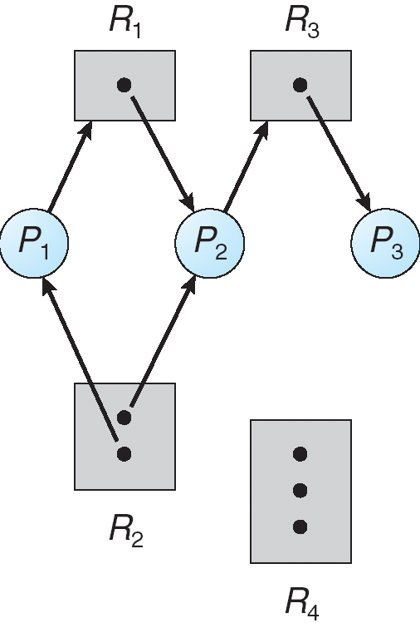
Example of a Resource Allocation Graph

Slide 47
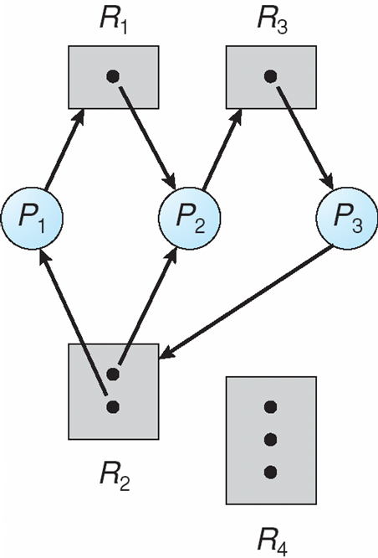
Resource Allocation Graph With A Deadlock

Slide 48
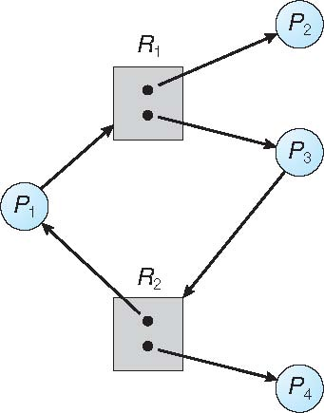
Graph With A Cycle But No Deadlock

Slide 49
Basic Facts
If graph contains no cycles ⇒ no deadlock
If graph contains a cycle ⇒
  if only one instance per resource type, then deadlock
  if several instances per resource type, possibility of deadlock

Slide 50
Methods for Handling Deadlocks
Ensure that the system will never enter a deadlock state:
  Deadlock prevention
  Deadlock avoidence
Allow the system to enter a deadlock state and then recover
Ignore the problem and pretend that deadlocks never occur in the system; used by most operating systems, including UNIX

Slide 51
Deadlock Prevention
Restrain the ways request can be made
Mutual Exclusion – not required for sharable resources (e.g., read-only files); must hold for non-sharable resources
Hold and Wait – must guarantee that whenever a process requests a resource, it does not hold any other resources
  Require process to request and be allocated all its resources before it begins execution, or allow process to request resources only when the process has none allocated to it.
  Low resource utilization; starvation possible

Slide 52
Deadlock Prevention (Cont.)
No Preemption –
  If a process that is holding some resources requests another resource that cannot be immediately allocated to it, then all resources currently being held are released
  Preempted resources are added to the list of resources for which the process is waiting
  Process will be restarted only when it can regain its old resources, as well as the new ones that it is requesting
Circular Wait – impose a total ordering of all resource types, and require that each process requests resources in an increasing order of enumeration

Slide 53
Deadlock Example
/* thread one runs in this function */
void *do_work_one(void *param)
{
pthread_mutex_lock(&first_mutex);
pthread_mutex_lock(&second_mutex);
/** * Do some work */
pthread_mutex_unlock(&second_mutex);
pthread_mutex_unlock(&first_mutex);
pthread_exit(0);
}
/* thread two runs in this function */
void *do_work_two(void *param)
{
pthread_mutex_lock(&second_mutex);
pthread_mutex_lock(&first_mutex);
/** * Do some work */
pthread_mutex_unlock(&first_mutex);
pthread_mutex_unlock(&second_mutex);
pthread_exit(0);
}

Slide 54
Deadlock Example with Lock Ordering
void transaction(Account from, Account to, double amount)
{
mutex lock1, lock2;
lock1 = get_lock(from);
lock2 = get_lock(to);
acquire(lock1);
acquire(lock2);
withdraw(from, amount);
deposit(to, amount);
release(lock2);
release(lock1);
}
Transactions 1 and 2 execute concurrently. Transaction 1 transfers $25 from account A to account B, and Transaction 2 transfers $50 from account B to account A

Slide 55
Deadlock Avoidance
Requires that the system has some additional a priori information
available
Simplest and most useful model requires that each process declare the maximum number of resources of each type that it may need
The deadlock-avoidance algorithm dynamically examines the resource-allocation state to ensure that there can never be a circular-wait condition
Resource-allocation state is defined by the number of available and allocated resources, and the maximum demands of the processes

Slide 56
Safe State
When a process requests an available resource, system must decide if immediate allocation leaves the system in a safe state
System is in safe state if there exists a sequence <P₁, P₂, …, P_{n}> of ALL the processes in the systems such that for each P_{i}, the resources that P_{i} can still request can be satisfied by currently available resources + resources held by all the P_{j}, with j < I
That is:
  If P_{i} resource needs are not immediately available, then P_{i} can wait until all P_{j} have finished
  When P_{j} is finished, P_{i} can obtain needed resources, execute, return allocated resources, and terminate
  When P_{i} terminates, P_{i +1} can obtain its needed resources, and so on

Slide 57
Basic Facts of System Deadlock
If a system is in safe state ⇒ no deadlocks
If a system is in unsafe state ⇒ possibility of deadlock
Avoidance ⇒ ensure that a system will never enter an unsafe state.

Slide 58
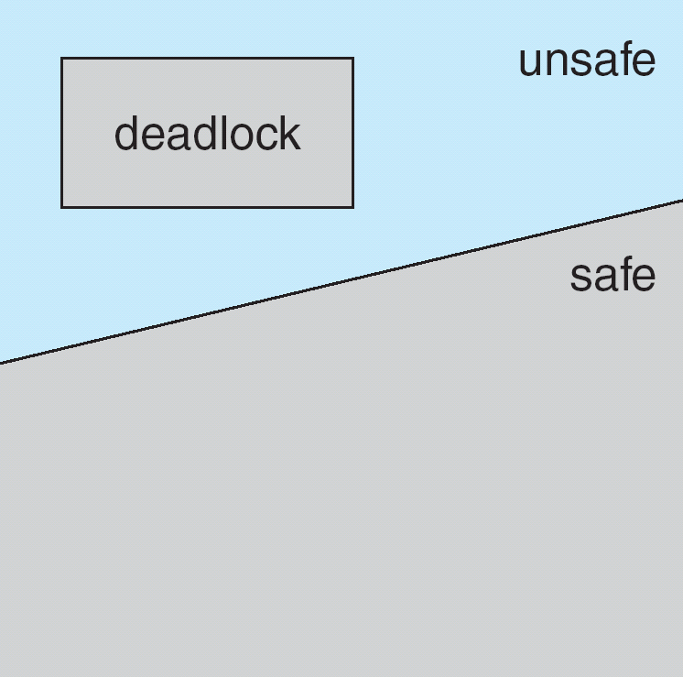
Safe, Unsafe, Deadlock State

Slide 59
Avoidance Algorithms
Single instance of a resource type
  Use a resource-allocation graph
Multiple instances of a resource type
  Use the banker’s algorithm

Slide 60
Resource-Allocation Graph Scheme
Claim edge P_{i} → R_{j} indicated that process P_{i} may request resource R_{j}; represented by a dashed line
Claim edge converts to request edge when a process requests a resource
Request edge converted to an assignment edge when the resource is allocated to the process
When a resource is released by a process, assignment edge reconverts to a claim edge
Resources must be claimed a priori in the system

Slide 61
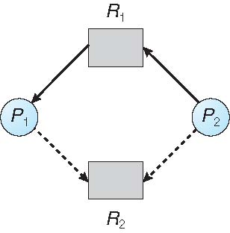
Resource-Allocation Graph

Slide 62
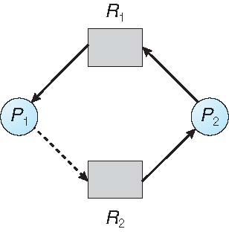
Unsafe State In Resource-Allocation Graph

Slide 63
Resource-Allocation Graph Algorithm
Suppose that process P_{i} requests a resource R_{j}
The request can be granted only if converting the request edge to an assignment edge does not result in the formation of a cycle in the resource allocation graph

Slide 64
Banker’s Algorithm
Multiple instances
Each process must a priori claim maximum use
When a process requests a resource it may have to wait
When a process gets all its resources it must return them in a finite amount of time

Slide 65
Data Structures for the Banker’s Algorithm
Let n = number of processes, and m = number of resources types.
Available: Vector of length m. If available [j] = k, there are k instances of resource type R_{j} available
Max: n x m matrix. If Max [i,j] = k, then process P_{i} may request at most k instances of resource type R_{j}
Allocation: n x m matrix. If Allocation[i,j] = k then P_{i} is currently allocated k instances of R_{j}
Need: n x m matrix. If Need[i,j] = k, then P_{i} may need k more instances of R_{j} to complete its task
    Need [i,j] = Max[i,j] – Allocation [i,j]

Slide 66
Safety Algorithm
1. Let Work and Finish be vectors of length m and n, respectively. Initialize:
      Work = Available
      Finish [i] = false for i = 0, 1, …, n- 1
2. Find an i such that both:
  (a) Finish [i] = false
  (b) Need_{i} ≤ Work
  If no such i exists, go to step 4
3. Work = Work + Allocation_{i}
Finish[i] = true
go to step 2
4. If Finish [i] == true for all i, then the system is in a safe state

Slide 67
Resource-Request Algorithm for Process P_{i}
Request_{i} = request vector for process P_{i}. If Request_{i} [j] = k then process P_{i} wants k instances of resource type R_{j}
  1. If Request_{i} ≤ Need_{i} go to step 2. Otherwise, raise error condition, since process has exceeded its maximum claim
  2. If Request_{i} ≤ Available, go to step 3. Otherwise P_{i} must wait, since resources are not available
  3. Pretend to allocate requested resources to P_{i} by modifying the state as follows:
      Available = Available – Request_{i};
      Allocation_{i} = Allocation_{i} + Request_{i};
      Need_{i} = Need_{i} – Request_{i};
    If safe ⇒ the resources are allocated to P_{i}
    If unsafe ⇒ P_{i} must wait, and the old resource-allocation state is restored

Slide 68
Example of Banker’s Algorithm
5 processes P₀ through P₄;
3 resource types:
A (10 instances), B (5instances), and C (7 instances)
Snapshot at time T₀:
Allocation Max Available
A B C A B C A B C
P₀ 0 1 0 7 5 3 3 3 2
P₁ 2 0 0 3 2 2
P₂ 3 0 2 9 0 2
P₃ 2 1 1 2 2 2
P₄ 0 0 2 4 3 3

Slide 69
Example (Cont.)
The content of the matrix Need is defined to be Max – Allocation
Need
A B C
P₀ 7 4 3
P₁ 1 2 2
P₂ 6 0 0
P₃ 0 1 1
P₄ 4 3 1
The system is in a safe state since the sequence < P₁, P₃, P₄, P₂, P₀> satisfies safety criteria

Slide 70
Example: P₁ Request (1,0,2)
Check that Request ≤ Available (that is, (1,0,2) ≤ (3,3,2) ⇒ true
Allocation Need Available
A B C A B C A B C
P₀ 0 1 0 7 4 3 2 3 0
P₁ 3 0 2 0 2 0
P₂ 3 0 2 6 0 0
P₃ 2 1 1 0 1 1
P₄ 0 0 2 4 3 1
Executing safety algorithm shows that sequence < P₁, P₃, P₄, P₀, P₂> satisfies safety requirement
Can request for (3,3,0) by P₄ be granted?
Can request for (0,2,0) by P₀ be granted?

Slide 71
Deadlock Detection
Allow system to enter deadlock state
Detection algorithm
Recovery scheme

Slide 72
Single Instance of Each Resource Type
Maintain wait-for graph
  Nodes are processes
  P_{i} → P_{j} if P_{i} is waiting for P_{j}
Periodically invoke an algorithm that searches for a cycle in the graph. If there is a cycle, there exists a deadlock
An algorithm to detect a cycle in a graph requires an order of n² operations, where n is the number of vertices in the graph

Slide 73
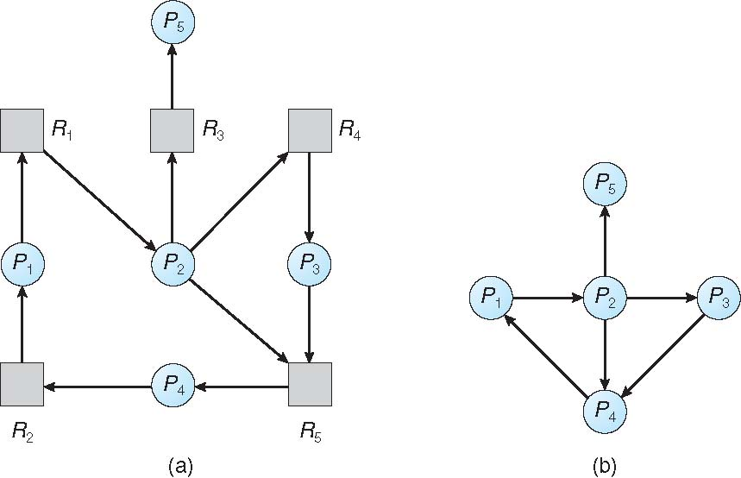
Resource-Allocation Graph and Wait-for Graph

Slide 74
Several Instances of a Resource Type
Available: A vector of length m indicates the number of available resources of each type
Allocation: An n x m matrix defines the number of resources of each type currently allocated to each process
Request: An n x m matrix indicates the current request of each process. If Request [i][j] = k, then process P_{i} is requesting k more instances of resource type R_{j}.

Slide 75
Detection Algorithm
1. Let Work and Finish be vectors of length m and n, respectively Initialize:
  (a) Work = Available
  (b) For i = 1,2, …, n, if Allocation_{i} ≠ 0, then
  Finish[i] = false; otherwise, Finish[i] = true
2. Find an index i such that both:
  (a) Finish[i] == false
  (b) Request_{i} ≤ Work
  If no such i exists, go to step 4

Slide 76
Detection Algorithm (Cont.)
3. Work = Work + Allocation_{i}
Finish[i] = true
go to step 2
4. If Finish[i] == false, for some i, 1 ≤ i ≤ n, then the system is in deadlock state. Moreover, if Finish[i] == false, then P_{i} is deadlocked
Algorithm requires an order of O(m x n²) operations to detect whether the system is in deadlocked state

Slide 77
Example of Detection Algorithm
Five processes P₀ through P₄; three resource types
A (7 instances), B (2 instances), and C (6 instances)
Snapshot at time T₀:
Allocation Request Available
A B C A B C A B C
P₀ 0 1 0 0 0 0 0 0 0
P₁ 2 0 0 2 0 2
P₂ 3 0 3 0 0 0
P₃ 2 1 1 1 0 0
P₄ 0 0 2 0 0 2
Sequence <P₀, P₂, P₃, P₁, P₄> will result in Finish[i] = true for all i

Slide 78
Example (Cont.)
P₂ requests an additional instance of type C
Request
A B C
P₀ 0 0 0
P₁ 2 0 2
P₂ 0 0 1
P₃ 1 0 0
P₄ 0 0 2
State of system?
  Can reclaim resources held by process P₀, but insufficient resources to fulfill other processes; requests
  Deadlock exists, consisting of processes P₁, P₂, P₃, and P₄

Slide 79
Detection-Algorithm Usage
When, and how often, to invoke depends on:
  How often a deadlock is likely to occur?
  How many processes will need to be rolled back?
    one for each disjoint cycle
If detection algorithm is invoked arbitrarily, there may be many cycles in the resource graph and so we would not be able to tell which of the many deadlocked processes “caused” the deadlock.

Slide 80
Recovery from Deadlock: Process Termination
Abort all deadlocked processes
Abort one process at a time until the deadlock cycle is eliminated
In which order should we choose to abort?
  Priority of the process
  How long process has computed, and how much longer to completion
  Resources the process has used
  Resources process needs to complete
  How many processes will need to be terminated
  Is process interactive or batch?

Slide 81
Recovery from Deadlock: Resource Preemption
Selecting a victim – minimize cost
Rollback – return to some safe state, restart process for that state
Starvation – same process may always be picked as victim, include number of rollback in cost factor

Slide 82
End of Chapter 6

