Slide 1
Introduction to Digital Image Processing

Slide 2
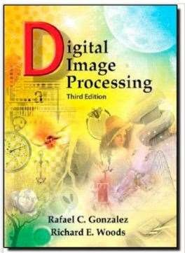
Text book: Digital Image Processing, 3rd edition by R.C. Gonzalez and R. E. Woods

Slide 3
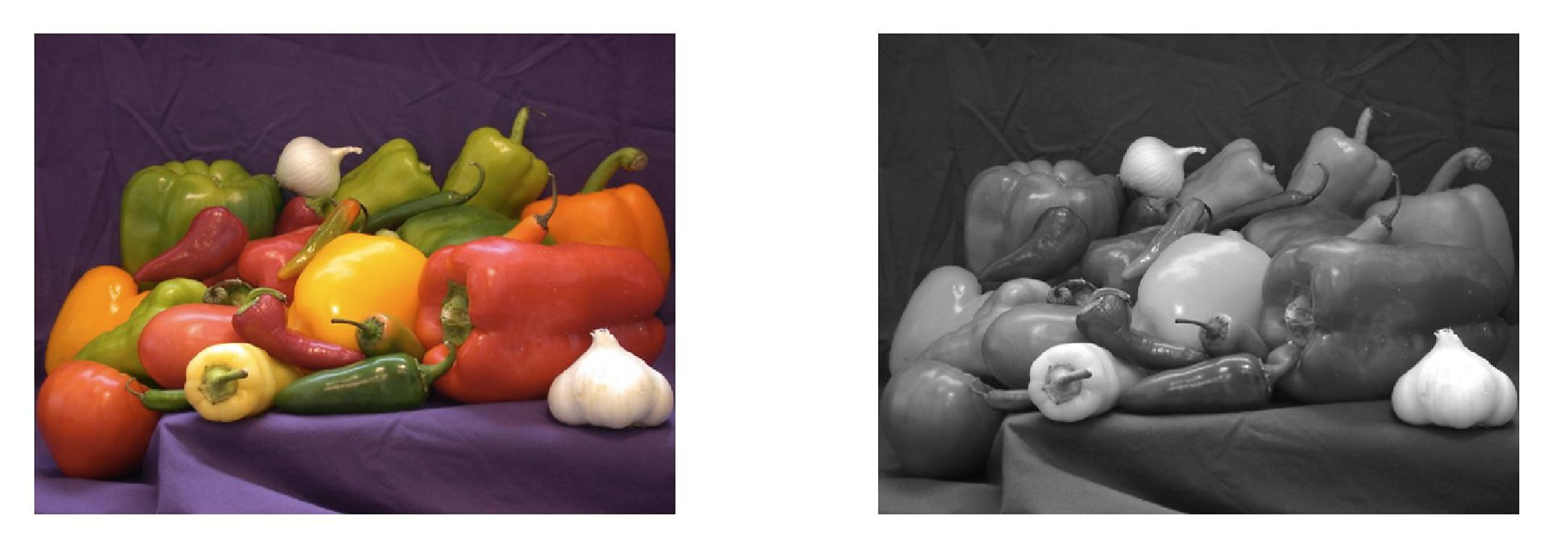
INTRODUCTION
What is a Digital Image
What is Digital Image Processing
The origins of Digital Image Processing
Applications of Digital Image Processing
Fundamental steps in Digital Image Processing
Components of an Image Processing System

Slide 4
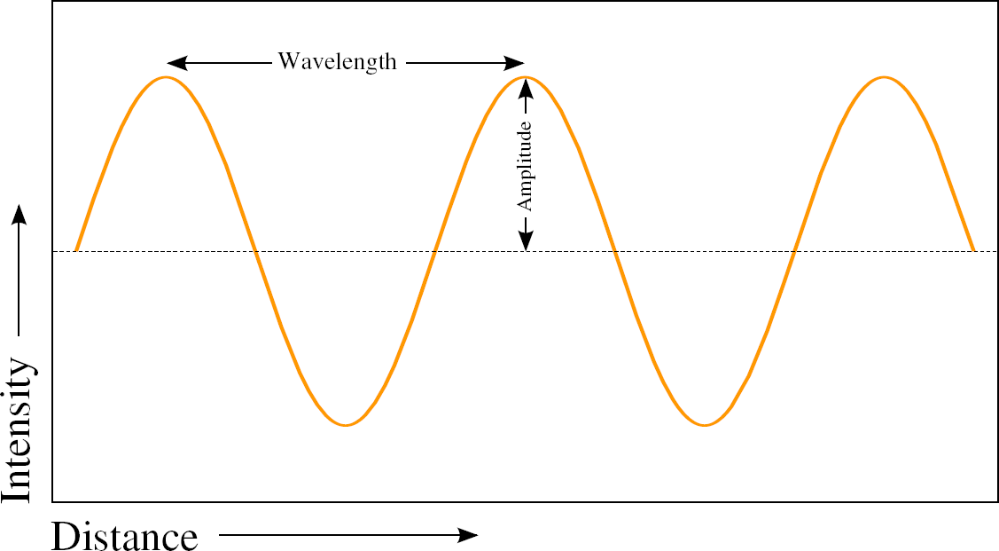
INTRODUCTION to Digital Image
An image is nothing more than a digital representation of light intensity in two dimensions at a particular time.
In other words, an image conveys information about the structure, shape or position of an object by representing the variation of light intensity reflecting from the particular object.
Thus, an image is a two dimensional signal.

Slide 5
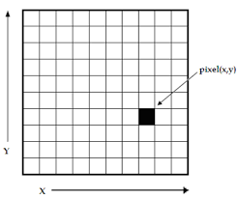
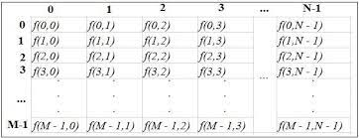
What is a Digital Image
A digital image is therefore a 2D array of intensity values and each such value is called a pel or pixel.
The size of the array represents the image size. So f(x,y) represents a pixel intensity at the position (x,y).
And the amplitude of the 2D signal f represents the intensity or gray level.

Slide 6
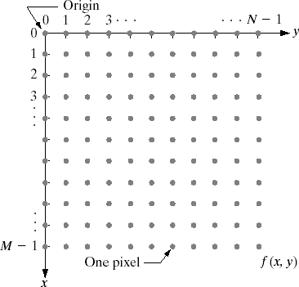
Conventional Coordinate for Digital Image Representation

Slide 7
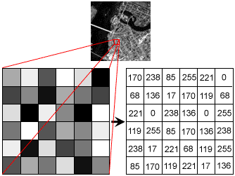
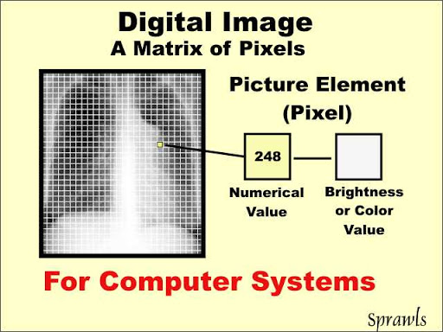
Digital Image Array

Slide 8
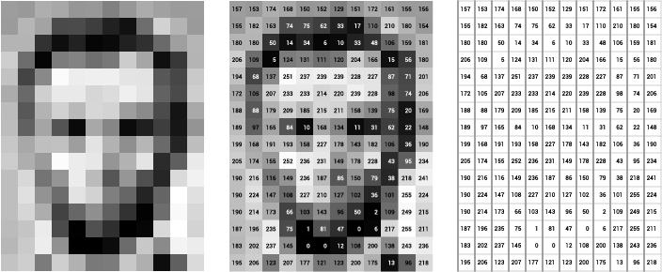
Digital Image Array

Slide 9
Digital Image Array

Slide 10
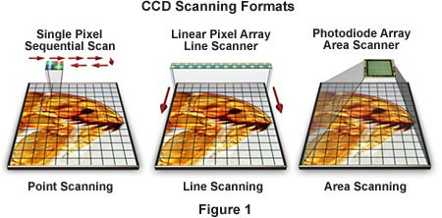
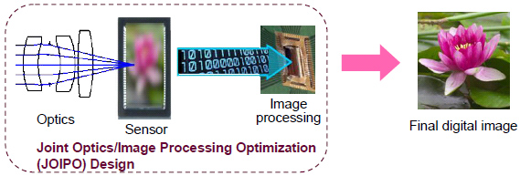
Digital Image Acquisition

Slide 11
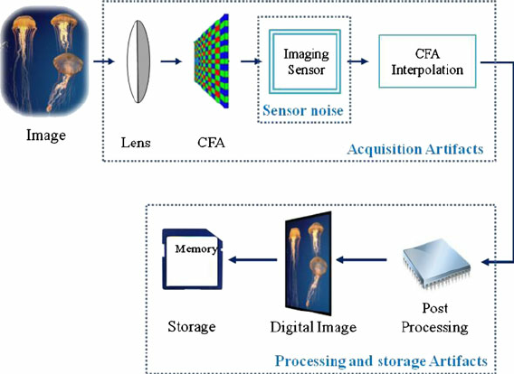
Digital Image Acquisition and Storage

Slide 12
What is Digital Image Processing?
Digital image processing is an area that uses digital circuits, systems, and software algorithms to carry out the image processing operations. The image processing operations may include quality enhancement and restoration of an image, segmentation of foreground and background objects/scenes, image compression, image analysis and classification.

Slide 13
Reasons for Popularity of DIP
It is easy to post-process the image. Small corrections can be made in the captured image using software.
It is easy to store the image in the digital memory.
It is possible to transmit the image over networks. So sharing an image is quite easy.
A digital image does not require any chemical process. So it is very environment friendly, as harmful film chemicals are not required or used.
5. It is easy to operate a digital camera.

Slide 14
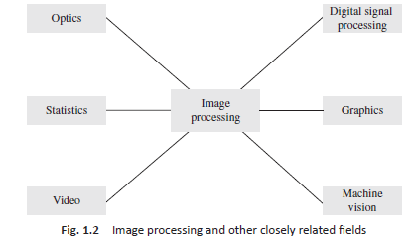
Image Processing and Related Fields

Slide 15
Relations with other branches
Image processing deals with raster data or bitmaps, whereas computer graphics primarily deals with vector data.
In digital signal processing, one often deals with the processing of a one-dimensional signal. In the domain of image processing, one deals with visual information that is often in two or more dimensions.
The main goal of machine vision is to interpret the image and to extract its physical, geometric, or topological properties. Thus, the output of image processing operations can be subjected to more techniques, to produce additional information for interpretation.

Slide 16
Relations with other branches
Image processing is about still images. Thus, video processing is an extension of image processing. In addition, images are strongly related to multimedia, as the field of multimedia broadly includes the study of audio, video, images, graphics, and animation.
Optical image processing deals with lenses, light, lighting conditions, and associated optical circuits. The study of lenses and lighting conditions has an important role in the study of image processing.

Slide 17
Relations with other branches
Image analysis is an area that concerns the extraction and analysis of object information from the image. Imaging applications involve both simple statistics such as counting and mensuration and complex statistics such as advanced statistical inference. So statistics play an important role in imaging applications.

Slide 18
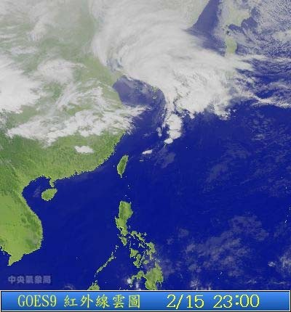
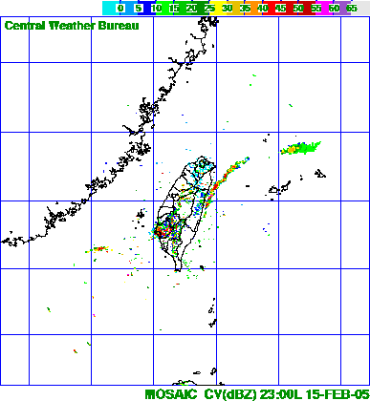
Digital Image Processing
  Processing of digital images on a digital computer
  Not just limited to the visual band of the electromagnetic(EM) spectrum
    Entire EM spectrum
    Ultrasound
    Electron microscopy
    Computer generated images

Slide 19
Image Processing to Computer Vision
High Level Processing
Object Recognition Artificial Recognition
Making Sense
Attributes
Mid Level Processing
Segmentation Classification
Attributes
Image
Low Level Processing Noise Reduction Contrast Enhancement
Image
Image

Slide 20
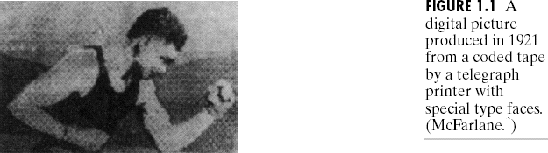
Origins of Digital Image Processing
Reproduced by a telegraph printer with a special typeface
This printing method was abandoned toward the end of 1921

Slide 21
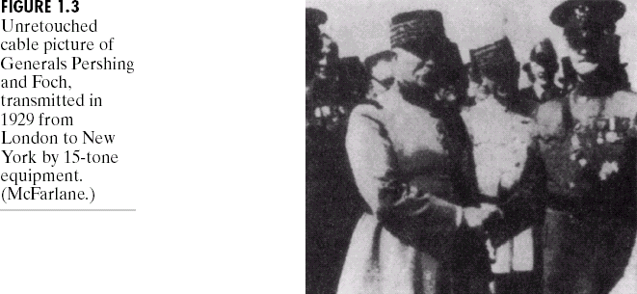
Origins of Digital Image Processing
1929
  Reproduced with 15 levels of grey.

Slide 22
Origins of Digital Image Processing
Computer Advances
  the invention of the transistor by Bell Labs. in 1948
  the development of the high-level programming languages
  the invention of the IC at Texas Instruments in 1958
  the development of operation systems in the early 1960s
  the development of microprocessor by Intel in the early 1970s
  introduction by IBM of the personal computer in 1981
  Large Scale IC in the late 1970s
  VLSI in the 1980s, ULSI present
  IC Technology, Mass storage and display systems
  Computers with powerful processing capability to handle processing of images.
  Embedded Vision

Slide 23
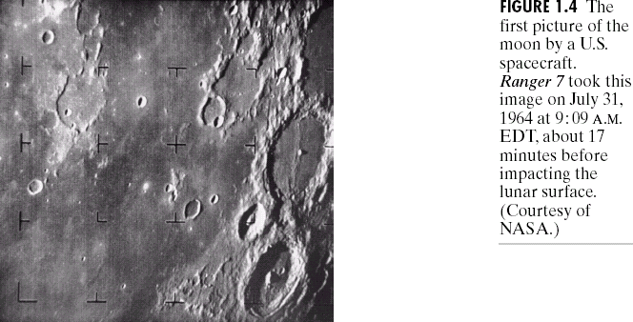
Origins of Digital Image Processing
Image processing applications
  The first computers powerful enough to carry out meaningful image processing tasks appeared in the early 1960s

Slide 24
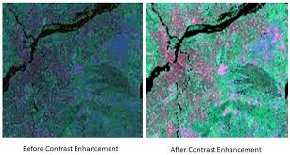
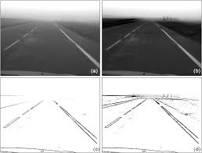
Image Processing Applications
  From 1960s to present
    Image processing are used in a broad range of applications
      Contrast enhancement or code the intensity into colour
        X-RAY, Industrial, Medicine, Biological sciences
        To study pollution patterns from aerial and satellite imagery
      Image enhancement and restoration
        Used to process degraded images of unrecoverable objects or experimental results too expensive to duplicate
        Archaeology - image restoration
        Physics - electron microscopy
      Astronomy, biology, nuclear medicine, law enforcement, defence, industrial applications

Slide 25
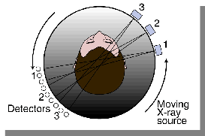
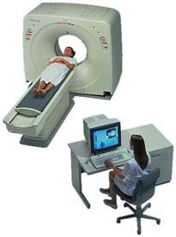
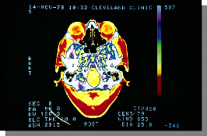
Image Processing Applications
  Computerized Axial Tomography (CAT)

Slide 26
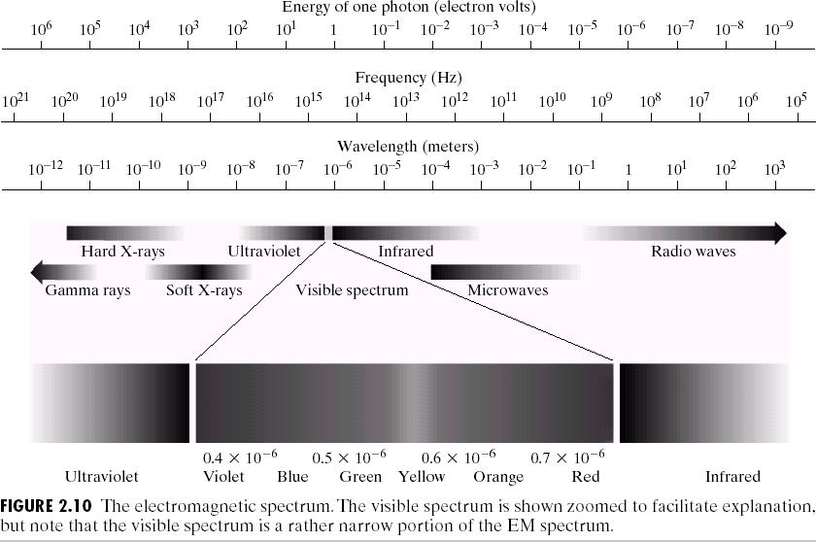
Visible Range in EM Spectrum

Slide 27
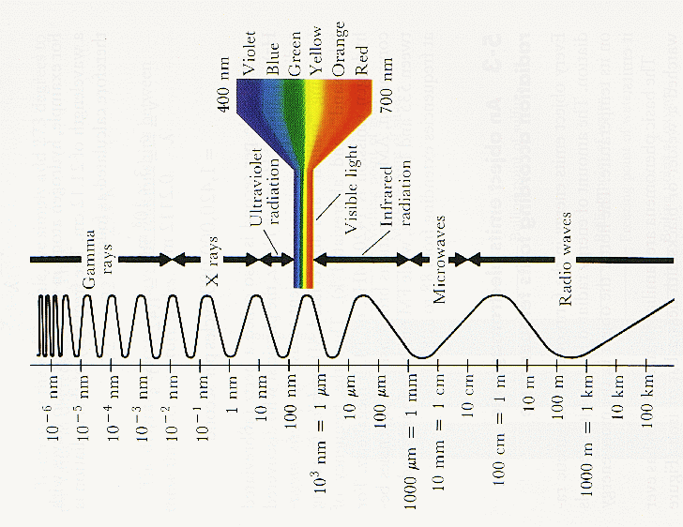
Visible Spectrum

Slide 28
Image Processing in Images formed by EM waves of various wavelengths
    Gamma-Ray Imaging
    X-Ray Imaging
    Imaging in the Ultraviolet Band
    Imaging in the Visible and Infrared Bands
    Imaging in the Microwave Band
    Imaging in the Radio Band
    Examples in which other imaging modalities are used

Slide 29
Current Image Processing Applications
Autonomous Vehicles
Medical Image Processing
Scene Classification
Remote Sensing
Forensic Science
Surveillance Systems
And Many More……

Slide 30
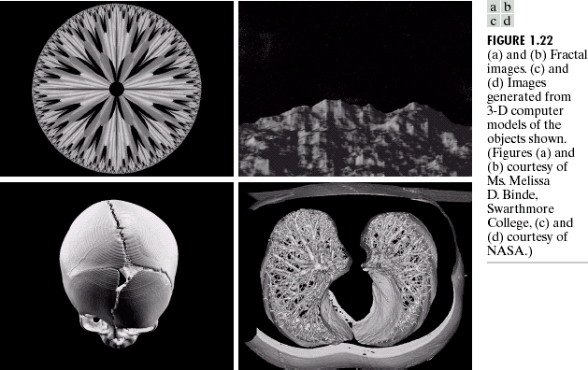
Synthetic Imaging

Slide 31

Key Stages in Digital Image Processing
Image Restoration
Morphological Processing
Image Enhancement
Segmentation
Object Recognition
Image Acquisition
Representation & Description
Problem Domain

Slide 32
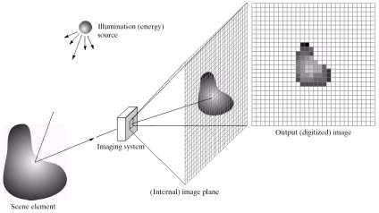
Key Stages in Digital Image Processing: Image Acquisition
Image Restoration
Morphological Processing
Image Enhancement
Segmentation
Object Recognition
Image Acquisition
Representation & Description
Problem Domain

Slide 33

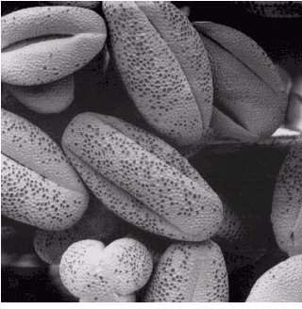
Key Stages in Digital Image Processing: Image Enhancement
Image Restoration
Morphological Processing
Image Enhancement
Segmentation
Image Acquisition
Object Recognition
Problem Domain
Representation & Description

Slide 34
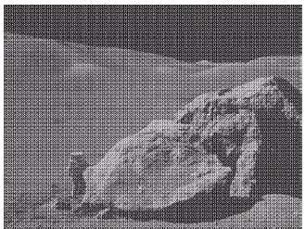
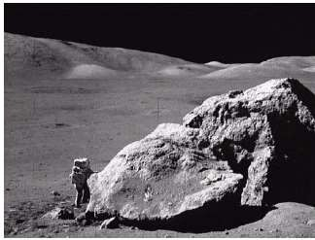
Key Stages in Digital Image Processing: Image Enhancement
Image Restoration
Morphological Processing
Image Enhancement
Segmentation
Object Recognition
Image Acquisition
Representation & Description
Problem Domain

Slide 35
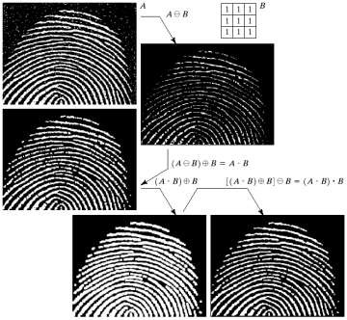
Key Stages in Digital Image Processing: Image Enhancement
Image Restoration
Morphological Processing
Image Enhancement
Segmentation
Object Recognition
Image Acquisition
Representation & Description
Problem Domain

Slide 36
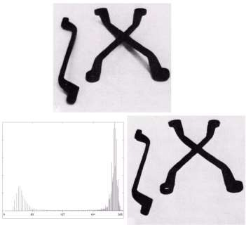
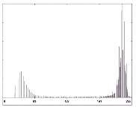
Key Stages in Digital Image Processing: Segmentation
Image Restoration
Morphological Processing
Image Enhancement
Segmentation
Object Recognition
Image Acquisition
Representation & Description
Problem Domain
 | Colour Image Processing |  | Image Compression

Slide 37
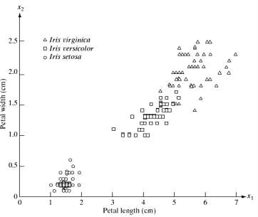
Key Stages in Digital Image Processing: Object Recognition
Image Restoration
Morphological Processing
Image Enhancement
Segmentation
Object Recognition
Image Acquisition
Representation & Description
Problem Domain

Slide 38
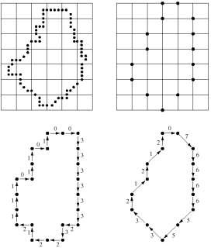
Key Stages in Digital Image Processing: Representation & Description
Image Restoration
Morphological Processing
Image Enhancement
Segmentation
Object Recognition
Image Acquisition
Representation & Description
Problem Domain

Slide 39
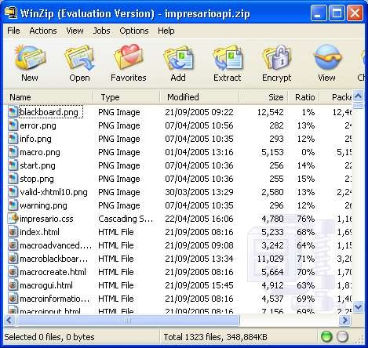

Key Stages in Digital Image Processing: Image Compression
Image Restoration
Morphological Processing
Image Enhancement
Segmentation
Object Recognition
Image Acquisition
Representation & Description
Problem Domain

Slide 40
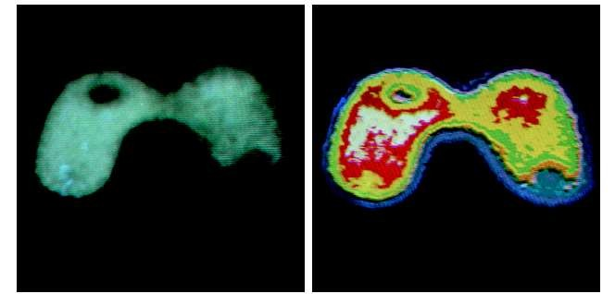

Key Stages in Digital Image Processing: Colour Image Processing
Image Restoration
Morphological Processing
Image Enhancement
Segmentation
Object Recognition
Image Acquisition
Representation & Description
Problem Domain
Problem Domain

Slide 41

End of Lecture 1

